Slide 1







EBS Employee Meetings
December 2000
©2000 TJ-2110247-<number>

Slide 2
Presentation Overview
Key Accomplishments for 2000
Organizational Update
Performance Evaluation Timeline
Objectives for 2001

Slide 3
Presentation Overview
Key Accomplishments for 2000
Organizational Update
Performance Evaluation Timeline
Objectives for 2001
Key Accomplishments for 2000

Slide 4

Enron Broadband Services
Enron
Intelligent
Network
Deploy the Most Open, Efficient Network with Broad Connectivity
Bandwidth Intermediation
Content Services
Be the World’s Largest Buyer and Seller of Bandwidth
Be the World’s Largest Provider of Premium Broadband Delivery Services
Pooling Points
Servers
Network Control
Fiber
Marketing & Trading of Bandwidth Delivery & Application Commodities
Comprehensive Bandwidth Risk Management
Semiconductor Services
Media Services
Broadband Content Management & Delivery
Data Management Services
®

Slide 5


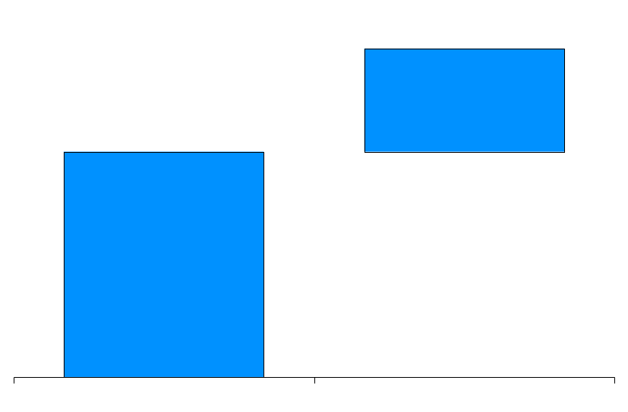
Enron Intelligent Network
Fiber
Servers
Pooling Points
Fiber
Route Miles Owned or Contracted
Servers
Pooling Point Cities
14,500
404
19
6
9,175
13
5,325
Complete
In Construction
Deployed
Complete
In
Installation
®

Slide 6
Bandwidth Intermediation
Vancouver
Seattle
Calgary
Montreal
Boise
Toronto
Boston
Portland
Detroit
New York
Amsterdam
Salt Lake City
Chicago
San Francisco
Denver
Philadelphia
London
San Jose
Frankfurt
Las Vegas
Washington D.C.
Paris
Los Angeles
Atlanta
Tokyo
Dallas
New Orleans
Houston
Miami
Transactions
Bandwidth Deliveries DS-3 Month Equivalents
139
2,816
90
1,399
24
985
22
35
3
35
432
17
17
17
1Q00
2Q00
3Q00
4Q00
YTD
1Q00
2Q00
3Q00

Slide 7

Bandwidth Intermediation
Over 100 Full-Time Professionals
139 Transactions Since Inception with 25 Counterparties
Terms up to 10 Years
Fixed Price Commitments and Option Structures
Over 75% Off-Network
Broad Product Offerings
Protected Circuits
Unprotected Circuits
IP Transport
32 Bandwidth Products Quoted on EnronOnline

Slide 8
Content Delivery Services Enron and Blockbuster Update
Seattle
Portland
New York
Salt Lake City
Phase I Markets
Qwest, AirSwitch, Reflex
SBC, FiberRide
Verizon
Covad
Telus
Contracting with Major Studios and Movie Encoding Underway
- More than 100 Movies from Trimark, Artisan, and MGM Studios
Equipment and Software Components Finalized and Deployed
- Network and Edge Servers - Digital Rights Management
- Set Top Box - Graphical User Interface
Introducing Service in New York, Salt Lake, Seattle, and Portland by Year-End - - - Approximately 1000 households in Phase I; 800 Households Already Signed
- Equipment Installed in Nearly 300 Homes
®

Slide 9
Presentation Overview
Key Accomplishments for 2000
Organizational Update
Performance Evaluation Timeline
Objectives for 2001
Organizational Update

Slide 10
Enron Broadband Services
Office of the Chairman
Ken Rice - CEO
Kevin Hannon - COO
North American Business Units
Global Business Units
Global Functions
Global Staff Functions
Wholesale
T. Seitz
Content Origination
D. Cox
Business Ventures
K. Garland
Semiconductor Services
W. Doshier
Enron Media Services
E. Ondarza
Enterprise Services
J. Crowder
EBS Europe
S. Elliott
EBS Asia Origination
S. Bhatnagar
Global Trading & Risk Management
J. Fallon
EBS Latin America
J. Thomsen
Chief Commercial Officer
D. Christodoulou
Structuring
B. Richter
Risk Mgmt Operations & Reporting
J. Echols
Network Engineering & Operations
M. Golden
Switching Systems
T. Stavropoulos
Product & Information Engineering
E. Plante
Strategic Development
S. Yeager
Legal
K. Mordaunt
Corporate Development
R. DiMichele
Human Resources
M. Barnard
Marketing, PR & Research
K. Kimberly
Business Control & Security
J. Brindle
Finance
K. Howard
©2000 TJ-2110247-<number>

Slide 11
Presentation Overview
Key Accomplishments for 2000
Organizational Update
Performance Evaluation Timeline
Objectives for 2001
Performance Evaluation Timeline

Slide 12
Performance Evaluation Timeline
NOVEMBER
DECEMBER
JANUARY
FEBRUARY
Nov 17
Deadline to
Submit Feedback
Nov 20
Departmental PRC Meetings Begin
Nov 28
EBS Analyst / Associate Pre-Rating Meeting
Dec 13 & 14
EBS Final PRC Meeting
Commercial - Managers & Above
Commercial Support, Technical, Specialized Technical - Directors & Above
Jan 5, 8 & 9
Enron Final VP
& MD PRC
Feb 1
Deadline for Performance Reviews and Forms Returned to HR
Feb 1
Effective Date of Promotions
Feb 5
Bonuses Distributed

Slide 13
Presentation Overview
Key Accomplishments for 2000
Organizational Update
Performance Evaluation Timeline
Objectives for 2001
Objectives for 2001

Slide 14
New Service Offerings
IPNet Connect
Bundle of Services that, through the EIN’s BOS, Provides Connectivity Options
Allows Customers to Select and Control the Quality of Service and the Reliability of Delivery
Replaces Expensive, Private Line Networks and Relieves Congested, Unreliable Internet Transport
Makes the EIN the First QoS-Enabled Network
Storage
Rise in Demand for Data Storage is Putting Upward Pressure on Storage Prices
Bandwidth On-Demand Solution Gives Customers Flexibility with the Option to Buy Bandwidth and Storage Space as Needed and Resell Excess Bandwidth and Storage into the Market

Slide 15
New Service Offerings
Semiconductors
Creating the World’s First Forward Market for Semiconductor Products, Including DRAM, CPU, Flash, LCDs, Wafers and Capacitors
Media Services
Building a Strategy to Develop a Forward Market for Advertising Time and Space
Altering the Risk Profile for Producers and Consumers of Advertising Space
Will Potentially Use These Media Services to Create New Commercial Structures for our Streaming Media Customers

Slide 16
2001 Operating Objectives
Have Enron Intelligent Network Fully Lit or Facilitated by Q4 2001
Reach a Total Contract Value (TCV) of $300 Million in 2001; Up 88 Percent
Increase Bandwidth Intermediation Business to 15,000 DS-3 Months Traded; Up 188 Percent
Deliver 1 Billion Megabytes (MB) in Content; Up from 10 Million MB in 2000
Grow Headcount by 45 Percent Overall; Focused in Europe, Asia, Trading, IT and Operations
Expand the Number of PoPs to 40; Up 90 Percent

Slide 17
2001 Business Development Objectives
Broaden Liquidity in Circuits, IP and Streams
Successfully Expand Internationally in Europe, Asia and India
Develop New Origination Models; i.e. Media Services
Continue to Realize Margins from Merchant Investing
Continue Global Expansion of Connectivity Using Switching Platform

Slide 18
®

