Slide 1

Employee Meeting March 13, 2001

Slide 2
Agenda
2001 Plan
Goals and Objectives
Organization
Forest Products Group
Strategy
Organization
Metrics
Steel Group
Strategy
Organization
Metrics
Logistics and Infrastructure
Conclusion

Slide 3
EIM 2001 Plan $ 000’s
Gross Margin
92,127
49,960
36,800
-
178,887
-
-
-
178,887
Direct Expenses
14,812
5,116
-
15,104
35,032
21,077
18,533
41,245
74,642
EBIT
77,315
44,844
36,800
15,104
143,855
(21,077)
(18,533)
(21,245)
83,000
Forest Products Group
Steel
Assets, Net
Commercial Expenses
Total Commercial
Direct Support
Indirect Support
Facility Costs

Slide 4
Enron Industrial Markets 2001 Goals & Objectives
Firmly establish EIM as a significant physical merchant by moving 3 million tons of product in each of the forest products and steel industries.
Expand international business by generating at least $10 million of gross margin.
Create vehicle to gain access to 500,000 tons/year of market pulp.

Slide 5
Enron Industrial Markets Headcount 1st Quarter 2001
12/30/00 2/8/01 Plan 2001
Forest Products 41 44 58
Steel 13 19 27
Asset Operations 0 1 5
Transportation Development & Other 31 58 37
Total Senior Commercial 85 102 127
Analysts, Assoc. & Other 22 15 33
Total Commercial 107 117 160
Support Departments 21 30 109
TOTAL HEADCOUNT 128 147 269
Senior Commercial
Total Headcount
127
269
102
85
147
128

Slide 6
EIM Organization

Slide 7
Forest Products Group

Slide 8
Enron’s 2001 Forest Products Strategy
Exceed the external 3,000,000 ton goal and touch 4,000,000 tons of physical product
Establish physical spot market with transparent pricing mechanisms
Establish trading hubs and create physical liquidity at those hubs in core products
Continue to grow financial trading business
Develop world class logistics and operations capability
Acquire physical pulp supply
Confidential

Slide 9
Initial Product Focus
Initial Focus
Newsprint
Market Pulp (NBSK)
Recycled (ONP/OCC)
Lumber
Linerboard/Packaging

Slide 10
Core Products Market Size

Slide 11
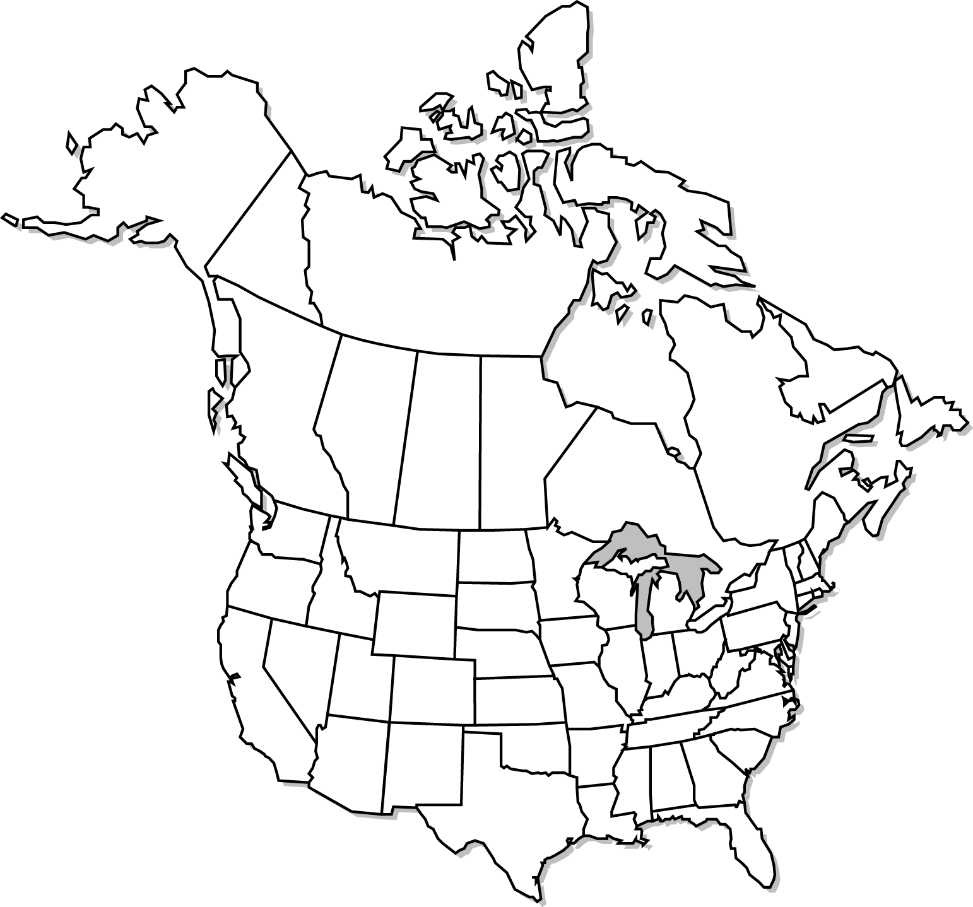
North American Newsprint Capacity,
Consumption & EIM Hubs
Quebec City
Mill
EIM Hubs
North America
Capacity
500,000
San Francisco
New England
Northeast
250,000
50,000
Mid-Atlantic
North America
Consumption
= 10,000
Los Angeles
Garden State
Paper
Denver
Chicago

Slide 12
Hub Establishment
North American and International Pulp Hubs:
Terneuzen
Pac Rim
Delivery
Region
Vancouver
Green Bay
Montreal
Livorno
Atlanta
Sao Paolo

Slide 13
Newsprint Status
Acquisitions
Purchased Garden State Newsprint in 3q 2000
200,000 tpy newsprint production located in northern New Jersey
300,000 tpy ONP consumption
Will close Daishowa Newsprint mill in 1q 2001
400,000 tpy newsprint production in Quebec City, Quebec
~200,000 tpy ONP consumption
Market Hub Creation
Standard specifications created
Currently making markets in the following hubs:
NJ/NY/Eastern PA (supported by GSP production)
New England States (supported by GSP production)
Chicago/SE WI area (able to access 3rd party volumes)
Will soon open San Francisco, Los Angeles, and Denver hubs (able to access 3rd party volumes
Market Acceptance
Asset acquisitions have greatly increased Enron’s level of acceptance among producers (now seen as a “player”)
Sales marketing effort will be improved to achieve higher exposure among buying community

Slide 14
Pulp Status
Established market pulp producer relationships
Seeking to acquire access to 500,000 tons per annum of pulp production through contract, “JV”, or potential asset purchase.
Control additional volumes through Marketing Agent relationships.
Pursuing Contractual Short Positions, fixed or floating
Traded products to date: NBSK, SBSK, BEK
Expanded Trader Count

Slide 15
Forest Products Group Metrics
$95 million gross margin.
Touch 4,000,000 tons of physical, pulp, paper, and lumber
Touch 100,000 tons of product from Latin America
Touch 200,000 tons of product within Asia
Originate $30 million from structured transactions

Slide 16
Products and Services
Physical Delivery
&
Logistics
Risk Management
Finance
Buy/Sell
Fixed Price
Price Swaps
Inventory Management
Buy/Sell
Index Price
Options
Caps, Floors, Collars
Asset Monetization
Hybrids
Cross Commodity, Etc.
Structured Finance

Slide 17
Steel Group

Slide 18
Steel Strategy and Objectives
Touch 3,000,000 tons of physical product
Develop physical and financial liquidity
Establish Enron as a leading market maker
Establish trading hubs
Build European capability and touch 500,000 tons in Europe
Develop world class logistics and operating capability

Slide 19
Production Process
Iron Ore
Natural Gas
Hot
Rolled
Coil
Cold
Mill
Blast
Furnace
Slabs
Hot Strip
Mill
Galvanized
Mill
Cold
Rolled
Coil
Limestone
Coal
Mini
Mill
Galvanized
Coil
Scrap
Electricity
Market
Market
Market

Slide 20
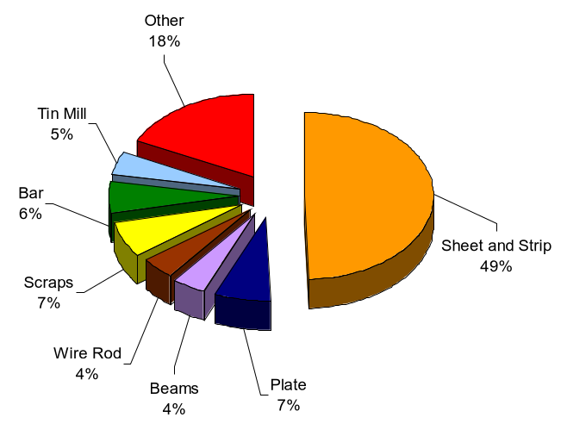
U.S. Finished Product Breakdown (metric tons)
Sheet and Strip are Commodity Products
Source: American Iron and Steel institute - 1999 US Production

Slide 21
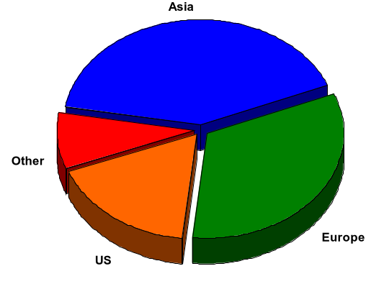
Market Size* Consumption
$103.0
$21.7
$82.0
$43.3
$250 Billion
*Flat and Long Products

Slide 22
Steel Mills - USA
Steel Mills - USA

Slide 23
Top 20 Import Points of
Hot-Rolled Products
Steel Mills - USA
Top 20 Import Points of Hot-Rolled Products

Slide 24
Top 20 Import Points of
Semi-Finished Products
Steel Mills - USA
Top 20 Import Points of Hot-Rolled Products
Top 20 Import Points of Semi-Finished Products

Slide 25
Enron Marketing Hubs
Steel Mills - USA
Top 20 Import Points of Hot-Rolled Products
Top 20 Import Points of Semi-Finished Products
Enron Marketing Hubs

Slide 26
Products and Services
Physical Delivery
&
Logistics
Risk Management
Finance
Buy/Sell
Fixed Price
Price Swaps
Inventory Management
Buy/Sell
Index Price
Options
Caps, Floors, Collars
Asset Monetization
Hybrids
Cross Commodity, Etc.
Structured Finance

Slide 27
2001 Metrics
Gross Margin
Physical Volumes
EOL Transactions
$50 Million
3 Million Tons
100

Slide 28
Logistics Capabilities
Build new physical Logistics capability to move core products (truck, rail, ship, and warehouse)
Performance must exceed current industry standards.
Logistics capability must be a core competency and the source of substantial business value.

