Slide 1

Enron Emissions Strategy Meeting
U.S. Emissions Issues –
Major Air Quality Regulations,
Enron Impacts and Strategies
Jeff Keeler, Director, Environmental Strategies, Enron Corp

Slide 2
U.S. Air Quality Regulation - Context
Clean Air Act (passed in 1970 and amended in 1977 and 1990) is extremely complex – over 9500 pages of regulations in the CFR!
New Federal regulations are constantly being developed to implement broad-ranging CAA requirements.
Regulations are unpredictable and fragmented – overlapping, contradictory in many cases
State and local air quality programs add to the confusion.
Business environment -- Lack of certainty

Slide 3
Current Issues – NAAQS
National Ambient Air Quality Standards (NAAQS) define levels of air quality that must be achieved to protect public health and welfare
  Not enforceable, but State Implementation Plan (SIP) and new/major modified source requirements are linked to compliance or “attainment” with the NAAQS
  Standards for “Criteria pollutants”
    Sulfur Dioxide (SO₂) -- from burning of fossil fuels (coal, oil); a precursor of “acid rain”
    Particulate Matter (PM₁₀ or PM_{2.5}) – combustion “soot”
    Carbon Monoxide (CO)
    Ozone – formed by volatile organic compounds (VOCs) and nitrogen oxides (NOx)
    NOx – from combustions sources, also forms acid rain
    Lead

Slide 4
National Ambient Air Quality Standards
Criteria Pollutant | Averaging time | Primary Standard
SO₂ | Max. 24-hour concentration Annual Arithmetic Mean | 0.14 ppm 0.03 ppm
PM₁₀ | 24-hour avg. concentration Annual arithmetic mean | 150 μg/m³ 50 μg/m³
CO | 8-hour concentration | 9.0 ppm
Ozone | 1-hour concentration | 0.12 ppm
NOx | Annual arithmetic mean | 0.053 ppm
Lead | Quarterly arithmetic mean | 1.5 μg/m³

Slide 5
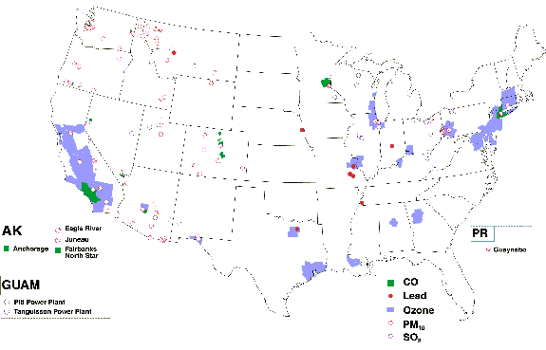
NAAQS Criteria Pollutant Non-Attainment Map

Slide 6
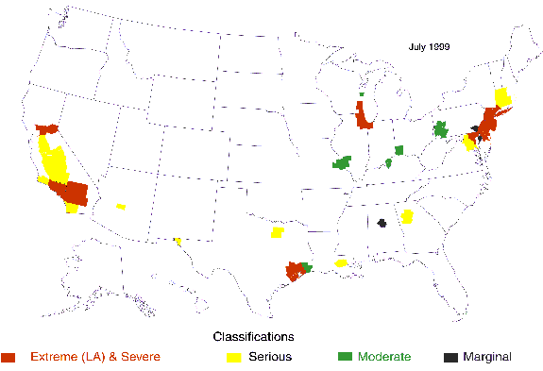
NAAQS Ozone Non-Attainment Map

Slide 7
Current Issues – NAAQS
Enron Impacts
Power Development and Investments – more regulation & costs in non-attainment areas
Customers in non-attainment areas – face more regulation, but more Enron opportunity?
Assets/Operations – more risks associated with non-attainment areas
Trading – more trading opportunities in non-attainment areas (offsets)
Strategy/Advocacy
NAAQS Revisions for PM & Ozone still under development by EPA (remanded by Courts)

Slide 8
Current Issues – SO₂
CAA 1990 Amendments “Title IV” created Acid Rain program, run by EPA Clean Air Markets
SO₂“Cap and Trade” program
  Phase I, 1995: 110 largest SO₂ emitters 263 units
  Phase II, 2000: all generators >25 MW
  Sources can “opt in” to program
  8.9 MM ton national, annual cap for power generators
  Allowances allocated at rate of 1.2 lb/MMBtu of base year heat input.
  Allows early reductions and unlimited banking
  No allowances for new sources, but EPA annual reserve is 250,000 tons for auction
Cost of pollution control much lower than predicted in 1990

Slide 9
Current Issues – SO₂
Enron Impacts:
Power development and investment
Trading – affects coal, gas, power, emissions
Customers – commodity, risk management
New technologies, renewables, energy efficiency
Strategy/Advocacy:
Additional cuts anticipated (50-75%)
State actions to further regulate SO₂ or limit allowance trading

Slide 10
Current Issues – NOx
Ozone Transport Region
1990 CAA Amendments created Ozone Transport Commission (OTC) to tackle interstate pollution
Ozone Transport Region (OTR) = 12 northeast states from Maine to Virginia
Several “MOUs” for joint state action to control VOCs and NOx
Caps during ozone season (May 1 – September 1)
  1999: 219,000 tons NOx
  2003: 143,000 tons NOx
  Emissions allowance banking and trading allowed for compliance
  “Flow control” triggered when bank is >10% of budget -- regulates rate of withdrawal from bank

Slide 11
OTR
States

Slide 12
Current Issues - NOx
RECLAIM
Local NOx and SO₂ trading program in South Coast Air Quality Management District (SCAQMD)
Started in 1994 for sources emitting 4 tons of either pollutant
Targeting 80 percent reduction by 2003
300+ affected sources - could drop

Slide 13
Current Issues – NOx
Enron Impacts:
Power development and investment
Trading – affects coal, gas, power, emissions
Customers – commodity, risk management plays
New technologies, energy efficiency
Strategy/Advocacy:
Upcoming regional programs – seek incentives for new, clean generation & trading markets
Fragmented regulation – regional, state, local, different time frames

Slide 14
Current Issues – New Source Review
Goal: Achieve NAAQS through pre-construction review process for new and major modified sources
Attainment: PSD - Prevention of Significant Deterioration
Major = emit >100 tpy (or >250 for some) of any CAA pollutant
BACT – Best Available Control Technology (can include cost factors)
Detailed air modeling
Non-attainment
Area NSR
Major = emit>100 tpy of criteria pollutant (SO2, O3, NOx, VOC, PM, CO, lead)
LAER – Lowest Available Emissions Rate (NO cost factors)
Offsets required, ratio can depend on severity

Slide 15
Current Issues – NSR Enforcement
NSR Enforcement Actions initiated in 1998 by EPA and DOJ against coal plants (Midwest/South) for “major modifications”
Included fines, forced technology application, confiscation of allowances
Settlements: TECO, Virginia Power, Cinergy (good PR, window-dressing!)
Holdouts/litigation: TVA, AEP, Southern
Other industries: refining, pulp & paper, pipeline?
NSR is too broad/vague -- long-standing debate/litigation over major modification sparks NSR reform discussions

Slide 16
Current Issues – New Source Review
Enron Impacts:
Power development and investment – offsets are limited; BACT/LAER costs, delays
Trading – opportunities for coal, gas, power; emissions trading harmed by enforcement
Customers – some commodity, risk management opportunity; NSR enforcement has chilled re-powering/upgrades by generators
Strategy/Advocacy:
White House energy policy – EPA backing off enforcement? (Advantage for incumbents)
Innovative ways to find offsets
NSR Reform, multipollutant offer opportunities

Slide 17
2 to 5 Years – NOx SIP & Sec. 126 Rules
NOx SIP Call
Significant NO_{x} reductions from large stationary sources in 22 states to meet regional ozone goals
Federal rule but each state develops SIP (or faces FIP)
Power generation (>25 MW) and large industrial boilers to in NO_{x} cap and trade program
  State by state NO_{x} caps developed based on projected 2007 heat input times 0.15 lb/MMBtu.
  Total 22 state budget of 546,181 tons per ozone season for power generation
  Compliance supplement pool of 200,000 tons for early reductions, banking, stress relief

Slide 18
NOx SIP Call
States

Slide 19
2 to 5 Years – NOx SIP & Sec. 126 Rules
SIP Call Litigation
SIPs originally due September 1999, with implementation date of 2003
Lawsuit placed stay on rule until court found in EPA’s favor in March 2000
Wisconsin excluded, Missouri, Georgia remanded
Supreme Court refuses appeal March 2001
Due to delay, new implementation date of May 2004 by which sources must comply

Slide 20
2 to 5 Years – NOx SIP & Sec. 126 Rules
Section 126 Rule
Allows states to petition EPA when harmed by sources in other states
Federal rule revived when SIP Call in litigation
EPA approved petitions by rule December 1999
Power generation and large industrial boilers to in NO_{x} cap and trade program
  Adds seven states outside the OTR; several states inside OTR will join; more petitions pending
  Budget of 256,078 tons per ozone season for power generation
  Compliance supplement pool of 97,000 tons

Slide 21
71°80’
86°00’
45°00’
42°03’
Section 126 Rule Areas

Slide 22
2 to 5 Years – NOx SIP & Sec. 126 Rules
Section 126 Litigation
Federal Appeals court upheld most of EPA rule on May 15, 2001
Remand on several technical issues could cause delay in implementation
Implementation date of May 2003 (1 year before SIP Call)
126 is trumped when SIPs are approved and implemented

Slide 23
2 to 5 Years – NOx SIP & Sec. 126 Rules
Enron Impacts:
Power development and investment
Trading – affects coal, gas, power, emissions
Customers – commodity, risk management plays
New technologies, renewables, energy efficiency
Strategy/Advocacy:
Fight against incumbents for fair new source allocations, incentives for efficiency, clean power
Create certainty – synchronize budgets, implementation

Slide 24
2 to 5 Years – State/Local Programs
Trends towards states taking additional action to reduce emissions
Connecticut, New York, New Hampshire, Massachusetts have bills/regulations in works
  NY bill limiting trading of SO₂ allowances from upwind
Texas SIP for NAAQS non-attainment
  Cap and Trade program for NOx
  Sources that emit >10 tpy NOx (or opt in)
  Cap starts in 2002, goal of making 100% reductions from 1997-1999 levels/average run hours
  Buy allowances to cover if fuel use/run hours exceeds 1997-99 levels
  Limits proposed for smaller sources as well

Slide 25
2 to 5 Years – State/Local Programs
Enron Impacts:
Power development and investment
Trading – affects coal, gas, power, emissions
Customers – commodity, risk management plays
New technologies, renewables, energy efficiency
Strategy/Advocacy:
Fight against incumbents for fair new source allocations, incentives for efficiency, clean power
Create certainty – synchronize budgets, implementation

Slide 26
2 to 5 Years – Regional Haze
EPA issues Regional Haze Rule in 1999 as long term strategy for visibility in parks/forests
Regulates NOx, SO₂ and PM
Each state is to address its contribution to visibility, can choose:
  Follow Grand Canyon Visibility Transport Commission recommendations
  Submit SIP with a group of states
  Submit own SIP
All three options have similar requirements:
  If a 13% reduction in SO₂ did not occur between 1990 and 2000 a budget trading program must be implemented.
  Long-term goals and “Best Available Retrofit Technology” (BART) requirements must be determined and plans must be developed for NOx and PM. Plans must be submitted by 2008
  Use 10% renewables in 2005, 20% in 2015

Slide 27
2 to 5 Years – Regional Haze
Western Regional Air Partnership (WRAP) – 12 states submitted plan to EPA
Goal of 510,000 tons, a regional reduction of 320,000 tons of SO₂ from 1990 baseline of 830,000
Covers 2003-2018 (long term goals of 2064)
“Backstop” program – Western Emissions Budget (WEB) trading, triggered if goals not met
Structure similar to EPA SO₂ and NOx programs
Reductions may be achieved by existing SO₂ programs

Slide 28
2 to 5 Years – Regional Haze
Enron Impacts:
Costs for power development and investment
Trading – affects coal, gas, power markets
New emissions allowance markets (maybe)
Customers – commodity, risk management plays
New technologies, renewables, energy efficiency
Strategy/Advocacy:
Confusion – more new standards (BART) and overlap with existing programs (SO₂, RECLAIM)

Slide 29
2 to 5 Years – Mercury
Pressure to require mercury reductions due to health effects – CAA “hazardous air pollutant”
December 2000 EPA Mercury Determination: states mercury regulation from coal- and oil-fired power plants is necessary (gas excluded)
Goal to develop regulations by December 2003, implement by December 2004
Emissions trading questionable -- mercury is subject to a Maximum Achievable Control Technology (MACT) standard as a HAP
Control options limited – probably a combination of NOx/SO₂ controls needed to be effective
Litigation: industry challenge still a bit premature

Slide 30
2 to 5 Years – Mercury
Enron Impacts:
Power development and investment
Trading – affects coal, gas, power markets
Emissions markets questionable
Customers – commodity, risk management
New technologies, energy efficiency
Strategy/Advocacy:
Litigation premature as new EPA weighs options
Multipollutant strategy an avenue for trading

Slide 31
2 to 5 Years – New PM/Ozone NAAQS
In 1997, EPA issued new NAAQS for PM and Ozone:
  8-hour standard for NOx: 0.08 ppm (replaces 0.12 ppm over 1-hour average concentration)
  Adds PM_{2.5} (fine particles), at 65 μg/m³ 24-hour average concentration
Upheld by U.S. Supreme Court (remanded for some timeline, PM_{2.5} issues) – Bush supports
Implementation date unclear until rules re-issued
Expectation that PM_{2.5} cuts will be achieved through 50% reduction in SO₂ cap around 2007
Tighter Ozone NAAQS means more of US in non-attainment – more offsets will be required

Slide 32
2 to 5 Years – New PM/Ozone NAAQS
Enron Impacts:
Power development – need for more offsets, additional SO₂ control
Trading – affects on coal, gas, power, emissions markets
Customers – commodity, risk management
New technologies, renewables energy efficiency
Strategy/Advocacy:
Need for innovative strategies to create offsets
Can costs of deeper SO₂ cuts be absorbed?

Slide 33
Long Term – CO₂
Most agree that something will happen on domestic CO2 regulation – but when?
Bush Administration still firm on no CO2 as part of multipollutant strategy
International commitments could change domestic landscape
Focus will be on voluntary programs (“opt-in”?) and on climate & coal technologies

Slide 34
Long Term – CO₂
Enron Impacts
Taking advantage of new markets in commodity, risk management, emissions trading and services
Risks for some operations and contracts
Renewables, efficiency, new technologies
Advocacy/Strategy
Show Administration/Congress how to do something meaningful on CO2 without links to Kyoto or economic collapse
Keep options open, remain engaged, and maintain solution-oriented approach

Slide 35
Putting the pieces together: Enron’s Multipollutant Strategy
Recurring themes throughout air regulation –
Enron strategies:
  New energy supply, development, capital turnover
  Cleaner, new technologies and efficiency
  Fuel diversity
  Flexible, market-oriented compliance options
  Regulatory certainty
Regulatory climate:
  Lack of certainty
  Tension between command and control (technology mandates) and market (trading) approaches
  Barriers to entry for new participants, incumbent advantages

Slide 36
Putting the pieces together: Enron’s Multipollutant Strategy
Multipollutant Strategy (if done properly) can solve regulatory, competitiveness concerns and hold multiple benefits for Enron
Multipollutant driven by NSR Enforcement problems of large coal utilities and other factors, but has focused only on old, high-polluting plants
A viable approach must include support for new, cleaner, more efficient power generation as well as control of existing sources
We need a market-based system that allows economics to drive emission reductions, capital turnover and infrastructure improvement
Organized “Clean Power Group” – Enron, ElPaso, Calpine, Trigen, NiSource

Slide 37
Enron’s Multipollutant Strategy
Include ALL generators 1 MW or greater (include CHP and credit for renewbales/conservation)
Each pollutant is subject to a “glideslope”: individual cap declining continuously over time
  NO_{x}, SO₂, Mercury (and CO₂ if desired)
  Allowance trading for flexibility and cost reduction, equalization.
  Output-based allocation system (i.e., lb/MWh) to reward efficiency and promote fuel diversity
  Economic protections in place: “Cost circuit breaker”
Trade-off is NSR reform: remove BACT/LAER or major modification review. (Retain some local impacts review)
Trading programs replace non-attainment offset function

Slide 40
Enron’s Multipollutant Strategy
Industry Pluses
Consistent, national rules
No more BACT/LAER or offsets
Certainty of future requirements
Economic protection – circuit breaker IS the cost of control.
Cost spread equally among generators
Environmental Benefits
Reductions are locked in immediately
Ensures continuing emissions reductions
Provides economic pressure for clean up of old plants and capital turnover
Cap is technology forcing
Retain control at local level

Slide 41
Enron’s Multipollutant Strategy
Solving today’s problems –
California (and other crises): expedite increased new generation with environmental security
CO₂: provide options that address CO₂ without economic risk or links to Kyoto
Reform NSR for ALL sources: market function is better than enforcement actions
Think long term: support new generating technologies, renewables/conservation, fuel diversity
Does all this sound familiar? (see Bush National Energy Plan)

Slide 42

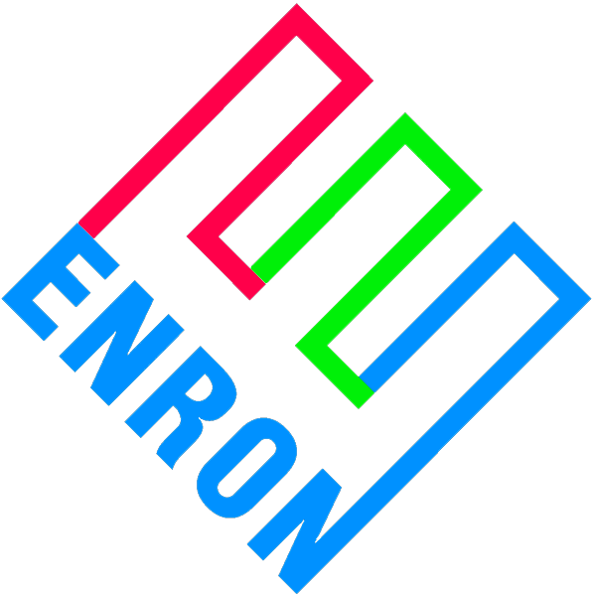


®
Enron Environmental Strategies
Jeff Keeler, Director 202.466.9157
Stacey Bolton, Manager 713.853.9916
Lisa Jacobson, Manager 202.466.9176
Mary Schoen, Manager 415.782.7803

