Slide 1
Edison Mission Energy
Reem Fahey
Illinois Commerce Commission – Alliance RTO
July 11, 2001

Slide 2
Midwest ISO/Alliance RTO Settlement
On May 8th, 2001 FERC approved the settlement agreement
The settlement agreement will allow the two competing organizations to remain separate entities with unified “super-regional” rate designed to resolve all seams issues and remove pancake rates between the two organizations
In exchange for the right to leave, the three Illinois companies agreed to pay MISO $60 Million in start-up cost

Slide 3
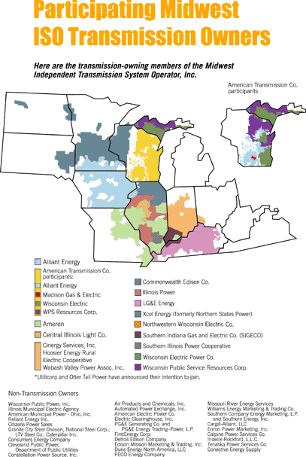
Alliance

Slide 4
Midwest ISO/Alliance RTO Settlement
Agreement to develop procedures and protocols to ensure compatibility across the region in the following areas:
  Real-time balancing market (May 31, 2001)
  Generation Interconnection Agreement (June 30, 2001)
  Day one and Long Term Congestion Management (December 31, 2001)
  One-stop shopping
  Coordinated Planning
  Cooperation in Security Coordination
  Independent Market Monitoring
  Compatible business practices (October 15, 2001)

Slide 5
Divergence in Energy Imbalance Market Design
In spite of the commitment per the settlement agreement to design a compatible and seamless energy imbalance market within the combined Alliance/Midwest ISO footprint, the proposals are fundamentally different as follows:
Design Aspect | Alliance | Midwest ISO
Overall Approach | Imbalance engine directs generators to inc/dec on a 15 minute basis | Allows entities to self-balance using Congestion Management prices for discovery of sources of incs/decs
Settlement Interval | 15 minutes | One hour
Regional Participation | Regional participation allowed (within Alliance) | No (balkanized per control area)
Penalties | No penalties | 15% penalty charge applicable to imbalance outside deadband

Slide 6
Interconnection Procedures & Agreement
Potential Non-Compliance
The Settlement Agreement requires one common Generation Interconnection Agreement by June 30, 2001
Progress to date indicates that MISO and Alliance each has its own procedure and agreement. The major differences are as follows:
  The parties involved in the agreement
  Treatment of generation interconnection at distribution voltage
  Transmission Credits

Slide 7
Potential Incompatibility in Long-Term Congestion Management
The Midwest ISO Advisory Committee directed their staff to propose to Alliance the formation of a “Joint MISO/Alliance Congestion Management Forum” to comply with the directive of the settlement agreement to create a seamless market
Proposal rejected by Alliance
As a result, Alliance and MISO each has a congestion management/market design committee that meet separately yet both are discussing and debating the same issues
This could potentially result in congestion management systems that are incompatible
Recommendation : The Alliance/Midwest ISO market needs to be designed as one thru a unified effort, and not by independently designing two markets and then piecing them together

Slide 8
ARTO Congestion Management
Hybrid Model
ARTO Day 2 Congestion Management Approach
WORK IN PROGRESS
Operational by 12/02
Forward market for transmission rights
LMP for real-time congestion management
Day 2

Slide 9
ARTO Congestion Management
Forward Market - Flowgates
Forward market for transmission rights based on Flowgates
Flowgates - transmission elements that have the potential to have congestion that exceeds a designated threshold
Designated by ARTO
  Intent is to identify all Flowgates with commercial significance - Commercially Significant Flowgates (CSFs)
  Value of flowgate transmission rights associated with CSFs determined by market
  May result in multiple hundreds of Flowgates within ARTO
  Designated a year in advance
<footer>

Slide 10
ARTO Congestion Management
Concerns Regarding the Flowgate Model
No industry experience
Premised on two false concepts:
  Congestion is easily predictable in the forward market
    Consequences :
      Uplift of congestion cost when RTO “misses” a commercially significant Flowgate
      Otherwise; Unmanageable number of Flowgates (multiple hundreds range)
  Distribution factors of transactions on Flowgates are stable
    Consequences :
      Uplift (if RTO guarantees against changes in distribution factors)
      Imperfect Hedges (if RTO directly assigns)

Slide 11
Alliance RTO
Key Issues
FGR Distribution Method (Auction vs. Allocation)
Long-term FGRs (5 years, 10 years)
Equivalent of “firm” transmission in the future
Balanced day-ahead schedules will be required .... no provision for self-scheduling
Extensive number of flowgates
Inter-RTO congestion management approach(es)
Retention of multiple control areas

Slide 12
Congestion Management Recommendations
Regulators (FERC and State Commissioners) should insist on a Standard Market Design Model (PJM’s LMP model)
Regulators should resist accepting “Innovative Market Design” proposals ...... consequences of a flawed model are too grave
If RTOs file for “Innovative Market Design” proposals, Regulators should put the burden of proof on the RTOs:
  How is the proposal superior to the Standard Market Design model?
  If superior, how will the proposal comply with Order 2000 “Function 8” (seamless trading between adjacent RTOs) ?

Slide 13
Alliance Stakeholder Process
As far as the Alliance stakeholder process, EME fully agrees with the State Commissioners assessment as described in their June 18th filing, as follows:
  “There is no managing member, no interim independent entity to facilitate the transition, no formal stakeholder process and no concrete plan for meeting the upcoming tariff filing milestones”
  “Instead of taking steps to formalize and implement a Stakeholder Advisory Committee, the Alliance Companies have implemented a “top-down” process whereby critical issues, including the compliance actions required by the Commission’s January 24 Order and the March 21 Settlement, are unilaterally decided and announced by the Alliance Companies without the full benefit of stakeholder input”

Slide 14
Alliance Stakeholder Process .. continued
The most troubling aspect of the Alliance stakeholder process is the fact that the market design is still primarily controlled by the Alliance Companies. This has also been very well articulated by the State Commission’s filing, as follows:
  “The design process remains under the control of the Alliance Companies, most of whom are transmission owners having a stake in the success of their own generation investments”

Slide 15
Stakeholder Process Recommendations
Again, EME fully supports the recommendations made by the State Commission as follows:
“(1) The creation of a formal stakeholder advisory process which provides all affected stakeholders, including State Commissions, with meaningful opportunity to collaborate and provide input into the formation of the RTO prior to its operational date;
and
(2) that the Alliance Companies take immediate measures to form the Alliance LLC and prior to its formation, take any other reasonable measure to ensure the independence of the RTO prior to its operation, such as the appointment of a majority non-owner transition board and staff to oversee RTO start-up and to interact with the formal stakeholder Advisory Committee ...“

