Slide 1
ets e-strategy

Slide 2
“e” stands for electronic networks and describes the application of network technology to improve and change business processes and to create new value chains
“e-commerce” covers the outward-facing processes that involve customers, suppliers and external partners
“e-business” includes e-commerce and also covers internal processes
source:http://www.gigaweb.com/content/PA/RPA-022000-00024.html

Slide 3
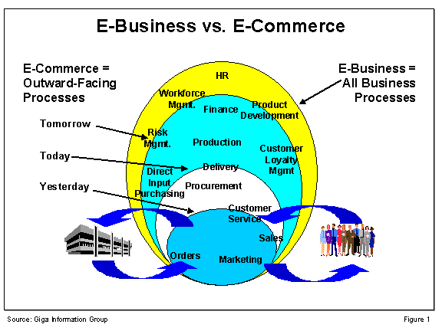

Slide 4
some ets e-commerce annual statistics
tms nominations: 1,305,784
tms confirmations: 2,891,875
tms invoices: 100,032
capacity release: 1000 bid/offers
hottap: fgt: 56,400 visits, 2,520,720 hits
nng: 96,000 visits, 2,776,320 hits
fgt, nng, tw: 90,000 hours logged in,
715 unique users
eol: 1 auction, 60 packages, 32 accepted

Slide 5
ets e
e-commerce =
outward facing processes
e-business =
all business processes
ehronline
filenet
telecom
tomorrow
sap hr
scada
class location
today
revenue management
yesterday
integrated supplier
i buy it
hottap
enron online

Slide 6
ETS e-commerce
E-commerce strategy
Visually augmented Informational Postings
(decision assisting graphs, maps, etc.)
Off-line Transactions/ Asynchronous Processing (PDA or notebook computer preparation)
Wireless Transactions
(e.g., higher bid notification
with bid response capability)
FERC
vendor
Pervasive Usability
(via pervasive XML)
Paperless Documents
(e.g., FERC filings, electronic contracts)
Real-time transaction feedback
(e.g., nom quantity versus MDQ and
available capacity at points)
Shared Functionality
(non-proprietary that add
customer value)
Data Mining
(e.g., Capacity Release)
Informational Postings (outage schedules,
gas quality, tariff, etc.)
- Transactions (noms, scheduled quantities,
confirmations, invoices, imbalances, etc.)
Email/ pager notifications (critical notices,
cuts, etc.)
- Real-time display (flow volumes)
customer
Today’s e-commerce
Field

Slide 7
E-strategy statement:
Our scope will include both e-commerce (external customer) and e-business (internal users).
E-commerce will focus on enhancing and extending capabilities already offered as well as identifying new opportunities to enhance revenue, reduce cost or retain/ attract market share.
E-business will focus on improved business processes, application integration and better decision-making tools.
We will create and follow a mindset in our business and IT organizations which seeks to exploit new technologies and paradigm shifts in order to cause continual and steady progress toward our e-strategy.

Slide 8
ETS e-business
E-business strategy
Visually augmented internal apps
(decision assisting graphs, maps; pipeline profile, etc.)
Off-line Transactions/ Asynchronous Processing (PDA or notebook computer preparation)
Wireless Transactions
(e.g., contract request approvals, field inspections, server reboots)
Mobile Workforce
Enron Entities
Real-time transaction feedback
(e.g., EOL deals, pricing)
Shared Functionality
(OTS to Business Apps to
HR/ Financial/ Accounting)
Data Mining
(e.g., Marketing
Dashboard)
Pervasive Usability
(via pervasive XML)
Intranet (Document Imaging, Progress Reporting, …)
Business Apps (Marketing, Market Services,
Gas Accounting, …)
OTS (Project Tracking, Emergency Response,
Class Location, …)
HR, Financial, Accounting
Home Office
Field
Today’s e-business

