Slide 1
E-Commerce: Energy Trading
Will Never Be The Same
Presentation by
Mark E. Haedicke
Managing Director and General Counsel, Enron Wholesale Group
Energy Bar Association – Washington, D.C. – November 16, 2000

Slide 2
Outline of Presentation
Milestones In Energy Trading
Website Development / Operation
EnronOnline.com
Where Are We Headed and What Does That Mean For Lawyers?

Slide 3
Outline of Presentation
Milestones In Energy Trading
Website Development / Operation
EnronOnline.com
Where Are We Headed and What Does That Mean For Lawyers?

Slide 4
MILESTONES IN ENERGY TRADING
1978 Natural Gas Policy Act – started wellhead pricing deregulation
1983 NYMEX Crude Oil Contract
1985 Development of OTC Spot Markets in Gas
FERC Order No. 436 – beginning of unbundling
1989 Natural Gas Wellhead Decontrol Act of 1989
1990 NYMEX Gas Contract
1992 FERC Order No. 636 – unbundling of sales and transport services
1996 NYMEX Power Contract
FERC Order No. 888 – provided access to transmission lines for wholesale transactions
1999 OTC Electronic Trading Platforms

Slide 5
OUTLINE OF PRESENTATION
Milestones In Energy Trading
Website Development / Operation
EnronOnline.com
Where Are We Headed and What Does That Mean For Lawyers?

Slide 6
GETTING STARTED
Structure a website as carefully as you would structure a loan agreement
Consider the nature of the business, the likely customers, the location of the customers
List and assess the law in all jurisdictions that could apply
Construct the business and site in light of all the foregoing

Slide 7
JURISDICTION/VENUE/CHOICE OF LAW
Which laws apply to your site?
  The internet has no borders
  Location of customers accessing the site
  Is the access passive or interactive?
  Consider practice in non e-commerce cross-border transactions
Jurisdiction
  Personal jurisdiction is less likely for passive sites
  More likely for interactive sites
Venue
Choice of Law

Slide 8
INTELLECTUAL PROPERTY ISSUES
Copyright
  What is copyrightable?
  Code, text, music, video, artwork?
  Who owns the copyrights on work done by independent contractors in developing the site?
  Place a notice of copyright in “terms of use” provision and on all web pages
  Carefully analyze materials from third-parties for copyright infringement issues
  Obtain written permission to use other’s copyrighted material

Slide 9
INTELLECTUAL PROPERTY ISSUES Continued
Patents
  Review software and site for potential patents
  Process or business method patents have been granted regarding several well known internet sites
  For example, reverse auction at Priceline.com
  Is the site infringing on existing patents

Slide 10
INTELLECTUAL PROPERTY ISSUES Continued
Trade Secret Protection
  Protect “know how” that cannot be protected by copyright, patent or trademark law through confidentiality agreements
  Protect the confidentiality of information, practices, etc. considered to be trade secrets
  Enter into confidentiality agreements with contractors and employees
Trademarks
  Register company marks used
  Appropriate attribution and consent to use third-party marks

Slide 11
CFTC ISSUES
Proposed Rulemaking: A New Regulatory Framework for Multilateral Transaction Execution Facilities (MTEFs), Intermediaries and Clearing Organizations
Commission proposes three regulatory tiers for the Markets: (i) recognized futures exchanges (RFEs), (ii)derivatives transaction facilities (DTFs) and (iii) exempt MTEFs
  Carefully consider application to energy
  Consider proposed rules when structuring an internet business
  Structure site as an exchange, a matching site or a one party site
Proposed Federal Legislation to Amend the Commodity Exchange Act

Slide 12
ADVERTISING
General Rules – same as print or broadcast restrictions
FTC prohibitions of deceptive advertising
Consider industry specific rules regarding commodities or energy

Slide 13
PRIVACY
Privacy Online: A Report to Congress – FTC Guidelines
  Notice to consumers about how personal information collected online is used
  Choice for consumers about whether and how their personal information is used
  Security of personal information collected and stored by an online provider
  Access for consumers to their own personal information to ensure accuracy

Slide 14
PRIVACY Continued
Formulate site’s policy regarding use of personal information obtained in the course of using the website; detail policy in “terms of use” provisions
FTC inquiry into profiling activities
European Union Data Privacy Directive – more restrictive than in U.S.
Consider Federal Communications laws and state privacy torts

Slide 15
OTHER LAWS TO REVIEW
Antitrust Issues
  Microsoft litigation
  Public Workshop: Competition Policy in a World of B2B Electronic Marketplaces (65 FR 30120)
Securities Issues
Increased enforcement staff for internet securities issues
Digital Defamation
  Has a defamatory remark been published
  Potential liability for distributors
Broadcasting Laws

Slide 16
OTHER ISSUES TO CONSIDER
The internet has no borders
Site visitors subject to “click wrap” agreement (contractual “terms of use” posted on the website); set forth “terms of use” on the home page
Disclaimers on the site
Warranties as to information on the site
Policy regarding linking to other sites (deep linking past the home page?)

Slide 17
OUTLINE OF PRESENTATION
Milestones In Energy Trading
Website Development/Operation
Developing Electronic Contracts
Existing Electronic Trading Sites
EnronOnline.com
Where Are We Headed and What Does That Mean For Lawyers?

Slide 18
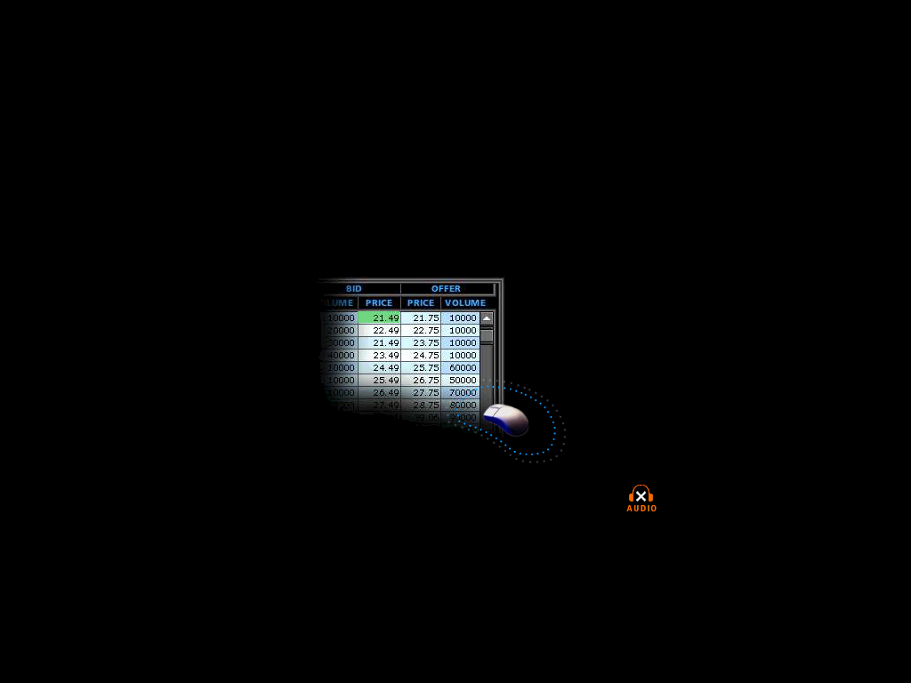
WHAT IS ENRONONLINE?
A Free, Internet-based, Global Transaction System Which Allows Counterparties to View Real Time Prices From Enron’s Traders and Transact Instantly Online
click & transact

Slide 19
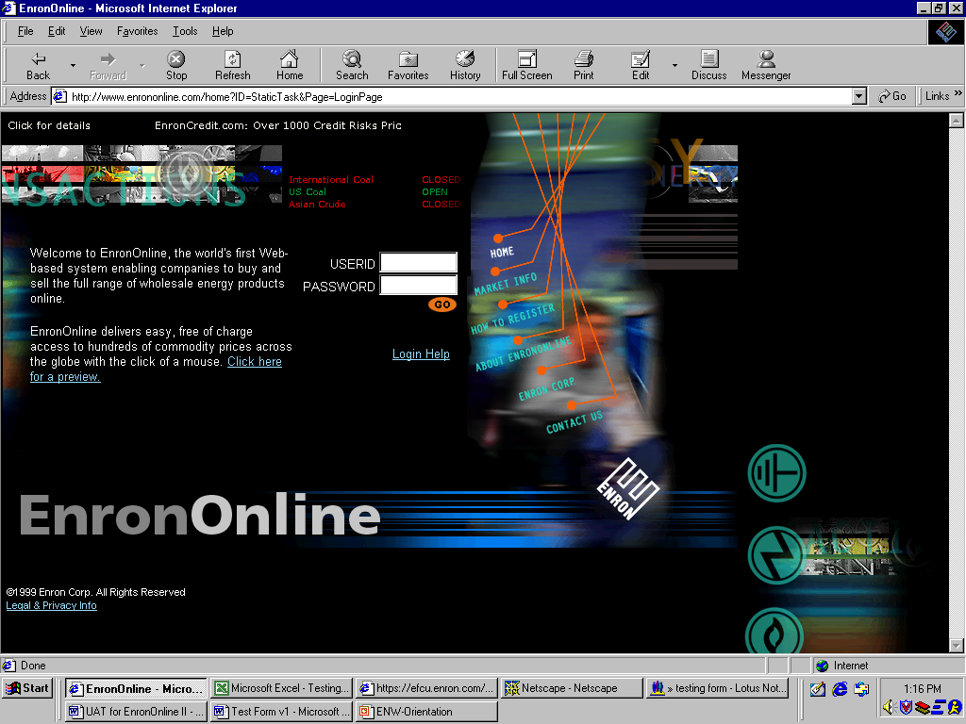

Slide 20
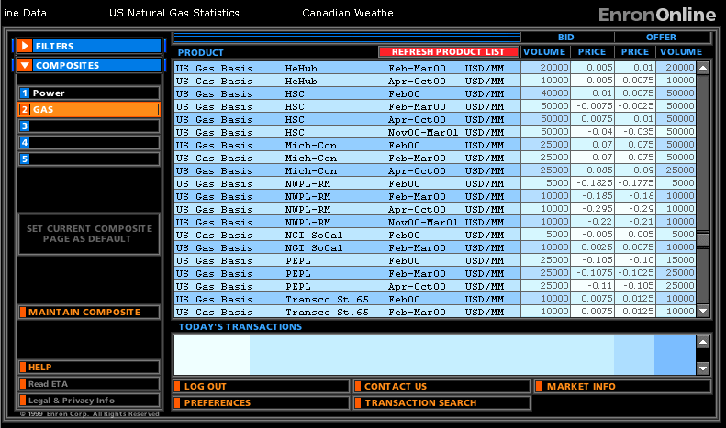
Click on Bid or Offer Price

Slide 21
Submission Screen

Slide 22
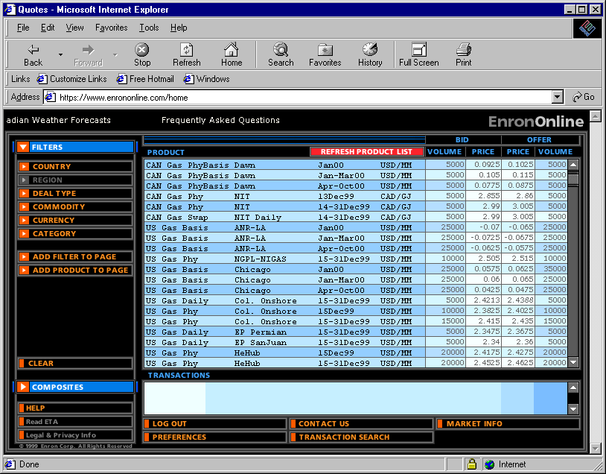
Successful Transaction

Slide 23
OUTLINE OF PRESENTATION
Milestones In Energy Trading
Website Development/Operation
Developing Electronic Contracts
Existing Electronic Trading Sites
EnronOnline.com
Where Are We Headed and What Does That Mean For Lawyers?

Slide 24
Where Are We Headed and What Does That Mean For Lawyers?
Most energy trading will be done electronically within 2 years
Lawyers are presented with a dramatically expanded set of legal issues
Electronic signatures will predominate; hard-copy signatures will be a relic of the past
The back office will become electronic

Slide 25
Where Are We Headed and What Does That Mean For Lawyers? Continued
Drafting and negotiation of Master Agreements will decrease to an insignificant portion of the time spent by trading lawyers
Lawyers will become risk managers of legal risk by making judgment calls on legal issues with little or no legal precedent for guidance
Lawyers will struggle to be aware of, review and approve all contracts entered into by their clients as electronic trading proliferates
Lawyers will have much less time to make legal judgment calls

