Slide 1
Enron North America Corp. E-Commerce Legal Considerations
Mark E. Haedicke

Slide 2
WEBSITE DEVELOPMENT; OPERATION
TERMS OF USE
“Click Wrap” Agreement
Disclaimers
Copyright
Warranties
Site Linking Policy

Slide 3
JURISDICTION/VENUE
Web Site Accessibility
Passive Sites – Less Likely To Result In Personal Jurisdiction
Interactive Sites – Personal Jurisdiction More Likely
Choice Of Forum/Choice Of Law Provisions
A Good Idea, But Not Bulletproof

Slide 4
ELECTRONIC CONTRACTS
Statute Of Frauds
Electronic Signatures
Patchwork Of State And Federal Legislation
Parol Evidence Rule
Course Of Dealing

Slide 5
INTELLECTUAL PROPERTY ISSUES
COPYRIGHT
Website Content
Client Created
Work-Product Of Contractors
Third-Party Materials – Infringement Issues
PATENTS
Software
Process or Business Method

Slide 6
INTELLECTUAL PROPERTY ISSUES (cont’d)
TRADE SECRET PROTECTION
Confidentiality Agreements
Contractors
Participants
Employees
TRADEMARK
Registration of Marks Used
Appropriate Use of Third Party Marks

Slide 7
PRIVACY
PRIVACY POLICY – SITE’S POLICY REGARDING USE OF PERSONAL INFORMATION
FTC GUIDELINES
CHILD ONLINE PRIVACY PROTECTION ACT OF 1998 – SITES DIRECTED TOWARD CHILDREN
FTC Regulations Effective April 21, 2000
PROFILING ACTIVITIES
Heightened Scrutiny Of Monitoring Usage
EUROPEAN UNION DATA PRIVACY DIRECTIVE
Very Restrictive

Slide 8
ELECTRONIC TRADING – TYPES OF SITES
EXCHANGE
CFTC ISSUES
MATCHING
No Firm Contracts Formed
ONE PARTY
Allows Contract Formation With Only One
Entity Offering A Product

Slide 9
ADVERTISING AND MARKETING REQUIREMENTS
GENERAL RULES – SAME AS PRINT OR
BROADCAST RESTRICTIONS
NO DECEPTIVE INFORMATION – FEDERAL
TRADE COMMISSION
INDUSTRY SPECIFIC ADVERTISING
REGULATIONS (e.g. FDA AND DDT)

Slide 10
SECURITIES LAWS
ANTITRUST ISSUES

Slide 11
INTERNATIONAL ISSUES
THE INTERNET HAS NO BORDERS
LOCAL LAWS ON THE FOREGOING ISSUES MAY
VARY DRAMATICALLY
Examples:
Restrictions On Comparative Advertising, or
Listing Prices In Local Currency
Contract Enforceability Issues

Slide 12
INTERNATIONAL ISSUES (cont’d)
OTHER INTERNATIONAL TRANSACTION ISSUES
ALSO APPLY
Examples:
Tax
Currency Controls
Export Controls

Slide 13
ELECTRONIC TRADING – EXISTING WEB SITES
Altra Energy www.altra.com Broker/matching site with
Technologies, Inc. some electronic back-office services and software packages
Natural Gas, Power
Altra Power www.altra.com Wholesale power, natural gas, crude oil, natural gas liquids
Automated Power www.brokertec.com Electricity products in California,
Exchange New York and the United Kingdom
Bloomberg Power Match
BrokerTec www.brokertec.com Cash and derivative fixed-income products, spot, forward foreign exchange, FX options, currency swaps

Slide 14
ELECTRONIC TRADING – EXISTING WEB SITES (cont’d)
CFOWeb www.cfoweb.com Interest rate swaps, caps/floors, forward rate agreements, loans and deposits
ChemConnect www.chemconnect.com Broker/matching site
Chemicals
ClickPaper Clickerpaper.com Pulp and paper principal trading
CoalHub www.freemarkets.coalhub.com Auction site – details unknown
Coal
Coral www.coralconnect.com “One-to-many” proprietary site

Slide 15
ELECTRONIC TRADING – EXISTING WEB SITES (cont’d)
Creditex www.creditex.com Single-name credit default swaps
CreditTrade www.credittrade.com Credit derivatives
DerivativesNet www.blackbird.net Interest rate swaps, forward rate agreements
EBS www.ebsp.com Forward rate agreements, spot and forward foreign exchange
Enermetrix.com www.enermetrix.com Many-to-many Exchange?
Exchange Electricity
EnronOnline www.enronline.com Energy commodities, crude and refined products, bandwidth, weather derivatives and credit derivatives trading. Gas storage, transportation and emissions credits auctions

Slide 16
ELECTRONIC TRADING – EXISTING WEB SITES (cont’d)
eSpeed www.espeed.com Government securities, access to Cantor Exchange providing US Treasury and agency futures
Essentials www.essentials.com Retail electricity, natural gas, propane, internet access, communications
Eurex (“EEX”)/European Physically-settled electricity,
Energy Exchange spot electricity (planned)
Gain Capital www.gaincapital.com Spot foreign exchange trading
GE Polymerland www.gepolymerland.com Plastics distribution and auction site

Slide 17
ELECTRONIC TRADING – EXISTING WEB SITES (cont’d)
HoustonStreet Exchange www.houstonstreet.com Broker/matching site
Wholesale electricity trading in Northeast US, expanding nationally
Icor TBA
Intercontinental Exchange Energy and metals trading, details to be announced
I-Wex www.I-wex.com Degree day products and other weather derivatives
NGX www.ngx.com Many-to-many Exchange w/ clearing
Natural gas

Slide 18
ELECTRONIC TRADING – EXISTING WEB SITES (cont’d)
NordPool www.nordpool.com Spot and forward electricity products in Sweden, Finland, Norway and Denmark
PetroCosm www.petrocosm.com “Energy Industry Marketplace” – probably limited to oil filed equipment, etc.
PlasticsNet www.plasticsnet.com
RateXchange Bandwidth
RedMeteor.com www.redmeteor.com Broker/matching site
Crude Oil, Electricity, Natural Gas, and Natural Gas Liquids
Schlumberger www.indigopool.com Information only re: Oil and
IndigoPool Gas properties offered for sale

Slide 19
ELECTRONIC TRADING – EXISTING WEB SITES (cont’d)
SwapsWire www.swapswire.com Benchmark swaps and vanilla instruments
TradeWeather www.tradeweather.com Degree day, precipitation and other weather derivative products
Utility.com www.utility.com Retail electricity, internet service provider and home warranties
Vol Broker www.volbroker.com Foreign exchange options

Slide 20
ELECTRONIC TRADING – TYPES OF SITES
EXCHANGE
CFTC Issues
MATCHING
No Firm Contracts Formed
ONE PARTY
Allows Contract Formation With Only One
Entity Offering A Product

Slide 21

WHAT IS ENRONONLINE?
A Free, Internet-based, Global Transaction System Which Allows Counterparties to View Real Time Prices From Enron’s Traders and Transact Instantly Online
click & transact

Slide 22
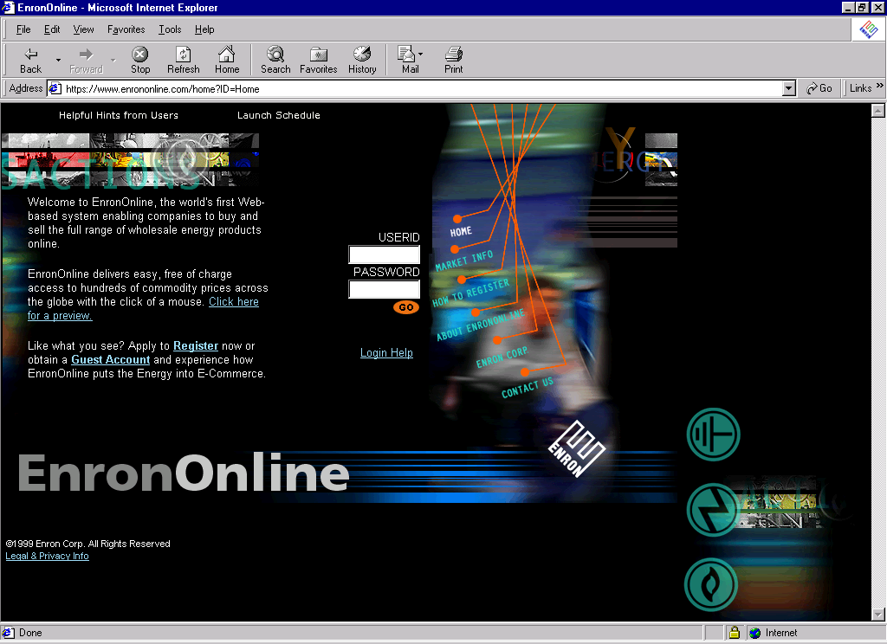
www.EnronOnline.com
New User
*******

Slide 23
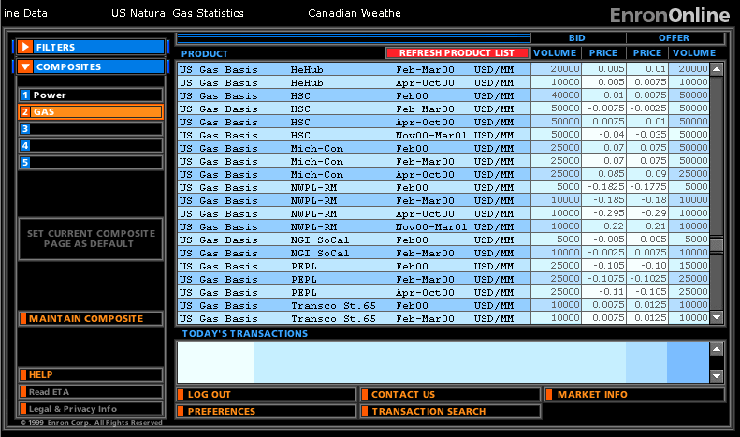
Click on Bid or Offer Price

Slide 24
Submission Screen

Slide 25
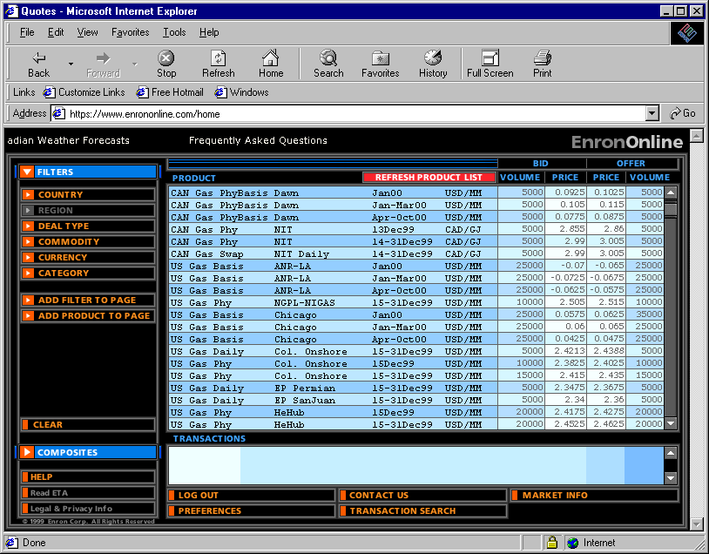
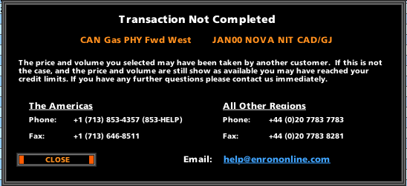
Failed Transaction

Slide 26
Successful Transaction

Slide 27
CONCLUSIONS
E-COMMERCE PRESENTS LAWYERS WITH MANY
CHALLENGES
RARELY IS THERE A CLEAR ANSWER IN SETTLED
LAW
BUSINESS PRACTICES ARE DEVELOPING AND
CHANGING RAPIDLY
The Law Is Struggling To Catch Up And Is Also Changing Rapidly (At Least By Usual Legal Standards)
Lawyers Will Be Called On To Balance An Uncertain Legal Status With The Legitimate Needs Of Their Clients To Do Business

