Slide 1







PARTNERSHIP TRACK
Promtion Criteria (EWS)
January 26, 2001

Slide 2
PRC Meeting Criteria
Commercial Director; successive impact and revenue generation

Slide 3
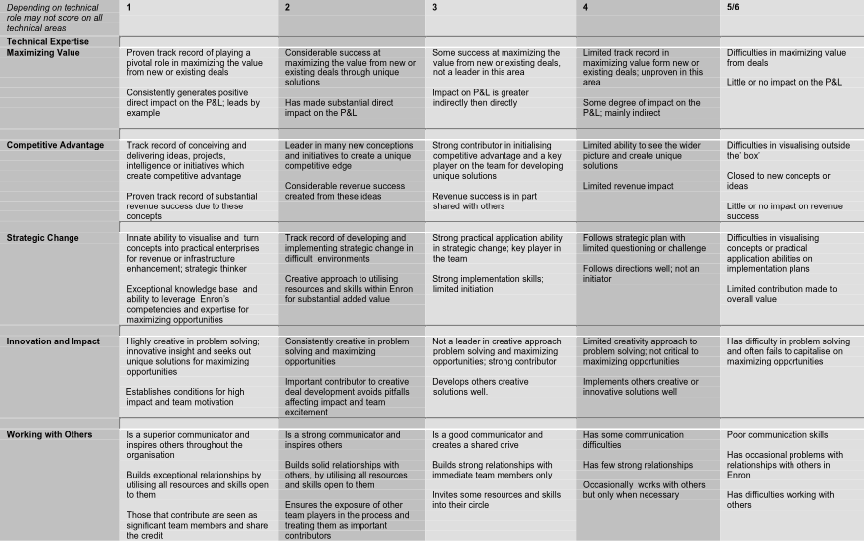
PRC Meeting Criteria
Strategic Professional and Technical; maximizing for unique competitive advantage

Slide 4
PRC Meeting Criteria
Support; indirect impact, essential delivery and execution

Slide 5
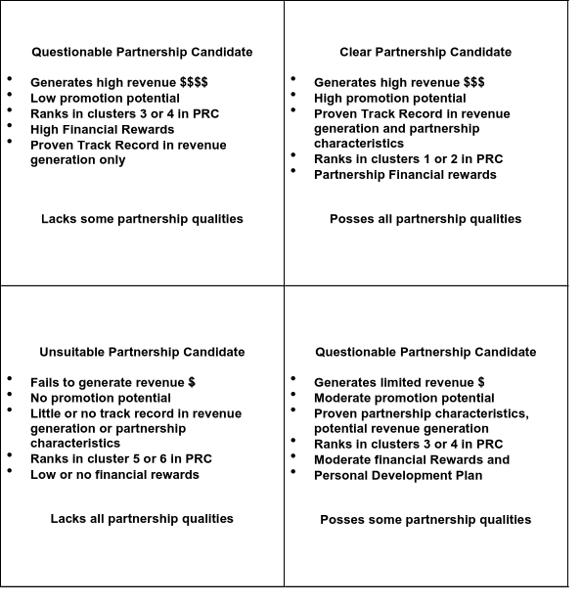
PARTNERSHIP TRACK
Commercial Partnership Candidate taken as an Example when PRC and Promotional criteria applied

Slide 6
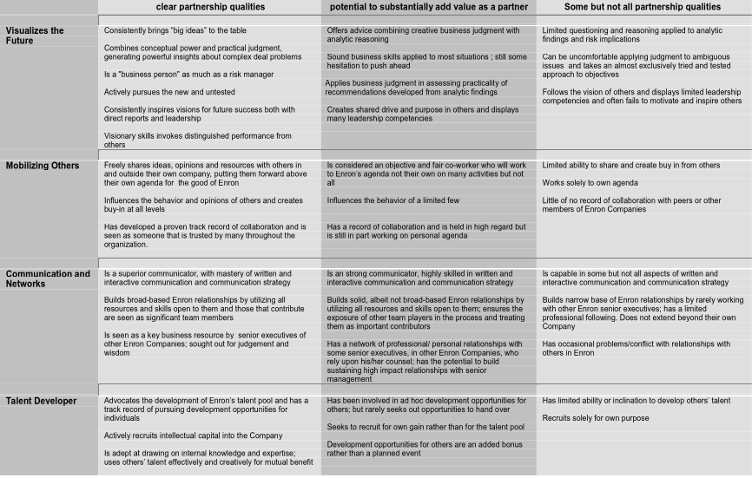
Partnership Promotion Criteria; all tracks

Slide 7
SUPPORT PARTNERSHIP TRACK
PRE - DEFINED PARTNERABLE ROLES
Need to demonstrate all of the following to determine if a partnerable role exists
A $ xxx of market capital value
B Organizational responsibility of # headcount
C Organization EBIT of $ xxx
once the above is satisfied the potential candidate can be considered against the agreed promotional criteria

Slide 8
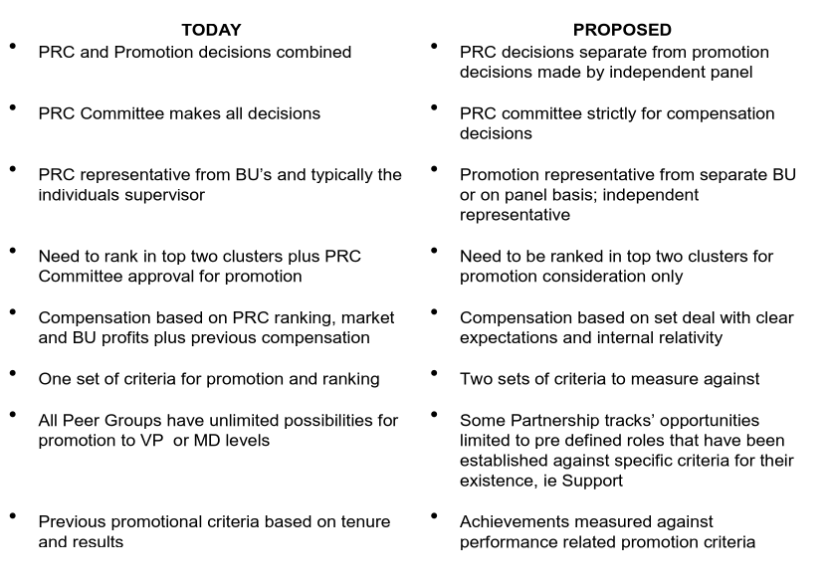
PARTNERSHIP PROMOTION PROCESS

Slide 9
Promotion Timeline
DECEMBER
JANUARY
MARCH
JANUARY
FEBRUARY
JAN / FEB
BU PRC meeting conclude
Elected reviewers interview candidates supervisors and some reviewers
Remaining candidates are interviewed by the committee
Candidates reviewed on paper by promotion committee
Final candidates are reviewed by the panel for final decision on promotion
Candidates in clusters 1 & 2 put forward for promotion consideration

