Slide 1







PARTNERSHIP TRACKS
ENRON WHOLESALE SERVICES (EWS)
January 17, 2001

Slide 2
Mission
Establishment of Professional Partnership models within Enron Wholesale Services
Mapping of current roles/functions within organisation to the Partnership Tracks
COMMERCIAL
STRATEGIC PROFESSIONAL AND TECHNICAL
SUPPORT
Establish each Partnership Criteria to be consistently applied throughout EWS
Define Promotion Criteria at Director, VP and MD levels
Determine ‘gray functional areas’ for discussion

Slide 3
Approach
Partnership Criteria was established for the 3 tracks
The spectrum of functions within EWS was identified
Basic assumptions and rules were applied
Model tested and ‘gray areas’ established

Slide 4
Considerations
All positions below Manager were placed in Support Partnership Track, the premise being that at that this level the direct level of influence and impact is limited.
Functions crossed two partnership tracks, i.e., Legal, Tax; primarily seen as support role yet there were individuals who have direct impact on the creation, development or closure of a commercial deal
Entire groups may be in one partnership track but the leader of that group may be in another track
Applied to ENA, EEL and Networks only

Slide 5
Guidelines for Mapping
COMMERCIAL PARTNERSHIP TRACK
Primary purpose of role’s existence isthe generation of revenue and creation of new business
Need to demonstrate at least 3 of the established criteria to be considered for the Commercial Partnership Track
Substantial Compensation risk
STRATEGIC PROFESSIONAL AND TECHNICAL
Maximising value and managing risk on the execution of commercial deals
Creates competitive advantage
Critical role in supporting commercial activities
Need to demonstrate at least 4 of the established criteria to be considered in the Strategic Professional and Technical Track
Significant Compensation Risk
SUPPORT
Essential franchise functions integral to EWS business
Maintenance and mitigation of risk for commercial deals, structures and organisation
High Compensation Risk

Slide 6
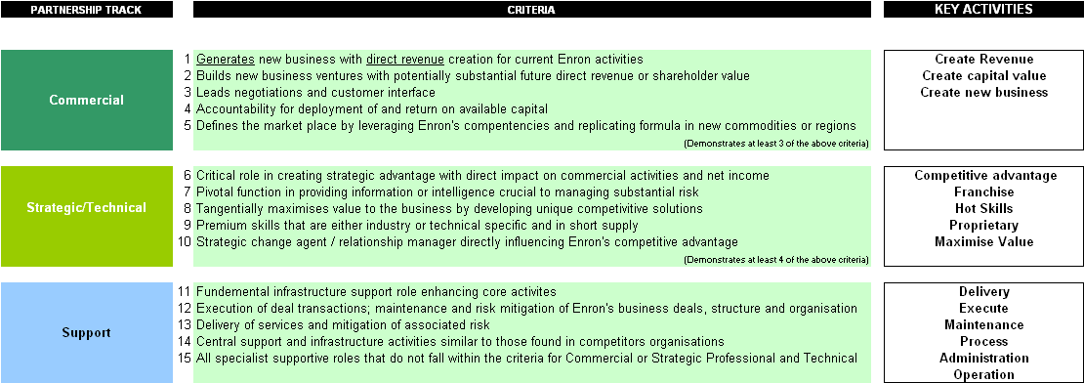
EWS Partnership Track Criteria

Slide 7
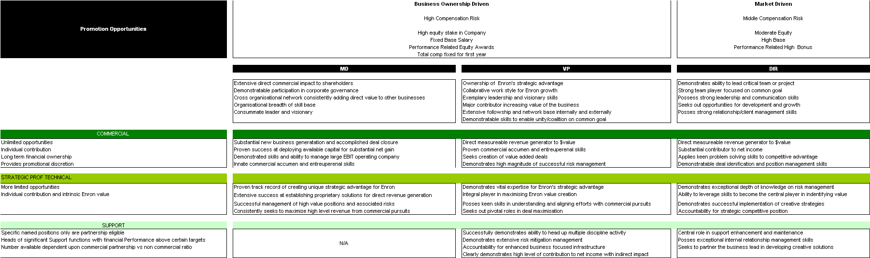
Promotion Criteria and Compensation

Slide 8
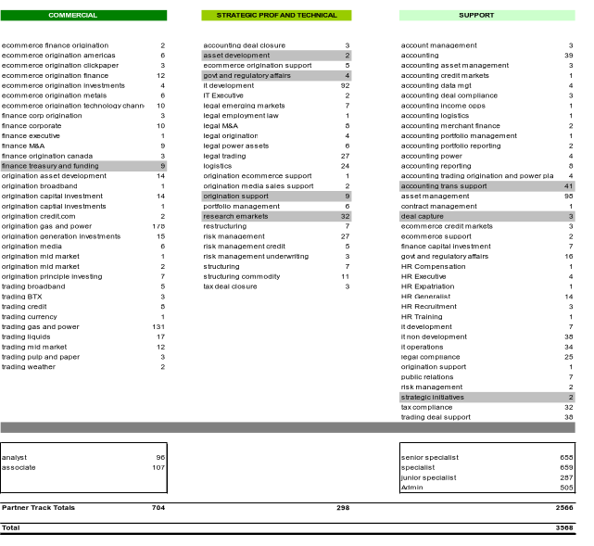
EWS Partnership Track Mapping

