Slide 1





Enron Government Affairs
Status Report to EWS
September 2001
<number>
Notes:
This is an excellent opportunity to meet with you guys in order to introduce Government and Regulatory Affairs to you. It is a short presentation after which I will be glad to receive your questions.
The structure of the presentation is pretty straight forward. It starts by

Slide 2
Overview

Slide 3
Government Affairs – Core Functions
Market Advocacy
Deal Support
Regulatory Risk Management
Regulatory Risk Management
Regulatory Origination
Primary Goal = remove all barriers and restrictions to energy markets
Key Wholesale = RTO
Key Retail = Direct Access
Minimize regulation of derivatives and financial markets
43% of $ resources in 2000 / 2001
Support commercial transactions
Information and Intelligence gathering
Power Desk Coverage
17% of $ resources in 2000 / 2001
Identify regulatory and political risks in current book
Develop and implement mitigation plan to protect value
4% of $ resources in 2000 / 2001
Identify Enron-only market opportunities for commercial teams (e.g., Silver Oak)
14% of $ resources in 2000 / 2001

Slide 4
Government Affairs - Approach
Leading Role - Enron positioned as the leading voice for competitive energy markets
Enlisting Allies – Coordinated ad-hoc and permanent coalitions to effect necessary changes and protect our books
Shifting Mission - From Market Advocacy toward Deal Support and Regulatory Risk Management
Aligning Resources – Employ centralized resource allocation process for $ and people to ensure consistency

Slide 5
Government Affairs – Key Issues
Minimize California Crisis’ impact on Enron
Recover outstanding debts
Restore California’s market
Finish Wholesale Electricity Markets
Push FERC on RTOs
Assist FERC with market power / market structure
Push for Additional Retail Market Openings
Finish implementing Texas and Ohio
Focus on opening MO, NV, FLA for C&I
Keep regulators from disrupting working markets
Natural gas
Financial derivatives
Protect EWS Retail Tariff positions
400 MM Mwh short
25 Utilities, 15 states

Slide 6
California Crisis
Recover Outstanding Debts
Negative CTC
Trade Credit with Utilities and ISO/PX
ISO Undercollection
Manage FERC Refund Cases
CA Refund -
PNW Refund -
Continue Direct Access
Delay CPUC suspension action under ABX1 to give Legislature opportunity to fix
Ensure best economic value proposition
Focus regulators on getting infrastructure in place
Natural gas takeaway capacity
Independent and workable CAISO
Protect EWS Retail Tariff positions
400 MM Mwh short
25 Utilities, 15 states

Slide 7
Wholesale Electricity Market Status
Push FERC on Order 2000
Turn “voluntary” nature into $ pain if further delays
Ensure RTO offers services in non-discriminatory manner
Broad regional scope (NE, SE, MW, ERCOT, West)
Support workable Wholesale Electricity Markets
Assist FERC with market power debate – end generator abuse
Drive FERC on sustainable market structures – PJM model
Conform Retail and Wholesale Markets
Balancing provisions uniform to all participants
Congestion Management with financial rights
ICAP and Ancillary Services
Establish Mandatory Reliability Function Under FERC

Slide 8
Retail Market Status
* As of April 2001.

Slide 9
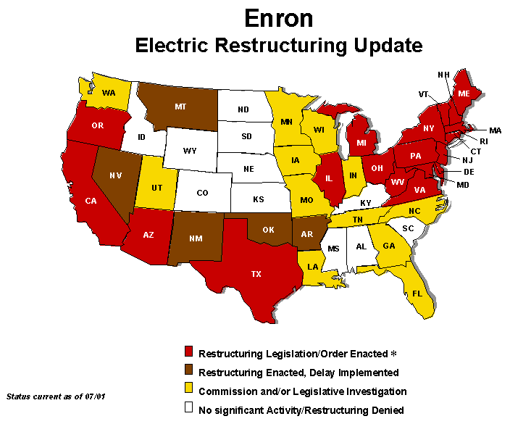

Slide 10
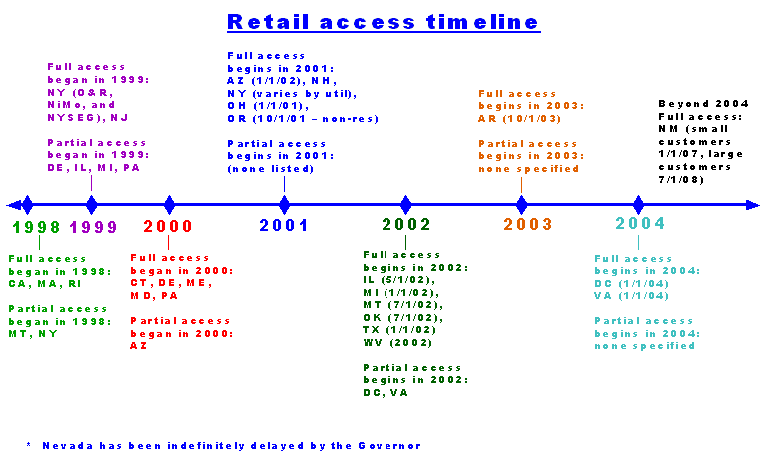

Slide 11
Minimize Regulatory Intervention Status
Pro-Market rules/restrictions for market-based authority
Role of e-Commerce in energy and industry
Natural gas & power affiliate codes of conduct
Natural gas & power reporting requirements

Slide 12
Protect EWS Retail Tariff Position
California
Financial Risk (FERC Refunds, Negative CTC…etc).
Market Progress (e.g. CA ISO control, CDWR role…etc).
Wholesale Market Reform
Equal Access
Detail Rules (Ancillary services, ICAP….etc).
Retail Market Opening
Timing
Quality

Slide 13
Retails Position, Relative Weights (URM)
July, 2001

Slide 14
Retail Risk, Nominal MWh (URM)
July, 2001

Slide 15
Retail Curves Review Process
Provided curve owners with the most updated regulatory information & identify regulatory risks in the curves which cover 80% of EES positions. The process is ready to be repeated every 90 days.
Currently Developing regulatory strategies jointly by URM and GA to protect and improve EES positions as necessary.
Perform impact analysis as required
Implement regulatory strategies agreed upon between URM and GA
Provide regular update on the progress of implementation plan

