Slide 1

®
Enron Transportation Services

Slide 2


How we’ve developed
InterNorth
(NNG, NBPL)
Houston Natural Gas
(HNG, FGT, TW)
HNG
InterNorth
1985
®

Slide 3
®
Enron Transportation Services
Northern
Natural Gas
(NNG)
Florida Gas
Transmission
(FGT)
Transwestern
Pipeline
(TW)
Northern
Border
Pipeline
(NBPL)
Notes:
Good morning! Thanks for having me here today. I’m glad to have the opportunity to share information about Enron Transportation Services with you.
Formerly known as the Gas Pipeline Group, we changed our name to Enron Transportation Services to reflect the variety of transportation services we offer and our intellectual capital, instead of our physical assets.
ETS is Enron’s oldest and most dependable business unit, and we continue to provide Enron with consistent earnings and cash flow.
We have a strong competitive position with expansion opportunities in each of the markets we serve.
We have fundamentally changed our approach to business from a unit focused on installed rate base to one focused on offering services to extend the use of existing assets and strategic growth to reach new markets.
The use of the Internet and other technology tools have been, and will continue to be, a key to our success.
Enron Transportation Services is made up of 5 interstate pipelines: Northern Natural Gas, Florida Gas Transmission, Transwestern, Midwestern Gas Transmission and Northern Border. Also included in the ETS organization are EOTT.

Slide 4
How does ETS fit into Enron? IBIT
ETS IBIT
$391 MILLION
Total Enron IBIT $2,482 MILLION
®

Slide 5
Our Business
ETS owns and operates one of the largest interstate pipeline networks in North America
ETS sells transportation and storage services to a wide range of customers including marketers, producers, utilities and end users.
Natural gas as a commodity has been deregulated. Pricing and tariffs of interstate pipelines serve as baseline regulation, with an opportunity to negotiate individual customer rates.
We are actively developing services that bridge the gap between the traditional regulated world and the financially driven new economy.
®
Notes:
We no longer think of ourselves as a regulated utility who uses the size of its rate base as the major determinant for our earnings. Those days are gone. We think of ourselves as a UPS, a Federal Express, Continental Airlines, or a railroad. We track it, we use the internet to conduct business deals, and we have in place pricing structures. It may be molecules of natural gas or barrels of crude oil instead of packages, but the issues are basically the same: how to get the product from point A to point B safely, reliably and at the lowest cost. The pipeline business is changing, and we have to rethink our business by reinventing ourselves and constantly introducing new services.

Slide 6
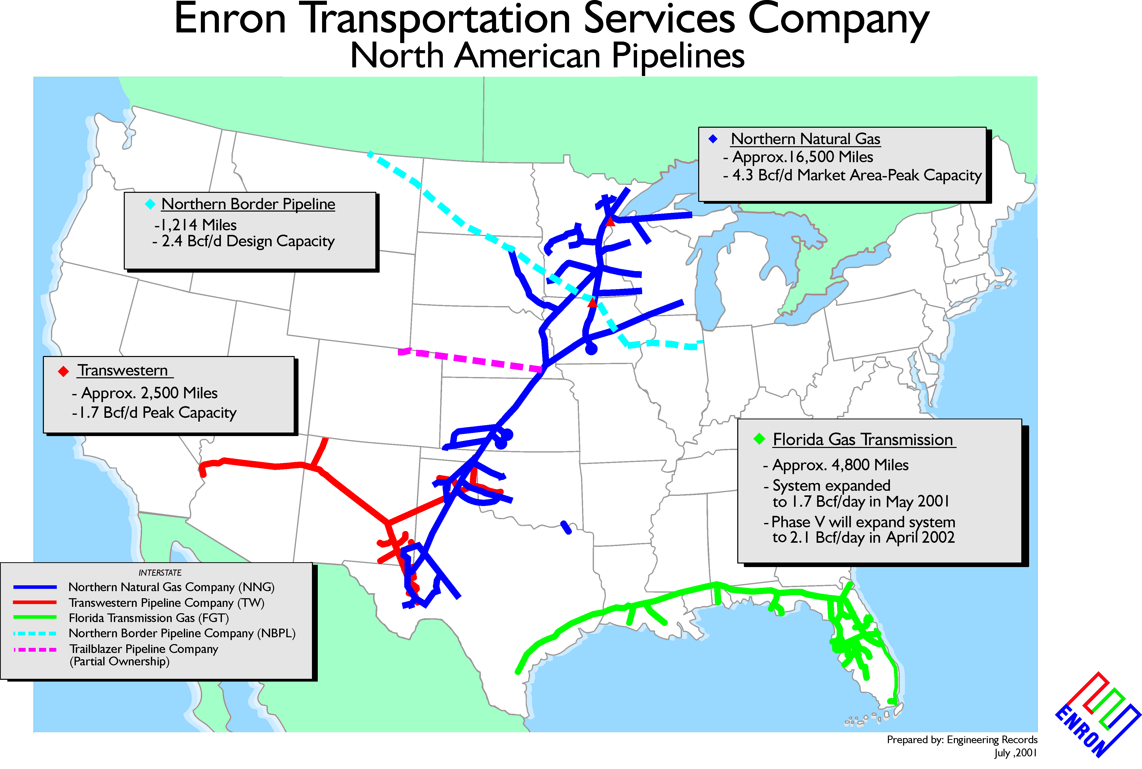

Slide 7
Northern Natural Gas Company
Western
Canadian Basin
Montana
North
Dakota
Minnesota
Michigan
Growth
Wyoming
South
Dakota
Wisconsin
.
New gas-fired power plants
Peak Day Max expansion
Interconnect Expansions in Market and Field areas.
Rocky Mountain Basins
Nebraska
Iowa
Market Area
Kansas
Illinois
Hugoton
Basin
Supply Area
Missouri
Oklahoma
Anadarko
Basin
New Mexico
Permian
Basin
Texas
®
Notes:
In addition to our growth opportunities, NNG continues to be a prominent player throughout the Midwest. Our Northern system serves as a key connection between Midwest utility customers and critical gas supplies to the north and south, providing our customers with supply optionality.
Northern Natural, with over 16,000 miles of pipe, is the largest single pipeline system in the U.S. and serves a market area in the upper Midwest, principally, Minneapolis, Wisconsin, Nebraska, Iowa and Illinois.
Northern is directly connected to the Permian, Anadarko and Hugoton supply basins in Texas, Oklahoma and Kansas. Through the Trailblazer pipeline system, which we have a 1/3 equity interest, we connect to supplies in the Rocky Mountains. And our NBPL system delivers up to 1.3 Bcf/D of Canadian supplies. This provides our customers with great supply options.
Northern also operates 56 Bcf of storage, providing shippers both physical and financial flexibility in managing their gas supply portfolios.
We are 95% contracted through 2003 in the market area. 85% revenues are fixed demand charges, and we have no rate case requirement through 2003.
We recently completed an open season for our market area to understand our customers needs for the future. We had non-bidding requests for over 300 MMcf/d of new capacity. We are working with customers to finalize deals.

Slide 8
Transwestern Pipeline
Nevada
Utah
Colorado
Growth
California
San Juan
Basin
Kansas
Anadarko
Basin
Gallup Expansion: 140 MMcf/d
New compression in Arizona expands system by 150 MMcf/d
Capacity increase from 1.1 Bcf to 1.24 bcf/d to the California border
Oklahoma
Arizona
New Mexico
Permian
Basin
Transwestern Pipeline
New Interconnections
Third Party
Power Plants
2001
2002
2003
Texas
®
Notes:
Just in time to have new capacity entering the California market, Transwestern expanded the mainline by 140 MMcf/d last March.
Transwestern filed an application with FERC in March of this year to install new compression at four existing stations in Arizona to expand its system by 150 MMcf/d of incremental firm capacity. TW’s total capacity to the California border will increase to 1.24 Bcf/d. The $93 million project is expected to be in service by June, 2002.
All natural gas has to come from outside of California. In addition, Arizona and Nevada have tremendous generation needs, and we will be keep with the increase demand for these western states.
Additionally, last year, Transwestern added connections into several key new markets in Arizona and Nevada. These new connects make it more attractive for shippers to enter long-term contracts with Transwestern, as they will now have the ability to drop off gas in Arizona, Nevada or California markets.
Transwestern has bi-directional flow capabilities and provides flexibility to rapidly adapt to the regional demand. We are able to deliver 1.1 Bcf to California, and with our b-directional flow capabilities, we are able to deliver 700 MMcf from west to east into the Texas market.
The western deliveries are fully subscribed through December 2005 and eastern deliveries are fully subscribed through 2002. We are well positioned for recontracting.

Slide 9
Northern Border Pipeline Company
Mazappa Plant
Mazeppa Plant
Williston
Basin
Wind
Powder
River
River
Basin
Basin
Growth
Unregulated Gas Gathering: Wyoming Basin
Canadian Midstream Assets: Mazeppa Plant and Gregg Lake/Obed Pipeline
Midwestern Gas Transmission: 350 mile pipeline from Illinois to Tennessee
®
Notes:
Northern Border Partners positioned itself for future growth in earnings and dividends in 2000 through both acquisitions and the development of a new pipeline project.
In 2000, NBP completed $270 million of accretive acquisitions of gathering assets in the Power and Wind River Basins of Wyoming. We also purchased Bear Paw Energy for $370 million. We expect to expand these gathering assets in 2001 with expansions totaling $50 to $60 million.
Earlier this year, NBP also purchased Midwestern Gas Transmission system. The 350-mile pipeline extends from Portland, Tenn. To Joliet, Ill and connects to other major interstate pipelines like Alliance, Tenn., Trunkline and Texas Gas to provide bi-directional service to markets in Kentucky, Indiana, southern Illinois, and the growing Joliet/Chicago market hub. This adds optionality to the NBPL system.
Northern Border also purchased in 2001 the Mazeppa Plant (100%) and a minority interest (36%) in the Gregg Lake/Obed Pipeline from Dynegy Canada for approximately $47 million (US). The Mazeppa Plant is a sour gas processing plant with 87 MMcf/d of combine capacity located southeast of Calgary.
The Gregg Lake/Obed Pipeline system is 85 miles of gathering lines with a capacity of approximately 150 MMcf/d located west of Edmonton, Alberta, Canada.
NBP’s proposed Bison Pipeline would connect Wyoming production to the NBPL system. The 500 million cubic feet, 325-mile interstate system is expected to cost $350-$400 million and be in-service by November, 2003.

Slide 10
Florida Gas Transmission
Growth
Alabama
Georgia
Mississippi
Two Major Expansions Underway: ~ 500 mmcf/d
Increase in throughput from 1.57 to 2.2 bcfd.
Additional demand-driven expansion opportunity for new generation
Evaluating supply connections to proposed LNG facilities
Texas
Louisiana
Texas and Louisiana Onshore
Mobile Bay and Deepwater Supply
Florida
Additional Gulf of Mexico Supply
®
Notes:
With FGT having regulatory stability and good customer relationships, we effectively serve a rapidly growing market.
85% capacity is contracted through 2010, and 70% is under contract through 2015. This provides FGT with revenue quality and stability that is perhaps unmatched in the industry.
FGT has few regulatory issues with customers and this creates an environment in which FGT and customers can focus on growth.

Slide 11
New Economy Meets Old Economy
We are making it easier for customers to do business with ETS
Offering innovative transportation and storage services
Capacity Trading via EnronOnline
Derivative-based transportation trading
Customer internet applications
Increased multi-day nomination opportunities
Optimization modeling
Automation of compression, monitoring and measurement
®
Notes:
With the transportation business changing, customers are beginning to look at their pipeline capacity contracts in the same way that they look at their gas supply portfolio. This provides opportunities for new types of transactions that reflect capacity optionality:
In California, we saw tremendous volatility between the price of gas at different delivery points. We entered into transactions to move gas between these delivery points, adding incremental revenue .
In the industry, storage facilities have long been thought of as a physical means to inject gas in the summer and withdraw during winter peaks. We have built a book of storage transactions that layer on a variety of contrasting short-term and interruptible transactions that allow Northern and its customers to take advantage of price movement.
Our plans for the booming east coast are to to further move from the midwest to the east, from Chicago to the east.
Last year our return on our equity was about 25%, and most companies can’t say that about themselves.
We have extended our ability to offer balancing service by securing rights to park gas downstream using customer storage facilities, when necessary, and sharing the additional revenue.
We have also rethought how our customers buy and sell capacity.
The point is, we now have a lot more products, services and flexibility to meet our customers’ needs and generate additional revenue.
(NOTE: the following information is for presentations to the A&A new hires)
We have many opportunities for growth at ETS.
With Enron’s new vision to become the world’s leading company, ETS will have to continue to achieve great things and seize new opportunities.
To do this, ETS needs the same skill sets all the other Enron business units need.
We need employees who think outside the box, who have an entrepreneurial spirit to challenge the status quo.
We need employees who have financial skills, technical skills, and are are analytical thinkers. We are constantly having to remake our business, while continuing to operate the pipelines safely. We are constantly challenged to keep our stable earnings base growing.
ETS is a great place to learn the dynamics of the natural gas and energy industry.

Slide 12
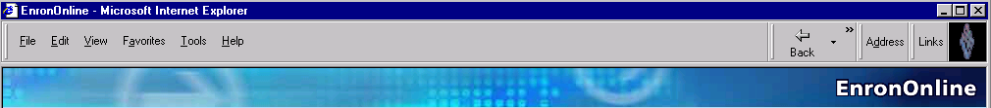
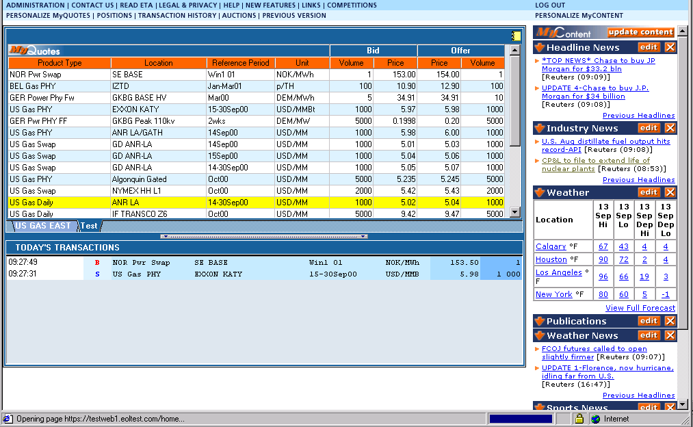
Capacity On Line
Notes:
A Free, Internet-based, Global Transaction System Which Allows Counter parties to View Real Time Prices From Enron’s Traders and Transact Instantly Online
Free, Reliable Transaction System with Enron as Principal
Fully Integrated into Enron’s Established Risk Management and Logistic Processes
Utilizing Site to Offer Energy-Related Auction Capabilities
Expands Enron’s Information Base and Market Knowledge
“Tried and Tested” Platform for Expanding Enron’s
eCommerce Activity

Slide 13
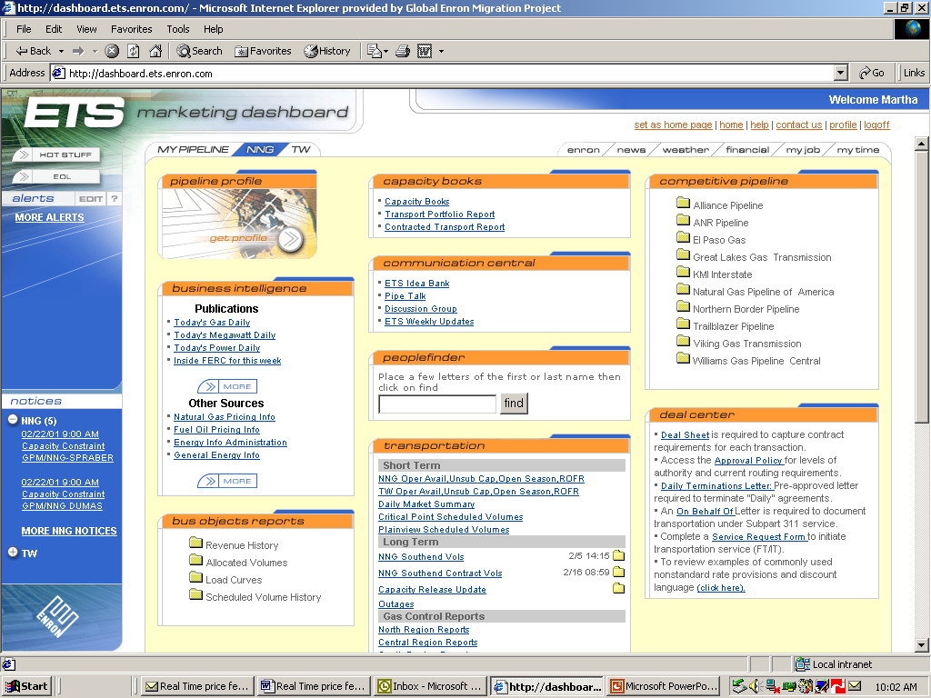
Marketing Portal
Common Platform
Personalization
Multiple Pipelines
Secondary Tabs
Alerts/Notices

Slide 14
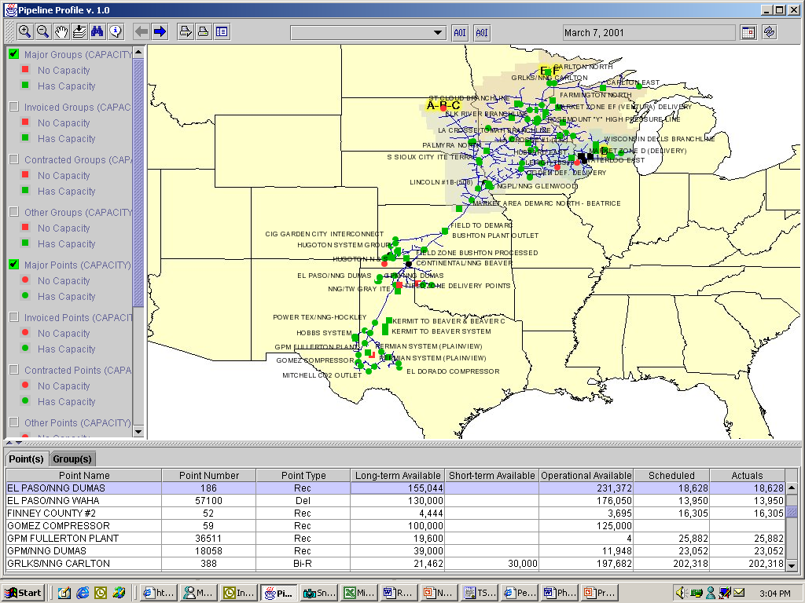
GIS Mapping Tool
Easy Access to Information
Timescale
Real-time Capacity
(Filters)
Visual
Alerts
Integration of Real-time Capacity & Nominations
Summary Information with
Detailed Pop-ups

Slide 15
ETS Asset Development - Strategies
Invest in on-system power projects
Leverage: Pipeline footprint, nominal development capital requirements; market area knowledge.
Risk: Timing, price volatility; few strategic growth opportunities, rising tide of competitors
Acquire and develop new pipelines in growth markets
Leverage: Accretive earnings, cash flow enhancement
Risk: Acquisition premiums, transaction costs dilute gains, integration issues
®

Slide 16
®
Enron Transportation Services

