Slide 1

SYSTEM PLANNING
THE KEY TO RELIABILITY AND
A LIQUID ELECTRIC MARKET
KENNETH A. DONOHOO
Manager of System Planning, Technical Operations
kdonohoo@ercot.com
www.ercot.com

Slide 2
PEAK DEMAND
Year | ERCOT Coincident Hourly Peak Demand MW | Annual Growth
1994 | 43,588 | --
1995 | 46,668 | 7.07%
1996 | 47,683 | 2.17%
1997 | 50,150 | 5.17%
1998 | 53,689 | 7.06%
1999 | 54,849* | 2.16%
2000 | 57,606 | 5.03%
 | Average Six Year Compound Growth | 4.85%
*This value would have been greater if there had been no interruptible load curtailments at the time.

Slide 3
SUMMER 2001
PROJECTIONS
 | LSE MOR* HISTORIC
Peak Demand (NCP) | 56,759 MW 59,565 MW 60,198 MW
Interruptible Load | 3,008 MW
Firm Peak Demand (NCP) | 53,751 MW 56,648 MW 57,190 MW
Generation Capacity | 69,947 MW
Summer Reserve w/o IL | 13,188 MW 10,382 MW 9,749 MW
Responsive Reserve | 2,300 MW
Remaining Reserve w/o IL | 10,888 MW 8,082 MW 7,449 MW
* Middle Of Road

Slide 4
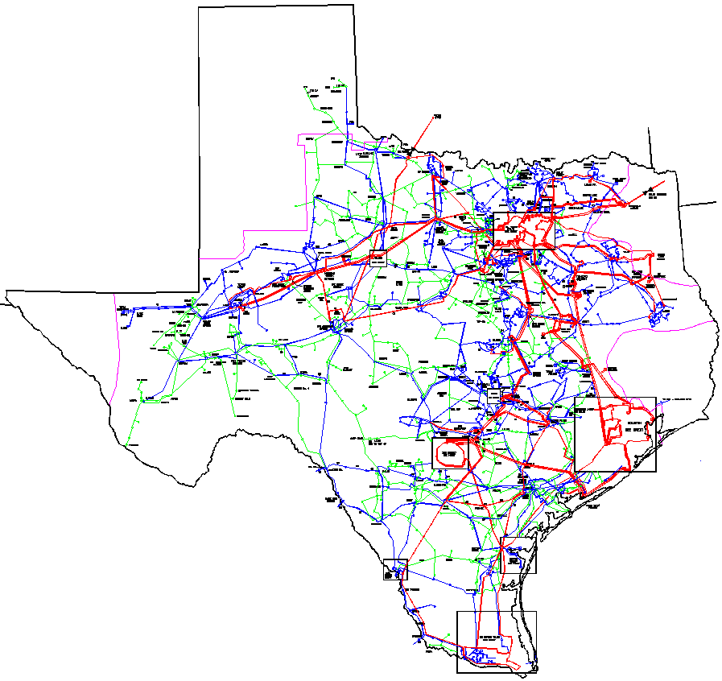
MONTICELLO-FARMERSVILLE 345 kV CIRCUIT
LIMESTONE-WATERMILL 345 kV DCKT
AUSTROP-LOST PINES-FPP 345 kV CIRCUIT
LYTTON-HOLMAN-FPP 345 kV CIRCUIT
NEW MAJOR TRANSMISSION
FOR 2001 SUMMER
MILITARY HIGHWAY STATCOM +/- 150 MVAR

Slide 5
MAJOR TRANSMISSION
PROJECTS UNDERWAY
FARMERSVILLE-ANNA 345 kV
CCN JANUARY 2001
IN SERVICE DEC 2002
GRAHAM – JACKSBORO 345 kV LINE
CCN FILED BY JUNE 2001
IN SERVICE DEC 2002
MORGAN CREEK–SAN ANGELO–COMANCHE SWITCH 345 kV LINE
CCN AUGUST 2001
IN SERVICE DEC 2002
SAN MIGUEL–PAWNEE 345 kV LINE
CCN NOVEMBER 2000
IN SERVICE MAY 2002
HOUSTON AREA UPGRADES
COLETO CREEK–PAWNEE 345 kV LINE
CCN DECEMBER 2000
IN SERVICE MARCH 2002
RIO GRANDE VALLEY SERIES CAPACITOR COMPENSATION
IN SERVICE SEPTEMBER 2001

Slide 6
MAJOR AREAS OF CONCERN
COLLIN – DALLAS - DENTON- TARRANT COUNTIES
  Possible Generation Reduction – Emissions Limits
  25% to 30% of ERCOT Load
  Growing 500 MW to 800 MW per Year
HOUSTON AREA
  New/Additional IPP Generation
WEST TEXAS
  New IPP Generation
  New Renewable Wind Generation
BRYAN – COLLEGE STATION AREA
  Voltage Problems
SOUTH TEXAS
  New/Additional IPP Generation
  Rio Grande Valley Load Growth
  Possible DC Ties to CFE (Mexico)

Slide 7
NEW TRANSMISSION
Most new transmission additions will be driven by new generation.
New transmission capacity provides opportunities for additional competition, which should result in lower prices.
Robust transmission network is required to support a liquid competitive electricity market.
Direct costs of transmission service in
ERCOT are a small fraction of the total cost of electricity, usually less than 10%.

Slide 8
ERCOT TRANSMISSION STUDIES
Focus on Security
Take Multiple Needs and Plans Into Account
Look Beyond Specific Entities’ Requests
Identify Broader Regional Needs
Promote Efficient Use of Transmission Corridors
New Transmission Additions Should Provide for More Capacity Than Current Identified Contingencies (Margin)
Consolidate Projects Where Practical
Based Upon ERCOT Planning Criteria

Slide 9
TRANSMISSION PLANNING PROCESS
Propose needed bulk transmission facility additions based on identified constraints.
Conduct an open process of review and comment on proposed facility additions.
Submit all final recommended bulk transmission facility additions to the ERCOT Board of Directors for review and concurrence.
Determine the designated transmission service providers of the additions.
Notify the Public Utility Commission of Texas (PUCT) of all Board supported transmission facility additions and their designated providers.
Projects proposed by interested parties may be submitted to ERCOT for review and considered for endorsement according to PUCT rules.

Slide 10
PHYSICAL CONSIDERATIONS
Transmission planning is no longer a vertically integrated utility generation/transmission planning process
There are fewer long term energy contracts to influence transmission planning
Almost all new generation is combustion turbines and can be built in 2 years
Significant transmission projects take in excess of 3 years to build
Generation buy/sell transactions based on market forces instead of traditional fuel costs and heat rates
Loads will be bidding in as an operating resource
Proposed generating units may insist that they be considered in lieu of new transmission
Many generating units are now being proposed – not all will be built

Slide 11
EDUCATIONAL CONSIDERATIONS
ISO, RTO and Transco planners tend to learn the new planning considerations very quickly
Traditional utility planners tend to be slow to change as they think mainly about “their” system
Regulatory agency reviewers still very traditional in looking at need and at cost – slow to realize that adequate transmission pays for itself in market liquidity
Need education in the new requirements to facilitate project acceptance and permitting

Slide 12
POLITICAL CONSIDERATIONS
Some transmission providers do not want new transmission as it fosters competition
Some new generators do not want new transmission for the same reason
Many regulatory agencies are not ready to face up to a “build nothing” public attitude
Public wants a reliable electric system but does not want new plants and lines
Investors are unlikely to spend money until it is clear that they will recoup their investment and earn a reasonable return on that investment.

Slide 13
FOOD FOR THOUGHT
Transmission planning should be done mainly by a third party ISO, RTO, or Transco and should include coordination with the involved regulatory bodies
ERCOT Regional Transmission Planning Process
  Includes TSP’s and PUCT Staff
  Review by Stakeholders
    Large projects reviewed by ERCOT Board
  Final Authority is PUCT in the form of a CCN

Slide 14
COMPARING TRANSMISSION
LIFETIMES
  Transmission is log-lived (30 to 50 years)
  Long life enhances confidence
  Reduces flexibility to respond to change
AVAILABILITY
  Transmission has very high availability factors
  Much higher than generation or load
CAPITAL AND OPERATING COSTS
  Transmission capital costs can be high
  Transmission operating costs are very low
  Generator operating costs are high and depend on uncertain future fuel prices
  Tradeoff between transmission sunk costs against operating costs for generation and load management

Slide 15
COMPARING TRANSMISSION
TECHNICAL APPLICABILITY
  Distributed resources cannot always solve problems
    High voltages
    Transient stability
    Need to replace aging or obsolete equipment
  Connection of distributed resources may impose new costs on the system
    System-protection schemes
ECONOMIES OF SCALE
  Building large transmission lines is cheaper per MW of capacity
  Higher voltage is cheaper per MW-mile and also requires less land per MW-mile

Slide 16
NEW TECHNOLOGIES
Superconducting Magnetic Energy Storage (SMES)
High-temperature Superconducting (HTS)
Flexiable AC Transmission System (FACTS)
High-voltage DC (HVDC)
HVDC Light
Current costs are generally more expensive when compared to regular transmission.
As they are improved and demonstrated, their costs may drop enough to become cost effective.
Lifetime is short when compared to transmission
Maintenance & Operating Costs is a major concern

Slide 17
~ 1100 MW to 1200 MW OUT
STABILITY LIMIT
~ 300 MW to 800 MW OUT THERMAL LIMIT
TOTAL TRANSFER CAPABILITY
CURRENTLY

Slide 18
CONSIDERATIONS
CONSTRUCTION CLEARANCES
DYNAMIC LINE RATING
  Thermal Only
  May actually result in lower ratings
  AEP & TXU are moving forward
HOT LINE CONSTRUCTION
  Safety
  Longer Construction Time
  More Expensive
SPECIAL PROTECTION SCHEMES
  Trip Off Line Generation

Slide 19
ASSESSMENT CRITERIA
Process must be open and rapid.
Strive for robust; rather than optimal, transmission solutions.
Recognize that regulated and competitive assets often perform the same function; select lowest-cost alternative.
Encourage investment in transmission projects that improve energy-market opportunities.
Encourage use of technologies that provide flow control, such as DC lines and FACTS devices.

Slide 20
ERCOT TEAMWORK &
ATTITUDE GOES A LONG WAY

Slide 21

QUESTIONS
FOR MORE DETAILS AND ADDITIONAL SYSTEM DATA
VISIT THE SYSTEM PLANNING TECHNICAL OPERATIONS
WEBSITE AT:
ftp://ftp.ercot.com/systemplanning/system_planning_department.htm

