Slide 1
What went wrong in California...
ERCOT Board Presentation
October 25, 2000
John Stout
Reliant Energy Wholesale Group

Slide 2
Generation Ownership/Control in the CAISO

Slide 3
Underlying Circumstances...
CAISO Load = 46,250Mw….CAISO Supply = 37,950Mw
Early end of rate freeze for SDGE customers
Frozen retail rates…5.4 cents for PG&E and 6.5 cents for SCE
Excess reliance on “last minute” supply purchases:
    Mandatory CALPX buy/sell obligation for the IOU’s
    CPUC limitations on amount of forward contracting
    Bad judgement by the IOU’s
  Doubling of natural gas prices and 10x increase in emissions credit prices
  Last 10% of generation used only 33 hours/year
  CTC recovery mechanism killed retail competition

Slide 4
What happened...
Generation owners sold most of their portfolios in the forward market…but not to the IOU’s
Considerably less hydro than last couple of years…record high “average” temperatures in the west…resulting in reduced imports to California
Marginal cost of peakers rose to over $300/mwh
Avg wholesale prices increased significantly:
    June Day Ahead Prices…$23.52 in 1999…$120.20 in 2000
    June Real Time Prices…$21.46 in 1999…$131.92 in 2000
  SDGE customers saw doubling and tripling of their bills
  PG&E and SCE revenue account shortfall of over $2bil each

Slide 5
Net imports were a fraction of expectations...

Slide 6
Underlying reasons...
The middle of the supply curve was missing
    Nearly 10,000 Mw of supply was no longer in the market
The buyers bid up the market unnecessarily
    Buyers raised their bids and paid hundreds of millions too much
Automatic pass through of PX/ISO pricing
    SDGE had no real incentive to manage spot market price risk
Pacific Northwest hydro suppliers were bargin shopping the California off-peak energy market in order to conserve remaining hydro
    Off peak prices were propped up by off peak demand
Too much volume at the worst possible price…..
    Price volatility was not the problem…it was the fact that 40,000mw of energy was being purchased at those high prices

Slide 7
The middle of the supply curve is missing...
Sold Forward
Shifted
Price
Price
MW
MW
1998 - 1999
Supply Curve
Summer 2000
Supply Curve
MWH

Slide 8
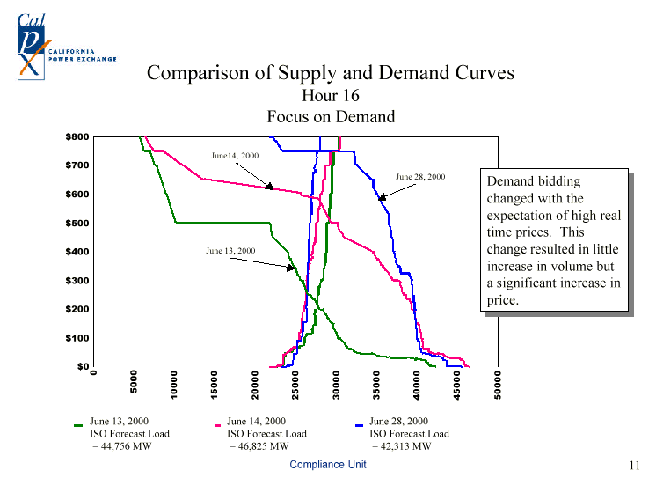
Buyers bid up the price unnecessarily...

Slide 9
Too much spot market energy...

Slide 10
.

Slide 11
Who really set the price...
Notes:
The Compliance Unit has developed a method of evaluating which Participants are influencing the unconstrained market clearing price (UMCP). This method determines the incremental supply offered in the market in a narrow price range around the UMCP and analyzes the Participants offering that incremental supply. Figure 32 is a schematic used to explain the Incremental Supplier methodology. The aggregate market supply and demand curves are shown at the MCP and the point on the supply curve that is 90% of the MCP. The market quantity at these points are determined and the difference represents the incremental supply offered. Note that the quantity scale on the X-axis is not the same for both graphs. The Participants supply curves are then evaluated to determine which Participants are contributing to the increase in supply around the narrow range of the MCP. These incremental Suppliers have the ability to influence the market clearing price by the price and volume offered within this narrow price range. Contrast the Participant curve below to a price taker’s supply curve which would be seen as a vertical line. A price taker would not offer any additional supply regardless of the change in price. The more a Participant increases supply offered in the narrow range around the MCP, the greater influence the Participant may have on the price.
As seen in Figure 33 – 35, the characteristic of the incremental suppliers changed from May 2000 to July 2000. For the 35 hours in May with prices greater than $100/MWh, NGOs were the dominant incremental supplier in all price ranges above $100/MWh. See Figure 33. In June, Importers became much more prevalent as a price driver and their influence was greatest during the highest priced hours. See Figure 34. In July, Importers overwhelmed the NGOs as the price drivers in all price ranges above $100/MWh. See Figure 35. This dispels the speculation that the NGOs are solely responsible for the high prices in the CalPX Day-Ahead Market. This method evaluates only those suppliers who contributed a significant quantity of incremental supply. The graphs above do not reach 100% in any price range because of the number of suppliers, which have a small impact on an individual basis. However, when taken together, these small suppliers may total up to 60% of all incremental supply

Slide 12
Customer Payments
Sales of Assets
Stranded
Cost
Account
+ $
Revenue
Account
50+ %
Supply
Costs
PX / ISO
Payments
Wires
Costs
Other
Suppliers

