Slide 1

ENRON BROADBAND SERVICES
Broadband Capacity
and
Risk Management
Products

Slide 2
Who is Enron Broadband Services?
Wholly Owned Subsidiary of Enron Corp.
Began in 1996 as CLEC in Portland, OR - FirstPoint Communications - Subsidiary of Portland General Electric
Enron Corp purchased PGE in 1997
FirstPoint renamed Enron Communications in 1997
Long Haul Build from Portland to LA with Touch America and Williams begins in 1997 (FTV)
Content Services, Carrier Services, Bandwidth Risk Management & Pooling Points begin development in 1998
First Bandwidth Trade occurs in December 1999
Enron Communications renamed Enron Broadband Services in 2000
First Bandwidth Trade on Enron’s online trading platform - EnronOnline - May 2000

Slide 3
Enron Broadband Services
Enron Intelligent Network
Bandwidth Intermediation
Content Services
Deploy the most open, efficient network with broad connectivity
Be the world’s largest provider of premium broadband delivery services
Be one of the world’s largest Buyers & Sellers of bandwidth
Fiber - Advanced Optics
Servers
Pooling Points
BOS
Trading
Risk Management
Structured Finance
Streaming Broadband Services
Data Asset Management
Distributed Content Delivery

Slide 4
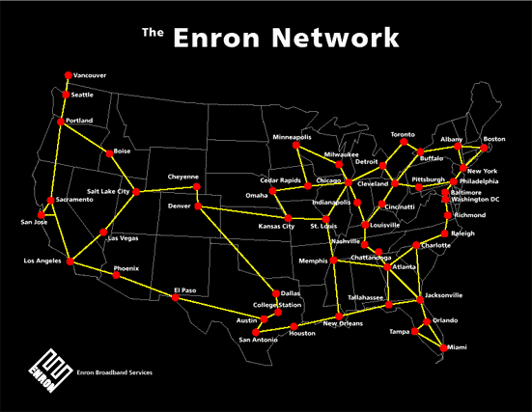
Trading - Physical Platform
Fiber Network
EBS is currently constructing a
nationwide 17,000 Route Mile fiber
network throughout North America.
The network is approximately 75% complete

Slide 5
Traditional Capacity
Enron Broadband Services is deploying the latest intelligent optical networking equipment on the fiber backbone that will allow for creation of traditional increments of bandwidth. Product offering will consist of DS3, OC3, OC12, OC48, OC192.
Intelligent network equipment will provide customers with next to real time provisioning of services and lower cost.

Slide 6
Provisioning
EBS will pre-provision local loops with CLECs and Carrier Hotels
Customer order is followed up with Firm Order Confirmation including CLLI Code of A and Z location and LOA CFA.
EBS commitment to real time provisioning will allow for end user satisfaction and superior end user product offerings.

Slide 7
Customer Control
EBS is developing an on line provisioning and network availability system.
Existing customers will access a web page that will generate LOA CFA to on net locations within minutes.
Customers can focus on marketing their services instead of managing their capacity vendor.

Slide 8
Trading
Foundation for Risk Management Services and New Product Development
Trading of Bandwidth Enables Nimble Reconfiguration of Portfolios
Establishment of Benchmark allows more effective Portfolio Management
Enron Has Been the Primary Architect of Market Structures in Most Major Markets in Which
It Participates

Slide 9
Benefits of Bandwidth Trading
Real-time contracting and delivery of capacity at pooling points
EBS offers full accountability through bilateral capacity agreements
Carriers can fill in unfinished networks with short-term capacity

Slide 10
Benefits of Bandwidth Trading
Network planners can buy redundancy at market rates and flexible terms.
Bandwidth users can now get more services in a real time fashion from multiple providers at one common location.

Slide 11
Benefits of Bandwidth Trading
EBS offers products to reduce service costs and price risk.
“Improve and Extend” is one method we use to improve customer margins while demonstrating our superior quality of service.
Customers can be confident they are paying market prices and receiving maximum flexibility.

Slide 12
In Conclusion...
With Enron capacity products customers can get next to real time delivery of services.
Enron capacity Products will provide customer control of network requirements and circuit information.
Enron network management and Intelligent Optical Network will provide customers with the most reliable services available in the industry today.

Slide 13
In Conclusion...
Market sensitive pricing will provide long term margins.
Enron’s low cost services will allow your sales department to win sales and grow revenue for your company.
Enron’s narrow focus and independent strength will provide consistent performance to improve your overall operations.

