Slide 1


Global Expansion Joint Venture Proposal
Notes:
Drive the Message:
…SHOW MOTIVATION, DESIRE, CONFIDENCE, AND THE WILLIINGNESS TO THROW ALL OUT ON THE LINE; READY TO ASSUME THE RISKS….

Slide 2

Agenda
Background of HoustonStreet
Background of EnronOnline
Joint Venture Proposal Overview
Proposal Benefits
Next Steps

Slide 3
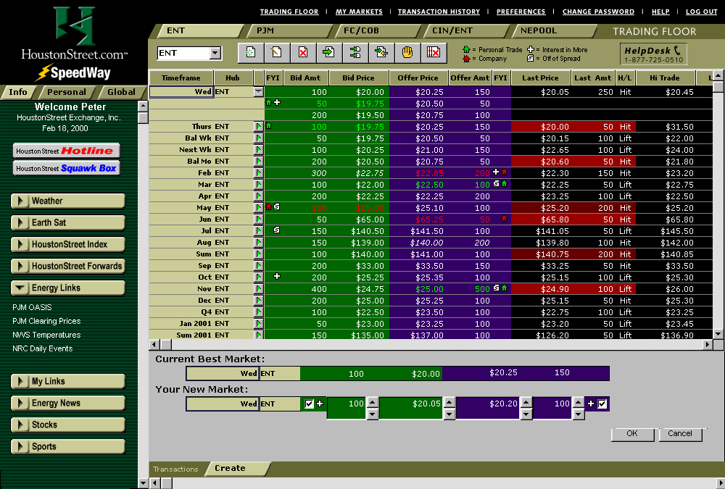
HoustonStreet Background
General Overview
HoustonStreet is an online energy services company providing trading platforms in Power, Crude & Refined Products, with a Natural Gas platform prepared for deployment upon the completion of the EnronOnline Link. Additionally, HoustonStreet offers customers a full suite of software solutions to help speed the efficiency of online trading through the integration of transacted data into customer’s mid- and back-office systems.

Slide 4
HoustonStreet Background
HoustonStreet Global Strategy
It is and has been HoustonStreet’s strategy to expand its trading platforms and solutions to global markets. HoustonStreet has a European subsidiary which currently operates a power exchange and has implemented back-office software solutions to several customers. HoustonStreet’s European strategic partners and investors include RWE, Vattenfall, and Electrabel, three of the six largest utilities in Europe. These partners provide liquidity and credibility to HoustonStreet’s European operations. HoustonStreet will not enter new global markets without upfront liquidity commitments from major players in those markets. The “Field of Dreams” strategy (“build it and they will come”) simply does not work.

Slide 5
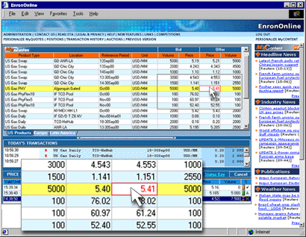
Enron Background
General Overview
It is without question that Enron is the leader in global commodities trading through EnronOnline and has a reputation for revolutionizing marketplaces. To provide further marketplace exposure beyond EnronOnline’s proprietary trading platform, EnronOnline has inked a definitive agreement with HoustonStreet allowing EnronOnline’s transactable data to be posted on HoustonStreet’s trading platforms. This “link” provides another outlet by which Enron can market reach and transact with its customers.

Slide 6
Enron Background
Enron Global Strategy
Enron currently services markets in North America, Europe, South America, Asia and Australia. It is apparent that Enron is aggressive in entering new global markets. Enron’s global presence and their participation as a market leader prompts the attention of all market participants within the global community. Simply stated, Enron is a big player and has a major influence when it enters a market. However, this status can cause apprehension among local market participants that fear EnronOnline will yield undue influence on local markets.

Slide 7
Joint Venture Proposal
Proposal Overview – Provide Choice to Local Markets
It is proposed that EnronOnline and HoustonStreet would team together, creating Joint Venture entities (“JV”s) in select global markets, to simultaneously launch both EnronOnline and HoustonStreet with a link similar to the arrangement in North America. This would provide local market participants with the ability to either transact directly with Enron through EnronOnline, or indirectly on a neutral, independent platform that has Enron as a principal market maker. Then, let the market decide how and where it wants to trade.
Equity Sharing
EnronOnline and HoustonStreet would receive a combined majority of the shares in the JV. Additional shares would be marketed and sold to local market makers and strategic investors that would complement the liquidity EnronOnline provides. The sale of these additional shares to regional participants will provide the cash necessary for deploying and running the operations of the JVs.

Slide 8
Benefits to EnronOnline
Benefits to EnronOnline
The deployment of JV’s would help EnronOnline in several ways. First, EnronOnline could realize increased volumes of commodities traded with the JV platforms providing additional exposure and information flow. Additionally, the alliance with HoustonStreet in forming the independent JV would address any issues local market participants have with Enron’s market influence. Furthermore, as an equity holder in the JV, EnronOnline would share in the successes of the trading platforms and software solutions provided by the JV to local market participants. Finally, the formation of JV’s enhances Enron’s strategy of opening up new markets (market liberalization) and providing liquidity to markets where it previously did not exist.

Slide 9
Benefits to HoustonStreet
Benefits to HoustonStreet
Aligning itself with EnronOnline through the JV formation would address the liquidity issue hindering additional global growth by HoustonStreet. With EnronOnline’s market making ability and HoustonStreet’s third-party, neutral platform, the JV would have a great amount of leverage in attracting additional local market participants for both equity investment and market participation.

Slide 10
Next Steps
Receipt and consideration of proposal by EnronOnline
Feedback as to feasibility of proposal
Identification of potential markets
Negotiation of JV formation issues

