Slide 1
Influence of the Bid/Offer Spread
Profit is higher if the spread is wider
Scenarios: 4 cents versus 6 cents

Slide 2
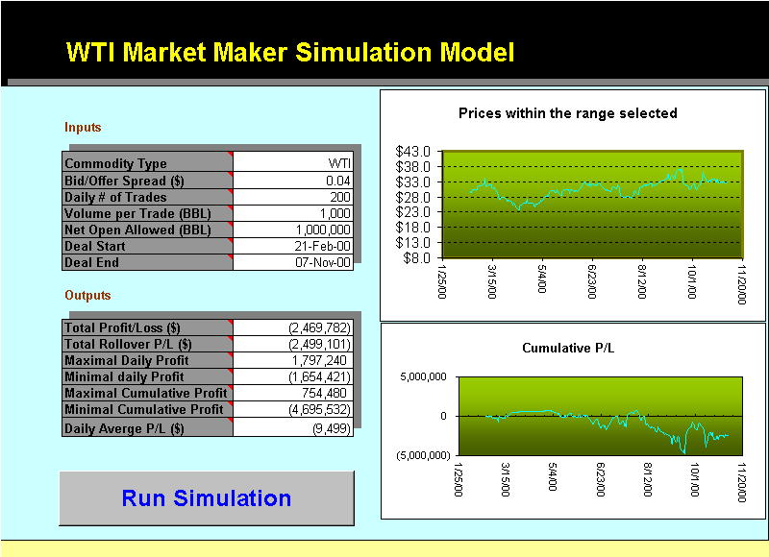

Slide 3


Slide 4


Slide 5


Slide 6


Slide 7


Slide 8


Slide 9


Slide 10


Slide 11


Slide 12
Influence of Net Open Position Allowed
The NOPA does not limit open position intra-day, but limit net open position carried to the next day
The larger NOPA, more volatile the cumulative P/L

Slide 14


Slide 15
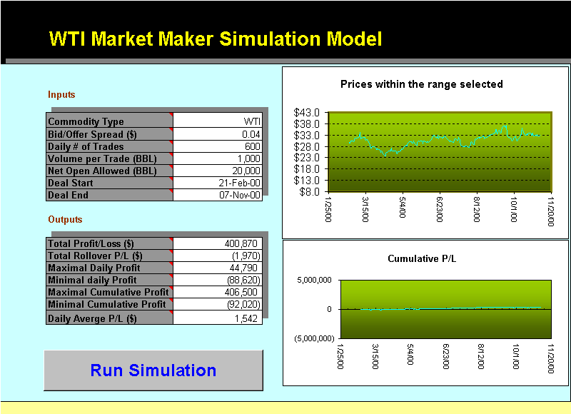

Slide 16


Slide 17
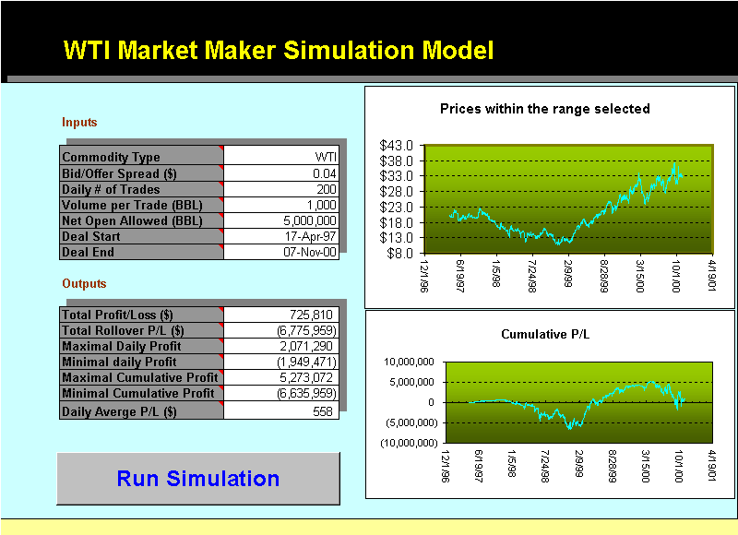

Slide 18


Slide 19


Slide 20
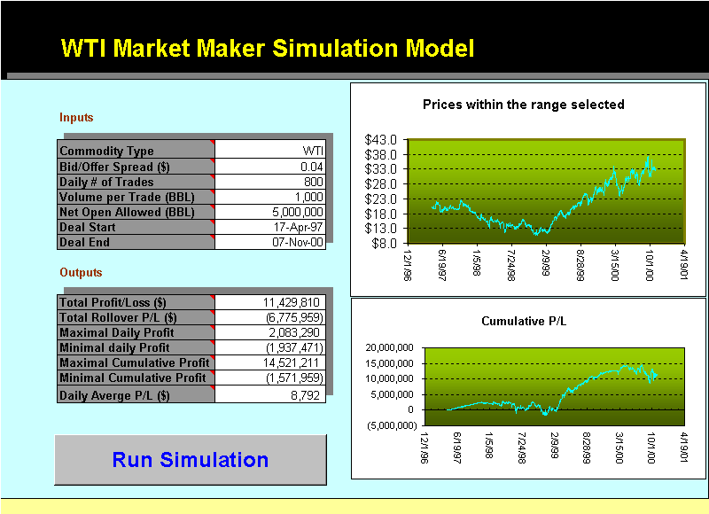

Slide 21


Slide 22


Slide 23
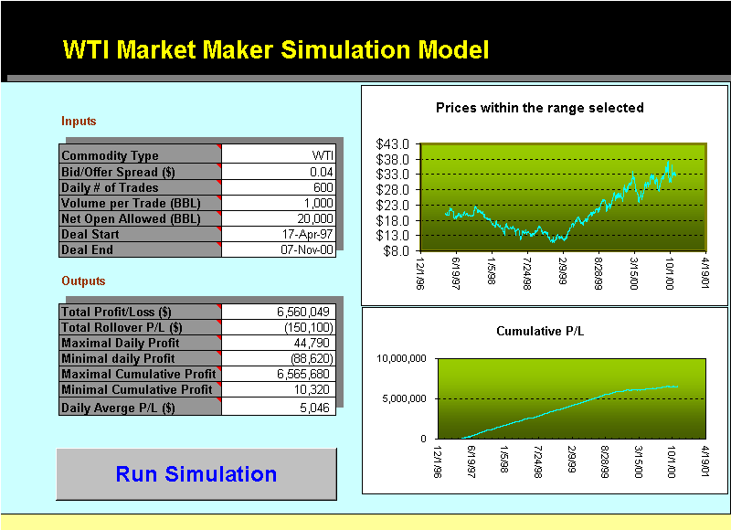

Slide 24


Slide 25


Slide 26


Slide 27


Slide 28


Slide 29
Influence of Tenor
Scenarios: One year versus five years back from
Nov. 7, 2000

Slide 30


Slide 31


Slide 32
