Slide 1


Computers for All Project
June 2000

Slide 2


Purpose
  Provide Enron employees at-home Internet devices, connection, employee-centric portal and support to narrow the digital divide.
  With this investment, the returns include:
    broadband commercial value
    improved employee productivity
    improved employee communications
    enhanced training medium, accessibility
    potential increased ranking on “Best Company to Work For” (Fortune)
Political Climate
Digital Divide Access to Technology Act of 2000 (House)
  Legislation introduced in the House of Representatives to allow employers to offer free or subsidized Internet devices and connectivity to employees with a positive tax treatment to employees.
  The bill allows employers to provide employees as a tax-free benefit like health insurance or pensions a total of $1,260 or $35 per month over three years for computer, software, and peripheral equipment, such as a monitor and printer, according to the description.
  The bill also provides that internet access charges paid by the company on behalf of the employee are not taxable to employees
  To participate in the program, the employer would be required to cover “substantially all employees of the company who live and work in the United States…. everyone from the janitor, factory workers, flight attendants and salesmen,” according to Congressman Weller’s description.
Bridging the Digital Divide Act of 2000 (Senate)
  Senate proposed legislation is even more flexible for employers with no dollar limitation on computer benefit and no time limit on how often computer upgrades may occur
  New tax law would apply to tax years beginning 2001 tax year

Slide 3

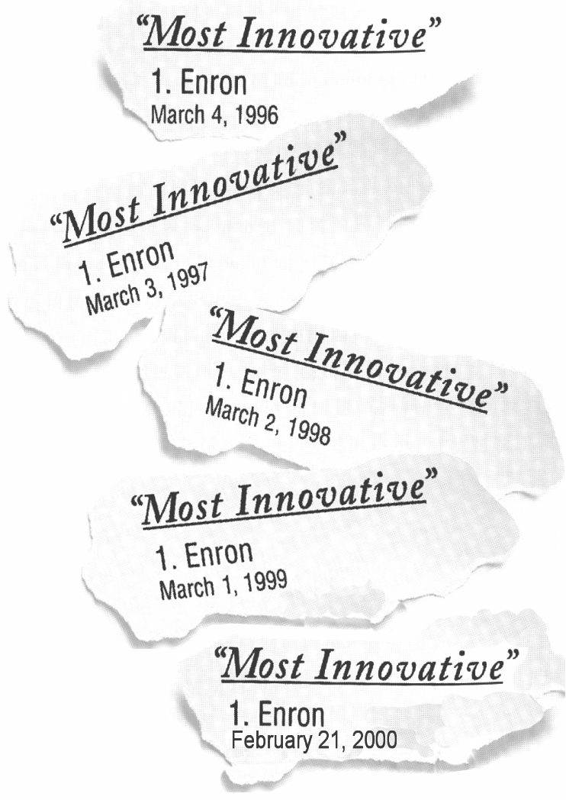
How Enron’s Program Surpasses Others
3 Year Value Program Offering
Company offers broadband connectivity where available
Base hardware offerings better than Intel, Ford, American and Delta
Internet
Device
$1,260
Connectivity
Portal
$1,620
Support
Over a three year period, Enron will provide “ENhome $” in the amount up to $2,880 ($1,260 cost of hardware, $1,620 cost of connectivity) to each employee to lease/purchase hardware, internet service, employee centric portal and technical support.
Any equipment or service rendered above the value of the “ENhome $” will be out-of-pocket costs to employees. This allows employees to upgrade as necessary.
If proposed tax legislation doesn’t pass, employees could be taxed for the value of this benefit.

Slide 4
Program Offerings
Connectivity
  DSL (preferred)
  Cable
  ISDN
  56K
Employee Centric Portal
  Employee communications
  E-Learning Portal
  Benefits Election
  Financial Planning tools
  Work balance communications
  Employee Self-service tools
  Career Opportunities
Internet Device
  Base Model (Desktop)
    Pentium III 600MGHz Processor
    128 RAM
    10 GB Hard Drive
    17” Monitor
    56K Modem
    CD ROM
  Upgrades if necessary
Support
  Consolidated technical support provided to employees
Enron Security
  Enron will not monitor internet usage if outside of firewall
  Security will be considered for entry into Enron domains
  Remove “Enron” from IP address for personal internet usage
Pre-loaded Software
  Internet Service Provider
  Windows 2000
    Small Business Edition (Microsoft Word, Excel, Outlook, Publisher and small business tools
Company Subsidy
  Company subsidy is intended to be used only for the ENhome program and may not be transferred or exchanged for cash or other benefits.

Slide 5
Domestic and International
15,000 employees (Excludes PGE)
(20% new employees thereafter)
Full Enron Subsidy of $1,260 Hardware or
$35/month for 3 Years
2001
$ Millions
Cost Reductions
Connectivity Savings ⁽¹⁾
Laptop Savings ⁽²⁾
Internal PC Configuration Savings ⁽³⁾
Separated Employee Reimbursements ⁽⁴⁾
2002
2003
Benefits
$ 0.63
0.44
0.18
0.15
$ 1.39
$ 0.63
0.44
0.18
0.24
$ 1.48
$ 0.63
0.44
0.18
0.27
$ 1.52
Employee Productivity Improvements - reduced personal usage of net at the office, improved computer literacy
Recruiting Benefit
Increased Retention
Enhanced Employee Communication Effectiveness
Enhanced Training Effectiveness - software training on business related applications like Excel, ability to train at home if necessary
Enhanced Telework Flexibility/Real Estate Savings/Virtual Teams/Travel Savings
At-home Program Uniformity Savings
Long Distance Connectivity Savings
EBS Commercial Value
Additional Volume Purchasing Leverage
Best Company to Work For
Costs
Hardware Lease Cost - Company Subsidy ⁽⁵⁾
Connectivity Cost - Company Subsidy ⁽⁶⁾
Portal Development & Implementation ⁽⁷⁾
Increased Broadband Maintenance ⁽⁸⁾
ENhome Infrastructure Cost/Maintenance ⁽⁹⁾
Split Tunnel Equipment Cost ⁽¹⁰⁾
Additional Connectivity Equipment Costs ⁽¹¹⁾
$ 6.30
6.22
1.00
0.51
0.50
2.60
2.03
$ 19.15
$ 7.56
6.69
0.00
0.43
0.50
0.52
0.41
$ 16.10
$ 9.07
7.10
0.00
0.43
0.50
0.62
0.49
$ 18.21
Pre-Tax Costs
$(17.76)
$(14.62)
$(16.69)
Tax Deductions
Tax Benefit
$ 7.66
$ 6.44
$ 7.28
After Tax Costs
NPV @ 10%
$(10.10)
$ (8.18)
$(9.40)
$(25.49)
⁽¹⁾ These savings eliminate double counting the At Home Program participants who already have some sort of company-paid Internet connection at home (ISDN - 400, DSL - 50, Analog - 500), a conservative estimate
⁽²⁾ These savings reflect a reduced need for an estimated 100 laptops, representing a saving of $4,420 per laptop
⁽³⁾ These savings come from not having to administer and reconfigure existing At Home Program PCs
⁽⁴⁾ The amount that separated employees pay to Enron if they voluntarily leave before the three year lease is paid in full, assumes a 10% separation rate (terminate within 1 year pays $600, terminates within 2 years pays $300)
⁽⁵⁾ Represents company subsidy for hardware at $35/month
⁽⁶⁾ Represents company subsidy for connectivity at $45/month for DSL, $10/month for 56K, $40/month for cable, $75/month for ISDN. We assumed a 12% decrease in each connectivity cost per year
⁽⁷⁾ One time costs
⁽⁸⁾ Represents additional equipment and maintenance to handle the increased concurrent broadband volume coming through the Enron firewall. One time cost of $81,000 for equipment and $432,000 per year for maintenance
⁽⁹⁾ Costs of additional servers, routers, and the maintenance of this equipment for security purposes
⁽¹⁰⁾ Additional hardware to support dual connections into the Enron building; estimated cost of $173 per PC
⁽¹¹⁾ Authentication equipment (estimated cost of $65 per PC) and NIC card (estimated cost of $70 per PC)

Slide 6

Employee Monthly Co-pay Scenarios
Monthly
Co-pay
NPV*
$5
(22.65)
$10
(19.67)
$20
(13.71)
* An administrative cost of $50,000 is included in co-pay scenarios
Tax Benefits and Concerns
Benefits
  Help subsidize Enron’s costs
  Builds ownership mentality of employee
Concerns
  To match Intel, full company subsidy is the benchmark
  Lower compensated employees may not utilize this benefit if subsidy is set too high
  Co-payments raise issues of PC ownership
    If Enron is seen as the owner, Enron could be held liable for employee actions
  Enron probably required to pursue remaining co-payments from employees who terminate within three years from the date co-payments begin.
    Collection may be difficult and burdensome
    Benefits may not be tax free if some employees terminate without making co-payments

Slide 7
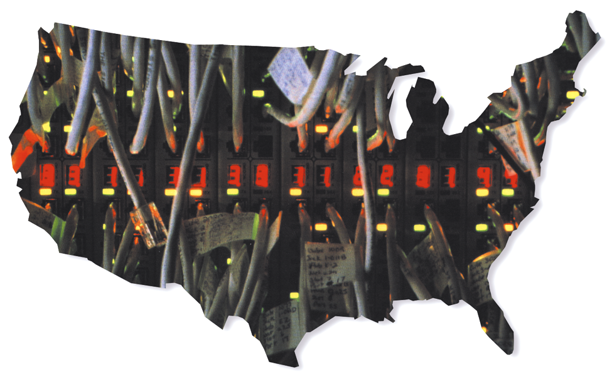
Broadband Connection Coverage
To provide a true broadband experience, the ENhome program intends to offer employees the highest speed connections available in their area:
Of the domestic program participants:
  60% will qualify for DSL connections
  15% will qualify for broadband access via cable connections
  10% will qualify for ISDN connections
  15% will receive standard dial-up service
International connectivity is still an issue to be discussed
US xDSL Lines Deployed: 1997-2002
1997
1998
1999
2000
2001
2002
IDSL
0
0
0
100,000
200,000
600,000
HDSL
650,000
690,000
725,000
710,000
1,150,000
1,600,000
ADSL
0
280,000
490,000
1,000,000
2,600,000
4,550,000
Source:
DSLReports
(http://www.
dslreports
.com/
clec
)
Technology Forecast 2000,
PriceWaterhouse

Slide 8

Timeline
Jun
00
Jul
00
Aug
00
Sep
00
Oct
00
Nov
00
Dec
00
Jan
01
Feb
01
Mar
01
Apr
01
May
01
Design & Development (120 days)
Pilot Period (90 days)
Employee Sign-up Begins
Deployment Begins

Slide 9
Team Members
Sponsors
  Cindy Olson Human Resources
  Drew Lynch Human Resources
  Steve Barth Enron Broadband Services
  Mike McConnell Enron Net Works
  Chris Holmes Enron Energy Services
Design Team
  Cynthia Barrow Enron Benefits
  Suzanne Brown Human Resources
  Sharon Butcher Legal
  Keith Dziadek Enron Net Works
  Allen Hill Enron Broadband Services
  Tony Jarrett Tax
  Sherry Lessner Human Resources Info Systems
  Susan Lopez Enron Net Works
  Todd Neugebauer Enron Broadband Services
  Randy Rice Enron Net Works
  John Tollefsen Enron Net Works

