Slide 1


Computers for All Project
Business Unit Presentation
July 2000

Slide 2


Purpose
Provide Enron employees at-home Internet devices, connection, employee-centric portal and support to narrow the digital divide.
With this investment, the benefits include:
broadband connectivity
improved employee productivity
improved employee communications
potential increased ranking on “Best Company to Work For” (Fortune)
Political Climate
Digital Divide Access to Technology Act of 2000 (House)
Legislation introduced in the House of Representatives to allow employers to offer free or subsidized Internet devices and connectivity to employees with a positive tax treatment to employees.
The bill allows employers to provide employees as a tax-free benefit like health insurance or pensions a total of $1,260 or $35 per month over three years for computer, software, and peripheral equipment, such as a monitor and printer, according to the description.
The bill also provides that internet access charges paid by the company on behalf of the employee are not taxable to employees
To participate in the program, the employer would be required to cover “substantially all employees of the company who live and work in the United States…. everyone from the janitor, factory workers, flight attendants and salesmen,” according to Congressman Weller’s description.
Bridging the Digital Divide Act of 2000 (Senate)
Senate proposed legislation is even more flexible for employers with no dollar limitation on computer benefit and no time limit on how often computer upgrades may occur
New tax law, if approved, would apply to tax years beginning 2001 tax year

Slide 3

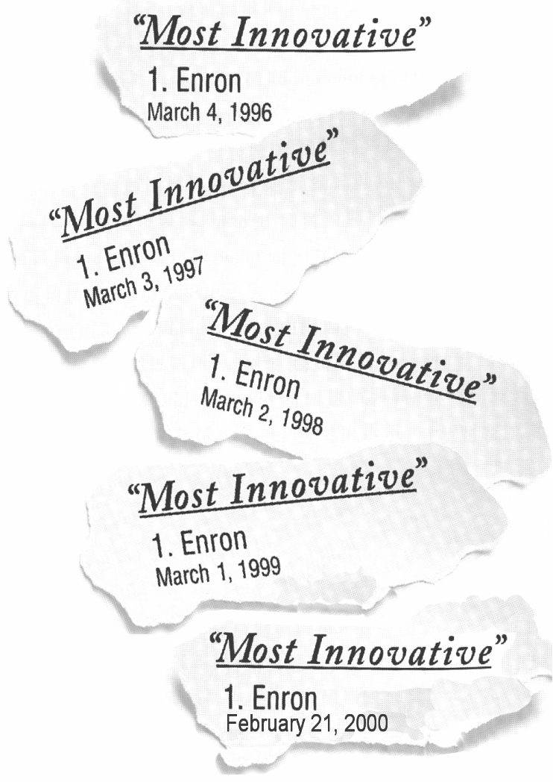
How Enron’s Program Surpasses Others
3 Year Value Program Offering
Company offers broadband connectivity where available
Base hardware offerings exceed Intel, Ford, American and Delta
Internet
Device
$1,260
Connectivity
Portal
$1,440
Support
Over a three year period, Enron will provide “ENhome $” in the amount up to $2,700 ($1,260 cost of hardware, $1,440 cost of connectivity) to each employee to lease/purchase hardware, internet service, employee centric portal and technical support.
Any equipment or service rendered above the value of the “ENhome $” will be out-of-pocket costs to employees. This allows employees to upgrade as necessary.
If proposed tax legislation doesn’t pass, employees could be taxed for the value of this benefit.

Slide 4
Program Offerings
Connectivity
DSL (preferred)
Cable
56K
Employee Centric Portal
Employee communications
E-Learning Portal
Benefits Election
Financial Planning tools
Work Life communications
Employee Self-service tools
Career Opportunities
Internet Device
Base Model (Desktop)
Pentium III 600+MGHz Processor
128 RAM
10 GB Hard Drive
17” Monitor
56K Modem
CD ROM
Upgrade options available
Support
Consolidated technical support provided to employees
Enron Security
Enron will not monitor internet usage if outside of firewall
Security will be considered for entry into Enron domains
Remove “Enron” from IP address for personal internet usage
Pre-loaded Software
Internet Service Provider
Windows 2000
Small Business Edition (Microsoft Word, Excel, Outlook, Publisher and small business tools
Company Subsidy
Company subsidy is intended to be used only for the ENhome program and may not be transferred or exchanged for cash or other benefits.

Slide 5
Cost Per Business Unit
$ Thousands
2001 2001
Business Unit Domestic Headcount International Headcount Total Headcount⁽¹⁾ BU Cost⁽²⁾ Employee CoPay
APACHI
CALME
Corp./Global
EBS
EES
ENA
Europe
GPG
India
South America
TOTAL
157
164
3,362
1,100
2,277
1,400
-
3,421
48
60
11,989
104
330
-
-
-
-
1,701
-
362
385
2,882
261
494
3,362
1,100
2,277
1,400
1,701
3,421
410
445
14,871
$109
$183
$1,630
$533
$1,104
$679
$532
$1,659
$137
$150
$6,716
$23
$38
$363
$119
$246
$151
$102
$370
$27
$30
$1,469
⁽¹⁾ Assumes 100% participation by all BU employees. BU headcounts need to be validated for accuracy.
⁽²⁾ Includes tax benefit, separated employee reimbursements, connection co-payments and connectivity savings only. Does not benefits listed on the following page.

Slide 6
Benefits not Included in Cost Analysis
Employee Productivity Improvements - reduced personal usage of net at the office, improved computer literacy
Recruiting Benefit
Increased Retention
Enhanced Employee Communication Effectiveness
Enhanced Training Effectiveness - software training on business related applications like Excel, ability to train at home if necessary
Enhanced Telework Flexibility/Real Estate Savings/Virtual Teams/Travel Savings
At-home Program Uniformity Savings
Long Distance Connectivity Savings
EBS Commercial Value
Additional Volume Purchasing Leverage
Best Company to Work For
Laptop Savings

Slide 7

Employee Monthly Co-pay Scenarios
Monthly
Co-pay
NPV*
$15 Co-pay for broadband connections and a
$5 Co-pay for standard dial-up connections
(16.93)
* An administrative cost of $50,000 is included in co-pay scenarios
The approved monthly employee out-of-pocket costs will be :
$15 DSL/Cable connectivity
$ 5 Standard 56K Dial up
* For international employees, research is underway to understand the
connectivity cost and feasibility in employee locations.
The international co-pays may be adjusted for total cost and indexed to the ORC.

Slide 8
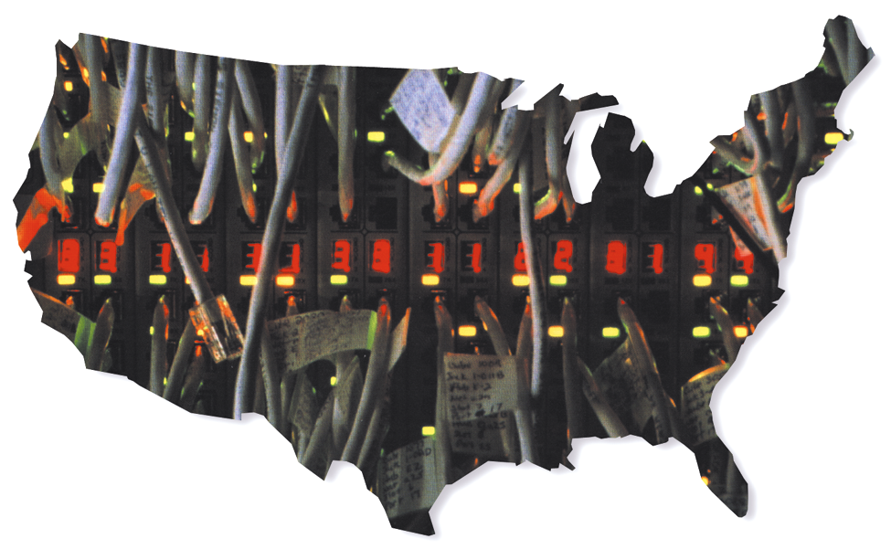
Broadband Connection Coverage
To provide a true broadband experience, the ENhome program intends to offer employees the highest speed connections available in their area:
Of the domestic program participants:
International connectivity is still an issue to be discussed
2001
2002
2003
Qualify for DSL connections
Qualify for broadband access
via cable connections
Receive standard dial-up service
10%
20%
30%
30%
30%
30%
60%
50%
40%

Slide 9

Timeline
Jun
00
Jul
00
Aug
00
Sep
00
Oct
00
Nov
00
Dec
00
Jan
01
Feb
01
Mar
01
Apr
01
May
01
Design & Development (120 days)
Pilot Period (90 days)
Employee Sign-up Begins
Deployment Begins

Slide 10
Team Members
Sponsors
Cindy Olson Human Resources
Drew Lynch Human Resources
Steve Barth Enron Broadband Services
Mike McConnell Enron Net Works
Chris Holmes Enron Energy Services
Design Team
Cynthia Barrow Enron Benefits
Suzanne Brown Human Resources
Sharon Butcher Legal
Keith Dziadek Enron Net Works
Allen Hill Enron Broadband Services
Tony Jarrett Tax
Sherry Lessner Human Resources Info Systems
Susan Lopez Enron Net Works
Todd Neugebauer Enron Broadband Services
Randy Rice Enron Net Works
John Tollefsen Enron Net Works

Slide 11
Domestic and International
15,000 employees (Excludes PGE)
(20% new employees thereafter)
Full Enron Subsidy of $1,260 Hardware or
$35/month for 3 Years
2001
$ Millions
Cost Reductions
Connectivity Savings ⁽¹⁾
Laptop Savings ⁽²⁾
Internal PC Configuration Savings ⁽³⁾
Separated Employee Reimbursements ⁽⁴⁾
Paperless Employee Communications ⁽⁵⁾
2002
2003
Benefits
$ 0.63
0.44
0.00
0.15
0.50
$ 1.72
$ 0.63
0.44
0.00
0.24
0.50
$ 1.81
$ 0.63
0.44
0.00
0.27
0.50
$ 1.85
Employee Productivity Improvements - reduced personal usage of net at the office, improved computer literacy
Recruiting Benefit
Increased Retention
Enhanced Employee Communication Effectiveness
Enhanced Training Effectiveness - software training on business related applications like Excel, ability to train at home if necessary
Enhanced Telework Flexibility/Real Estate Savings/Virtual Teams/Travel Savings
At-home Program Uniformity Savings
Long Distance Connectivity Savings
EBS Commercial Value
Additional Volume Purchasing Leverage
Best Company to Work For
Costs
Hardware Lease Cost - Company Subsidy ⁽⁶⁾
Connectivity Cost - Company Subsidy ⁽⁷⁾
Portal Development & Implementation ⁽⁸⁾
Increased Broadband Maintenance ⁽⁹⁾
ENhome Infrastructure Cost/Maintenance ⁽¹⁰⁾
Split Tunnel Equipment Cost ⁽¹¹⁾
Additional Connectivity Equipment Costs ⁽¹²⁾
$ 6.30
3.53
1.00
1.28
1.50
3.25
1.47
$ 18.32
$ 7.56
4.45
0.08
1.20
0.30
0.81
0.29
$ 14.69
$ 9.07
5.41
0.08
1.20
0.30
1.17
0.35
$ 17.59
Pre-Tax Costs
$(16.60)
$(12.88)
$(15.73)
Tax Deductions
Tax Benefit
$ 7.33
$ 5.88
$ 7.03
After Tax Costs
NPV @ 10%
$(9.27)
$ (7.00)
$(8.70)
$(23.00)
⁽¹⁾ These savings eliminate double counting the At Home Program participants who already have some sort of company-paid Internet connection at home (ISDN - 400, DSL - 50, Analog - 500), a conservative estimate
⁽²⁾ These savings reflect a reduced need for an estimated 100 laptops, representing a saving of $4,420 per laptop
⁽³⁾ These savings come from not having to administer and reconfigure existing At Home Program PCs
⁽⁴⁾ The amount that separated employees pay to Enron if they voluntarily leave before the three year lease is paid in full, assumes a 10% separation rate (terminate within 1 year pays $600, terminates within 2 years pays $300)
⁽⁵⁾ Savings are realized by the reduction of printing and distribution costs for mailing information to employees’ homes
⁽⁶⁾ Represents company subsidy for hardware at $35/month
⁽⁷⁾ Represents company subsidy for connectivity at $45/month for DSL, $10/month for 56K, and $40/month for cable. We assumed a 12% decrease in each connectivity cost per year, except for 56K connections
⁽⁸⁾ One time costs
⁽⁹⁾ Represents additional equipment and maintenance to handle the increased concurrent broadband volume coming through the Enron firewall. One time cost of $81,000 for equipment and $1,200,000 per year for maintenance
⁽¹⁰⁾ Costs of additional servers, routers, and the maintenance of this equipment for security purposes
⁽¹¹⁾ Additional hardware to support dual connections into the Enron building; estimated cost of $540 per PC only for those with DSL and cable connections
⁽¹²⁾ Authentication equipment (estimated cost of $65 per PC) and NIC card (estimated cost of $33 per PC)

