Slide 1
Enron Net Works June 12, 2000
<number>

Slide 2
Presentation Summary
EnronOnline
Technology Update
Enron Net Works Vision

Slide 3
“ It is Not the Strongest of the Species
That Survives, Not the Most Intelligent,
but the Most Responsive to Change.”
Charles Darwin
The Origin of the Species

Slide 6
EnronOnline

Slide 7

Putting the Energy into e-commerce
EnronOnline
TM
TM
Enron Net Works All Employee Meeting
June 12, 2000
Louise Kitchen

Slide 8
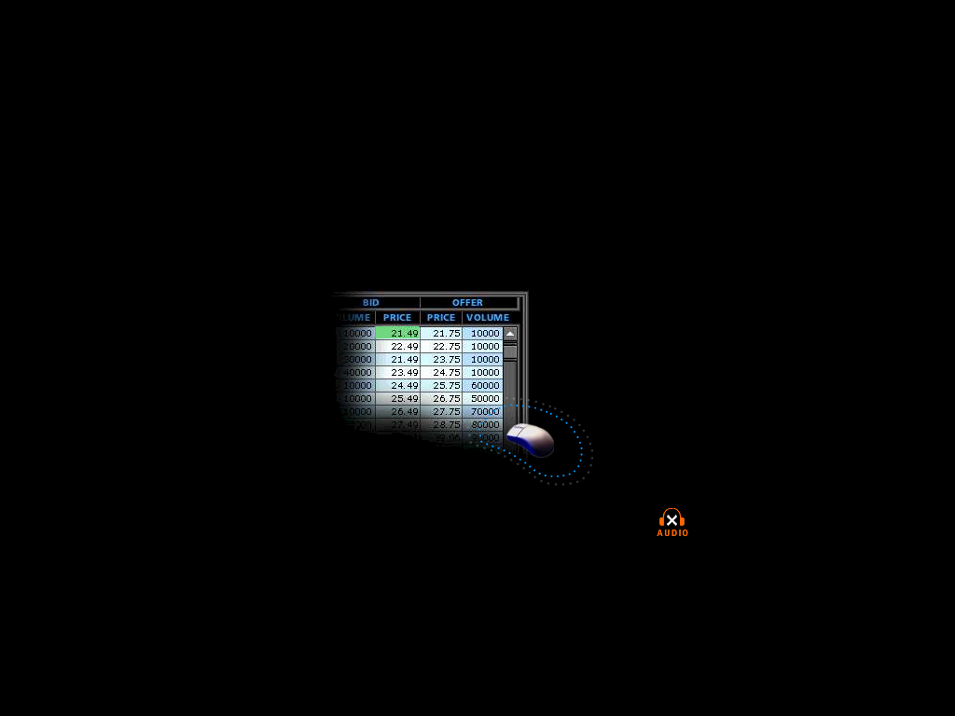

What is EnronOnline?
A Free, Internet-based, Global Transaction System Which Allows Counterparties to View Real Time Prices From Enron’s Traders and Transact Instantly Online
click & transact
Putting the Energy into e-commerceTM

Slide 9
How does EnronOnline differ from current way our customers currently conduct business?
Currently With EnronOnline
Internet
Enron
Enron
Putting the Energy into e-commerceTM

Slide 10
EnronOnline Launch Schedule
November 1999 US & Canadian Natural Gas
December 1999 US Power
Nordic Power
Plastics
Pulp & Paper
Coal
January 2000 Belgian Natural Gas
Emissions
German Power
LPG
Oil & Refined Products
Petrochemicals
Spanish Power
Swiss Power
UK Natural Gas
UK Power
US Weather
Putting the Energy into e-commerceTM

Slide 11
Enron’s global wholesale transaction business …………..moves online
February 2000 EnBank Virtual Storage Auction (UK)
European Weather
March 2000 Australian Power
Credit Derivatives
Dutch Power
Emissions Auctions (US)
April 2000 Austrian Power
May 2000 Bandwidth
European Coal
Asian Crude & Products
June 2000 Pipeline Capacity Auction
Putting the Energy into e-commerceTM

Slide 12
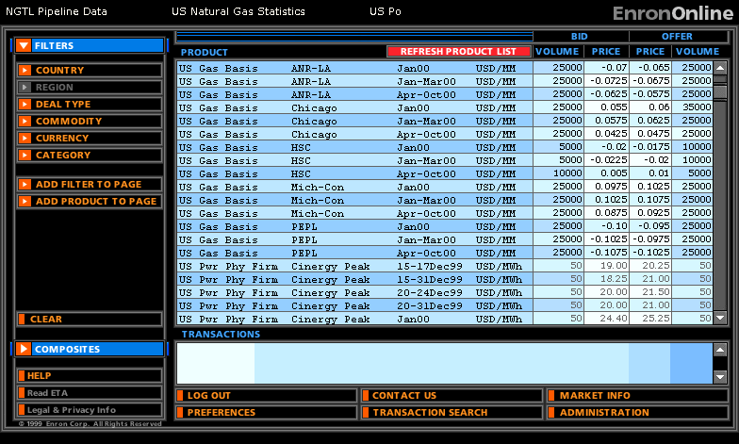
Quotes Page
Putting the Energy into e-commerceTM

Slide 13
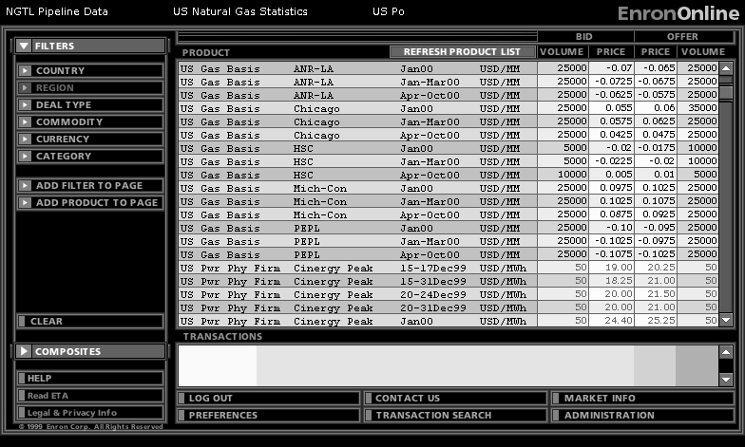
Quotes Page
Putting the Energy into e-commerceTM

Slide 14

Making the global market
Putting the Energy into e-commerceTM

Slide 15
Making the global market
Putting the Energy into e-commerceTM

Slide 16
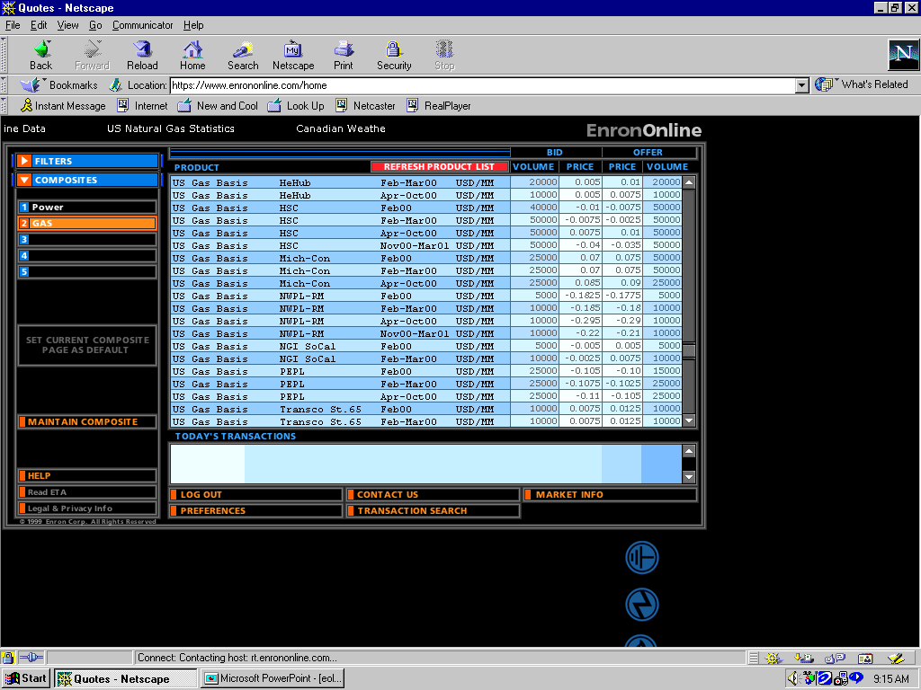
Click on Bid or Offer Price
Putting the Energy into e-commerceTM

Slide 17
Submission Screen
Putting the Energy into e-commerceTM

Slide 18
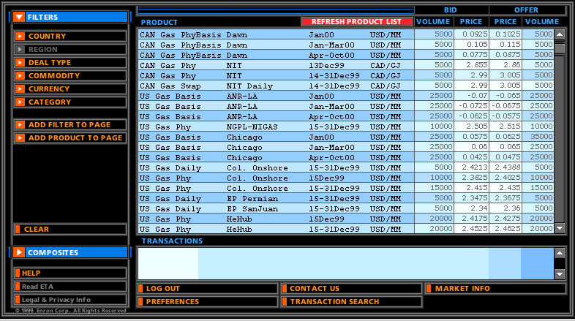
Successful Transaction
Putting the Energy into e-commerceTM

Slide 19
Benefits of EnronOnline
Free of charge
Real-Time Pricing Information
Access to complementary markets and product information
Simple access via the Internet
Easy to use
Fast and Secure Execution
Enron’s Best Prices
Putting the Energy into e-commerceTM

Slide 20
"EnronOnline was having problems this morning, so we were flying blind,"
Gas Daily April 11th, 2000
"Enron promised that the Internet would boost its operations and profits, and it did.”
Enron Rides Internet to Profit, Higher Shares,
Barbara Shook The Oil Daily,
Putting the Energy into e-commerceTM

Slide 21
EnronOnline Statistics
Total Life to Date Transactions > 142,000
Currently > 52 % of Enron’s Transactions
Average Daily Transactions > 1,800
Life to Date Notional Value of Transactions > $62 billion
Daily Notional Value Approximately $1 billion
Currently > 45% of Enron’s Notional Volume
Number of Products Offered - Approximately 800
Number of Currencies Traded in = 13
Development Time Approximately 7 Months
Announcement Date October 26, 1999
Launch Date November 29, 1999
Putting the Energy into e-commerceTM

Slide 22
Transactions via EnronOnline (Weekly)

Slide 23
Utilization of EnronOnline
(% of Transactions)
Traditional Channels
EnronOnline
Putting the Energy into e-commerceTM

Slide 24
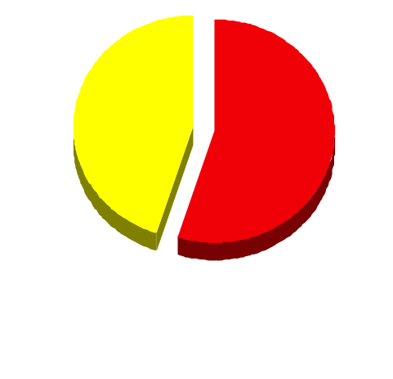
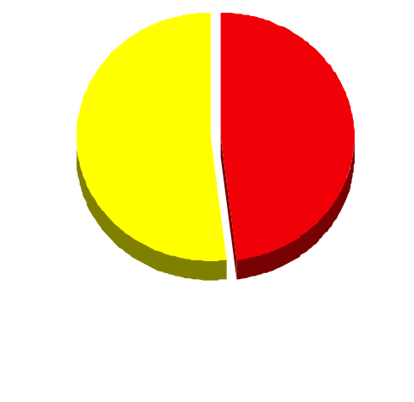
EnronOnline Versus Traditional Channels (Currently)
Volume
Transactions
45%
52%
48%
55%
EnronOnline
Traditional Channels
Putting the Energy into e-commerceTM

Slide 25
eCommerce Business Comparison
Value of Goods
(Millions)
Business To Consumer (B2C)
eBay
Amazon.com
Dell.com
$ 2,650
1,600
10,190
1999 Data*
Business To Business (B2B)
FreeMarkets
Cisco
Intel
Altrade
$ 1,400
9,480
10,500
12,000
2000 Est.**
EnronOnline
> $ 40,000
* Est. 1999 Annual Results
** Annualized Based on Results to Date
Putting the Energy into e-commerceTM

Slide 26
Comparison of Competing Contracts
EnronOnline versus NGX
Putting the Energy into e-commerceTM

Slide 27
Comparison of Competing Contracts
EnronOnline versus Altrade
Putting the Energy into e-commerceTM

Slide 28
Comparison of Competing Contracts
EnronOnline versus International Petroleum Exchange
Putting the Energy into e-commerceTM

Slide 29
eCommerce Business Comparison
Value of Goods
(Millions)
Business To Consumer (B2C)
eBay
Amazon.com
Dell.com
$ 2,650
1,600
10,190
1999 Data*
Business To Business (B2B)
FreeMarkets
Cisco
Intel
Altrade
$ 1,400
9,480
10,500
12,000
2000 to date
EnronOnline
> $ 34,000
* Est. 1999 Annual Results
Putting the Energy into e-commerceTM

Slide 30
Putting the Energy into e-commerceTM

Slide 31
Technology Update

Slide 32
Technology Update
Enron North America
Gas Pipeline Group
Enron Europe
International Groups
Global Infrastructure
eCommerce

Slide 33
ENA Major Projects for 2000
Projects Delivered
Streamlined Gas Logistics processes by:
Delivering real time deal updates to the schedulers
Increasing seamless electronic nominations to 85% of gas volumes
Outsourcing of services to Bridgeline, Sunoco & Dofasco
Integrated the CES Marketing portfolio into ENA applications
Projects in Progress
Enhance the deal capture, position management, valuation and settlements processes for financial commodity transactions
Power settlements and volume management for the the Toronto Power Exchange or ENERconnect
Increase the overall scalability of Commercial Support systems
SAP Integration
Volume management for the California Power ISO

Slide 34
ENA Physical Gas Sales Volumes Processed through Sitara & Unify per Average Day
28,499
100% Increase
23,442
BBTU/D
16,514
14,220
15,489
Note: Sales Volumes include desk to desk transactions & outsourcing service arrangements

Slide 35
Electronic Deal Confirmations Generated via DCAF per Average Day
2,429
344% Increase
793
547

Slide 36
ENA Invoiced Amounts
$5,098
47% Increase
$3,462
$ Million

Slide 37
ENA New Deal Counts
89,796
171% Increase
41,530
33,120

Slide 38
GPG eCommerce
In July of this year, GPG will be the first pipeline to offer Capacity Bidding using EnronOnline.
Future offerings under consideration include:
Capacity Options Trading
Storage Capacity Auctions
Fuel Auctions
Capacity Release Program
Imbalance Trading

Slide 39
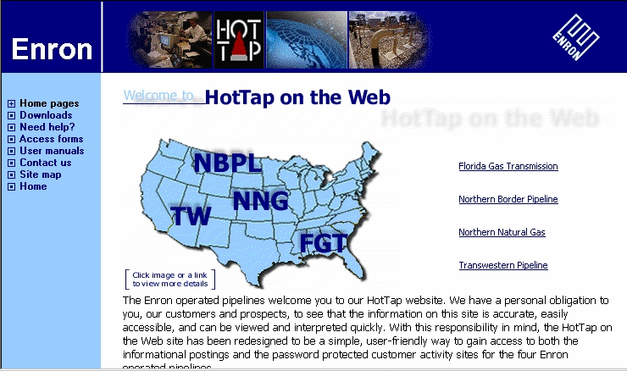
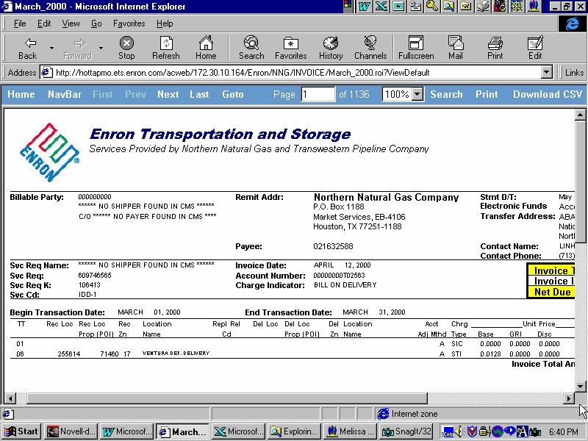
GPG eCommerce
Nominations and Scheduling
Informational Posting
Capacity Release
Flowing Gas

Slide 40
GPG Day to Day Support
1,200 external customers
25 different service types across 2,000 contracts
Average of 95,000 nomination transactions per month
Average of 35,000 confirmation transactions per month
Average of 2,500 invoices per month

Slide 41
Enron Europe
MG Integration
EnronCredit
Project Thunderball
EnVoice - London Settlements
Enron Direct - customer websites and scaling of core system
Windows2000
Exchange
EnPower rollout for UK
EnCompass - Livelink document management rollout
Market Tracker

Slide 42
International Regions
New Tokyo office
Launched EnronOnline in Sydney
eCommerce development for SK Enron
Upcoming launch of EnronOnline for Japan, Brazil, and Argentina
Launched Enron India website on May 31, 2000
Proposal to build world class Data Center in India starting with
Mumbai and Banglore and expanding to other major cities

Slide 43
Global Infrastructure Group
Windows 2000 rollout
Exchange rollout
Ardmore Data Center revitalization project
24x7 support group to facilitate the start of an Operations Control Center
Help Desk/Resolution Center re-engineering project
Procurement/Receiving/Asset Management re-engineering project

Slide 44
Enron.com
July Release
New product & service content directly on the front page to educate & drive commerce
Sharp new look for ease of navigation and consistency with new Enron brand image
World region & business units selector
Future Release
Allow all business units to modify their own content on Enron.com
Individuals in each business unit world wide can post current Enron news articles to the site through either an automated or manual process.
Multi-language capability - English, Spanish, Portuguese, French, German, Japanese, Hindi...

Slide 45
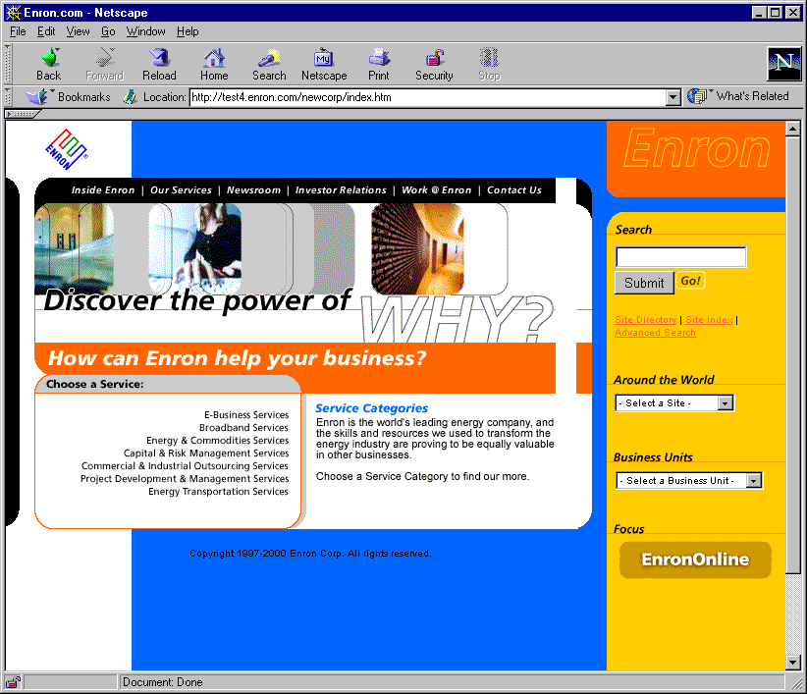
Enron.com

Slide 46
Clickpaper.com
July Release
ClickMatch - product auction for paper and pulp
Portal site with industry information
Capability to apply and send 1% sales commission invoice to the seller
Trading Release
ClickTrade - exchange for prime-quality product
Initially, EnronOnline will post physical and financial products onto Clickpaper.
Ability to have Clickpaper be a many to many exchange as opposed to principal only

Slide 47
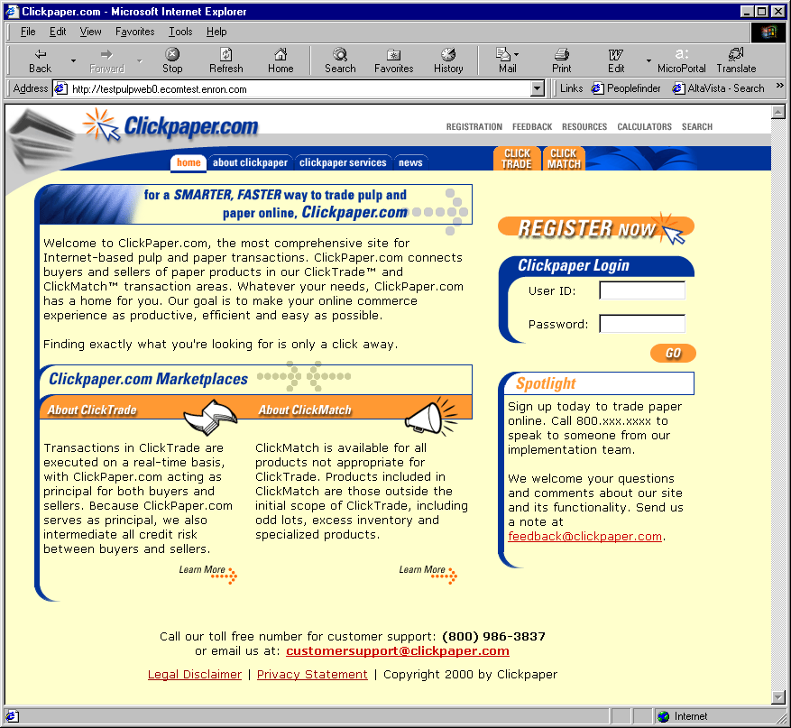
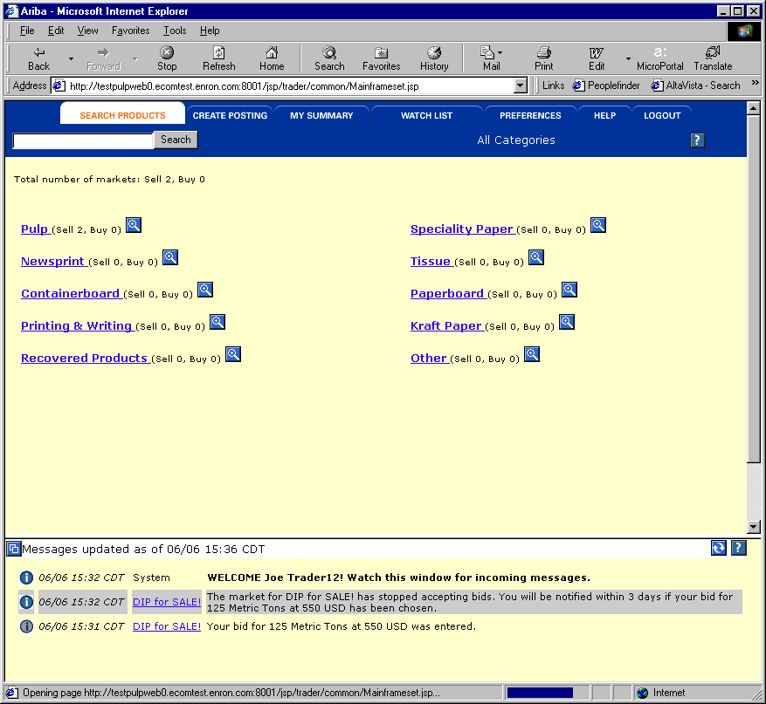
Clickpaper.com

Slide 48
EnronDirectFinance
May Release
One (Enron) to Many (Issuers)
Two Bank Product Offerings
Online “Commit” (bid) form for investors
June Release
Reduce the role of an underwriter
Many (investors) to Many (Issuers)
Products and Functionality
Seeking partnerships with other banks to enhance deal flow

Slide 49
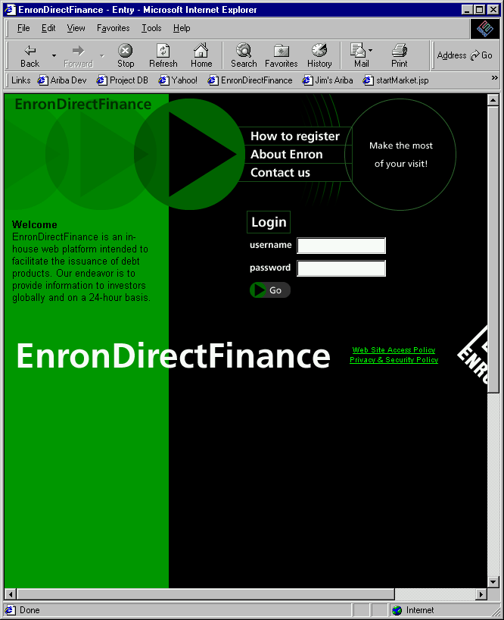
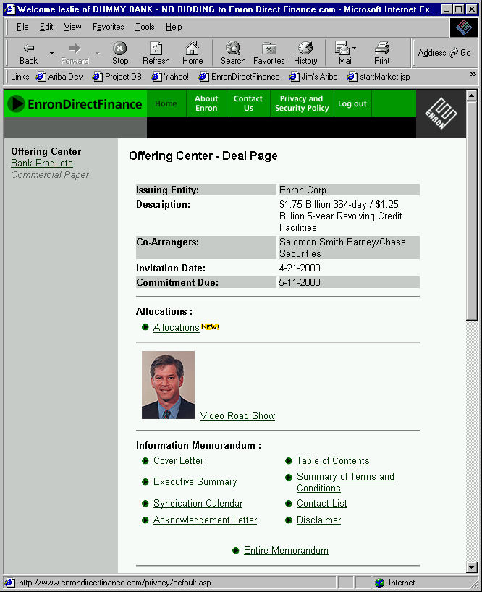
EnronDirectFinance

Slide 50
Enron Net Works Vision

Slide 51
Current Market Conditions
Many industries exist that sell commodity - like products through legacy distribution channels comprised of complex sales forces and long term relationships with little price transparency (“Dine ‘Em and Sign ‘Em”).
Result - Enormous inefficiencies exist in the pricing of commodity products.
The internet provides a unique opportunity to have immediate and inexpensive access to customers through a web-based transaction platform.
Result - All incumbent companies are vulnerable due to reduced/no barriers to entry.
The equity markets have created an enormous value differential between old economy businesses and new economy businesses.
Result - Possible rate of return opportunities are multiples of historical rates of return (“Winner Takes All”).

Slide 52
“ In five years time, all companies will be
internet companies, or they won’t be
companies at all.”
Andrew Grove
Chairman, Intel Corp.

Slide 53
U.S. eCommerce Growth
B2B
B2C
Source: Forrester Research, Inc.

Slide 54
Worldwide eCommerce Growth
Source: Forrester Research, Inc.

Slide 55
Business Strategy
Identify industries that have commodity-like products where the incumbents are predominantly using legacy distribution channels.
Determine entry vehicle into the industry (i.e. partnership, acquisition, contractual rights, etc.).
Deploy eCommerce platforms to capture market share rapidly.
Convert old economy businesses into new economy businesses and capture the value creation.
Combine Enron’s IT Group and eCommerce efforts into one commercial organization for focused execution of the business plan with the objective of increasing Enron’s multiple.

Slide 56
Lessons Learned
Principal based vs. Exchange based (“Bulletin Board”) is THE ONLY SUSTAINABLE eCOMMERCE B2B MODEL.
Everyone is a potential competitor.
Time to market is critical with product roll-out (first mover advantage).
Must continue to innovate to maintain first mover advantage.
Business model could have broad applications in other industries.

Slide 57
Why Enron?
We have been B2B for years.
We have strong skills in risk intermediation and good systems to control risk.
We are already positioned as having successfully migrated from the “old economy” to the “new economy” company.
We have a proven Business Model and track record of transforming markets.
We have successfully sourced capital for all potential investments.

Slide 58
Execution Plan
Upgrading
Streamlining processes to do business the best, most
efficient way we can.
Expanding
Growing market share in current businesses.
Penetrating
Rapidly establishing significant stakes in new markets.

Slide 59
eCommerce Initiatives
Energy EnronOnline.com
Pulp & Paper ClickPaper.com
Metals MG plc
Credit EnronCredit.com
Financial Products EnronDirectFinance.com
Energy Settlements CommodityLogic.com

Slide 60
Enron’s Global eCommerce Activities
= EnronOnline Trading Activity
= Other eCommerce Activity
= Planned eCommerce Activity

Slide 61
Funding Decision Tree
EPS Dilution
Issue Common, Convert and/or Debt
Issues
P/E Multiple Reduction
Credit Rating Dilution
Yes
Substantial Upside Sharing
Fund on Balance Sheet?
Enron Support?
Vehicle Governance
Enron Net Works Business Model
No
No
Create Incubator Vehicle
Raise Private Equity
VC Funds
LBO Funds
Pensions
CalPERs
Issues
Costly Capital
Credit Rating Dilution
Exit Strategy
Yes
Structured Transaction
Issues
Use of Capacity
Limited Risk Transfer
JEDI II
Condor
LJM
Other

Slide 62
Financial Sponsor Considerations
Issues
Sharing of Control
Business integration with ENE
business units
Credit Support
Transfer Pricing
Potential Conflict of Interest
Benefits
Additional Deal Flow
Potential upside to ENE stock price (“Sizzle”/Publicity)
New Ideas
Financial Depth

Slide 63
Enron Net Works Organization
Office of the Chairman
Greg Whalley - Chairman and Chief Executive Officer
Mike McConnell - Vice Chairman & Chief Operating Officer
Jeff McMahon - Vice Chairman & Chief Commercial Officer
Technology
Philippe Bibi
CTO
Human Resources
Robert Jones
Vice President
Corporate Development
TBD
Investments & New
Markets Identification
Jay Fitzgerald
Managing Director
Finance
Bill Brown
Vice President &
Regional CFO
Technology Origination
Allan Sommer
Vice President
Enron Online
Louise Kitchen
Managing Director
Pulp & Paper
Greg Piper
Managing Director
Metals
Bruce Garner
Vice President
Financial Markets
Harry Arora
Vice President
Energy Settlements
Tom Gros
Vice President
Procurement
George Wasaff
Managing Director

