Slide 1
Enron Net Works
June 12, 2000
<number>

Slide 2
Presentation Summary
EnronOnline
Technology Update
Enron Net Works Vision

Slide 3
“ It is Not the Strongest of the Species
That Survives, Not the Most Intelligent,
but the Most Responsive to Change.”
Charles Darwin
The Origin of the Species

Slide 6

Putting the Energy into e-commerce
EnronOnline
TM
TM
Enron Net Works All Employee Meeting
June 12, 2000
Louise Kitchen

Slide 7
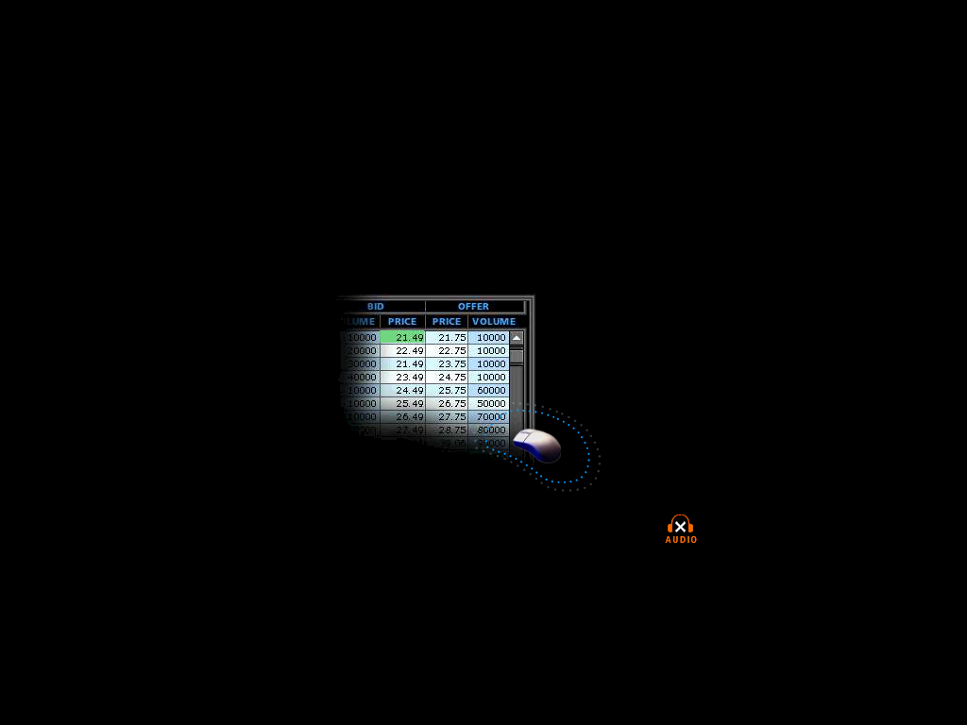

What is EnronOnline?
A Free, Internet-based, Global Transaction System Which Allows Counterparties to View Real Time Prices From Enron’s Traders and Transact Instantly Online
click & transact
Putting the Energy into e-commerceTM

Slide 8
How does EnronOnline differ from current way our customers currently conduct business?
Currently With EnronOnline
Internet
Enron
Enron
Putting the Energy into e-commerceTM

Slide 9
EnronOnline Launch Schedule
    November 1999 US & Canadian Natural Gas
    December 1999 US Power
    Nordic Power
    Plastics
    Pulp & Paper
    Coal
    January 2000 Belgian Natural Gas
    Emissions
    German Power
    LPG
    Oil & Refined Products
    Petrochemicals
    Spanish Power
    Swiss Power
    UK Natural Gas
    UK Power
    US Weather
Putting the Energy into e-commerceTM

Slide 10
Enron’s global wholesale transaction business
…………..moves online
    February 2000 EnBank Virtual Storage Auction (UK)
    European Weather
    March 2000 Australian Power
    Credit Derivatives
    Dutch Power
    Emissions Auctions (US)
    April 2000 Austrian Power
    May 2000 Bandwidth
    European Coal
    Asian Crude & Products
    June 2000 Pipeline Capacity Auction
Putting the Energy into e-commerceTM

Slide 11
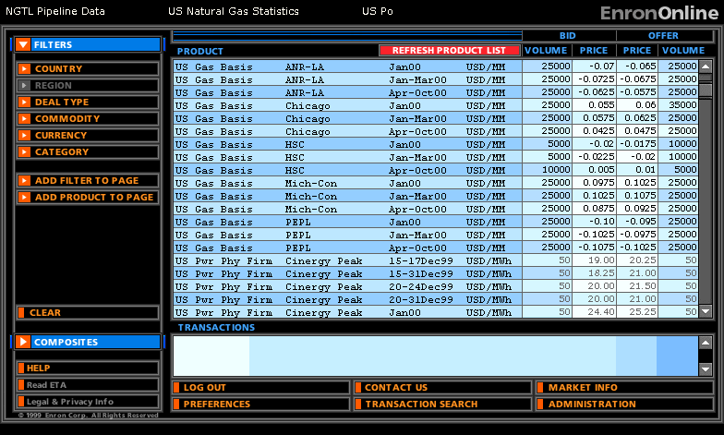
Quotes Page
Putting the Energy into e-commerceTM

Slide 12
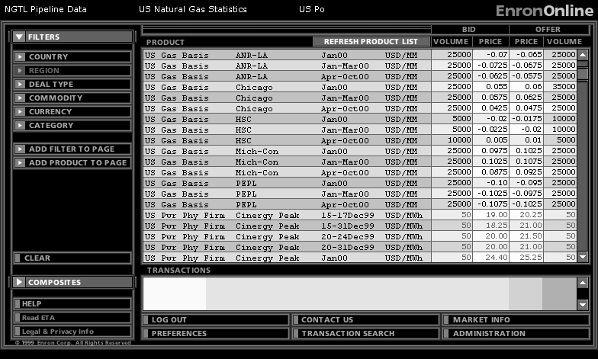
Quotes Page
Putting the Energy into e-commerceTM

Slide 13

Making the global market
Putting the Energy into e-commerceTM

Slide 14
Making the global market
Putting the Energy into e-commerceTM

Slide 15
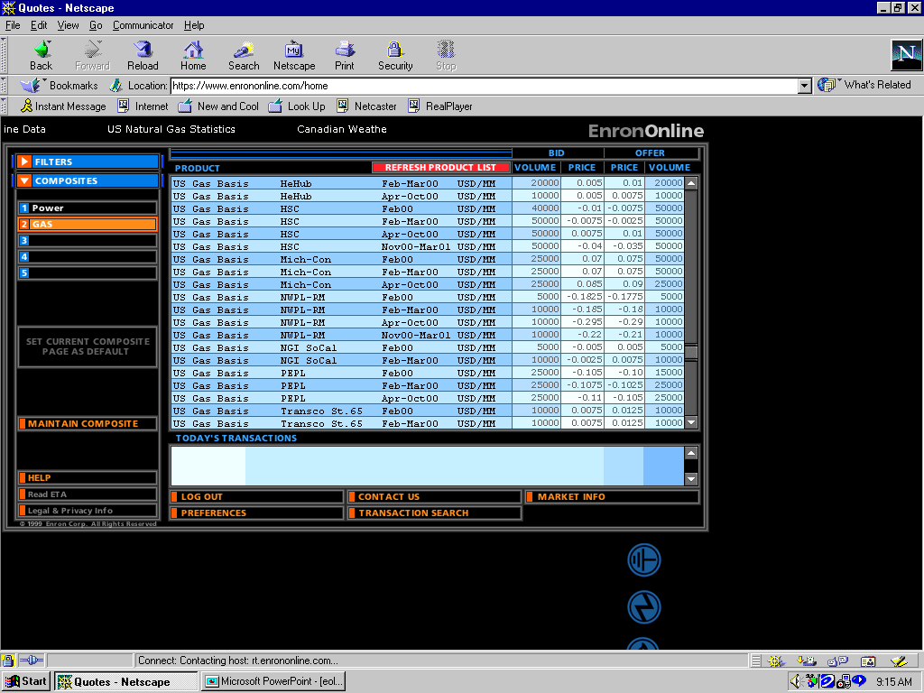
Click on Bid or Offer Price
Putting the Energy into e-commerceTM

Slide 16
Submission Screen
Putting the Energy into e-commerceTM

Slide 17
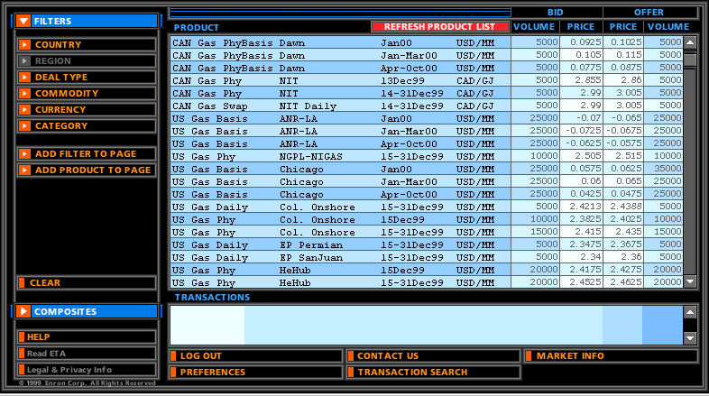
Successful Transaction
Putting the Energy into e-commerceTM

Slide 18
Benefits of EnronOnline
Free of charge
Real-Time Pricing Information
Access to complementary markets and product information
Simple access via the Internet
Easy to use
Fast and Secure Execution
Enron’s Best Prices
Putting the Energy into e-commerceTM

Slide 19
"EnronOnline was having problems this morning, so we were flying blind,"
Gas Daily April 11th, 2000
"Enron promised that the Internet would boost its operations and profits, and it did.”
    Enron Rides Internet to Profit, Higher Shares,
    Barbara Shook The Oil Daily,
Putting the Energy into e-commerceTM

Slide 20
EnronOnline Statistics
Total Life to Date Transactions > 142,000
Currently > 52 % of Enron’s Transactions
Average Daily Transactions > 1,800
Life to Date Notional Value of Transactions > $62 billion
Daily Notional Value Approximately $1 billion
Currently > 45% of Enron’s Notional Volume
Number of Products Offered - Approximately 800
Number of Currencies Traded in = 13
Development Time Approximately 7 Months
Announcement Date October 26, 1999
Launch Date November 29, 1999
Putting the Energy into e-commerceTM

Slide 21
Transactions via EnronOnline
(Weekly)

Slide 22
Utilization of EnronOnline
(% of Transactions)
Traditional Channels
EnronOnline
Putting the Energy into e-commerceTM

Slide 23

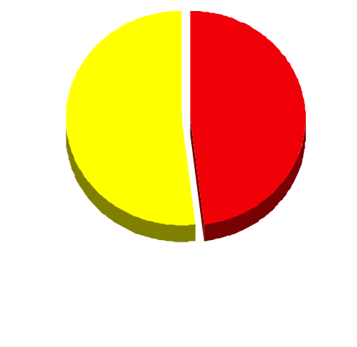
EnronOnline Versus Traditional Channels
(Currently)
Volume
Transactions
45%
52%
48%
55%
EnronOnline
Traditional Channels
Putting the Energy into e-commerceTM

Slide 24
eCommerce Business Comparison
Value of Goods
(Millions)
Business To Consumer (B2C)
eBay
Amazon.com
Dell.com
$ 2,650
1,600
10,190
1999 Data*
Business To Business (B2B)
FreeMarkets
Cisco
Intel
Altrade
$ 1,400
9,480
10,500
12,000
2000 Est.**
EnronOnline
> $ 40,000
* Est. 1999 Annual Results
** Annualized Based on Results to Date
Putting the Energy into e-commerceTM

Slide 25
Comparison of Competing Contracts
EnronOnline versus NGX
Putting the Energy into e-commerceTM

Slide 26
Comparison of Competing Contracts
EnronOnline versus Altrade
Putting the Energy into e-commerceTM

Slide 27
Comparison of Competing Contracts
EnronOnline versus International Petroleum Exchange
Putting the Energy into e-commerceTM

Slide 28
eCommerce Business Comparison
Value of Goods
(Millions)
Business To Consumer (B2C)
eBay
Amazon.com
Dell.com
$ 2,650
1,600
10,190
1999 Data*
Business To Business (B2B)
FreeMarkets
Cisco
Intel
Altrade
$ 1,400
9,480
10,500
12,000
2000 to date
EnronOnline
> $ 34,000
* Est. 1999 Annual Results
Putting the Energy into e-commerceTM

Slide 29
Putting the Energy into e-commerceTM

Slide 30
Technology Update
Enron North America
Gas Pipeline Group
Enron Europe
International Groups
Global Infrastructure
eCommerce

Slide 31
ENA Major Projects for 2000
Projects Delivered
  Streamlined Gas Logistics processes by:
    Delivering real time deal updates to the schedulers
    Increasing seamless electronic nominations to 85% of gas volumes
  Outsourcing of services to Bridgeline, Sunoco & Dofasco
  Integrated the CES Marketing portfolio into ENA applications
Projects in Progress
  Enhance the deal capture, position management, valuation and settlements processes for financial commodity transactions
  Power settlements and volume management for the the Toronto Power Exchange or ENERconnect
  Increase the overall scalability of Commercial Support systems
  SAP Integration
  Volume management for the California Power ISO

Slide 32
ENA Physical Gas Sales Volumes Processed through
Sitara & Unify per Average Day
28,499
100% Increase
23,442
BBTU/D
16,514
14,220
15,489
Note: Sales Volumes include desk to desk transactions & outsourcing service arrangements

Slide 33
Electronic Deal Confirmations
Generated via DCAF per Average Day
2,429
344% Increase
793
547

Slide 34
ENA Invoiced Amounts
$5,098
47% Increase
$3,462
$ Million

Slide 35
ENA New Deal Counts
89,796
171% Increase
41,530
33,120

Slide 36
GPG eCommerce
In July of this year, GPG will be the first pipeline to offer Capacity Bidding using EnronOnline.
Future offerings under consideration include:
  Capacity Options Trading
  Storage Capacity Auctions
  Fuel Auctions
  Capacity Release Program
  Imbalance Trading

Slide 37
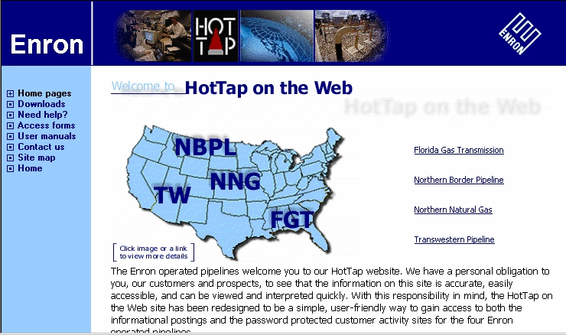
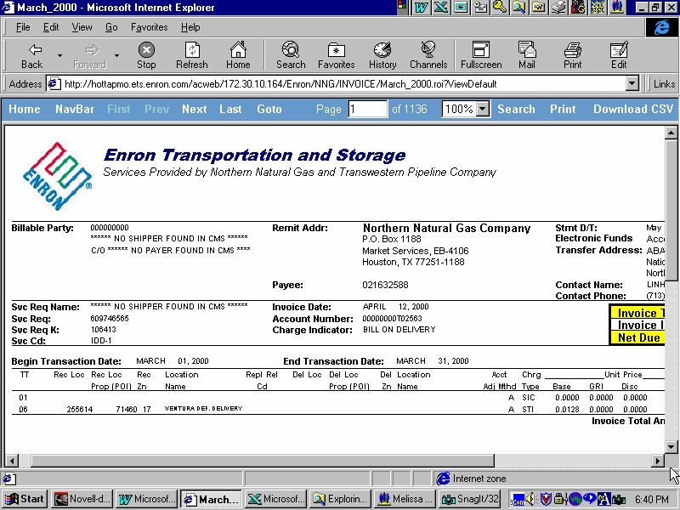
GPG eCommerce
Nominations and Scheduling
Informational Posting
Capacity Release
Flowing Gas

Slide 38
GPG Day to Day Support
1,200 external customers
25 different service types across 2,000 contracts
Average of 95,000 nomination transactions per month
Average of 35,000 confirmation transactions per month
Average of 2,500 invoices per month

Slide 39
Enron Europe
MG Integration
EnronCredit
Project Thunderball
EnVoice - London Settlements
Enron Direct - customer websites and scaling of core system
Windows2000
Exchange
EnPower rollout for UK
EnCompass - Livelink document management rollout
Market Tracker

Slide 40
International Regions
New Tokyo office
Launched EnronOnline in Sydney
eCommerce development for SK Enron
Upcoming launch of EnronOnline for Japan, Brazil, and Argentina
Launched Enron India website on May 31, 2000
Proposal to build world class Data Center in India starting with
Mumbai and Banglore and expanding to other major cities

Slide 41
Global Infrastructure Group
Windows 2000 rollout
Exchange rollout
Ardmore Data Center revitalization project
24x7 support group to facilitate the start of an Operations Control Center
Help Desk/Resolution Center re-engineering project
Procurement/Receiving/Asset Management re-engineering project

Slide 42
Enron.com
July Release
  New product & service content directly on the front page to educate & drive commerce.
  Sharp new look for ease of navigation and consistency with new Enron brand image.
  World region & business units selector.
Future Release
  Allow all business units to modify their own content on Enron.com.
  Individuals in each business unit world wide can post current Enron news articles to the site through either an automated or manual process.
  Multi-language capability - English, Spanish, Portuguese, French, German, Japanese, Hindi...

Slide 43
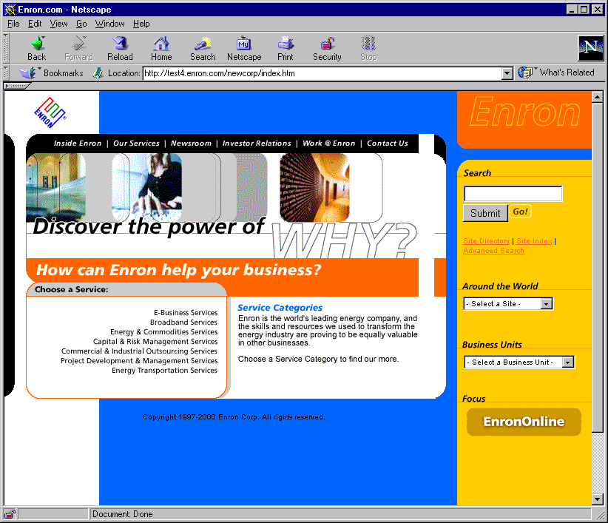
Enron.com

Slide 44
Clickpaper.com
July Release
  ClickMatch - product auction for paper and pulp
  Portal site with industry information
  Capability to apply and send 1% sales commission invoice to the seller.
Trading Release
  ClickTrade - exchange for prime-quality product
  Initially, EnronOnline will post physical and financial products onto Clickpaper.
  Ability to have Clickpaper be a many to many exchange as opposed to principal only.

Slide 45
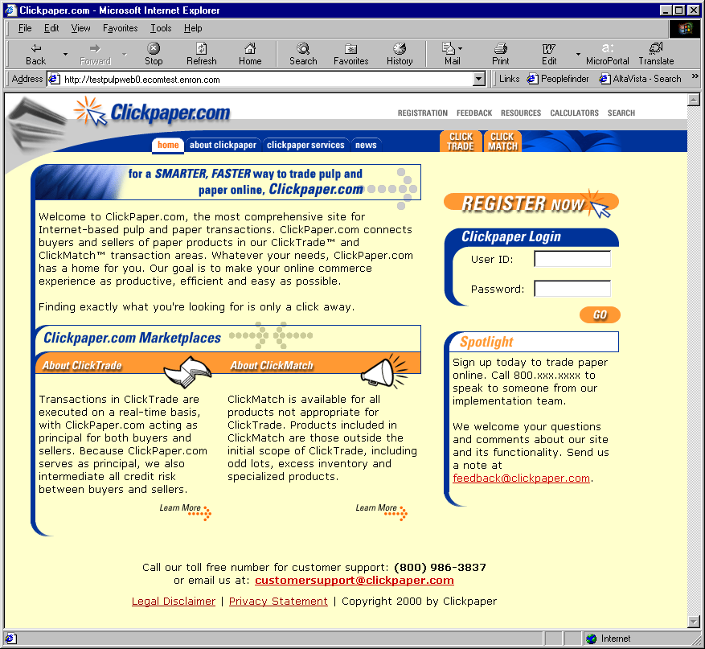
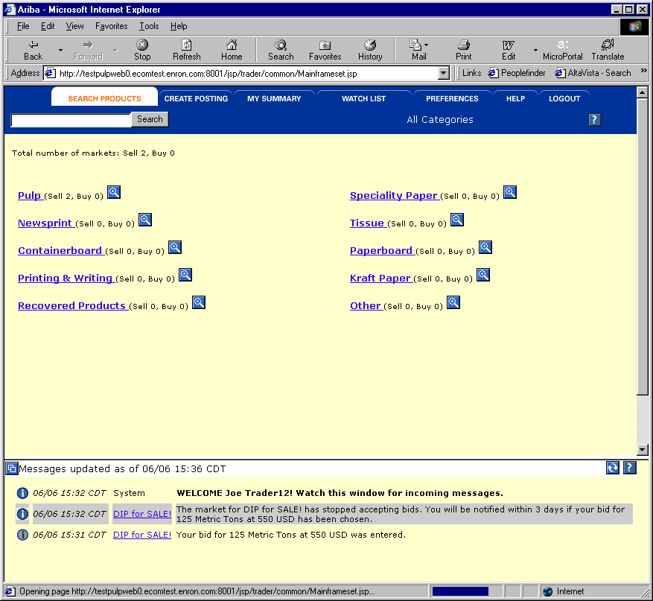
Clickpaper.com

Slide 46
EnronDirectFinance
May Release
  One (Enron) to Many (Issuers)
  Two Bank Product Offerings
  Online “Commit” (bid) form for investors
June Release
  Reduce the role of an underwriter
  Many (investors) to Many (Issuers)
  Products and Functionality
  Seeking partnerships with other banks to enhance deal flow

Slide 47
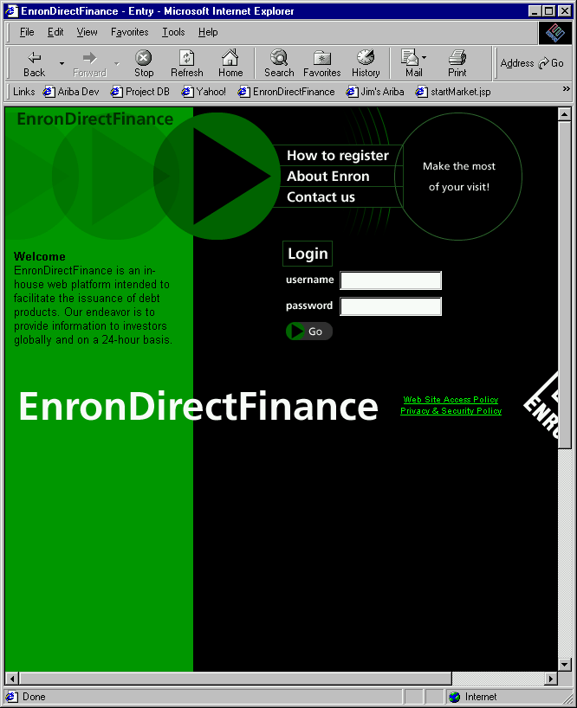
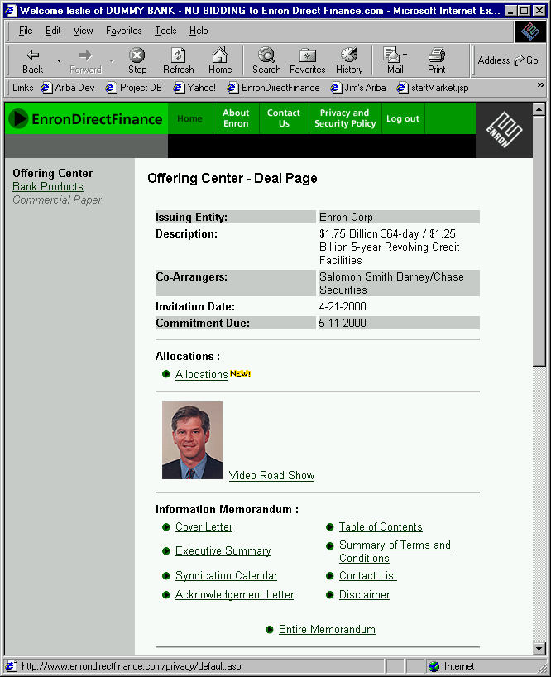
EnronDirectFinance

Slide 48
Current Market Conditions
Many industries exist that sell commodity - like products through legacy distribution channels comprised of complex sales forces and long term relationships with little price transparency (“Dine ‘Em and Sign ‘Em”).
  Result - Enormous inefficiencies exist in the pricing of commodity products.
The internet provides a unique opportunity to have immediate and inexpensive access to customers through a web-based transaction platform.
  Result - All incumbent companies are vulnerable due to reduced/no barriers to entry.
The equity markets have created an enormous value differential between old economy businesses and new economy businesses.
  Result - Possible rate of return opportunities are multiples of historical rates of return (“Winner Takes All”).

Slide 49
“ In five years time, all companies will be
internet companies, or they won’t be
companies at all.”
Andrew Grove
Chairman, Intel Corp.

Slide 50
U.S. eCommerce Growth
B2B
B2C
Source: Forrester Research, Inc

Slide 51
Worldwide eCommerce Growth
Source: Forrester Research, Inc

Slide 52
Business Strategy
Identify industries that have commodity-like products where the incumbents are predominantly using legacy distribution channels.
Determine entry vehicle into the industry (i.e. partnership, acquisition, contractual rights, etc.).
Deploy eCommerce platforms to capture market share rapidly.
Convert old economy businesses into new economy businesses and capture the value creation.
Combine Enron’s IT Group and eCommerce efforts into one commercial organization for focused execution of the business plan with the objective of increasing Enron’s multiple.

Slide 53
Lessons Learned
Principal based vs. Exchange based (“Bulletin Board”) is THE ONLY SUSTAINABLE eCOMMERCE B2B MODEL.
Everyone is a potential competitor.
Time to market is critical with product roll-out (first mover advantage).
Must continue to innovate to maintain first mover advantage.
Business model could have broad applications in other industries.

Slide 54
Why Enron?
We have been B2B for years.
We have strong skills in risk intermediation and good systems to control risk.
We are already positioned as having successfully migrated from the “old economy” to the “new economy” company.
We have a proven Business Model and track record of transforming markets.
We have successfully sourced capital for all potential investments.

Slide 55
Execution Plan
Upgrading
  Streamlining processes to do business the best, most
  efficient way we can.
Expanding
  Growing market share in current businesses.
Penetrating
  Rapidly establishing significant stakes in new markets.

Slide 56
eCommerce Initiatives
Energy EnronOnline.com
Pulp & Paper ClickPaper.com
Metals MG plc
Credit EnronCredit.com
Financial Products EnronDirectFinance.com
Energy Settlements CommodityLogic.com

Slide 57
Enron’s Global eCommerce Activities
= EnronOnline Trading Activity
= Other eCommerce Activity
= Planned eCommerce Activity

Slide 58
Funding Decision Tree
EPS Dilution
Issue Common, Convert and/or Debt
Issues
P/E Multiple Reduction
Credit Rating Dilution
Yes
Substantial Upside Sharing
Fund on Balance Sheet?
Enron Support?
Vehicle Governance
Enron Net Works Business Model
No
No
Create Incubator Vehicle
Raise Private Equity
  VC Funds
  LBO Funds
  Pensions
  CalPERs
Issues
Costly Capital
Credit Rating Dilution
Exit Strategy
Yes
Structured Transaction
Issues
Use of Capacity
Limited Risk Transfer
JEDI II
Condor
LJM
Other

Slide 59
Financial Sponsor Considerations
Issues
Sharing of Control
Business integration with ENE
business units
Credit Support
Transfer Pricing
Potential Conflict of Interest
Benefits
Additional Deal Flow
Potential upside to ENE stock price (“Sizzle”/Publicity)
New Ideas
Financial Depth

Slide 60
Enron Net Works Organization
Office of the Chairman
Greg Whalley - Chairman and Chief Executive Officer
Mike McConnell - Vice Chairman & Chief Operating Officer
Jeff McMahon - Vice Chairman & Chief Commercial Officer
Technology
Philippe Bibi
CTO
Human Resources
Robert Jones
Vice President
Corporate Development
TBD
Investments & New
Markets Identification
Jay Fitzgerald
Managing Director
Finance
Bill Brown
Vice President &
Regional CFO
Technology Origination
Allan Sommer
Vice President
Enron Online
Louise Kitchen
Managing Director
Pulp & Paper
Greg Piper
Managing Director
Metals
Bruce Garner
Vice President
Financial Markets
Harry Arora
Vice President
Energy Settlements
Tom Gros
Vice President
Procurement
George Wasaff
Managing Director

