Slide 1
Enron Net Works
June 12, 2000
Draft
<number>

Slide 2
Presentation Summary
Technology Update
Enron Net Works Vision
EnronOnline

Slide 3
Current Market Conditions
Many industries exist that sell commodity - like products through legacy distribution channels comprised of complex sales forces and long term relationships with little price transparency (“Dine ‘Em and Sign ‘Em”).
  Result - Enormous inefficiencies exist in the pricing of commodity products.
The internet provides a unique opportunity to have immediate and inexpensive access to customers through a web-based transaction platform.
  Result - All incumbent companies are vulnerable due to reduced/no barriers to entry.
The equity markets have created an enormous value differential between old economy businesses and new economy businesses.
  Result - Possible rate of return opportunities are multiples of historical rates of return (“Winner Takes All”).

Slide 4
IT Compliance
Created to independently evaluate and improve IT Controls and Security.
  Focal point for Year 2000 activities involving 2000 Enron personnel and contractors.
  Rolled out Minimum IT Control Standards (Call Andrew Parsons for a copy).
  Conducts Penetration Studies.
  Manages Enterprise IT Audits.

Slide 5
GPG eCommerce
In July of this year, GPG will be the first pipeline to offer Capacity Bidding using EnronOnline.
Future offerings under consideration include:
  Capacity Options Trading
  Storage Capacity Auctions
  Fuel Auctions
  Capacity Release Program
  Imbalance Trading

Slide 6
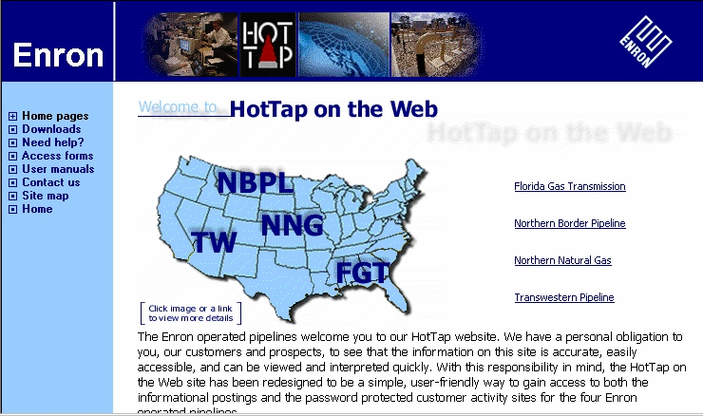
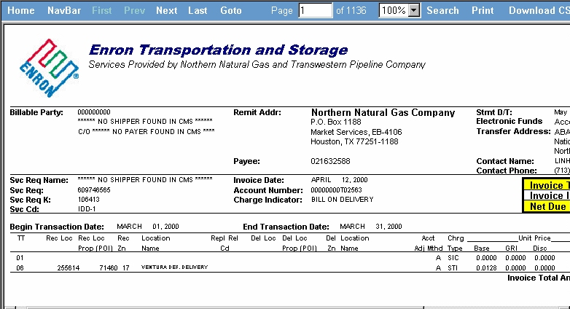
GPG eCommerce
Nominations and Scheduling
Informational Posting
Capacity Release
Flowing Gas:
  Invoices/Bill Presentment
  Measurement
  Imbalance Reports

Slide 7
Enron India
Launched Enron India website on May 31, 2000.
Proposal to build world class Data Center in India starting with Mumbai and Banglore and expanding to other major cities.
  Initially offering Co-location, Managed Services, Web Hosting , and International Connectivity.

Slide 8
“ In five years time, all companies will be
internet companies, or they won’t be
companies at all.”
Andrew Grove
Chairman, Intel Corp.

Slide 9
U.S. eCommerce Growth
B2B
B2C
Source: Forrester Research, Inc

Slide 10
Worldwide eCommerce Growth
Source: Forrester Research, Inc

Slide 11
Business Strategy
Identify industries that have commodity-like products where the incumbents are predominantly using legacy distribution channels.
Determine entry vehicle into the industry (i.e. partnership, acquisition, contractual rights, etc.).
Deploy eCommerce platforms to capture market share rapidly.
Convert old economy businesses into new economy businesses and capture the value creation.
Combine Enron’s IT Group and eCommerce efforts into one commercial organization for focused execution of the business plan with the objective of increasing Enron’s multiple.

Slide 12
Lessons Learned
Principal based vs. Exchange based (“Bulletin Board”) is
THE ONLY SUSTAINABLE eCOMMERCE B2B MODEL.
Everyone is a potential competitor.
Time to market is critical with product roll-out (first mover advantage).
Must continue to innovate to maintain first mover advantage.
Business model could have broad applications in other industries.

Slide 13
Why Enron?
We have been B2B for years.
We have strong skills in risk intermediation and good systems to control risk.
We are already positioned as having successfully migrated from the “old economy” to the “new economy” company.
We have a proven Business Model and track record of transforming markets.
We have successfully sourced capital for all potential investments.

Slide 14
Execution Plan
Upgrading
  Streamlining processes to do business the best, most
  efficient way we can.
Expanding
  Growing market share in current businesses.
Penetrating
  Rapidly establishing significant stakes in new markets.

Slide 15
eCommerce Initiatives
Currently Underway
Energy
Pulp & Paper
Metals
Credit
Energy Settlements
EnronOnline.com
ClickPaper.com
TBD
EnronCredit.com
CommodityLogic.com

Slide 16
eCommerce Initiatives
Under Consideration
Petrochemicals
Grains
Transaction Management
Logistics (Shipping, air cargo, etc.)

Slide 17
Enron’s Global eCommerce Activities
= EnronOnline Trading Activity
= Other eCommerce Activity
= Planned eCommerce Activity

Slide 18
Enron Net Works Organization
Office of the Chairman
Greg Whalley - Chairman and Chief Executive Officer
Mike McConnell - Vice Chairman & Chief Operating Officer
Jeff McMahon - Vice Chairman & Chief Commercial Officer
Technology
Phillipe Bibi
CTO
Human Resources
Robert Jones
Vice President
Investments
Steve Horn
Vice President
New Markets
Identification
Jay Fitzgerald
Managing Director
Finance
Bill Brown
Vice President &
Regional CFO
Technology Origination
Allan Sommer
Vice President
Corporate Development
TBD
Enron Online
Louise Kitchen
Managing Director
Pulp & Paper
Greg Piper
Managing Director
Metals
Bruce Garner
Vice President
Financial Markets
Harry Arora
Vice President
Energy Settlements
Tom Gros
Vice President
Procurement
George Wasaff
Managing Director

Slide 19
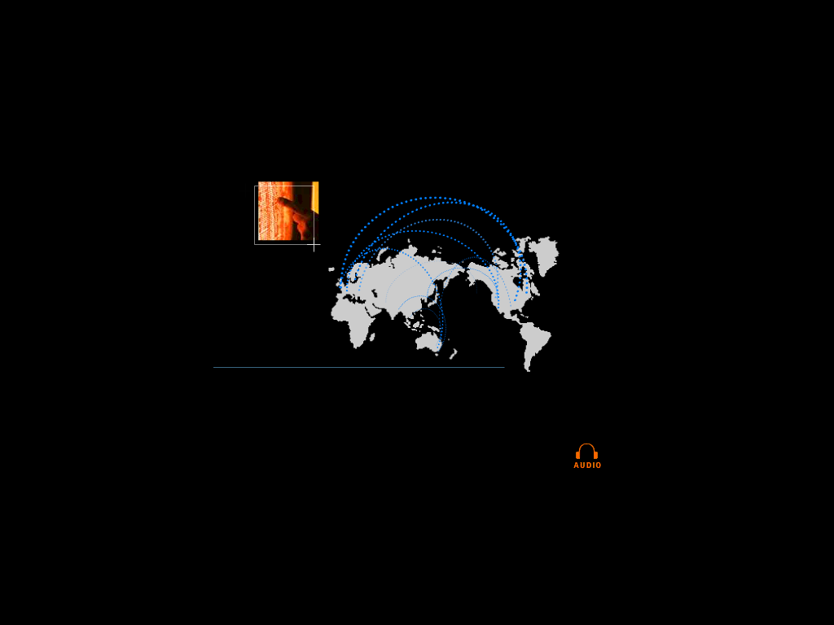

eCommerce is Becoming Core to the Global Energy Business
01010
91919
01382
83710
91817
01010
91919
01382
83710
91817
01010
91919
01382
83710
91817
01010
91919
01382
83710
91817
91919
010102374621985712398571928509129759812659821598601010237462198571239857192850912975981265982159860101023746216
010102374621985712398571928509129759812659821598601010237462198571239857192850912975981265982159860101023746298
global networks

Slide 20
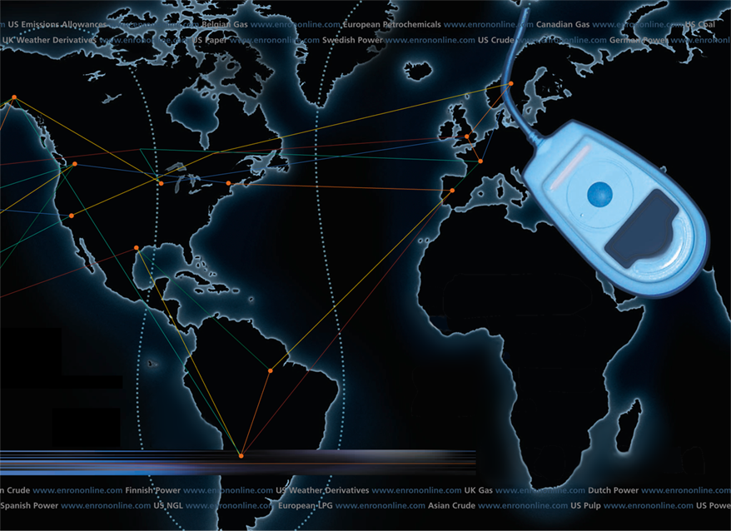
Putting the Energy into e-commerce
EnronOnline
TM
TM

Slide 21
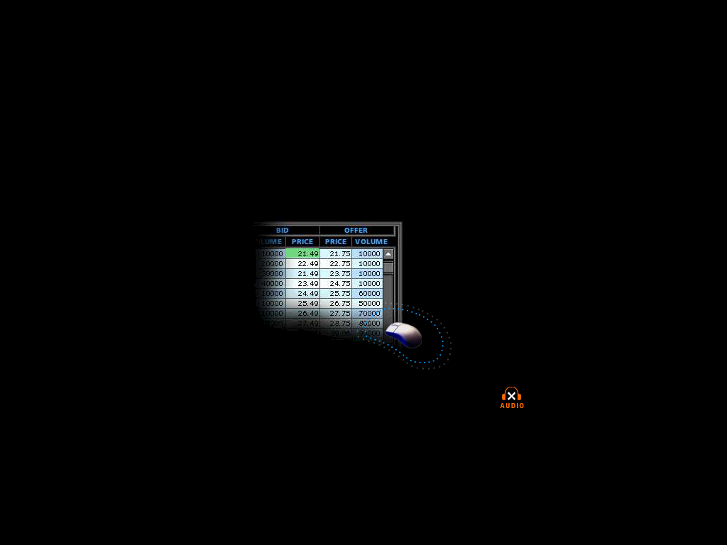
What is EnronOnline?
A Free, Internet-based, Global Transaction System Which Allows Counterparties to View Real Time Prices From Enron’s Traders and Transact Instantly Online
click & transact

Slide 22
Benefits of EnronOnline
Free of charge
Real-Time Pricing Information
Access to complementary markets and product information
Simple access via the Internet
Easy to use
Fast and Secure Execution
Enron’s Best Prices

Slide 23
Enron’s global wholesale transaction business
….……..moves online
    November 1999 US Natural Gas
    Canadian Natural Gas
    December 1999 Coal
    Nordic Power
    Plastics
    Pulp & Paper
    US Power
    January 2000 Continental European Power
    Continental European Gas
    Emissions
    LPG
    Oil & Refined Products
    Petrochemicals
    UK Gas
    UK Power
    Weather
    February 2000 EnBank Virtual Storage Auction (UK)
    March 2000 Credit Derivatives
    Enron Emissions Auctions (US)
    Australian Power
    May 2000 Bandwidth
    Spring 2000 Singapore Crude Products
    Summer 2000 European Coal
Clicks & Mortar

Slide 24
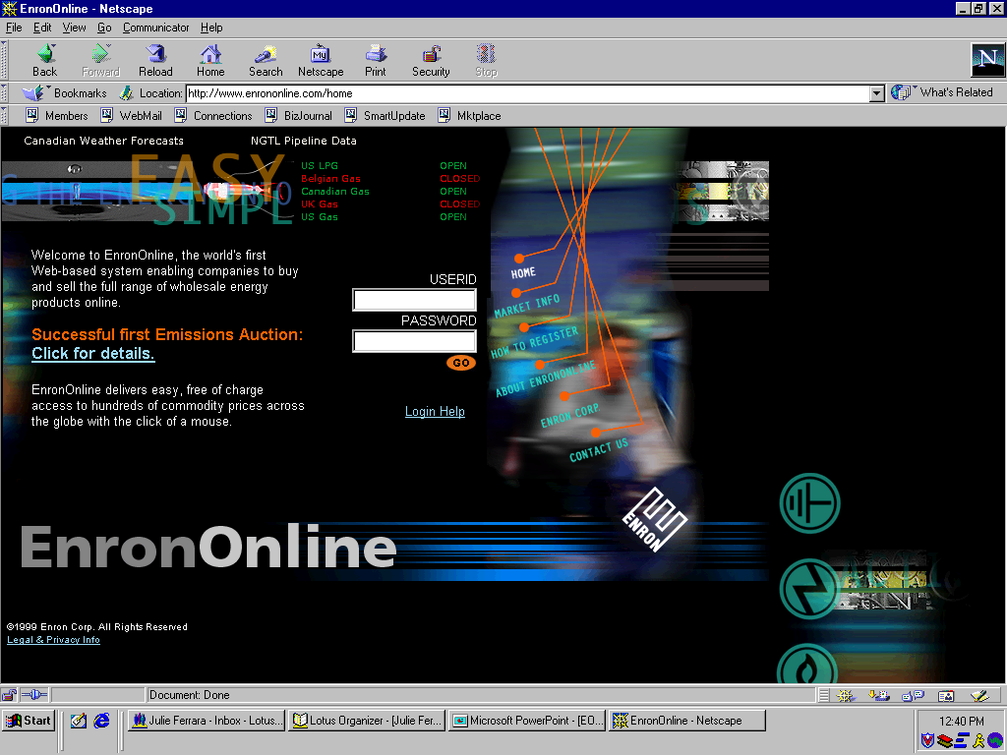
www.EnronOnline.com
New User
*******

Slide 25
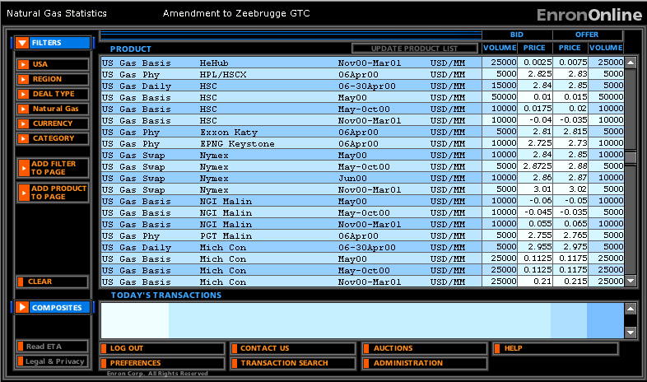
Quotes Page

Slide 26
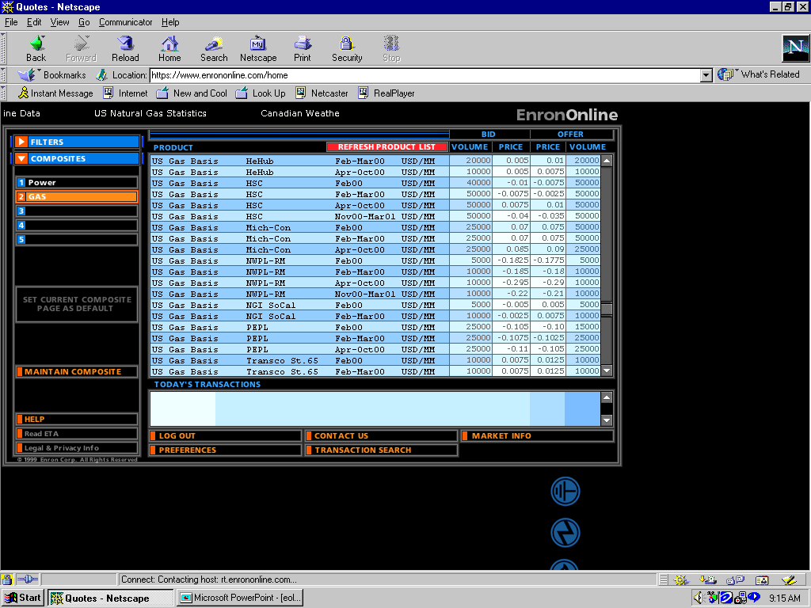
Click on Bid or Offer Price

Slide 27
Submission Screen

Slide 28
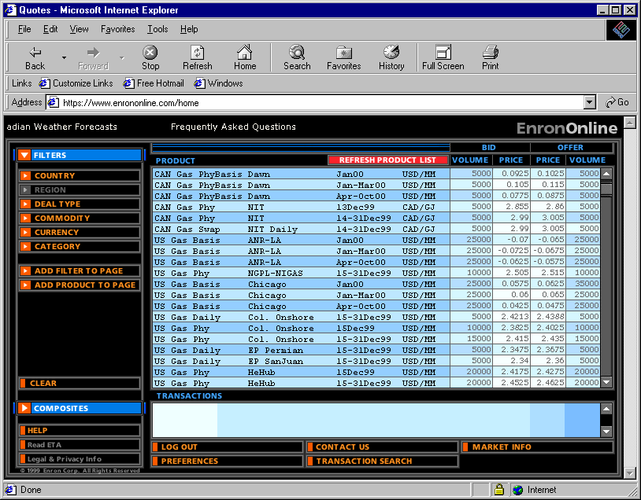
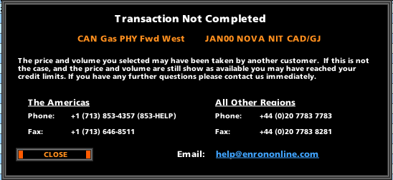
Failed Transaction

Slide 29
Successful Transaction

Slide 30
EnronOnline Statistics
Total Life to Date Transactions > 128,000
Currently > 52 % of Enron’s Transactions
Average Daily Transactions > 1,800
Life to Date Notional Value of Transactions > $50 billion
Daily Notional Value Approximately $900 Million
Currently > 45% of Enron’s Notional Volume
Number of Products Offered - Approximately 800
Number of Currencies Traded in = 13
Development Time Approximately 7 Months
Announcement Date October 26, 1999
Launch Date November 29, 1999

Slide 31
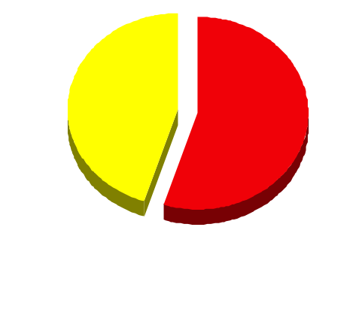
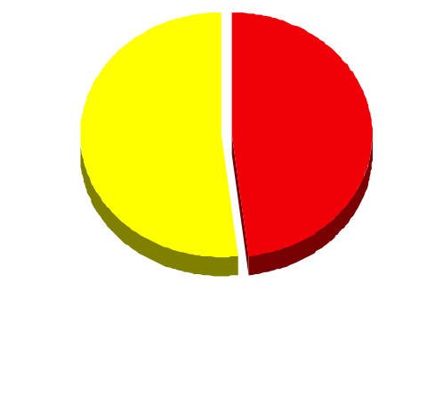
EnronOnline Versus Traditional Channels
(Currently)
Volume
Transactions
45%
52%
48%
55%
EnronOnline
Traditional Channels

Slide 32
eCommerce Business Comparison
Value of Goods*
(Millions)
Business To Consumer (B2C)
eBay
Amazon.com
Dell.com
$ 2,805
1,640
10,435
1999 Data*
Business To Business (B2B)
FreeMarkets
Cisco
Intel
Altrade
$ 2,700
9,500
10,500
12,000
2000 Est.**
EnronOnline
> $ 50,000
* Actual 1999 Results: eBay, Amazon.com, Dell.com, FreeMarkets
Est. 1999 Annual Results: Cisco, Intel, Altrade
** Annualized Based on Results to Date

Slide 33


