Slide 1
Enron Americas
Notes:
<number>
<footer>
<header>
<date/time>

Slide 2
Agenda
Business Principles
Financial Results
Gas & Power Fundamentals
North America Business Discussion
Retail Risk Management Discussion
South America Merchant Discussion

Slide 3
Business Principles (Merchant Natural Gas and Power Business)
Goals are to expand and enhance our capabilities in:
RECRUIT AND RETAIN THE BEST TALENT
CONSTANTLY EXPAND LIQUIDITY - PRODUCTS AND LOCATIONS
BE THE LEADING MARKET MAKER
COVER ALL THE WHOLESALE CUSTOMERS TO ENSURE SIZEABLE DEAL FLOW
CONTINUALLY EXPAND OUR OUTSOURCING RELATIONSHIPS
CREATE A WORLD CLASS INTERNAL RESEARCH CAPABILITY
ACCOMPLISHING THESE GOALS LEADS TO:
THE ABILITY TO IDENTIFY AND EXECUTE HIGHLY STRUCTURED TRANSACTIONS
THE ABILITY TO SUCCESSFULLY TAKE POSITIONS ON MARKET DIRECTION

Slide 4
Enron North America EBIT Without Reductions ($ in millions)
EGM and EIM transferred out 3Q 2000
Includes ($665M) of EES Wholesale 2001 YTD
Generated additional $958M in prudency
3,843
Reserve
($958M)
EES
($665M)
2,220

Slide 5
Financial Highlights ($ in millions)
Total Year 2000
EA EA EES W YTD
9/30 YTD 2001
Earnings Before Interest & Taxes $ 1,362 $ 2,885 $ (665) $ 2,220
Funds Flow $ 937 $ 2,101 $ 30 $ 2,131
Cash Flow from Operations $ 2,988 $ (36) $ (538) $ (574)
Capital Deployed* $ 3,252 $ 3,194 $ 750 $ 3,944
*Excludes Goodwill and HPL FV $3.0B
Notes:
<number>
<footer>
<header>
<date/time>

Slide 6
Enron North America Net Assets (excludes Retail Risk Management) ($ in millions)
Property, Plant & Equipment
Merchant Assets
Other Investments
$4,279
$3,014
$2,696
$2,190
$1,943
Bridgeline
HPL
$1,321
Mariner
Sithe
Legacy Assets

Slide 7
Key Fundamental Events Gas Market
Gas rig count peaked at 1,058 in July 2001
Domestic production of gas increased by 2 Bcf/day
2.5 Bcf/day of industrial gas demand was lost from March 2000 to January 2001
Injected 2,130 Bcf this season; 4.9 Bcf/day more than last year
Notes:
<number>
<footer>
<header>
<date/time>

Slide 8
NG Forward Curve Comparison
Notes:
<number>
<footer>
<header>
<date/time>

Slide 9
Key Fundamental Events East Power
Supply Factors
Over 60,000 MW of gas-fired generation came on in the last 21 months
Nuclear generation up by 5.8% over 2000 – 4,364 MW
Demand Factors
Lower than expected load growth – 1-2% actual vs. 4-5% forecast
Slowing economy/ Industrial recession
Stabilizing prices
Notes:
<number>
<footer>
<header>
<date/time>

Slide 10
Notes:
<number>
<footer>
<header>
<date/time>

Slide 11
U.S. Power Price Volatility - East
Notes:
<number>
<footer>
<header>
<date/time>

Slide 12
Key Fundamental Events West Power
Supply factors
Added 9,000 MW of gas-fired generation over the last 21 months
Nuclear utilization up 2,300 MW vs. 2000
Hydro down 8,500 MW vs. 2000
Net + 3,000 MW more supply
Demand
Lost 2,300 MW due to residential/commercial conservation
Lost 1,500 MW from load shedding in Pacific Northwest
Lost 1,000-3,000 MW due to slowing economy
Added 1,000 MW due to hotter summer than 2000
Net 5,000 MW less demand
Notes:
<number>
<footer>
<header>
<date/time>

Slide 13
Notes:
<number>
<footer>
<header>
<date/time>

Slide 14
U.S. Power Price Volatility - West
Notes:
<number>
<footer>
<header>
<date/time>

Slide 15
Enron North America Commercial Headcount
2
54
109
81
111
357
3
48
98
101
120
370
9
56
139
155
113
472
8
41
104
103
174
433
Managing Directors
Vice Presidents
Directors
Managers
Analysts & Associates
TOTAL
1998
1999
2000
2001

Slide 16
Employment Agreement Statistics
Overall Totals Agreement Details 2001
Number % Under Signed
in Job Employment Employment Total Total
Group Agreement Agreements Cash Equity
Mng. Directors 8 88% 5 $400,000 $3,850,006
Vice Presidents 41 80% 20 $1,700,000 $8,345,012
Directors 104 44% 26 $1,530,000 $3,170,000
TOTAL 150 70% 51 $3,630,000 $15,365,018

Slide 17
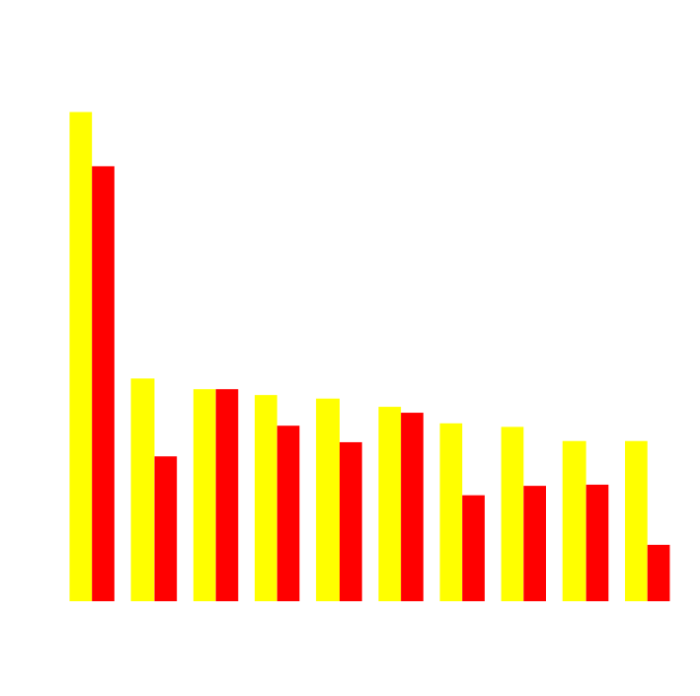
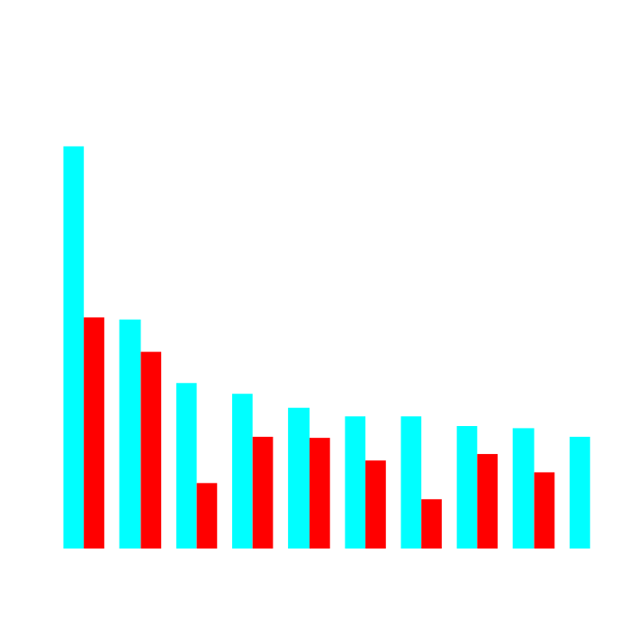
Enron’s Leading Market Position
Second Quarter 2000 vs Second Quarter 2001
(TBtue/d)
Gas Power
2Q01
2Q00
2Q01
2Q00
Notes:
<number>
<footer>
<header>
<date/time>

Slide 18
Enron North America Volumes (Bbtue/d)
Physical Gas
2000
2001
Financial Gas
2000
2001
Physical Power
2000
2001

Slide 19
Enron North America Volumes (Bbtue/d)
Volumes in ‘000s
Financial
Physical
Physical Power
Margin
Margin $ in MM
1995 1996 1997
1998
1999
2000
2001

Slide 20
Enron North America Gas Transactions Per Day
Non EOL
EOL
1997
1998
1999
2000
2001

Slide 21
Enron North America Power Transactions Per Day
Non EOL
EOL
1997
1998
1999
2000
2001

Slide 22
Enron North America EOL Counterparties
Gas
Power
1999
2000
2001
1999
2000
2001

Slide 23
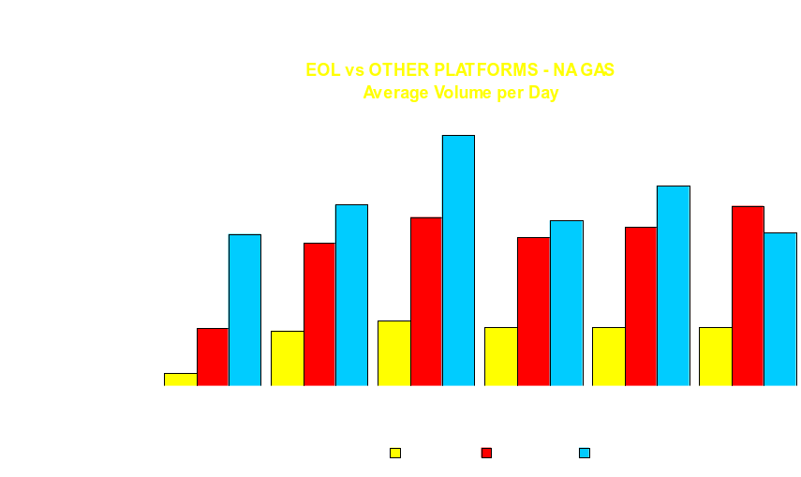
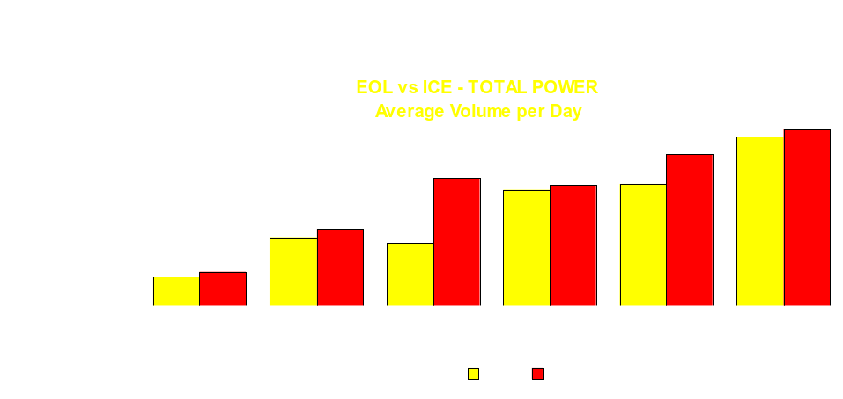
Notes:
<number>
<footer>
<header>
<date/time>

Slide 24
Origination
320MM
175MM
10MM
50MM
10MM
5MM
17MM
11MM
28MM
29MM
10MM
Gas
Power
Power Development
4MM
2001 YTD $700mm (excluding sold peakers)

Slide 25

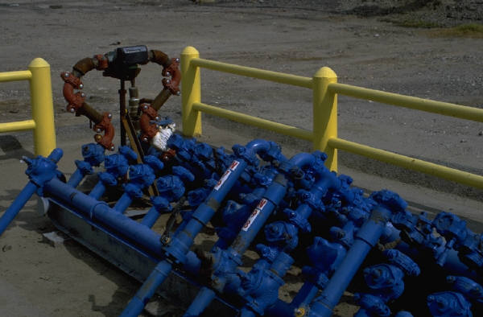



Structured Natural Gas Transactions
SunCor Service Agreement
Petro Canada Services Agreement
Sierra Pacific
Long term assignment of PGT capacity
Michigan Gas Utilities
3 year Outsourcing Transaction
EPMI provides power for MGU’s supply needs
MGU releases all upstream gas supply assets to EPMI
Financial Transactions in Mexico
200 bcf Natural Gas ($4mm Origination)
Financial Zinc, Fuel Oil
Kern Transport
Syndication to 7 shippers of Kern River from emergency open season

Slide 26
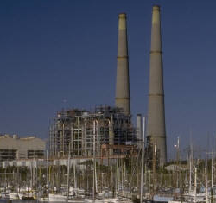

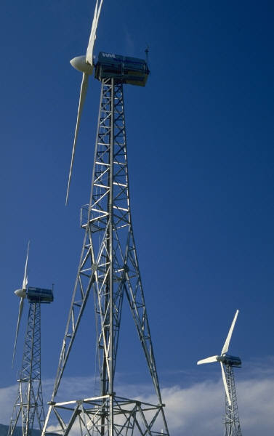


Structured Power Transactions
Alberta PPA
Purchase of output of 700MW plant for 20 years
Las Vegas Cogen II
QF expansion and sale
Turbine Book
WAPA Edwards
WAPA Navy
5 year transactions including ‘green’ energy
Central Maine Power
Load following
transaction
Heywood
Power plant site
City of San Antonio
25 year wind PPA
Mississippi Delta Energy Agency
Asset Management Transaction for 85 MW of load and 90 MW generating capacity and outside supply contracts of 26 MW

Slide 27
Summary of 2001 Asset Sales ($ in millions, excludes items <$10million)
Book Sales
Basis Proceeds Gain
Historical Assets
HPL $ 364.2 $ 352.5 $ (11.7)
Development Projects
Peakers 1,045.0 1,682.0 637.0
Pastoria 72.5 112.9 40.4
Fountain Valley PSCO 115.6 130.6 18.0
SW Power /Las Vegas Cogen 120.1 142.8 22.7
Heywood Site 1.0 12.7 11.7
Turbines – 2 x 7 EAs 40.3 49.5 9.2
Power Assets
Alamac / NCPH 7.5 22.0 14.5
Saguoro 18.5 20.7 1.5
Forecast Q4 2001 disposals
Vitro Sale 24.0 39.5 14.0
Onondaga 7.9 10.0 2.1
Doyle - 4.8 4.7
TOTALS $ 1,817 $ 2,580 $ 764

Slide 28
Retail Risk Management Discussion

Slide 29
South America Merchant Discussion

Slide 30
Enron Americas
Notes:
<number>
<footer>
<header>
<date/time>

