Slide 1
Enron Americas
Notes:
<number>
<footer>
<header>
<date/time>

Slide 2
Enron North America EBIT
EGM and EIM transferred out 3Q 2000
Includes ($503M) of EES Wholesale 2001 YTD
Generated additional $780M in prudency

Slide 3
Enron North America Assets
Property, Plant & Equipment
Merchant Assets
Other Investments
$4,279
$3,014
$2,696
$2,190
$1,943
Bridgeline
HPL
$1,321
Mariner
Sithe
Legacy Assets

Slide 4
Key Fundamental Events Gas Market
Gas rig count peaked at 1058 in July’01
Domestic production of gas increased by 2 Bcf/Day
2.5 Bcf/Day of industrial gas demand was lost from March 2000 to January 2001
Injected 2130 Bcf this season; 4.9 Bcf/Day more than last year
Notes:
<number>
<footer>
<header>
<date/time>

Slide 5

NG Forward Curve Comparison
Notes:
<number>
<footer>
<header>
<date/time>

Slide 6
Key Fundamental Events East Power
Supply Factors
Over 60,000 MW of gas-fired generation came on in the last 21 months
Nuclear generation up by 5.8% over 2000 – 4,364 MW
Demand Factors
Lower than expected load growth – 1-2% actual vs. 4-5% forecast
Slowing economy/ Industrial recession
Stabilizing prices
Notes:
<number>
<footer>
<header>
<date/time>

Slide 7
Notes:
<number>
<footer>
<header>
<date/time>

Slide 8
U.S. Power Price Volatility - East
Notes:
<number>
<footer>
<header>
<date/time>

Slide 9
Key Fundamental Events West Power
Supply factors
Added 9,000 MW of gas-fired generation over the last 21 months
Nuclear utilization up 2,300 MW vs. 2000
Hydro down 8,500 MW vs. 2000
Net + 3,000 MW
Demand
Lost 2,300 MW due to residential/commercial conservation
Lost 1,500 MW from load shedding in Pacific Northwest
Lost 1,000-3,000 MW due to slowing economy
Added 1,000 MW due to hotter summer than 2000
Net 5,000 MW less demand
Notes:
<number>
<footer>
<header>
<date/time>

Slide 10
Notes:
<number>
<footer>
<header>
<date/time>

Slide 11
U.S. Power Price Volatility - West
Notes:
<number>
<footer>
<header>
<date/time>

Slide 12
Enron North America Commercial Headcount
2
54
109
81
111
357
3
48
98
101
120
370
9
56
139
155
113
472
8
41
104
103
174
433
Managing Directors
Vice Presidents
Directors
Managers
Analysts & Associates
TOTAL
1998 1999 2000 2001

Slide 13
Employment Agreement Statistics
Overall Totals Agreement Details 2001
Number % Under % Under
in Job Employment Employment Employment Employment Total Total
Group Agreements Agreement Agreements Agreements Cash Equity
Managing Directors 8 7 88% 5 16% $400,000 $3,850,006
Vice Presidents 41 33 80% 20 49% $1,700,000 $8,345,012
Directors 104 46 44% 26 25% $1,530,000 $3,170,000
Managers 103 16 16% 5 5% $330,000 $400,000
TOTAL 256 102 40% 56 22% $3,960,000 $15,765,018

Slide 14
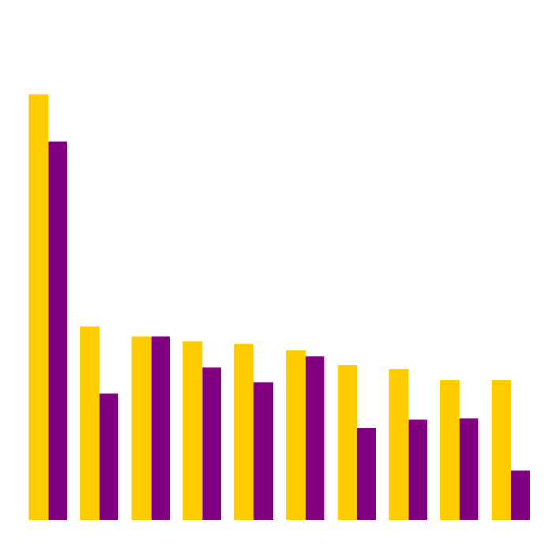
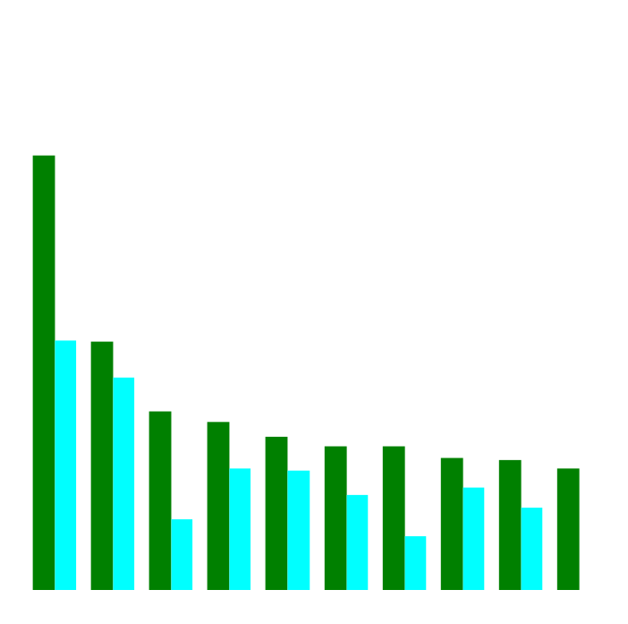
Enron’s Leading Market Position
Second Quarter 2000 vs Second Quarter 2001
(TBtue/d)
Gas Power
2Q01
2Q00
2Q01
2Q00
Notes:
<number>
<footer>
<header>
<date/time>

Slide 15
Enron North America Volumes (Bbtue/d)
Physical Gas
2000
2001
Financial Gas
2000
2001
Physical Power
2000
2001

Slide 16
Enron North America Gas Transactions Per Day
Non EOL
EOL
1997
1998
1999
2000
2001

Slide 17
Enron North America Power Transactions Per Day
Non EOL
EOL
1997
1998
1999
2000
2001

Slide 18
Enron North America EOL Counterparties
Gas
Power
1999
2000
2001
1999
2000
2001

Slide 19
EOL vs Other Platforms – NA Gas
Average Volume per Day

Slide 20
Summary of 2001 Asset Sales and Power Development
Book Sales
Basis Proceeds Gain
Closed in 2001
2000 Peakers (Allegheny) $635.5 $1,047.7 $412.2
Brownsville and Caledonia (Cinergy) $274.3 $499.6 $225.3
HPL (AES) $364.2 $352.5 ($11.7)
Pastoria (Calpine) $72.5 $112.9 $40.4
Alamac / NCPH (AIG Highstar) $7.5 $22.0 $14.5
Turbines – 2 x 7 EAs (Northwestern) $40.3 $49.5 $9.2
Fountain Valley PSCO (Black Hills) $115.6 $130.6 $18.0
SW Power /Las Vegas Cogen (Black Hills) $120.1 $142.8 $22.7
Turbines – 2 x 7 EAs (Northwestern) $40.3 $49.5 $9.2
Heywood Site (AEP) $1.0 $12.7 $11.7
New Albany (Duke) $136.1 $135.0 0
Saguoro (NRG) $18.5 $20.7 $1.5
(excludes items <$10mm)
Forecast Q4 2001 disposals
Vitro Sale * $24.0 $39.5 $14.0
Onondaga $7.9 $10 $2.1
Doyle 0 $4.8 $4.7

Slide 21
Origination YTD

Slide 22
Structured Power Transactions
Power Development
Heywood, Las Vegas Cogen II, Equipment Sales
WAPA Edwards/WAPA Navy
5 year transactions including ‘green’ energy
PPA to San Antonio
25 year wind PPA
Central Maine Power
Load following transaction
Kaiser/BPA
Aluminium smelter resold energy during summer ’01
Mississippi Delta Energy Agency
Asset Management Transaction for 85 MW of load and 90 MW generating capacity and outside supply contracts of 26 MW

Slide 23
Structured Natural Gas Transactions
Sierra Pacific Transportation Transaction
Long term assignment of PGT capacity
Kern Transportation
Syndication to 7 shippers of Kern River from emergency open season
Michigan Gas Utilities
3 year Outsourcing Transaction
EPMI provides power for MGU’s supply needs
MGU releases all upstream gas supply assets to EPMI
Financial Transactions in Mexico
200 bcf Natural Gas ($4mm Origination)
Financial Zinc, Fuel Oil
Alberta PPA
Purchase of output of 700MW Coal plant for 20 years

