Slide 1
Enron Americas
Notes:
<number>
<footer>
<header>
<date/time>

Slide 2
Agenda
Overview of North American Natural Gas Market
Overview of North American Power Market
East
West
Enron Americas Achievements 2001 YTD

Slide 3
Key Fundamental Events Gas Market
US natural gas prices rose to $10 by Dec’00 and are currently less than $2 (first time in last 3 years)
Gas rig count peaked at 1,058 in July’01; up almost 400 rigs since summer 2000
Domestic production of gas increased by 2 Bcf/day (4%) over past 12 months
2000 winter: the coldest November and December on record
2.5 Bcf/day of overall industrial gas demand was lost from March 2000 to January 2001. Only 1.5 Bcf/day has returned
Overall storage level is currently 355 Bcf higher than last year
Injected 2130 Bcf this season; 4.9 Bcf/day more than last year
Current events further depress the industrial market
Notes:
<number>
<footer>
<header>
<date/time>

Slide 4
Current Weekly U.S. Inventory Levels
Notes:
<number>
<footer>
<header>
<date/time>

Slide 5
Historical Implied Volatility – 10 Day Moving Average
Notes:
<number>
<footer>
<header>
<date/time>

Slide 6
Key Fundamental Events East Power
Supply Factors
- Additional generation capacity - 67,721 MW
- Nuclear generation up by 5.8% over 2000 – 4,364 MW
Demand Factors
- Lower than expected load growth – 1-2% actual vs. 4-5% forecast
- Slowing economy/ Industrial recession
Stabilizing prices
Notes:
<number>
<footer>
<header>
<date/time>

Slide 7
Notes:
<number>
<footer>
<header>
<date/time>

Slide 8
U.S. Power Price Volatility - East
Notes:
<number>
<footer>
<header>
<date/time>

Slide 9
Key Fundamental Events West Power
Supply factors
- Additional generation capacity – 8,274 MW
- Nuclear utilization up 3.3% over 2000 - 2,343 MW
Demand
- Residential/Commercial incentive for conservation - 2,343 MW
- Industrial load shedding in Pacific Northwest – 1,511 MW
- Slowing economy
Stabilizing prices
Notes:
<number>
<footer>
<header>
<date/time>

Slide 10
Notes:
<number>
<footer>
<header>
<date/time>

Slide 11
U.S. Power Price Volatility - West
Notes:
<number>
<footer>
<header>
<date/time>

Slide 12
Enron North America EBIT
EGM and EIM transferred out 3Q 2000
Includes ($507M) of EES Wholesale 2001 YTD
Generated additional $780M in prudency

Slide 13
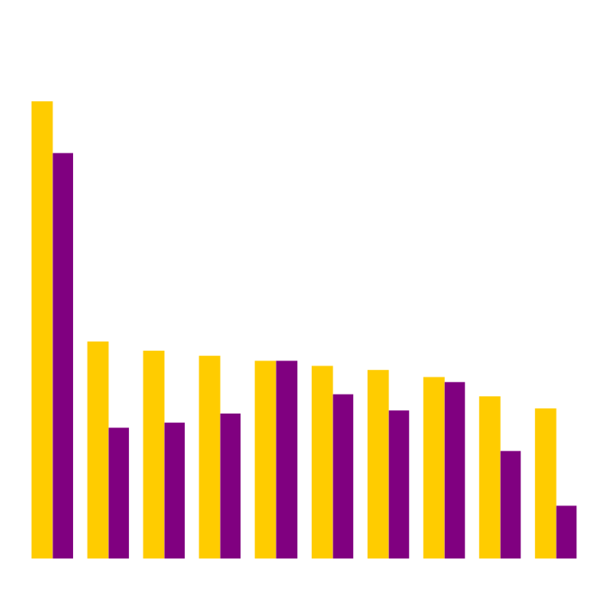
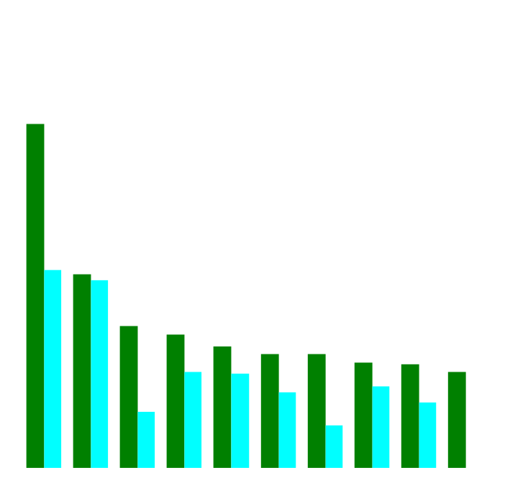
Enron’s Leading Market Position
Second Quarter 2000 vs Second Quarter 2001
(TBtue/d)
Gas Power
2Q01
2Q00
2Q01
2Q00
Notes:
<number>
<footer>
<header>
<date/time>

Slide 14
Enron North America Volumes (Bbtue/d)
Physical Gas
2000
2001
Financial Gas
2000
2001
Physical Power
2000
2001

Slide 15
Enron North America Gas Transactions Per Day
Non EOL
EOL
1997
1998
1999
2000
2001

Slide 16
Enron North America Power Transactions Per Day
Non EOL
EOL
1997
1998
1999
2000
2001

Slide 17
Enron North America EOL Counterparties
Gas
Power
1999
2000
2001
1999
2000
2001

Slide 18
Enron North America Assets
Property, Plant & Equipment
Merchant Assets
Other Investments
Sithe $910
Bridgeline $231
Mariner $517
HPL $285

Slide 19
Summary of 2001 Asset Sales
Book Sales
Basis Proceeds Gain
Closed in 2001
2000 Peakers (Allegheny) $635.5 $1,047.7 $412.2
Brownsville and Caledonia (Cinergy_ $274.3 $499.6 $225.3
HPL (AES) $364.2 $352.5 ($11.7)
Alamac / NCPH (AIG Highstar) $7.5 $22.0 $14.5
SW Power /Las Vegas Cogen (Black Hills) $120.1 $142.8 $22.7
Turbines – 2 x 7 Eas (Northwestern) $40.3 $49.5 $9.2
New Albany (Duke) $136.1 $135.0 0
(excludes items <$10mm)
Forecast Q4 2001 disposals
Vitro Sale $25.5 $39.5 $14.0
Onondaga $7.9 $10 $2.1
Doyle

Slide 20
Structured Power Transactions
Enron Americas has successfully developed power projects and disposed of them at differing stages of development based on the state of the marketplace. Different projects included some of all of the elements below:
Own or option land
Own or option equipment
Enter into EPC
Permit
Obtain connection agreements and utilities
Enter into
Fuel supply agreements
Power purchase agreement
Tolling
Examples of Completed 2001 transactions
Basis Gain
Pastoria (Calpine) $72.5 $40.4
Fountain Valley PSCO (Black Hills) $115.6 $18.0
2 x 7FA Turbines (Delta Power) $56.8 $11.0
Heywood Site (AES) $1.0 $5.0

Slide 21
Structured Natural Gas Transactions
Kern Transportation
Michigan Gas Utility
Financial Gas Transactions with Mexican Counterparties
MTM $4mm
165 bcf

Slide 22
Enron North America Commercial Headcount
2
54
109
81
111
357
3
48
98
101
120
370
9
56
139
155
113
472
8
44
104
103
174
433
Managing Directors
Vice Presidents
Directors
Managers
Analysts & Associates
TOTAL
1998 1999 2000 2001

Slide 23
Enron Americas
Notes:
<number>
<footer>
<header>
<date/time>

