Slide 1
Enron North America
Notes:
<number>
<footer>
<header>
<date/time>

Slide 2
Enron North America EBIT
EGM and EIM transferred out 3Q 2000
Includes ($507M) of EES Wholesale 2001 YTD
Generated additional $780M in prudency

Slide 3
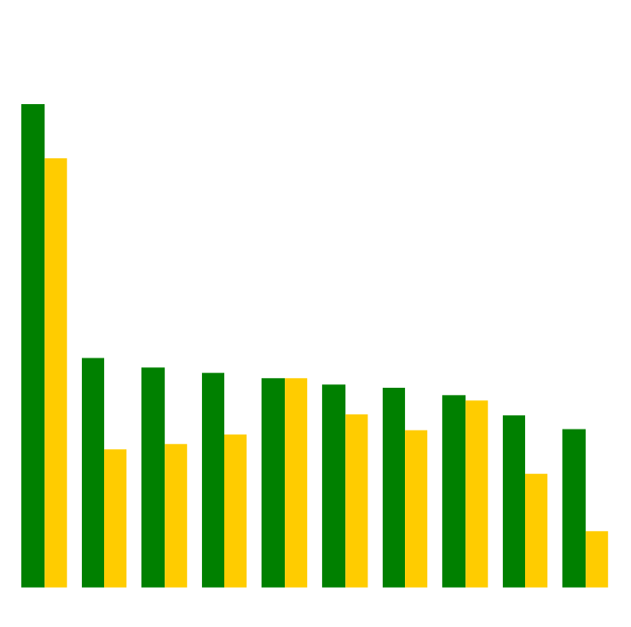
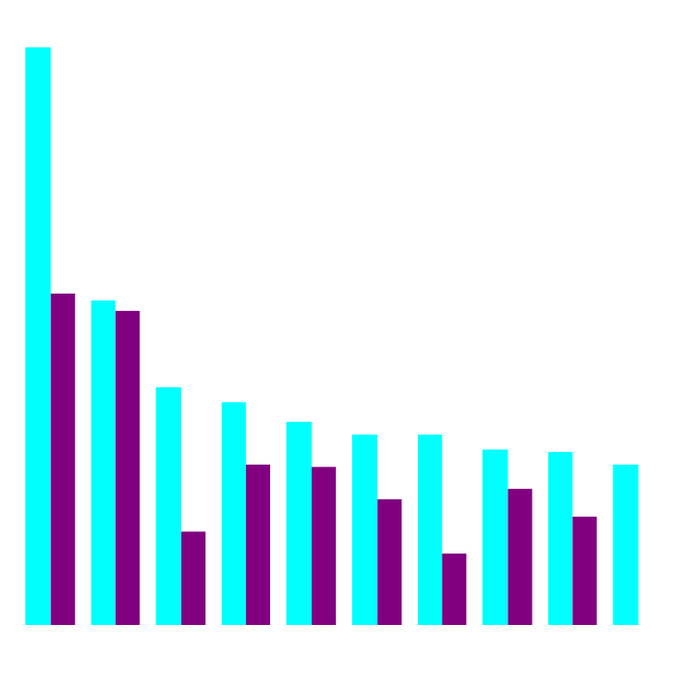
Enron’s Leading Market Position
Second Quarter 2000 vs Second Quarter 2001
(TBtue/d)
Gas Power
2Q01
2Q00
2Q01
2Q00
Notes:
<number>
<footer>
<header>
<date/time>

Slide 4
Enron North America Volumes (Bbtue/d)
Physical Gas
2000
2001
Financial Gas
2000
2001
Physical Power
2000
2001

Slide 5
Enron North America Gas Transactions Per Day
Non EOL
EOL
1997
1998
1999
2000
2001

Slide 6
Enron North America Power Transactions Per Day
Non EOL
EOL
1997
1998
1999
2000
2001

Slide 7
Enron North America EOL Counterparties
Gas
Power
1999
2000
2001
1999
2000
2001

Slide 8
Enron North America Commercial Headcount
2
54
109
81
111
357
3
48
98
101
120
370
9
56
139
155
113
472
8
44
104
103
174
433
Managing Directors
Vice Presidents
Directors
Managers
Analysts & Associates
TOTAL
1998 1999 2000 2001

Slide 9
Enron North America Net Assets
PRM $380
PP&E $1,494
Merchant Assets $655
Other Investments $587
Working Capital $218
Other ($2)
PRM ($322)
PP&E $489
Merchant Assets $399
Other Investments $1,248
Working Capital $866
Other $251
PRM $358
PP&E $626
Merchant Assets $0
Other Investments $695
Working Capital $91
Other $840
Gas Assets $285
PRM $922
PP&E $1,717
Merchant Assets $124
Other Investments $1,250
Working Capital ($1,745)
Other ($80)
PRM ($112)
PP&E $974
Merchant Assets $446
Other Investments $770
Working Capital $218
Other ($510)
Mariner $363
Sithe $910
Bridgeline $213
Excludes deferred taxes.

Slide 10
Summary of 2001 Asset Sales
Book Sales
Basis Proceeds Gain Multiple
Sale of 2000 Peakers to Allegheny* $635.5 $1,047.7 $412.2 1.65
Sale of Noram Rig (EnSir Co) $4.5 $4.5 $0.0 1.00
Sale of Brownsville and Caledonia to CINergy $274.3 $499.6 $225.3 1.82
Pastoria $48.4 $85.8 $37.4 1.77
Fountain Valley PSCO $0.0 $15.0 $15.0 -
Delta Turbines $0.0 $11.0 $11.0 -
Alamac/NCPH $7.5 $22.0 $14.5 2.93
SW Power (LVC) $120.1 $142.8 $22.7 1.19
HPL $364.2 $352.5 ($11.7) 0.97
Blue Dog Turbines - Northwestern $0.0 $9.2 $9.2 -
Sale of New Albany to Duke $136.1 $135.0 ($1.1) 0.99
FORECASTED SALES
Vitro Sale $26.0 $40.0 $14.0 1.54
Cornhusker $8.0 $23.6 $15.6 2.95
*includes $23 million for unwind of COMED capacity transaction.

