Slide 1
Enron North America
Notes:
<number>
<footer>
<header>
<date/time>

Slide 2
Enron North America EBIT
EGM and EIM transferred out 3Q 2000
Includes ($503M) of EES Wholesale 2001 YTD
Generated additional $780M in prudency

Slide 3
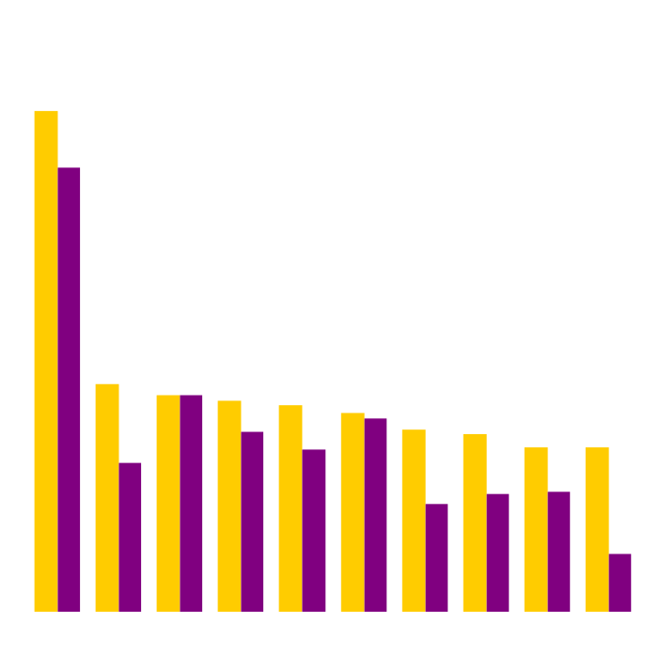
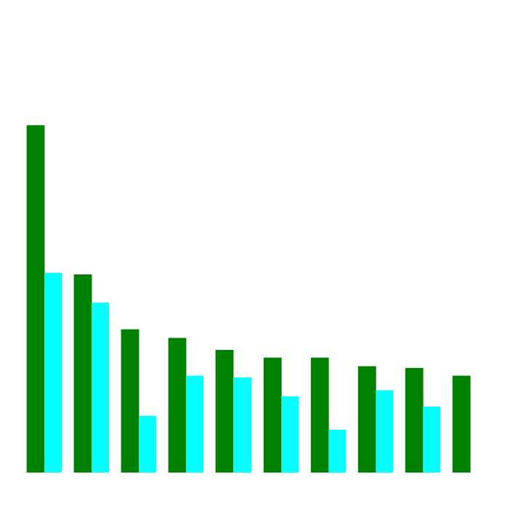
Enron’s Leading Market Position
Second Quarter 2000 vs Second Quarter 2001
(TBtue/d)
Gas Power
2Q01
2Q00
2Q01
2Q00
Notes:
<number>
<footer>
<header>
<date/time>

Slide 4
Enron North America Volumes (Bbtue/d)
Physical Gas
2000
2001
Financial Gas
2000
2001
Physical Power
2000
2001

Slide 5
Enron North America Gas Transactions Per Day
Non EOL
EOL
1997
1998
1999
2000
2001

Slide 6
Enron North America Power Transactions Per Day
Non EOL
EOL
1997
1998
1999
2000
2001

Slide 7
Enron North America EOL Counterparties
Gas
Power
1999
2000
2001
1999
2000
2001

Slide 8
Enron North America Commercial Headcount
2
54
109
81
111
357
3
48
98
101
120
370
9
56
139
155
113
472
8
41
104
103
174
433
Managing Directors
Vice Presidents
Directors
Managers
Analysts & Associates
TOTAL
1998 1999 2000 2001

Slide 9
Enron North America Assets
Property, Plant & Equipment
Merchant Assets
Other Investments
Sithe
Bridgeline
Mariner
HPL

Slide 10
Summary of 2001 Asset Sales
Book Sales
Basis Proceeds Gain Multiple
Sale of 2000 Peakers to Allegheny* $635.5 $1,047.7 $412.2 34
Sale of Noram Rig (EnSir Co) $4.5 $4.5 $0.0 -
Sale of Brownsville and Caledonia to CINergy $274.3 $499.6 $225.3 22
Pastoria $72.5 $112.9 $40.4 -
Fountain Valley PSCO $115.6 $130.6 $15.0 -
Delta Turbines $56.8 $67.8 $11.0 -
Alamac/NCPH $7.5 $22.0 $14.5 -
SW Power (LVC) $120.1 $142.8 $22.7 19
HPL $364.2 $364.2 $352.5 ($11.7) 5
Blue Dog Turbines - Northwestern $40.3 $49.5 $9.2 -
Sale of New Albany to Duke $136.1 $135.0 ($1.1) 11
FORECASTED SALES
Vitro Sale $25.5 $39.5 $14.0 -
Cornhusker $228.4 $244.0 $15.6 10
*includes $23 million for unwind of COMED capacity transaction.

