Slide 1

NAVIGATING THE
MANAGEMENT MINEFIELD
Kerry E Notestine

Slide 2
MANAGERS AND SUPERVISORS ARE TARGETS
Eyes and ears and voice of the Company -- the perceived “deep pocket”
Often managers are the first to know of issues/problems
Company’s duty to defend
Individual liability and responsibility

Slide 3
INTRODUCTION
NUMERICAL SIGNIFICANCE
  2,000% Increase In Number Of Cases
  100,000 Backlogged EEOC Charges
  Likelihood Of Litigation Has Increased (50.6% Of Employers Report Greater Likelihood Than 5 Years Ago).

Slide 4
INTRODUCTION
COMPLEXITY OF WORKPLACE RULES
  New Case Law
  Greater Awareness Of Individual Rights
  Growth Of The Plaintiffs’ Bar

Slide 5
INTRODUCTION
EMPLOYMENT LAW ISSUES TOUCH MANAGERS AND SUPERVISORS PERSONALLY
  Individual Liability Accompanies Employment Law Litigation
  Cost Of Defense Includes Loss Of Management Time
  Increased Standards Of Individual Awareness And Training

Slide 6
INTRODUCTION TO EEO LAW
Fairness and Consistency
C.O.U.C.H.
(Communicate, Objectively, Uniformly, Contemporaneously and Honestly)
No Good Deed Goes Unpunished

Slide 7
TITLE VII OF THE CIVIL RIGHTS ACT OF 1964
Who Is Protected?
National Origin
Race
Religion
Sex
Color

Slide 8
AGE DISCRIMINATION IN EMPLOYMENT ACT
Individuals Over the Age of Forty
No Upper Age Limit

Slide 9
OTHER FEDERAL EEO LAWS
Equal Pay Act
Civil Rights Act of 1866 and 1871
Executive Order 11246
The Rehabilitation Act
The Pregnancy Discrimination Act
The Immigration Reform and Control Act of 1986

Slide 10
TEXAS COMMISSION
ON HUMAN RIGHTS ACT
The TCHRA Prohibits Employers From Discriminating on the Basis of Race, Color, Disability, Religion, Sex, National Origin, and Age
Any Employer Engaging in an “Industry Affecting Commerce With Fifteen or More Employees for Each Working Day in Each of Twenty or More Calendar Weeks in the Current or Preceding Year and Any Agent of That Person.”

Slide 11
BASIC PRINCIPLES OF EQUAL EMPLOYMENT OPPORTUNITY
Equal treatment for equal qualifications, skills and abilities
Decisions based on valid business related reasons
Policies and rules enforced uniformly and consistently
Equal impact of neutral standards
Avoidance of stereotypes
Reasonable accommodation

Slide 12
KNOW INTERNAL POLICIES
Employee Handbook
Equal Employment Opportunity Policy
Harassment Policy
Family and Medical Leave Policy
Attendance and Punctuality
Disciplinary Action Policy
Substance Abuse Policy

Slide 13
SUPERVISORY “DO’S”
IMMEDIATELY Involve Human Resources And Investigate All Claims
Take Prompt And Effective Remedial Action
Recognize That Sexual Harassment Law Is Different
Policy Should Be “Hands Off”
Find Other Things To Talk About
Includes Other Categories, Such As Racial, Ethnic, Disability

Slide 14
SUPERVISORY “DONT’S”
Make Unwarranted Assumptions
Reach A Conclusion Before Conducting An Investigation
Delegate All Responsibility For Preventing Harassment

Slide 15
Supervisor’s Template:


7 Steps
for Dealing with the
Injured / Disabled Employee






Slide 16

CONSIDER
Workplace Safety Issues (OSHA)
OSHA
1

Slide 17

SAFETY ISSUES
Safety First!
If Work Related Injury, Review Causes
Eliminate Known Hazards
Recordkeeping
Required Reports

Slide 18
Step Two:
Determine FMLA Coverage
2

Slide 19
FMLA:
ELIGIBILITY REQUIREMENTS
Employee: Worked for 1 Year for Employer
Employee: Worked 1,250 Hrs. In Prior Year
Employee: Has “Serious Health Condition”

Slide 20
FMLA:
IF EMPLOYEE IS ELIGIBLE
Employer Duty: Begin Counting Immediately
Days May Be Double Counted As Both FMLA and As “Other” – Paid Sick Leave, Etc.

Slide 21
FMLA:
IF EMPLOYEE IS ELIGIBLE
Provide Forms
Consider Possible Challenges to Coverage
Get Ready for Intermittent Leave

Slide 22
Supervisor’s Template:


7 Steps
for Dealing with the
Injured / Disabled Employee





.

Slide 23
Step Three: Determine if the
Injury / Disability is Work Related

Slide 24

Relation to the Workplace
If Work Related, Provide Workers Comp. Forms
Notify Carrier or Claims Administrator
Denial of Relationship Between Injury and Workplace
Must Be Made Promptly

Slide 25
Supervisor’s Template:


7 Steps
for Dealing with the
Injured / Disabled Employee





.

Slide 26
Step Four:
Evaluate ADA Coverage

Slide 27
“DISABILITY” DEFINED
Physical or Mental Impairment That Substantially Limits One or More Major Life Activities
OR
A Record of a …
OR
Being Regarded As Having a ...

Slide 28
“QUALIFIED INDIVIDUAL WITH A DISABILITY”
An “Individual With a Disability” Who Can Perform the Essential Functions of the Job Held or Applied For, With or Without Reasonable Accommodation

Slide 29
TWO FUNDAMENTAL
OBLIGATIONS
Don’t Discriminate
Do Accommodate

Slide 30
Not Required of Employers
Transferring Another Person to Make Room for a Disabled Individual

Slide 31
Supervisor’s Template:


7 Steps
for Dealing with the
Injured / Disabled Employee






Slide 32
Step Five:
Ensure Appropriate Confidentiality

Slide 33
CONFIDENTIALITY
Securing Records
Limiting the Scope and Nature of Inquiries – Balance the Natural Tension Between ADA and FMLA Inquiries

Slide 34
Supervisor’s Template:


7 Steps
for Dealing with the
Injured / Disabled Employee





.

Slide 35
Step Six:
Evaluate Application of Employer Policies and Practices

Slide 36
EMPLOYER
POLICIES & PRACTICES
Employee Handbook
Past Practice
EMPLOYEE
HANDBOOK

Slide 37
Supervisor’s Template:


7 Steps
for Dealing with the
Injured / Disabled Employee





.

Slide 38
STEP SEVEN:
ONGOING MONITORING
AND FOLLOW UP

Slide 39
LATE STAGE ISSUES
Ongoing Monitoring of All Available Leaves
Keeping Employee Notified

Slide 40
LATE STAGE ISSUES
Making a Record of Accommodations Offered
and Suggested
Employee Does Not Return From FMLA Leave

Slide 41
EVALUATIONS, DISCIPLINE AND CORRECTIVE ACTION

Slide 42
EVALUATION: A POWERFUL TOOL
Do it regularly.
Be objective.
Be consistent.
Focus on factors important to job.
Review with employee.

Slide 43

EFFECTIVE EVALUATIONS
Evaluate the performance, not the person.
Avoid grade inflation.
Do evaluations which are:
  Timely
  Honest
  Correlate with employee’s job

Slide 44
EFFECTIVE EVALUATIONS
Document facts, not conclusions.
Use active voice: You failed to complete your projections---NOT The projections were not completed. (Assign responsibility to the employee.)
Avoid unsupported judgments.

Slide 45
EFFECTIVE EVALUATIONS
Avoid unreferenced judgments.
Avoid unsupportable judgments.
Avoid making excuses for employee.
Avoid directions which fail to direct.

Slide 46
EFFECTIVE EVALUATIONS
Cover the entire evaluation period.
Allow employee to explain disagreement, but don’t negotiate evaluation.
Consider narratives rather than checklists.

Slide 47
THE POOR PERFORMER:
TWO APPROACHES
Clearly communicate expectations, with ongoing monitoring of performance so employee may improve and correct deficiency.
Create a written record to support decision to terminate employee who does not contribute.

Slide 48
CORRECTIVE ACTION PLAN
State clear goals.
Let employee participate in goals.
Let employee know how falling short.
Let employee know how performance will be measured.

Slide 49
CORRECTIVE ACTION PLAN
Build in timetables.
Focus on training
Let employee know consequences if he does not meet expectations.
Get employee’s commitment in writing
Follow up

Slide 50
DOCUMENTATION OF MISCONDUCT
Document
what you...
WHO (witnesses, supervisors)
WHEN
WHAT
WHY NOT?
saw
heard
smelled
touched

Slide 51
INVESTIGATE FIRST
Investigate incidents promptly.
Interview all potential witnesses.
Review documentary evidence.
Always notify employee of charges and give employee an opportunity to respond before taking action.

Slide 52
DISCIPLINE SHORT OF TERMINATION
Oral counseling
Written warning
Suspension
Demotion
Probation
  may create a contract for that period of time

Slide 53
LEGAL CHALLENGES TO EMPLOYMENT TERMINATION

Slide 54
CHALLENGES TO TERMINATION
Workers’ Compensation
(TEX. LAB. CODE § 45.0014)
Jury Service
(TEX. CIV. PRAC. & REM. CODE § 122.001(a) )
Child Support or Custody Order
(TEX. FAM. CODE § 158.209)
EEOC, TCHR
State or federal court litigation

Slide 55
DISCHARGE: LEGAL STANDARD
Presumption: employment is at-will unless there is a written or oral agreement to continue for a specified time period.
Substantial exceptions to the general rule

Slide 56
EXCEPTIONS TO AT-WILL PRESUMPTION
Public Policy
  Sabine Pilot
  Whistleblower (TEX. GOV’T CODE § 554.001-009)
Statute
No Implied Covenant of Good Faith and Fair Dealing in Texas
  Avoidance of pension benefits

Slide 57
WRONGFUL TERMINATION LAWSUITS
ARE WON BEFORE THE TERMINATION
Be at-will
Control hiring

Slide 58
BEFORE TERMINATION
Take reviews seriously
Never put anything in writing you don’t want the jury to see
Investigate before terminating
Discipline without delay
Avoid “bruising” the employee’s ego
Consider alternatives to termination

Slide 59
BEFORE TERMINATION
Carefully draft the termination letter
Secure HR approval
Be aware of legal developments
Do not be afraid of preventative legal advice
  Review terminations involving employees with long service, on-the-job injuries or who are in a protected class

Slide 60
TERMINATION PROCESSING

Slide 61
THE TERMINATION MEETING
Choosing the location
Identifying the participants
Avoid antagonizing, causing hostility
Don’t forget the purpose of the meeting
Do not touch or physically restrain
Be careful in advising others

Slide 62
TERMINATION PROCESSING
Informing employee of reason for termination (oral? written?)
Informing other employees (?)
Exit interviews
Resignation letters
Severance pay, release of claims
Request for reference letter

Slide 63
TERMINATION PROCESSING
Payment for accrued but unused vacation only if policy
COBRA
Return of company property
Deductions from final paycheck
  Wage and Hour
  Texas Payday Law
Security measures -- computer passwords, locks, etc.

Slide 64
JOB REFERENCES
Risk: defamation
Benefit: may be able to obtain information from other employers
Follow company policy
Centralize communications: only one person responds to requests for references

Slide 65
QUESTIONS
ANSWERS

Slide 66
BREAK

Slide 67
VIDEO PRESENTATION
Litigation
Landmines

Slide 68


Slide 69

WHY DO I NEED THIS TRAINING?
Sexual
Harassment
Training

Slide 70
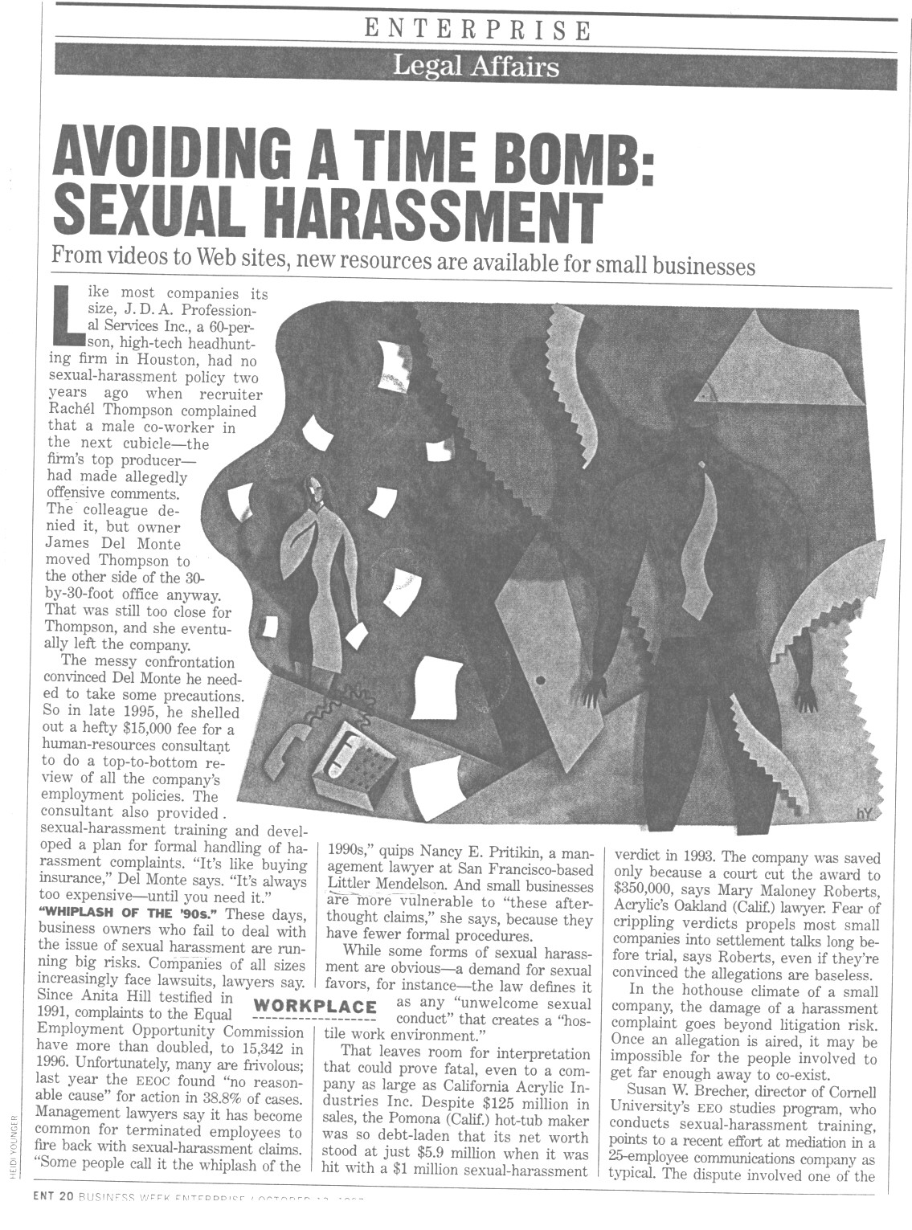

Slide 71
CONSEQUENCES OF POLICY VIOLATIONS:
1. Financial -- for you and the Company
2. Personal -- ruined reputations and marriages
3. Career -- loss of job or position; damage to
work relationships

Slide 72
STERLING’S HARASSMENT POLICY
Prohibited Activities
Harassment
Policy
Quid Pro Quo
Hostile Environment
Complaint
Investigation
Corrective Action

Slide 73

All Harassment is Prohibited
Including:
Sexual
Religion
Age
  Racial
Disability
Color
Citizenship
Veterans Status
National Origin

Slide 74
TODAY’S WORKPLACE

Slide 75
WHAT IS
SEXUAL HARASSMENT????

Slide 76







Who Can Harass?
Employees
Temps
Contractors
Customers
Vendors
Others

Slide 77
QUID PRO QUO
(or this for that)

Slide 78

Quid Pro Quo: Acceptance
Linked to promise of benefit
“Sleep with me and I’ll
see that you get that raise”
Results in actual benefits

Slide 79
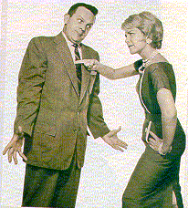
Quid Pro Quo: Rejection
Linked to threat
of negative employment
action
“If you’re not good to me,
I can stand in the way
of that promotion”
Results in actual adverse
employment action
  termination
  denial of promotion
  poor review

Slide 80
Hostile Environment

Slide 81
Conduct Based On Sex, Race, Age, etc.
Conduct Must Be Severe And Pervade Working Environment
Conduct Must Be Offensive To Reasonable Person

Slide 82
Crude Behavior
May Not Violate the Law
Does Violate Company Policy
Policy
Crude

Slide 83
95% Claims Based
On Men Harassing
Women

Slide 84
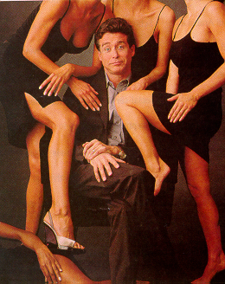
FEW CLAIMS BASED ON
WOMEN HARASSING MEN

Slide 85
Oncale v. Sundowner Offshore Services --March 1998
(recognized same sex harassment)

Slide 86
Few Claims By Men
Against Women, BUT:
Dominos Pizza Case
Cost to Company: approx: $500,000
Male employee sued, claiming his female boss
sexually harassed him by:
Rubbing his back and neck
Placing her arms around his waist
Squeezing his body
Complimenting his body
Stating that he “turned her on”
Stating that she wanted to have a relationship
Expressing her love for him
Offering to care for him and his son
Inviting him to move in with her
Informing him of her underwear slipping and inquiring whether this
revelation “turned him on.”

Slide 87
$200,000.00

Slide 88
Cases:
Walmart -- $50,000,000.00
Repeated Comments About Breasts And
Other Body Parts
Better Treatment of Male Employees
Boss Intoxicated
Hostile And Abusive
Language
Complaint Met With
Offer Of Demotion

Slide 89
Cases:
Pipeline Case: $300,000.00
Over 10 Year Period Of Time
Joke About Mastectomy
Grabbed Elbow
Compared To Vessel Of Holy Water
Statement About Keeping Boss
Satisfied
Yelled And Touched During
Disagreement
Different Co-Worker Referred To
Women In Derogatory Terms
Three Stooges Antic

Slide 90
Cases:
Ross v. Double Diamond: $20,000
Worked Only 2 Days
Asked Whether She “Fooled Around”
Asked If She Would Pant Heavily
Asked To Pull Up Her Dress For A
Photo
Trapped Her On Lap And
Against Door

Slide 91
Other Cases:
$21,000,000 Against Doctor
$15,000,000 Against Smith Barney
$300,000 Against Car Dealership
$7,000,000 Against Law Firm

Slide 92

Sterling’s Rules On Harassment

Slide 93
1. NO TRASH TALK OR INSENSITIVE COMMENTS
No Profanity
No Dirty, Ethnic, or Racial Jokes or Innuendoes
No Demeaning Descriptions of Men and Women
No Sexist Words (baby, chick, girls, stud, hunk, broads, sweetie, Suzies, darling)
No Stereotyping
No Imitating Accents
No Jokes About Religion, National Origin, Disability,
Or Age

Slide 94
Percentage of Americans who think that calling someone “honey” or “babe” at work is offensive: 68
WE REALLY HATE THE ONE ABOUT THE GIRAFFE AND THE BLONDE
Percentage of people who are offended by dirty jokes at work: 77

Slide 95
2. DO NOT TOUCH CO-WORKERS!!
No Massages/Rubbing
No Hugs/Kisses
No Horseplay
No Backing Fellow Employees Into
Corners Or Walls
No Grabbing Of Any Body Parts
No Touching Of Co-Workers’ Clothes

Slide 96
3. NO SEXUAL COMMENTS
No Discussion Of Body Parts
No Discussion Of Sex Lives
No Raunchy Or Suggestive Email
No Discussion of Playboy,
Playgirl, Viagra

Slide 97
4. NO REQUESTS FOR SEXUAL FAVORS
No Requests For Dates (with few exceptions)
Work Standards Apply to Socializing
with Co-Workers (with few exceptions)
No Invitations To Hotel Room (no exceptions)
No Requests For Sex -- explicit or implicit
No Requests For Hugs, Kisses, Or Massages
No Lingering and Longful Looks

Slide 98
5. NO SUGGESTIVE PICTURES OR BEHAVIOR!
No Calendars, Cards, Or Posters Of Partially Clad Or Nude Men Or Women
No Sales Meetings at Strip Clubs
No Sex Toys
No Offensive Cartoons
No Wolf Calls Or Whistles
No Sexual Or Obscene Gestures
No Display Of Body Parts
No Suggestive Email, Web Sites, Screen Savers

Slide 99
DRESS AND BEHAVE
PROFESSIONALLY
NOTHING DISTRACTING!
Don’t Fish This Way!
Don’t Take the Bait!

Slide 100
STERLING’S HARASSMENT POLICY
Employee Responsibility
Company Commitment
Harassment
Policy
Quid Pro Quo
Hostile Environment
Complaint
Investigation
Corrective Action

Slide 101
RULE: Take Responsibility
SPEAK UP!
LET OTHERS KNOW WHEN YOU FIND
CONDUCT OFFENSIVE!
REPORT ANY POSSIBLE VIOLATION
OF HARASSMENT POLICY TO
SUPERVISOR OR HUMAN RESOURCES
DISCONTINUE OBJECTIONABLE
BEHAVIOR

Slide 102
Prompt Corrective Action --
It’s The Law

Slide 103
COMPANY’S COMMITMENT:
1. To investigate promptly each report of policy
violations.
2. To keep the report and investigation
confidential to the extent
possible without impairing
investigation.
3. To take prompt and corrective
action if policy violation is found.
4. No retaliation.
It is your duty to report any
violations of the harassment
policy!

Slide 104
PROHIBITED HARASSMENT:
Unique Role of the Supervisor
Notes:
Supervisors play a crucial role in the prevention and handling of sexual harassment complaints. They can be the company's best asset in the prevention of sexual harassment or the company's greatest liability if they engage in sexually harassing behavior themselves or fail to take action to stop sexual harassment in their work group.

Slide 105
Supervisors: If someone makes a complaint
Ensure confidentiality
No such thing as "off the record”
Take notes
Notes:
Supervisors must: (1) insure confidentiality; (2) treat everything as "on the record;" (3) take notes . . .
[Continue on next slide] . . .

Slide 106
Supervisors: If someone makes a complaint
Review policy
Ask, "Is there anything else?
Ask for confidentiality
Report to human resources
Notes:
. . . [Continued from previous slide.]
(4) review ABC's policies; (5) ask: "is there anything else?;" (6) ask for confidentiality; and (7) report to Human Resources.
Be thorough and objective -- explain to all persons involved in the investigation that it is confidential and failure to maintain confidentiality is a serious violation of ABC's policy. With regard to explaining that there is no such thing as "off the record," ABC is obligated under the law to maintain a workplace free of sexual harassment and take prompt remedial action to stop harassment, so supervisors cannot fail to take action based on a worker's request. Remember, Human Resources can be your best asset.

Slide 107
Supervisors Who Witness Harassment
Change the subject
Take persons aside and speak to them privately & individually
Review policy
Provide suggestions
Report to human resources
Notes:
Supervisors who witness sexual harassment must: (1) change the subject to avoid further discussion or conduct involving inappropriate sexual content; (2) speak to the offending person privately, outside of the presence of the group; (3) review ABC's sexual harassment policies and the employee's obligations under the policy; (4) provide suggestions to avoid continued inappropriate comments/conduct; and (5) report the incident to Human Resources for an assessment of the need for additional investigation and/or discipline of the harasser.

Slide 108
WORKPLACE ROMANCE
Presents difficult legal and practical issues
Is difficult to regulate by
rule or policy
Notes:
The topic of workplace romance is extremely difficult and often very sensitive.
Workplace romance presents difficult legal and practical issues.
Moreover, it is difficult to regulate by rule or policy.
[Continue on next slide] . . .

Slide 109
WORKPLACE ROMANCE
Potential for emotional hurt present in any romantic relationship is magnified by potential for legal hurt as well
Notes:
Many, if not all, adults have had challenging romantic relationships in their lives. These relationships are frequently complicated and can involve the full range of human emotions. A romantic relationship, by itself, can be very challenging and draining, and even stressful. However, when a romantic relationship occurs in the workplace, the degree of complexity is greatly magnified. The work relationships in place can be impacted by the romantic relationship, and vice versa.
If the relationship ends in a break-up, in addition to the emotional pain suffered by the participants, there may be legal implications as well for the organization.

Slide 110
WORKPLACE ROMANCE
Legal Issues
Quid Pro Quo harassment
If a manager or supervisor is involved in a relationship with
a subordinate employee,
if the relationship terminates,
later it may be characterized as “unwelcome”
Notes:
Supervisors act to bind the company. When a supervisor acts, it is as though the company itself is acting.
Though a relationship may be "consensual" at first, if it goes sour, it will be very easy for the subordinate worker to claim that the relationship was "coerced" all along.
Supervisors who date subordinate workers are playing with fire.

Slide 111
WORKPLACE ROMANCE
Legal Issues
Hostile Environment harassment
If a relationship terminates,
later it may be characterized as “unwelcome”
Notes:
One of the keys to a claim of prohibited harassment is that the conduct complained of was unwelcome. In a romantic relationship, typically both parties welcome the relationship, and therefore welcome conduct that otherwise might constitute prohibited harassment (private hugging, kissing, etc.)
If the relationship ends in a break up, it becomes quite easy for one party to claim that the conduct really was not welcome, but that he or she "went along with it" in order to preserve his or her job. Workplace romance is very, very high-risk behavior.

Slide 112
WORKPLACE ROMANCE
Practical Issues
Impact on other employees
Many believe employee in the relationship gets extra job benefits because of relationship
Notes:
Workplace romance presents very difficult issues for all persons who are close to the relationship, not just for the participants. For example, if a supervisor is dating a subordinate employee, and the subordinate employee gets an extra job benefit -- an upgraded computer, a nicer desk, or a promotion, then other employees might believe that the only reason that the extra benefit was received was because the employee is dating the boss.

Slide 113
WORKPLACE ROMANCE
Practical Issues
Impact on other employees
or they may believe
they’re suffering
because they
are not in the
relationship
Notes:
On the other hand, if the employee not in the relationship suffers some job detriment -- an unfavorable assignment, a requirement of weekend work, etc., that employee might believe that he or she is suffering on the job because he or she is not dating the boss.

Slide 114
WORKPLACE ROMANCE
A Friendly Suggestion
Find someplace
other than work
to start a
romantic relationship
Notes:
While individuals may respond with "none of your business" when provided with suggestions on romance, this suggestion is intended to communicate, in as positive a manner as possible, that the risks associated with workplace romance are so significant that most persons probably would be better off if they looked elsewhere for romance.

Slide 115
CO-WORKER WORKPLACE ROMANCE
Tell the co-workers to remain professional at work
Call HR or Personnel
Notes:
Here are some SUGGESTIONS for addressing this most difficult issue. No single approach will work best in all different situations.
In general, if the conduct at issue is not prohibited by ABC policy, supervisors can ignore it unless it interferes with work performance. Note that some state laws prohibit anti-fraternization policies.
If the relationship (or talk by others about the relationship) is interfering with work performance, supervisors certainly can tell the workers to remain professional at work.
Call HR or Personnel. This is good advice in all situations involving supervision of romantically involved co-workers. HR may be able to bring a new perspective or provide guidance on how similar situations have been addressed in the past.

Slide 116
GAME TIME

