Slide 1

エンロン ジャパン
www.enron.co.jp
Tokyo
平成21年9月

Slide 2
Why Build an “Interactive” Enron Japan Website?
Establish means to communicate ideas, concepts and commercial products to as broad a “customer” base as possible
Feed a market generally starved of unbiased information
Prioritize customers interested in new products and solutions
Provide a painless way to talk with Enron
First Market Entry Opportunity for Enron to use the power of the “net”

Slide 3
Target Audience
Large industrials, commercials and industry groups
Utilities/ Trading Houses
Financial institutions
Government and Academics
Press
Investors
Potential Employees

Slide 4
How to Get Target Audience to Site and Keep Them Coming Back
How to get them there
  Press Release
  Links
  Word of mouth
  Direct Mailing
How to keep them coming back
  Must offer tangible benefits to the client
  Must be fast and easy to navigate through
  First page must capture both new visitors and repeat visitors
  Must regularly provide fresh content
  Japanese language essential
  Keep clients appraised of new site additions/ information via:
    email
    I-mode technology (mobile)
    Direct mailing
    Printed Media and online advertising

Slide 5
Content “Requirements”
Ready source of new content crucial
  Current/ future developments in Japan and other similar markets
  Enron white papers, speeches etc
  Academics reports
  Enron press releases
  News: weather, energy, economic, breaking
Means to establish commercial relationship and foundation for deal flows (but at Enron’s pace)
Need consistency of message without undue editorial influence
Site must look and feel Japanese

Slide 6
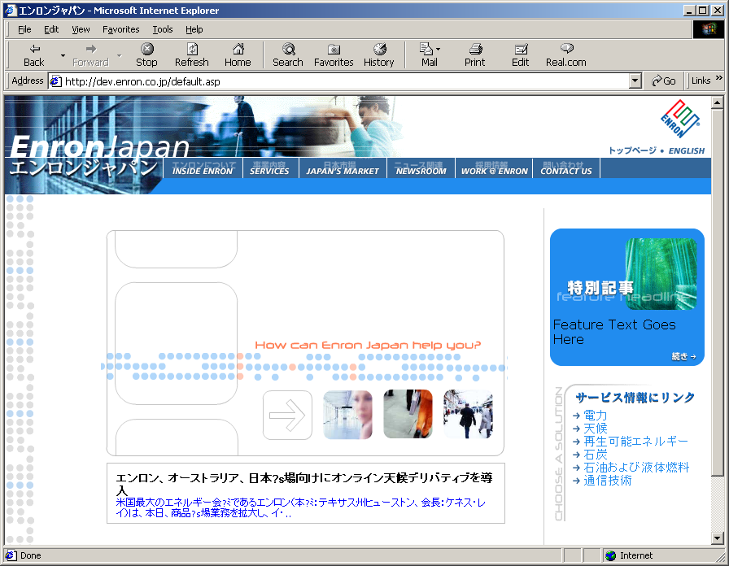
www.enron.co.jp

Slide 7
Site Map (Top Level)

Slide 8
Proposed Future Content
October
  Event
    Introductory Issue
  Headline
    California deregulation
  Articles
    Benefits of liberalization
    Participation by new entrants
November
  Event
  Headline
    What can learn from Japan’s telecom deregulation?
  Articles
    EPS Agreement – contracting with Enron
    Introduction to energy risk management
      Reduced earnings fluctuations
      Greater coverage ratios
      Lower cost of capital
      Better management control and oversight
    Metering interim proposals

Slide 9
Proposed Future Content
December
  Event
    Government finalizing reports on deregulation #2
  Headline
    Utility Tactics with deregulation
      Sell long term contracts
      Subtle pressure against using new entrants
      Reliability
  Articles
    Enron’s preferred electricity system structure
    Asset utilization and rate base
January
  Event
    Electricity and gas tariffs released
  Headline
  Articles
    Access to information - Information supporting tariffs
    Introduction to gas debate
      Show costs of gas molecule traveling from source to final customer
      Lower cost of generation access to LNG terminals

Slide 10
Proposed Future Content
February
  Event
    Comments submitted on tariffs
  Headline
    Related to tariff analysis
  Articles
    Tariff analysis
      Break down components
      Excess capacity
    Introduction to e-commerce debate
March
  Event
  Headline
    Related to progress with electricity competition
  Articles
    Continuation of gas debate
    Continuation of e-commerce debate

Slide 11
What are Your Global Competitors Paying for their Electricity?
(Financial Benefits Calculator)
Table driven calculator
  gives user an opportunity to determine potential benefits that could be achieved through lower prices
  allows user to compare domestic prices with prices paid by their global competitors
Questions (Simple form with check offs)
  How much do you pay for your power?
  How much power do you consume?
  Country of comparison:
    Domestic utility areas, North America, Europe, and other regions
  Table shows differences from current price paid in Japan to other selected region
    EJ uses past yearly average prices for industrials and commercials in comparison areas
Additional contact information is collected as well as links to Price Requester

Slide 12
Financial Benefits Calculator
An Internet-based interface for customers
to compare their Electrical Energy Costs with
those of end-users in other world markets.
What Determines Electrical Energy Costs?
Peak Load (MW)
Load Profile, i.e., usage throughout the billing period
Energy Usage (MWh)
Service Type, i.e., voltage level, interruptible, cogen, etc
Other factors such as power factor, past usage, etc
Rate Structures in service area
Notes:
Enron has the capability to work with customers to help them analyze energy costs and identify methods to better manage these costs. The Financial Benefits Calculator is a web-based demonstration of comparing locale User Electrical Energy Cost with that of other world regions. It uses a simple graphical user interface and incorporates normalized data to estimate as closely as possible what a user could pay if their business was located elsewhere.
A user needs to understand what determines Electrical Energy Cost. Rates are typically applicable to all qualified users in a service area and depending on sophistication of the measurement technique, cost is determined by Peak Load, the distribution of the load throughout the billing period (Load Profile), Energy Usage as well as non-numeric options such as voltage level, etc.

Slide 13
Financial Benefits Calculator
Description of method of comparison:
Via the web interface, the user provides the following:
Electrical Energy Usage (MWh)
Electrical Energy Cost
Where their business operates
Select from a list the closest description of their Business Type,
either by SIC Code descriptor or by facility type
Select from a list the geographic region for Comparative rates
The Financial Benefits Calculator then determines:
Monthly Electrical Energy Usage, if the user entered an annual total
Monthly Electrical Energy Cost, if the user entered an annual total
Charts of Monthly Electrical Energy Usage and Costs for Japan
and region that user wishes to compare with
Notes:
It would be onerous to expect users to replicate their exact determinants of their electrical rate. Also, similar service types may not be exactly equivalent in the Regions of Comparison.
Therefore, using reasonable Estimates of Bundled Rates, the user is expected to only enter their Usage, Cost, Business locale, Business Type and what Region they wish to compare with.
The Financial Benefits Calculator would identify a load profile based on the user Business Type and locale. Also, it would select a Estimated Bundled Rate on the basis of Business Type and region of comparison. It then applies the Load Profile and Bundled Rates to the Usage to calculate Monthly Cost.
The resultant calculated Monthly Cost is charted against the Cost that the user provided. Monthly Usage is also charted to indicate the Load Profile.

Slide 14
Financial Benefits Calculator
Method of Comparing Electrical Energy Costs
Distributing Annual Electrical Energy to Monthly based on Usage
User Inputs
MWh
Business Type
Region of Comparison
Cost
DB
Distribute Annual
Usage and Cost
to Monthly Using
Load Profile
Coefficients
MWh, Business Type,
Region of Comparison
Load Profile Coefficients
Monthly Cost and Usage
Notes:
Method of Comparing Electrical Energy Costs:
The User has the luxury of entering a single number representing the sum total of Usage and Cost. To provide month-by-month comparison of their Monthly Cost versus the Cost for operating a similar business in another Region of Comparison, theses single Annual numbers need to be distributed intra-year.
Using the Usage(Expressed in MWh), Business Type and Region of Comparison, select the Load Profile Coefficients from the Database. This set of 12 Coefficients is then used to distribute the Annual Usage and Cost numbers to derive Monthly numbers.

Slide 15
Financial Benefits Calculator
Method of Comparing Electrical Energy Costs
Lookup Estimated Bundled Rates and Calculate Monthly Cost
Estimated Bundled Yen/MWh rates
based on:
MWh range
Business Type
Region of Comparison
User Inputs
DB
MWh
Business Type
Region of Comparison
Obtain Bundled Rates
by selecting from
available Estimated
Bundled Rates
MWh, Business Type,
Region of Comparison
Bundled Rates
From Previous Step
Bundled Rates
Multiply Bundled
Rates by
Monthly Usage
Monthly Usage
Monthly Cost for
Region of Comparison
Notes:
Method of Comparing Electrical Energy Costs:
Now that the Annual Usage has been distributed to Monthly Usage, we now need to obtain the Estimated Bundled Rate for each month. Estimated Bundled Rates are normalized on the basis of MWh range of operation, Business Type, and Region of Comparison. This is because high MWh numbers qualify end-users for different rate structures than lower MWh numbers. Also, different Business Types and Regions would produce different distributions of Usage and therefore cost, especially when considering Time-Of-Use rates.
The Estimated Bundled Rates (Expressed in Currency/MWh), is then multiplied by Monthly Usage numbers to result in the Monthly Cost for Region of Comparison. This result is an estimate of what it would cost to operate that business in the selected Region of Comparison.

Slide 16
Financial Benefits Calculator
Output: Charts of Monthly Electrical Energy
Usage and Costs
User Inputs
MWh
Business Type
Region of Comparison
Cost
Financial
Benefits
Calculator
(Sample theoretical data shown)
Notes:
This is a summary of the previous slides. The User has 4 inputs to provide which is then used to compare their Costs with those of the selected Region of Comparison. Two charts are produced: one comparing costs, the other showing the distribution of annual Usage to Monthly.

Slide 17
Can You Choose Your Electricity Supplier?
Series of questions that will allow user to determine if they are able to purchase electricity from suppliers other than their traditional utility
  If sufficient information provided that could verify that they are connected to the high voltage grid and consume at least 2Mw per hour then banner indicates that they are contestable and asks if they would they like more information on what their options are
Additional links to EJ pages on benefits of deregulation, benefits calculator, and price requester, etc
If not contestable, but would like to reap benefits then explain means to contact officials
  Consider electronic “postcard”

Slide 18
What are the Benefits of Energy Market Deregulation?
Introductory paper discussing the benefits of deregulation
Discuss
  Lower prices
  Improved reliability and service
  Allocation of scarce resources
Counter reliability and unemployment issues
International and domestic examples
Feature Californian discussion

Slide 19
How Can You Participate in the New Electricity Market?
Discussion on opportunities for new entrants participating in the new market
  Types of businesses that can participate
  Licensing requirements to participate in the new market
  Means to further ask questions to Enron particularly if believe have received disinformation
Illustrate basic statistics on Japanese electricity market
  Also cover other energy markets including gas, coal, crude, etc
  Could also provide alerts if chance for further costs to be passed onto end customer e.g. fuel escalators, JCC, etc

Slide 20
How Can Enron Japan Help You?
Form driven request that allows user to indicate whether they are interested in buying or selling electricity, or other commodities to or from Enron Japan
  User inputs volumes, term and any special characteristics associated with the sale of purchase of electricity
  User also inputs bid/offer indication on where they are interested in transacting
  Can request based on particular bid/offer detected in the market
Will collect customer profile
EJ trader receives information and responds as appropriate
  Not contemplated that prices would be provided in real time
  EJ trader to contact with indicative proposal via email, fax or phone
  Possible follow up meeting set up if request particularly complex or it seems customer is frequently at site trying numerous combinations

Slide 21
Structural Considerations

Slide 22
Implementation Schedule
Schedule and Milestones
  Inception Document: June 12
  Functional Requirements and Web Page Layout: July 25
  Content and Web Page Development: August and September
  User Acceptance Testing: Early October
  Soft launch (internal + selected clients): Mid October
  Go-live date: End of October

Slide 23
Website Development Team
Web Page Development
  Developers from Houston, London, and Sydney
Content
  Members of Enron Japan Regulatory/Public Affairs Team
  Trading Team
  Human Resources
Creative Design
  Renaissance Multimedia – Japanese web design firm
Translation
  Outside firm
Web Hosting
  Enron Europe

Slide 24
Future Development Considerations
Use a content management tool
Statistics collection and analysis
Acceptance of cookie use
Firewall issues
Need for local Japanese news
Need for local hosting in Japan
Online and printed media advertisements
Expansion into non-imode wireless internet services (EZ Web and J-Sky)

