Slide 1
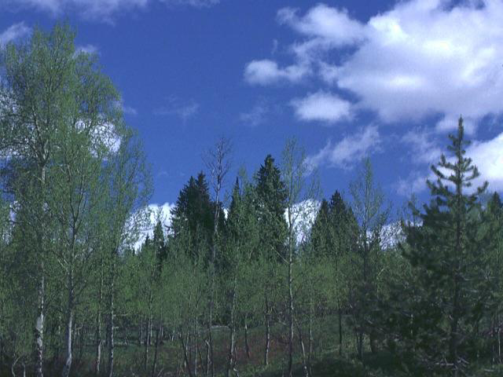


Pulp
Price Risk Management
®
...Endless Possibilities
-<number>-
-1-

Slide 2
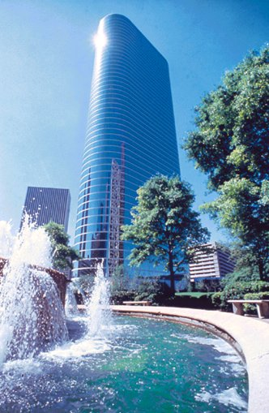
Enron North America
$55 Billion in Sales
  - Ranked #18, Fortune 500, April 2000
$33 Billion in Assets
Largest Natural Gas Marketer in North America
Largest Electricity Marketer in North America
Largest Marketer of Newsprint & Paper Risk Management Products in North America

Slide 3
EIM Asset Ownership(
Garden State Paper
Purchased 3rd Q 2000
Located in northern New Jersey
200,000 tpy newsprint production
300,000 tpy ONP consumption
Papiers Stadacona
(formerly Daishowa’s Quebec City Mill)
Purchased 1st Q 2001
Located in Quebec City, Canada
Production:
    387,000 tpy newsprint
    83,000 tpy directory
    45,000 tpy paperboard
Seventh largest producer of newsprint in North America

Slide 4

®
Enron’s Pulp & Paper Business
-<number>-

Slide 5
Enron’s Pulp & Paper Business
Transaction Counts
Yearly
Cumulative

Slide 6
Enron Contract Volumes to Date
(Metric Tonnes) by Grade
6.7 Million
Newsprint
Recovered Papers
6.1
Million
All Pulps
3.9
Million
4.4
Million
Packaging
.6
Million
LWC
.009
Million
White Paper
Cumulative Volume by Enron 22 Million Metric Tonnes

Slide 7
Enron’s Pulp & Paper Business
Cumulative Notional Trade Values

Slide 8
®
Pulp Price Volatility
-<number>-

Slide 9
Historical Ten Year RISI – NBSK & NBHK
Delivered - U.S.

Slide 10
Risk Management Objective
The ultimate goal of a risk-hedging strategy is the elimination of volatility in business performance
Hedging contracts allow companies to offset the risk of fluctuating prices as they purchase physical paper from suppliers of choice
A more stable performance will better enable management to provide the capital and other resources necessary to sustain the growth and the future earnings of the company

Slide 11
®
Pulp Price Risk Management
-<number>-

Slide 12
Basic Risk Management Tools
1. Financial Fixed
Price Swap
Fixed Price
Cap
Your Price
2. Financial Collar
Your Price
Floor
Cap
Your Price
* Financial Cap
Premium
Your Price
* Financial Floor
Premium
Floor
Your Price

Slide 13
Financial Paper Price Hedge
Fixed Price With Enron
Pulp Mill
Fixed
Floating
Pulp
Floating
Market
Price
Pulp consumer

Slide 14
Financial Pulp Price Hedge
Exchange of Cash Flow
Market Price = $580
Fixed Price = $570
Pulp Mill
$570
Fixed Price
Market Price
$580
Pulp
Market
Price
Net Cash Flow: Result
  Producer pays $10 to Enron to bring market price to agreed fixed pricing
Assumptions:
  Market Price (RISI) is $580 per ton
  Prices are for illustrative purposes only
$580
Pulp consumer

Slide 15
Financial Pulp Price Hedge
Exchange of Cash Flow
Market Price = $560
Fixed Price = $570
Pulp Mill
$570
Fixed Price
Market Price
$560
Market
Price
Net Cash Flow: Result
  Enron pays $10 to producer to bring market price to agreed pricing
Assumptions:
  Market Price (RISI) is $560 per ton
  Prices are for illustrative purposes only
Pulp
$560
Pulp Consumer

Slide 16
Financial Fixed Price Swap
Cash Flow Examples
Example:
Financial Fixed $
RISI
Payment to (from) Producer
Consumer pays Pulp supplier(s)
5% Discount
Physical Price
A
$ 560
$ 580
$ (-20)
$ 580
$ 52
$ 528
B
$ 560
$ 520
($+40)
$ 520
$ 47
$ 473
C
$ 560
$ 500
($+60)
$ 500
$ 45
$ 455
Financial
(with Enron)
Physical
(w/ current supplier)
Net Financial / Physical Price
$ 508
$ 513
$ 515

Slide 17
North America Indices Available
(This is not all, but indicative of the major applicable indices. If there is an
index, we can do a swap)
RISI Std. No. 4 83-85 Brt Xerographic
RISI 50 Lb. Offset
PPW 50 Lb. Offset
RISI 20 Lb. Formbond
RISI Coated No. 1 80 Lb. Sheets
RISI Coated No. 3 60 Lb. Rolls
RISI Coated Groundwood No. 4 50 Lb.
RISI Coated No. 5 34 Lb. Roll
RISI Coated No. 5 40 Lb.
PPW Coated No. 5 40 Lb.
RISI 35 Lb. SC-A Offset
PPW SC-B
22.5 LB. White Directory
RISI NBSK, NBHK, SBSK, Fluff BEK, Deinked delivered to US or Europe
RISI East 42 Lb. Linerboard & 26 Lb. Semichemical Medium, PPW East and West 42 Lb. Linerboard & 26 Lb. Semichemical Medium
PPW Mottled White
PPW 16 Pt. Folding carton (SBS)
RISI 15 Pt. Clay Ctd Bleached Folding (SBS)
PPW 20 Pt. Clay Coated News
RISI 20 Pt. Clay Coated Recycled folding
OBM-all points OCC, ONP, mixed paper
RISI OCC, ONP, mixed paper
PPW-all points OCC, ONP, mixed paper

Slide 18
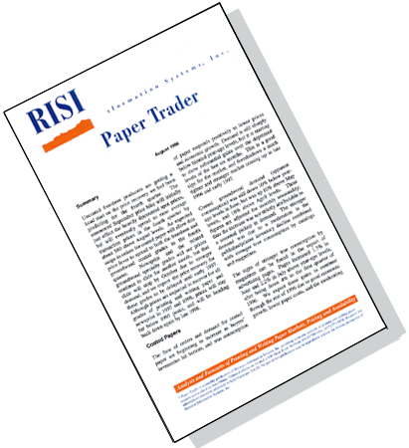
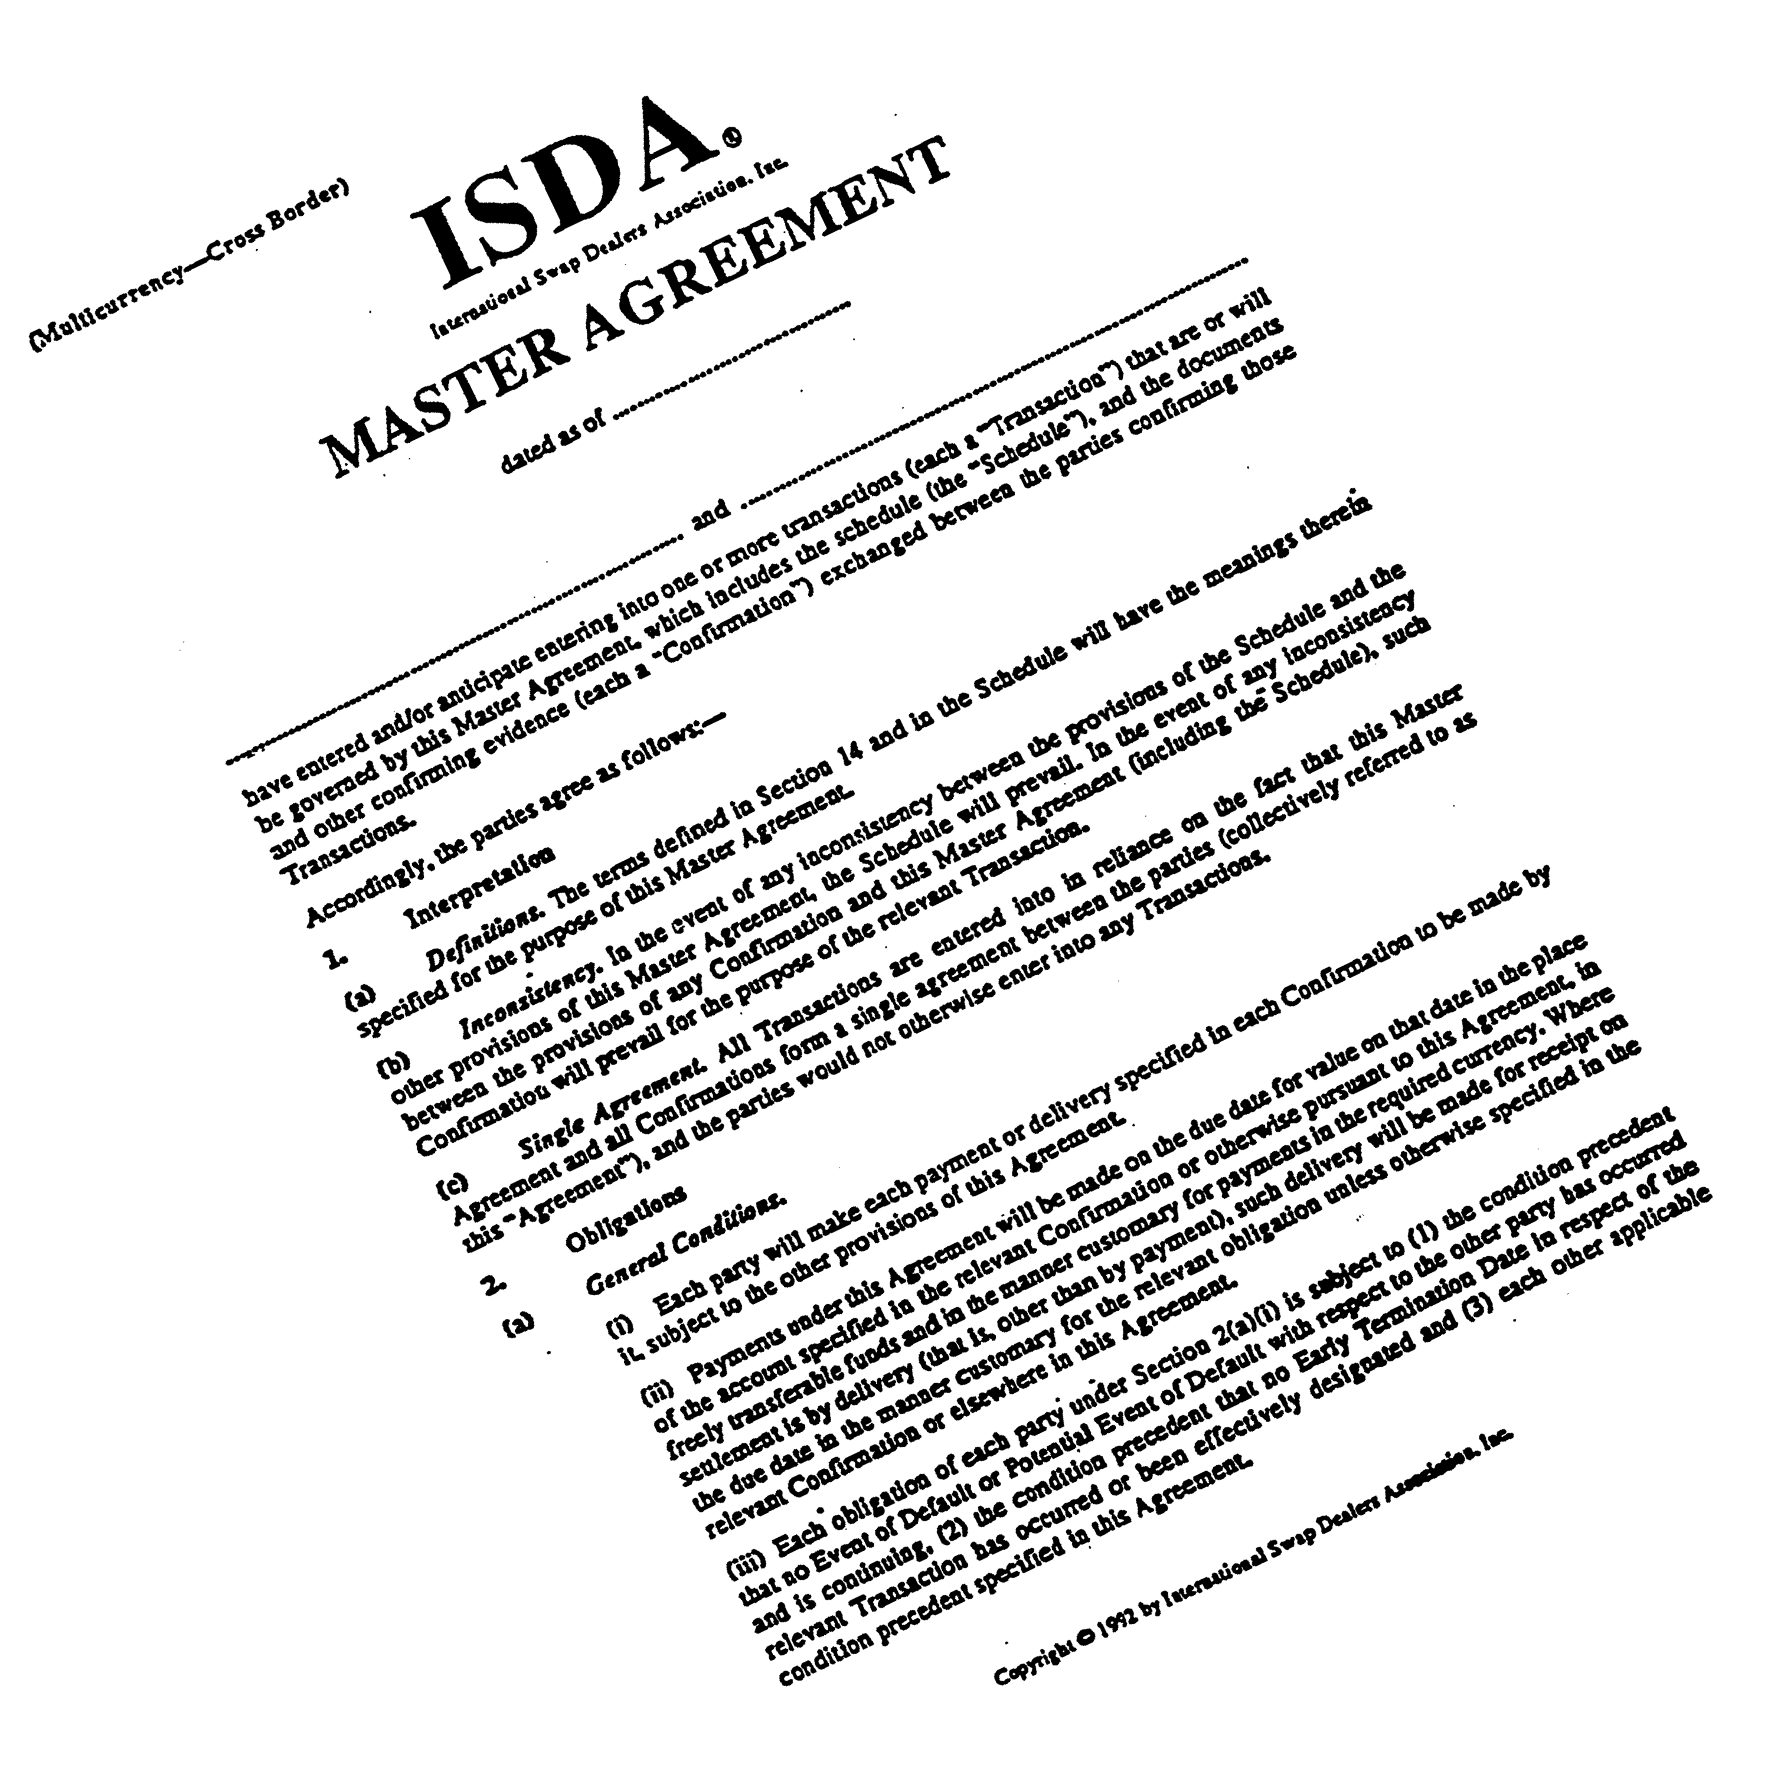
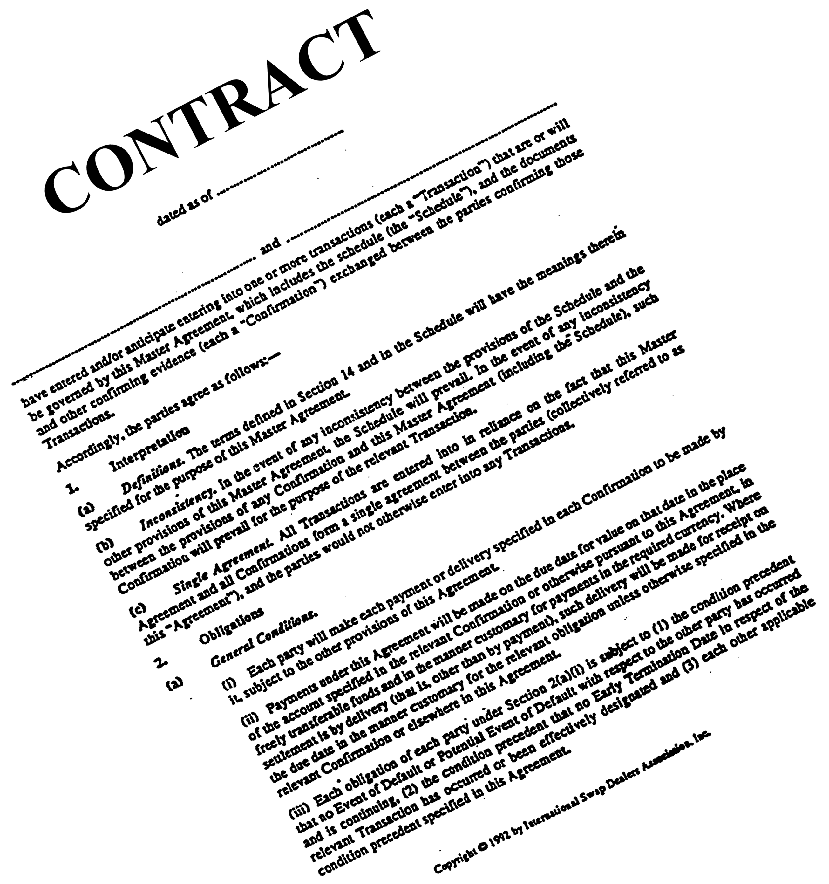
How Do We Put Together a
Financial Transaction?
There are three components to a financial swap transaction
The indices that will be used to settle the contract
A standard ISDA⁽¹⁾ agreement
The contract
⁽¹⁾ International Swap and Derivatives Association

