Slide 1
Enron Agricultural Trading
Grains
June 1, 2001
Appendix

Slide 2
Appendix
Table of Contents
Research/Contact List
Crop Summaries
“Big 3” Market Shares
Integrated Player Profiles
ADM
Cargill
ConAgra
Notes:
<number>
<footer>
<header>
<date/time>

Slide 3
Research / Contact List
Food Companies
Tyson Foods Inc.
General Mills
Keebler (Kraft)
Interstate Bakeries
Coca-Cola Company
Maple Leaf Foods
Proctor & Gamble
ConAgra Foods
Grain Trading Firms
DeBruce Grains
Lansing Grain
Kanematsu USA
Columbia Grain Intl.
Mitsubishi Intl. Corp.
Seaboard Trading
TradiGrain
Anderson Grain
Processors
AE Staley
Focus Groups
Elevator Operators
Minneapolis
Illinois
Iowa
Feedlots
Cactus Feeders
ContiBeef
AZTX Cattle Co.
Texas Beef Producers
Barrett – Crofoot
Friona Industries
National Farms
King Ranch
Financial Firms
BMO Nesbitt Burns
Stonegate Partners
Prudential Securities
Consulting Firms
Sparks Companies
McKinsey & Co.
World Perspectives
Akin Gump
Doane Agricultural Services
Information Co.
DTN
Exchange / E-Com
ConAgra Grain Division
Minneapolis Grain Exchange
CyberCrop.com
ICECorp.com
Farms.com
Politicians
Anne Veneman (Sec. Of Ag)
Richard Lugar (Chairmen of Senate Ag Committee)
Larry Combest (Chairmen House Ag Committee)
Keith Collins (USDA Chief Economist)
Notes:
<number>
<footer>
<header>
<date/time>

Slide 4
Corn Summary
Notes:
<number>
<footer>
<header>
<date/time>

Slide 5
Wheat Summary
Notes:
<number>
<footer>
<header>
<date/time>

Slide 6
Soybeans Summary
Soybeans
Physical
Domestic
1996
1997
1998
1999
2000
Market Size (B)
17.4
17.3
13.5
12.4
13.1
Production (B bu)
2.3
2.6
2.7
2.6
2.7
Domestic Cash Price
7.3
6.4
4.9
4.7
4.7
Financial (CBOT only)
Market Size (B)
731.4
7.4
506.6
396.7
411.3
Volume (MM)
19.4
19.5
16.7
16.7
16.5
Average Price
7.6
7.6
6.1
4.8
5.0
Acerage
1999
2000
Planted Acerage (MM)
74
75
Harvested Acerage (MM)
72
73
Usage
1999
2000
Domestic
67%
68%
(~45% Food/Industrial -- 23% Feed)
Export
33%
32%
Major Players
Processing
2000
ADM
32%
Cargill
21%
Bunge
15%
AGP
10%
IA
Growing Areas
(B Bu)
1999
% of Total
2000
% of Total
IL
0.5
18%
0.5
17%
MN
0.4
17%
0.5
17%
IN
0.3
11%
0.3
11%
0.2
8%
0.3
10%
Key Crop Information
Planting
Beginning May - through June
Flowering
July-August
Harvesting
Late September - Early December
Global Trade (M Metric Tons)
Exporters
Importers
United States
25,310
Netherlands
4,950
Brazil
9,100
Japan
4,700
Argentina
4,000
Germany
3,740
Notes:
<number>
<footer>
<header>
<date/time>

Slide 7
“Big 3” Market Shares
Note: All figures are based on 2001 data with the exception of grain storage. Asterisks designate “Big 3” affiliated companies. “Big 3” and affiliated companies’ market shares are illustrated in red.
Sources: USDA, 2000 Grain & Milling annual, CSFB Reports, SSB Reports

Slide 8

Business Overview
Archer Daniels Midland is a major processor and merchandiser of agricultural commodities that are used in the production of food and beverage products, livestock feed, industrial ingredients and nutritional supplements.
Most of ADM’s business involves converting raw soybeans, corn and wheat into further processed ingredients for the U.S. and global food manufacturing industry.
With the acquisition of Grace Cocoa in 1997 and the subsequent purchase of ED&F Man’s cocoa processing operations, ADM also has the largest cocoa grinding capacity.
Oilseed Products
Corn Products
Wheat and Other
Milled Products
Grain Trading
and Other
Products sold include soybean meal, soybean oil, other feed ingredients and nutraceuticals
The company operates 20 domestic soybean facilities and 16 foreign plants
Accounts for 63% of sales growth and 25-35% of earnings
Corn products include corn sweeteners, ethanol, starch and nutraceuticals.
ADM’s corn processing is concentrated in North America, but is expanding worldwide in all key markets
ADM’s corn processing capacity is 46,000 metric tons per day
ADM owns approximately 45% of US ethanol refining capacity.
Accounts for 30-40% of earnings
Each day ADM Milling process 1.2 million bushels of wheat
ADM Milling has over 70 facilities ranging throughout the US, Canada, Central America and the Caribbean
ADM Cocoa has 5 domestic and 9 foreign facilities that grind approximately 20% of the world cocoa crop
Accounts for 10% of earnings
Owns the US’s largest and fastest growing grain trading and origination group
Owns a worldwide transportation network consisting of 13,000 railcars, 2,250 barges, 1,200 trucks and 100 ships
North American Elevators (1)
Select Merchant Investments (2)
Port 6
River 41
Terminal/Sub 110
Country 287
Farmland Facilities 24
Total Facilities 468
Capacity (mm bu.) 822
% Firm Primary Products Geography
30% Minnesota Corn Processors High Fructose Corn Syrup US
29% Gruma SA Bread and Bakery Products Latin America, Europe
16% Tate & Lyle/AE Staley Sugar/HFCS Global/US
12% IBP Meat Processing US
7% Imperial Sugar Sugar US
(1) Source: Grain and Milling Annual 2000
(2) Source: Company SEC Filings, Analyst Reports
Notes:
<number>
<footer>
<header>
<date/time>

Slide 9
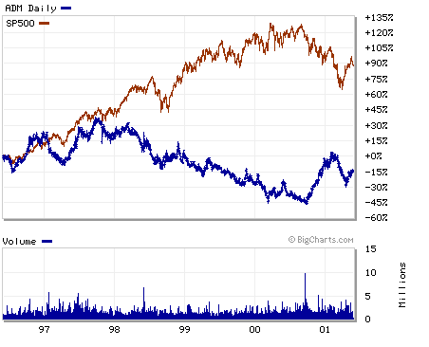
Summary Financials and Stock Performance
2000 Revenues by Segment (1)
Op. Income (2) 1999 2000 2001E
(1) BA Report 5/01
(2) MS Report 4/30/01
Notes:
<number>
<footer>
<header>
<date/time>

Slide 10
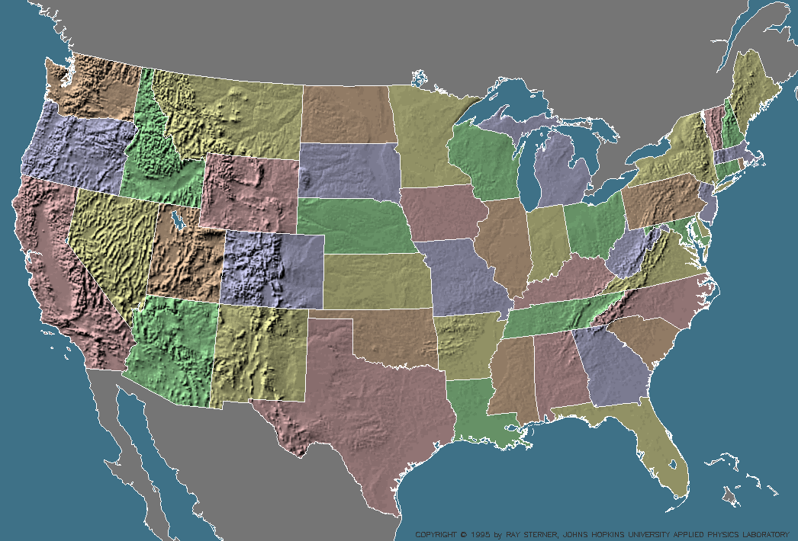
ADM Facilities
Port Facilities
River Facilities
Terminals
Subterminals
*Country Elevators not shown, but should follow pattern of terminal/ sub-terminal placement.
Notes:
<number>
<footer>
<header>
<date/time>

Slide 11
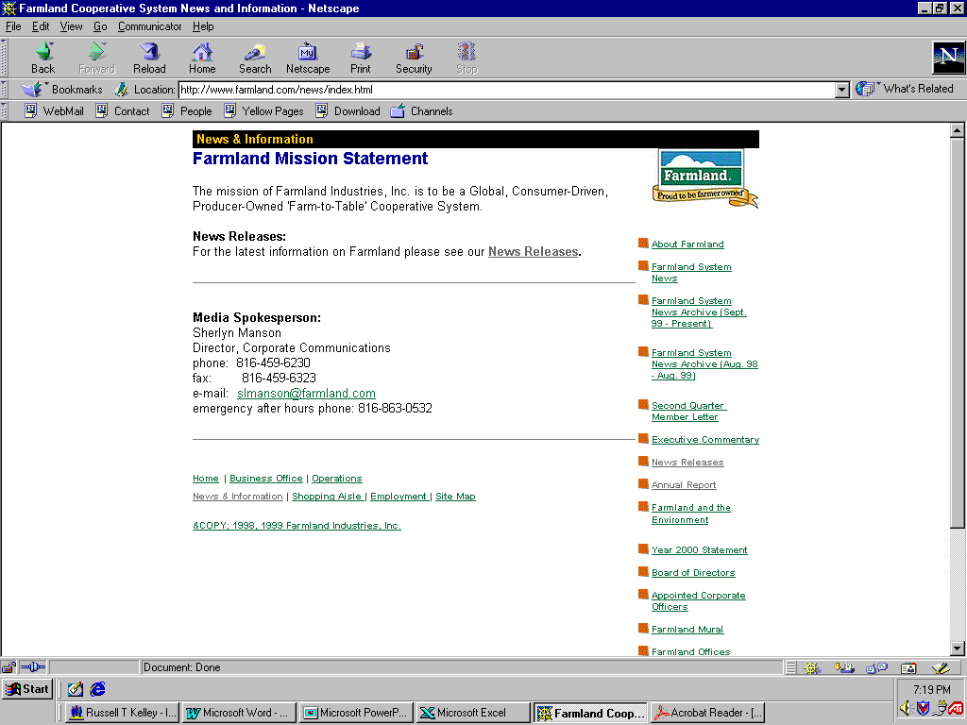
Farmland Facilities
Port Facilities
River Facilities
Terminals
Subterminals
*Country Elevators not shown, but should follow pattern of terminal/ sub-terminal placement.

Slide 12

Business Overview
Cargill is a globally diversified processor and marketer of agricultural commodities that are consumed by feed, food and industrial users. Its US business is predominantly focused on grains and oilseeds.
It is one of the largest private companies in the world, has 82,000 employees and operates from more than 1000 locations in 59 countries.
Processing and Trading
Industrial
Financial
Processing
Trading
Agriculture
Supplier
Steel Manufacturing: through North Star Steel, Cargill manufactures wire rods, merchant bars, specialty bar and light structural steel for industrial uses. It operates 6 electric minimills and a rolling mill.
Recycling: North Star Recycling operates six scrap processing facilities
Steel Processing: Process and sell flat rolled steel in 6 locations
Global Steel Merchandizing: worldwide merchant of ferrous raw materials and steel mill products.
Value Investing & Trading
Trading and Investing in financial markets of developing countries.
Trade structuring
Corn milling
Oilseed processing
Cocoa processing
Flour & rice mills
Citrus juice
Feedlot operator and beef processor
Hog producer and pork processor
Salt milling
Grain
Sugar
Cocoa
Cotton
Energy
Fats & Oils
Commodity/Futures and Brokerage
Freight operations
Feed milling
Seeds
Risk management products
Fertilizer production
Salt products
Farm and agricultural consulting
Bio-sciences
Segment Breakout⁽¹⁾ Revenues % of EBIT
(in millions) 1999 Total 1999
North American Elevators
(1) - Source: 1999 Cargill Annual Report
Notes:
<number>
<footer>
<header>
<date/time>

Slide 13
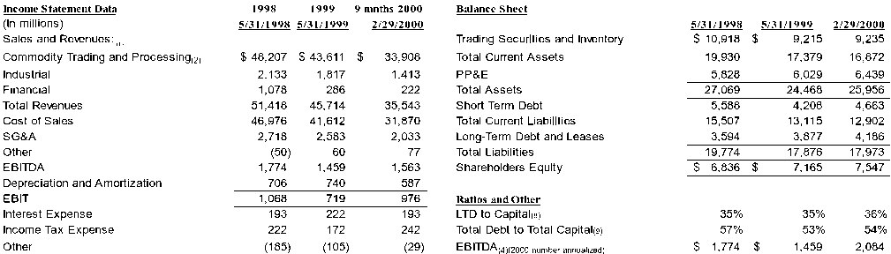
Summary Financials
Source: Cargill Annual Report
Estimated Breakdowns, by Segment
Notes:
(1) Revenues for Trading are shown on a gross basis. (2) 9 months breakdown calculated by using percentages of total revenue as occurred in 1999. (3) Total CAPEX net gain on disposal of property and other. (4) 2/29/00 EBITDA is annualized in order to compare with other years. (5) This number is calculated with both annualized EBITDA and annualized LTD interest. (6) Based on ADM 10Q- 9 months ending 3/31/00. EBITDA for ADM annualized. (7)EBITDA calculated by taking estimated EBIT 99 as seen in “Estimated Segment Financials” slide, and estimating a segment depreciation by taking industry relative depreciation compared to storage capacity and applying Cargill’s storage Capacity. (8) Method from Cargill prospectus: LTD & Leases/(LTD & Leases+SE). (9) Method from Cargill prospectus:( STD + LTD & Leases)/(STD + LTD & Leases + SE). (10) Segment revenues were extrapolated based upon (I) Cargill Market share, comparable company market share, and comparable company revenue size. (11) Operating income was extrapolated based upon Cargill revenues as calculated in (1), operating margins of publicly traded comparable businesses and notes in the Cargill 1999 annual report
Notes:
<number>
<footer>
<header>
<date/time>

Slide 14
Cargill Facilities
Port Facilities
River Facilities
Terminals
Subterminals
*Country Elevators not shown, but should follow pattern of terminal/ sub-terminal placement.
Notes:
<number>
<footer>
<header>
<date/time>

Slide 15
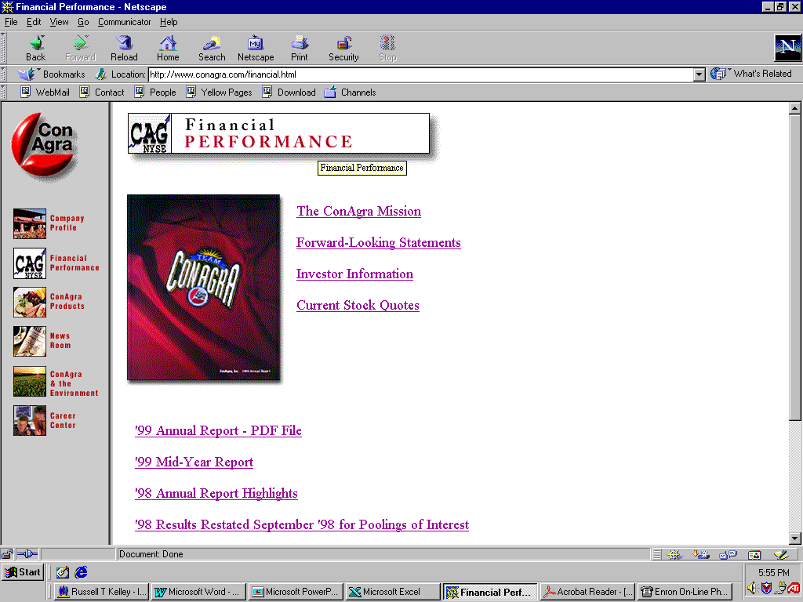
Business Overview
ConAgra is a diversified food company involved in the processing and merchandising of agricultural commodities and the manufacture of both food ingredients and packaged food products. The focus of the Company’s operations are the packaged and refrigerated food segments, which account for fully 81% of the Company’s revenues and 87% of the Company’s operating margin. The Company holds the #1 position in 20 product categories and has 38 brands with over $100mm in sales.
The Company and its “Operation Overdrive” effort to increase operating margins have lead to numerous divestitures. The focus on increasing shareholder value has led analysts to predict that a “deconsolidation” of the agricultural segment will occur.
Packaged Foods
Agricultural
Products
Refrigerated Foods
Production and marketing of frozen and self-stable foods and dairy products for grocery, foodservice and special market customers such as club stores and super centers. Also involved in food services.
Production and marketing of branded processed meats, beef and pork products, and chicken and turkey products.
Agricultural Inputs
(United Agri Products)
Agricultural Trading &
Processing Companies
United Agri Products (UAP) is a leading global distributor of crop inputs (seeds, fertilizer products, crop protection chemicals and information systems).
Division including grain merchandising, milling and specialitiy food ingredients
Milling
Specialty Food
Ingredients
Companies
North American Elevators
Grain
Merchandising
Port 5
River 11
Terminal/Sub 65
Country Elevators 19
Total Storage Facilities 100
Capacity (mm bu.) 213
Includes ConAgra’s grain, edible bean and commodity services businesses.
Offers both external and internal customers responsive and sophisticated purchasing, selling and risk management services.
ConAgra Flour Milling Company, a longtime leader in the U.S flour milling industry, has 25 mills in 14 states. ConAgra also jointly owns one flour mill with another company.
Most profitable of ConAgra’s trading and processing businesses in fiscal 1999.
Manufactures and markets internationally a broad line of food ingredients-flavorings, seasonings, blends and other specialty ingredients.
Notes:
<number>
<footer>
<header>
<date/time>

Slide 16
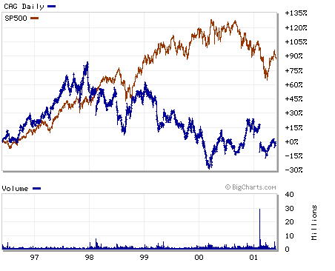
Summary Financials and Stock Performance
Income Statement Data (1)
Current Market Data
(MM $, FY End May 31)
1999
2000
2001E
Financials: MM $, as of 5/31/00
Net Sales
$
24,594
$
25,588
$
27,379
Per Share Data: Actual, as of 5.18/01
Operating Income
1,440
1,591
1,655
Current Price
$20.84
Net Income
696
799
747
LTM High/Low
$17.50 - $26.19
Shares Outstanding (MM Diluted)
475.0
479.0
514.0
BV/Share
$7.61
EBITDA per Share
$
4.08
$
4.44
$
4.39
Shareholder Equity
$4,112
EPS Reported
$
1.46
$
1.67
$
1.45
Equity Mkt Value
$11,171
Net Debt
$7,815
Other Financial Data
Enterprise Value
$18,986
Interest Expense
$
317
$
304
$
451
Valuation Metrics
Depreciation & Amortization
500
537
604
Total Debt/Total Cap
53%
Capital Expenditures
662
539
550
Price/Book
2.7 x
Acquistions, net of Sales
373
235
995
Price/2001EBITDA
4.7 x
Dividends
312
375
473
Price/2001EPS
14.4 x
Segment Sales (1)
1999
2000
2001E
EV/EBITDA
8.4 x
(MM $, FY End May 31)
Operating Income (2)
1999
2000
2001E
Packaged Foods
$
7,427
$
7,714
$
7,348
(MM $, FY End May 31)
Refrigerated Foods
11,591
12,522
13,285
Total Packaged Foods*
$
992
$
1,088
$
1,245
International Home Foods
-
-
1,800
Total Refrigerated Foods
361
491
439
Agricultural
5,580
5,150
5,290
Total Agricultural
355
331
253
Total Revenues
$
24,598
$
25,386
$
27,723
United Agri Products
150
155
40
Source: Robinson Humphries and Bank America Securities Analyst Reports
Notes:
(1) Robinson Humphries Analyst Report.. All associated ratios calculated off these numbers.
(2) Bank America Securities Analyst Report.
Grain Merchandising
15
10
40
Milling
125
110
115
Specialty Products
65
56
58
Total Operating Earnings
$
1,708
$
1,910
$
1,937
*Includes Int'l Home Foods
Notes:
<number>
<footer>
<header>
<date/time>

Slide 17
ConAgra Facilities
Port Facilities
River Facilities
Terminals
Subterminals
*Country Elevators not shown, but should follow pattern of terminal/ sub-terminal placement.
Notes:
<number>
<footer>
<header>
<date/time>

Slide 18
Transaction Details & Economics
3 Year Corn Swap: Tyson & Enron
Counter-Party: Tyson Foods, Inc.
Term: 3 years
Commodity: Corn
Quantity: 12mm bushels/year
(1mm bushels/month)
Fixed Price: $2.35/bushel
Settlement: CBOT Corn Futures Contract
(Close of 1st business day before the 15th)
3 Year Corn Swap: Tyson & Enron
Fixed: $2.35
Tyson
Floating
Enron
Economics & Risk Assessment
Revenue
Mark to Model Earnings: $3.2MM
Exposure Summaries
Confidence Intervals:
σ: ($5.1MM)
2σ: ($10.5MM)
Max Loss (Max price last 3 years) ($10.6MM)
Max Price Change (Last 3 years):
1 Day: $0.23 – 10%
1 Month: $0.37 – 16%
Implied Annual Volatility 23%
Hedging 100% Risk
Buy at-the-market call options ($2.9 MM)
(Macquarie Bank, Refco)
Maximum exposure ($5.4 MM)
Total ($8.3 MM)

Slide 19
Position Management
Cover first year with fix/float swaps
Resulting exposure is in back 18 months
Limited liquidity beyond front 3 months
Contracts traded 18 months out
Curve management through Fundamentals
Weather Intelligence and Products
Competitive Analysis
Regulatory Expertise
Information Flow from physical trading business
Correlated Markets (i.e. ethanol, gas/fertilizer)
Notes:
<number>
<footer>
<header>
<date/time>

Slide 20
Supply Strategies
Strategy Call Option Customer: Elevator/Farmer Need $ up front NO margining required Low risk for limited % of production | Issues Could be financially replicated on the Board (only one year available) Credit Risk – deal with elevators and co-ops, not farmers. Risk is total non-performance. Could use catastrophic weather yield insurance product.
VPPs Customer: Large Co-ops, Elevators Need $ up front Should be able to contract less than “cost of carry” | Credit Risk – mitigated by “captive customer” analysis
Netback Structures Example: Greater of FP or 90% market Customer: Elevator/Farmer, Co-ops Insured FP at level greater than current market/ less than “cost of carry” Share in upside potential No margin required | Call options required to hedge/limited liquidity
Physical Trading Strategy Create long position thru physical market (i.e. buy 18 months physical and store, storage is cheaper as prices rise). Need expertise for infrastructure, contacts, information flow, etc. | Currently do not have expertise
Notes:
<number>
<footer>
<header>
<date/time>

