Slide 1

Enron Global Markets
Offsite Meeting
Miami, Florida
February 23 - 25, 2001

Slide 2
Agenda
7:30 - 8:00 a.m. Breakfast available in meeting room
8:00 - 8:15 a.m. Opening - Mark Frevert
8:15 - 8:40 a.m. EGM Overview - Mike McConnell
8:40 - 9:00 a.m. Crude & Products - John Nowlan
9:00 - 9:20 a.m. LNG - Rick Bergsieker and Eric Gonzalez
9:20 - 9:40 a.m. Risk Management - Per Sekse
9:40 - 10:00 a.m. Break
10:00 - 10:20 a.m. Coal - George McClellan
10:20 - 10:40 a.m. Freight - Dan Reck
10:40 - 11:00 a.m. Weather - Mark Tawney
11:00 - 11:20 a.m. Financial Trading - Gary Hickerson
11:20 - 11:40 a.m. Conclusion - Jeff Shankman

Slide 3
Opening
Mark Frevert

Slide 4
Enron Wholesale Services
Regional Energy Networks
North America
Europe
Offices 11
Employees 2,730
Offices 18
Employees 1,520
Australia
Offices
Marketing Activity
Japan
Gas
Power
Global Markets
Crude & Products, Coal & Emissions, Weather, LNG
Industrial Markets
Pulp, Paper & Lumber, Metals, Steel
Global Assets
Asset Operations Worldwide
Enron Net Works

Slide 5
Enron’s North American
Wholesale Energy Franchise
MAAC
Henry
Henry
Henry
Henry
Hub
Hub
Hub
Hub

Slide 6
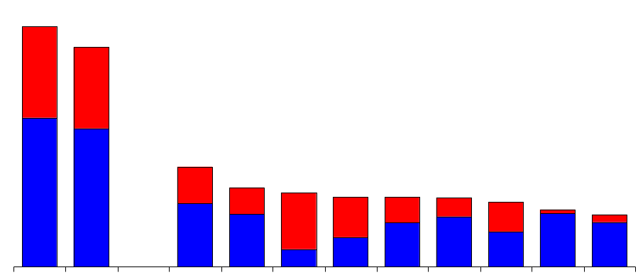
Domestic Energy Marketers
Enron’s Leading Market Position - 2000
(Tbtue/d)
45.6
41.7
Power
Gas
19.2
15.0
14.1
13.3
13.2
13.1
12.3
10.9
9.9
Enron
FY00
Enron
Duke
Aquila
AEP
PG&E
Reliant
Dynegy
Southern
Coral
Sempra
3Q YTD
Source: Gas Daily, Power Markets Week, Oil Daily

Slide 7
Enron’s European
Wholesale Energy Franchise
Helsinki
3.6 Bcf/d Natural Gas Marketed Annually
53 Million MWh Power Marketed Annually
Over 2,000 Employees in 14 Countries
Nord
Pool
Oslo
Stockholm
Teesside
1,875 MW
Wilton
154 MW
Amsterdam
Oxford
Hamburg
Moscow
APX
Warsaw
IPE
London
EEX
Nowa Sarzyna
116 MW
Brussels
Frankfurt
Enron Offices
Energy Exchange
Energy Partnerships
Leased Capacity
Utility Services
Power Plants
In Operation
Under Development
Marketing Activity
Gas
Power
Coal
Metals
Enron/Petrom JV
Zurich
Budapest
Milan
Bucharest
Sarlux
551 MW
Madrid
Mora la Nova
1,600 MW
Marmara
478 MW
Arcos
1,200 MW

Slide 8
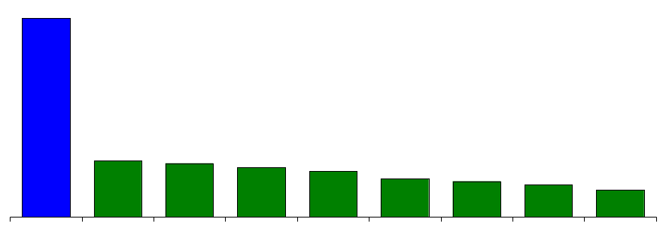
International Energy Companies
Enron’s Leading Market Position
Natural Gas and Power
(Tbtue/d)
45.6
13.0
12.3
11.5
10.6
8.9
8.2
7.5
6.3
Enron
BP
Amoco
EdF
France
Exxon
Mobil
RWE
Germany
Chevron
Royal
Dutch
Shell
Tokyo
Electric
Japan
ENEL
Italy
Source: Company Reports, Enron Analysis

Slide 9
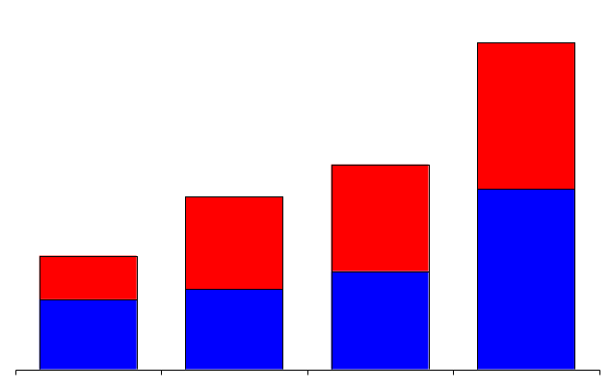
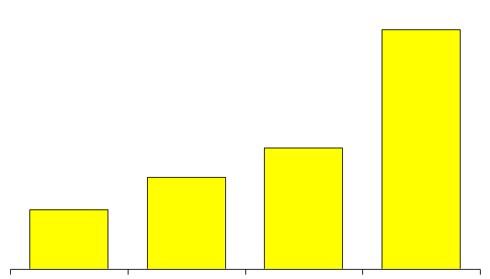
Wholesale Services
Physical Volumes
(BBtue/d)
Financial Settlements
(BBtue/d)
Power and Other
Gas
51,715
196,148
32,429
27,308
99,337
17,970
75,266
49,082
1997 1998 1999 2000
1997 1998 1999 2000

Slide 10
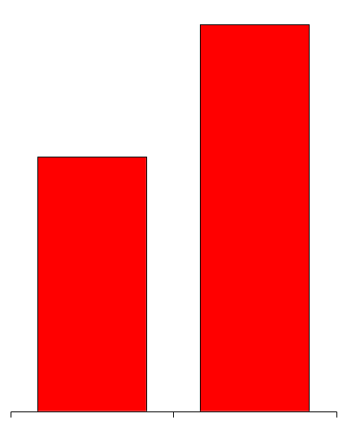
Volume Growth - North America
Natural Gas
(Bcf/d)
Power
(Millions MWh)
24.7
579
381
13.9
+77%
+52%
1999 2000
1999 2000

Slide 11
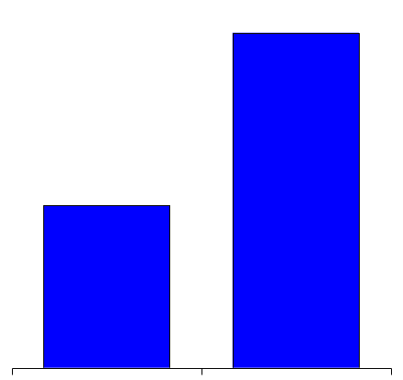
Volume Growth - Europe
U.K. Gas
(Bcf/d)
U.K. Power*
(Millions MWh)
Nordic Power*
(Millions MWh)
Continental Power
(Millions MWh)
3.1
113
77
46
1.5
53
31
7
107%
113%
148%
557%
1999
2000
1999
2000
1999
2000
1999
2000
*Financial and Physical Settled Volumes

Slide 12
Wholesale Services
Income Before Interest and Taxes
(Millions)
Commodity Sales and Services
Assets and Investments
$2,260
$1,317
$968
$654
48%
36%
72%
1997
1998
1999
2000

Slide 13
Total Return to Shareholders
(Periods Ended 12/31/2000)
One Year
Five Years
Ten Years
89%
350%
1,415%
129%
383%
(9%)
Enron
S&P 500
Enron
S&P 500
Enron
S&P 500

Slide 14
Earnings Performance
(Recurring Per Diluted Share)
$1.47
$1.18
$1.00
$.87
+ 15%
+ 18%
+ 25%
1997 1998 1999 2000

Slide 15
EGM Overview
Mike McConnell

Slide 16
EGM - Gross Margin 1998-2001
($ millions)
Actual Actual Actual Plan
1998 1999 2000 2001
Gross Margin $116 $186 $206 $497
Gross Margin
$497
$186
$206
$116
Note: Puerto Rico, Middle East and LNG EBIT included in 4Q 2000 and 2001 only.

Slide 17
EGM - Earnings Growth 1998-2001
($ millions)
Actual Actual Actual Plan
1998 1999 2000 2001
EBIT $30 $81 $67 $270
EBIT
$270
$81
$67
$30
Note: Puerto Rico, Middle East and LNG EBIT included in 4Q 2000 and 2001 only.

Slide 18
Expansion of Existing Business
Crude & Products

Slide 19
Expansion of Existing Business
Crude & Products

Slide 20
Expansion of Existing Business
Crude & Products

Slide 21
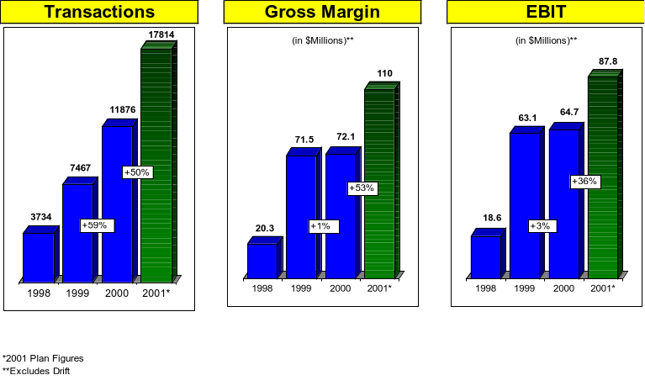
Expansion of Existing Business
Financial Trading

Slide 22
Expansion of Existing Business
Coal and Emissions

Slide 23
Expansion of Existing Business
Weather

Slide 24
Crude & Products
John Nowlan

Slide 25
Global Products Volumes - US
* is an estimate based on the amount of change each starting in 1998.

Slide 26
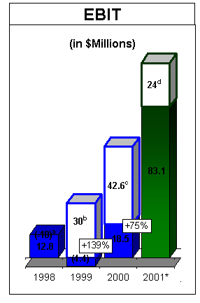
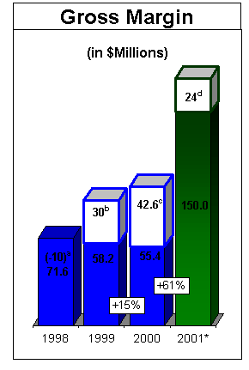
Global Products Profits

Slide 27
2001 Milestones
Reorganize to better focus on key business areas
Generate $150 million gross margin & $ 83 million EBIT
Create global mid marketing function
Develop origination group to identify and close transactions to build structure within the business
Expand EOL product offering and transactions
Identify transactions or assets which will provide deal flow, information and profits for the group

Slide 28
Key Business Areas
Crude Oil
  Expand international crude trading, targeting 100,000 BBLS/day
  Close refinery thruput deal (i.e. Orion, Western, Farmland)
LPG
  Expand physical presence in USA
  Expand business into Asia
    Korea & Japan target markets

Slide 29
Key Business Areas
Gasoline
  Expand ARB business
  Exploit Grade/Spec opportunities
Petchems
  Expand into physical polyolefins
  Develop strategy partner, JV, or acquisition to accelerate growth
  Exploit EOL position

Slide 30
Requirements to Meet Objectives
1) Personnel:
a. Naptha trader London and Asia
b. LPG trader Asia
c. Financial trader Singapore
d. Financial trader London (Products)
e. Physical LPG trader London
f. Derivatives trader London
2) Systems:
a. Avistar or similar system for all key traders
b. Project “Thunderball” delivered
3) Miscellaneous
a. Competitive compensation
b. Appropriate limits - V@R & Position
c. Understanding credit function

Slide 31
LNG
Rick Bergsieker
Eric Gonzalez

Slide 32
Enron Global LNG
OUR VISION:
  To become the world’s leading merchant/marketer of LNG, generating $100 million per year of sustainable earnings by 2005.
OUR TEAM:
  We have assembled a world-class LNG team, with expertise in every aspect of the LNG business
OUR STRATEGY:
  Identify/quantify our preferred long/short position in each element of the LNG chain
  Gain control of a “critical mass” portfolio of each element in the chain to cover our preferred long/short position, via either contracts or, if necessary, selective asset development
  Put LNG OnLine as soon as possible

Slide 33
Enron Global LNG Organization
Eric Gonzales
Rick Bergsieker
Atlantic Basin
Trading & Risk Management
Eastern Hemisphere
Logistics, Fuel Management & Technical Support

Slide 34
Top Three Objectives - 2001
Close financing on Jose LNG project/generate significant near-term income via either mark-to-market or other monetization mechanisms. (Value: +/- $50 million)
Work out Dabhol LNG supply and shipping problems (created by MSEB’s inability to take all of its Phase II commitments) in a manner that protects Enron, enhances relationships with Oman and Abu Dhabi, and optimizes the value of surplus Dabhol LNG supplies in the Enron system. (Value: preservation of Enron equity in Dabhol plus at least $25 million ($5 million/year) in margins for redirecting 1 mmt/yr of DPC LNG to other markets)
Position Enron to be a leading player in LNG e-commerce through the development of a LNG trading hub with Petronas affiliates and by extending the scope of Enron online to include LNG. (Value: unquantified)

Slide 35
LNG Production Facilities
Existing and Planned
*
Kenai
Marsa el Brega
Arzew, Skikda
*
*
*
*
*
*
*
Bintulu
Atlantic LNG
*
*
*
*
Bonny Island
Lumut
Venezuela LNG
Arun
*
Bontang
*
North
West
Shelf
Ras Laffan, QatarGas, Oman LNG, Das Island
Existing
Planned or
Under Construction
Notes:
<number>
<footer>
<header>
<date/time>

Slide 36
LNG Receiving Facilities
Existing and Planned
Belgium 1
Turkey 1
France 2
Japan 23/3
United States 4
Portugal
China
Korea 2/1
Spain 3
Puerto Rico
Italy 1
Taiwan 1/1
India 2
Greece
Japan: 2 Under Construction; 1 Planned
Korea: 1 Planned for 2002
Turkey: 1 Planned
Taiwan: 1 Planned
USA: Elba Island/Cove Point to reopen in 2002
Existing
Planned or
Under Construction

Slide 37
Other Key Objectives - 2001
Obtain LNG supplies to cover front-end short gas position at Enron’s Arcos Project in Spain.
Ensure that the three Enron-controlled LNG carriers (Lakshmi, Hoegh Galleon and Excalibur) are built to contract specifications and delivered on time; optimize the utilization of all three ships, taking into account both Enron’s internal needs for LNG supplies and profitable third-party merchant opportunities.
Define shipping strategy to manage merchant trading and merchant shipping activities for the next five years. Enter charter agreements to manage internal merchant trading requirements while also creating merchant subcharter offerings.
Obtain Enron-controlled access to additional LNG terminals in both the Atlantic and Pacific basins, either through strategic asset development or through contract negotiations, focusing on the following targets.
  Japan (either via Osaka Gas or via new terminal)
  Elba Island (with no heating value restrictions)
  Bahamas/Florida
  Eco Electrica expansion
  Dominican Republic
Execute Master Spot/Term Agreements with a portfolio of suppliers that balance/cover our shipping and terminalling positions while at the same time provide maximum optionality to Enron.

Slide 38
Eastern Hemisphere 2001 Objectives
Build Flexible Supply Portfolio
  Conclude Master Sales Agreements with Adgas, Pertamina, and MLNG to provide for additioinal merchant opportunities on the Lakshmi, Hoegh Galleon, and Excalibur
  Obtain LNG supplies for Arcos Project
  Define shipping needs and coverage strategy for next 5 years and execute charter agreements to cover shortfall
E-commerce with Petronas
  Convince Petronas to place LNG manufacturing and shipping capacity on Enron On-Line.
Support Strategic Asset Development
  Conclude terminal feasibility study with BHP in Nagoya area and support E-Power Aomori project
  Work out Dabhol LNG supply and shipping problems

Slide 39
Western Hemisphere 2001 Objectives
Project Jose
Bahamas LNG Terminal
LNG Sales in Puerto Rico

Slide 40
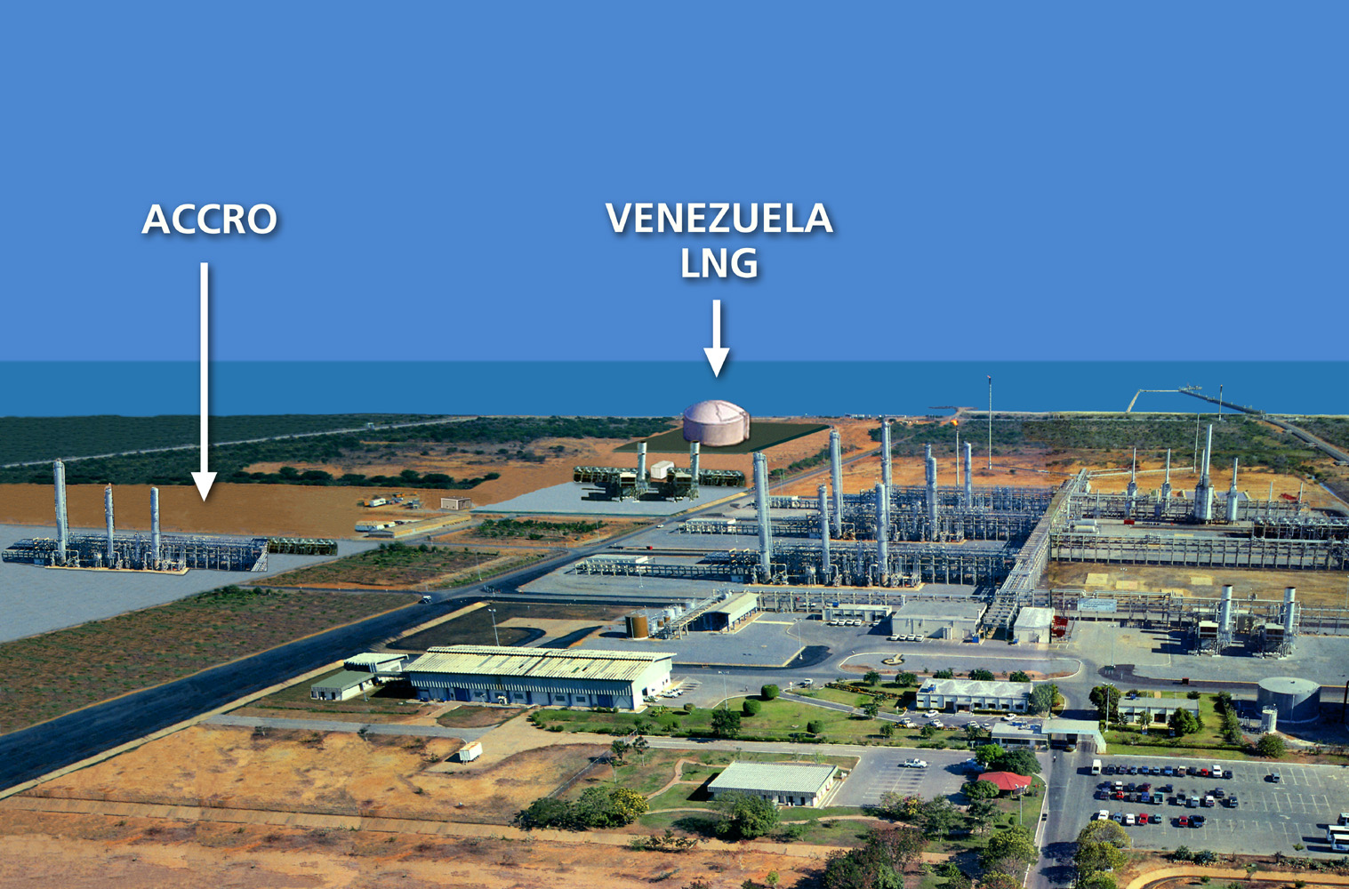
Project Jose
LNG liquefaction, storage, and export facility in Jose Venezuela
  Enron holds 100% of project, PDVSA has option to purchase up to 25% interest with associated off-take
  2.1 MMTPA capacity (300,000 MMBtu/d)
  Estimated all-in capital cost: $700 MM
  Commercial Operations Target date of Q4 2004
  MTM structure requires equity sell down to 3rd parties
350 MMBtu/d purchase from PDVSA delivered to plant (portfolio sale with PDVSA Corp guarantee)
Target LNG markets: U.S. East Coast
Next Steps
  Complete Jose LNG Venezuela agreements in April 2001 (SA, GSA, Off-take)
  Release 2 EPC contractor Feed works Q2 2001
  Receive required environmental and construction permits by end Q3 2001
  Select EPC Contractor in Q4 2001 (EE&CC vs third party contractor)
  Target Financial Close and NTP release date of Q4 2001

Slide 41
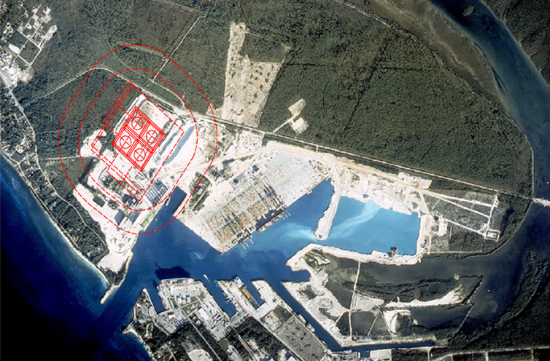
Bahamas LNG Terminal
The terminal will receive and off-load LNG from Atlantic LNG supplies
  The terminal will store the LNG in specially designed tanks, revaporize it, and feed it into a 90-mile, 24” sub-sea pipeline. Initial terminal deliverability is expected to be 300-400 mmcf/d
  The pipeline will deliver the natural gas to Florida, near Port Everglades
  Total initial capital investment in the project of approximately US$ 390 million
Secured the terminal site end 2000
  Approximately 90 acres of land adjacent to Freeport Harbor
  Enough land to accommodate up to 900 mmcf/d of throughput capacity
Bahamian permit process underway
Next steps
  Complete preliminary engineering design work March 2001
  FERC pipeline application submittal scheduled for March 2001
  EPC tender release Q2 2001
  All required environmental and construction permits to be received by Q3 2001
  EPC notice to proceed release Q4 2001
  Project onstream Q4, 2004

Slide 42
LNG Trading
Milestones Reached
  Desk Setup, 4Q 2000
  8 traded cargos, 18 million MMBtu
  MTM earnings of US$6M (includes 4Q00 and 1Q01)
  Hoegh Galleon, 87500 cm LNG vessel, placed into merchant trade for 2001
Goals 2001
  Trade 3 spot cargoes per quarter (sales into US, Europe, Far East)
  Secure 3 years of supply for Arcos power project
  Purchase supply for Elba Island capacity
  Place Excaliber, 138,000 cm LNG vessel, into merchant trade for 4Q 02 and for 2003
  Sign 5 Master Supply Agreements by year end
  Increase origination coverage for selected producers:
    - Oman - Malaysia - Nigeria
    - Indonesia - Qatar - Angola
    - Abu Dhabi - Trinidad - Egypt

Slide 43
LNG Shipping/Operations & Development Engineering
Source additional LNG shipping capacity as required to support Enron's merchant trading needs and merchant shipping strategy.
Optimize the utilization of all existing vessels (3) under charter.
Achieve delivery and profitable operation of the LNG carrier "Hoegh Galleon".
Complete construction oversight and delivery of the LNG carrier "Lakshmi". Work out DPC's LNG shipping issues created by MSEB's inability to take contracted power.
Provide ongoing charter and construction oversight to ensure the LNG carrier "Excalibur" is built to specification and delivered on time.
Develop and agree with the DPC's LNG suppliers all contract implementation procedures and schedules. Achieve successful first LNG cargo delivery to DPC.
Improve and add work procedures to ensure timely and efficient fuel management and operation activities at EcoElectrica.
Optimize optionality in the EcoElectrica LNG Supply Purchase Agreement.
Provide development engineering, shipping technical and logistical support as required to promote Enron LNG global merchant efforts.

Slide 44
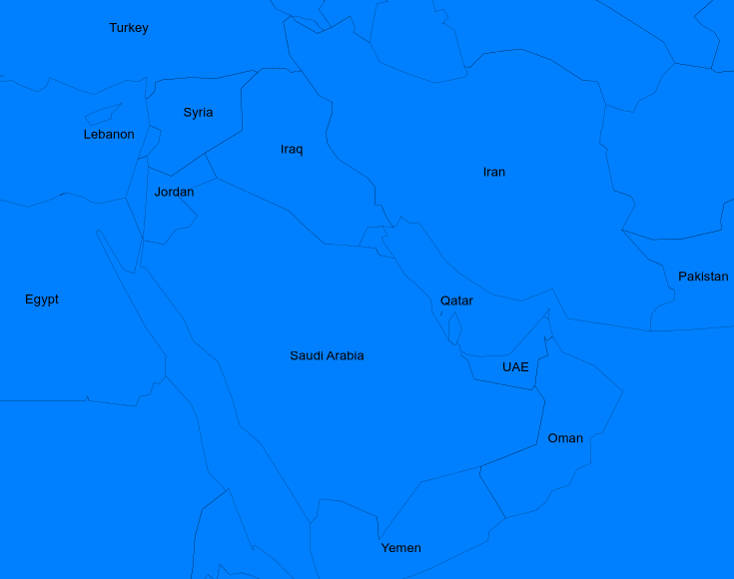
Middle East Region

Slide 45
Enron Middle East
Managing Director (D)
Rick Bergsieker
Managing Director (H)
Terry Thorn
General Counsel (H)
Dan Rogers
Admin Coordinator (H) Brenda Johnston
Asst. Sr. Admin. (H)
Carol Barcus
Asst. Admin. (D)
Sunita Katyal
Asst. Sr. Admin. (H) Laurie Davidson
Director (D)
Mac McClelland
Sr. Project Director (H)
Jan Bass
Vice President (D)
Robert Stewart
Asst. General Counsel (D)
(Vacant)
Vice President
(D)
Maurizio La Noce
Director (D)
Kevin Ruffcorn
Asst. Admin. (D)
Lesley Mneimne

Slide 46
Top Three Objectives - 2001
  Project Dolphin: execute binding gas supply/gas marketing agreements and bring forward/monetize Enron’s share of Dolphin’s value. (Value: $150 million or more from upstream selldown plus growth potential from prompt expansion of marketed volumes)
  Originate at least two new commodity transactions. Immediate targets (Value: unquantified):
    Saudi/Xenel polypropylene and/or solvent offtake agreements
    Syria/Turkey power marketing
  Enhance our presence and relationships in Oman by closing and selling down Enron’s Oman Gas marketing project. (Value: $2 million in 2001, with growth potential thereafter)

Slide 47
Other Key Objectives - 2001
Sort out Gaza problems and sell Enron’s interest at breakeven or better.
Continue to manage EGM’s Dugas MTBE and feedstock contracts
Define a new infrastructure development business model that combines another party’s equity funds with Enron fee-based structuring/financing/operating services; using this model, close on one new development project that provides either regional or global network value to Enron. Possible targets:
  Dubal/Jebel Ali power plant with gas/electricity/aluminum hedge and operating services
  Egypt/Jordan gas marketing venture with network and growth opportunities
  UOG-sponsored Fujairah IPP/water plant tied to Dolphin supplies
  Oxy/Enron Saudi Gas Initiative with spinoffs of other Enron opportunities in Saudi Arabia
  TABREED district cooling plant in Oman, fueled via Enron’s Oman gas marketing company
Originate at least one viable business opportunity in Saudi Arabia for a non-EGM Enron business unit. Key targets:
  EES audit/elimination of liquids fuel inefficiencies along West Coast of Saudi Arabia (proposed to
  Enron by Aramco)
  Convince Saudi Aramco or SABIC to subscribe to Enron Online
Assist EBS in identifying and capitalizing on the opportunity to participate in the rapidly developing Internet and media hub business opportunities in Dubai.

Slide 48
Risk Management
Per Sekse

Slide 49
2001 Goals and Objectives
Global Risk Markets:
  EBIT of $26 million on $38 million in margin.
  Expand origination
    Increase deal pipeline to a minimum of 20 potential transactions under discussion at any given time.
  Execute transactions in three primary markets:
    Contingent Calls: commodity price options which knock in due to a physical event – Outage Options.
      Apply product to other commodity markets.
    Upstream: using Reliable Reserves (variation of VPP) and Term Working Interest structures.
    Power Market: using long term spark spread cover and residual value insurance structures.
  Extend insurance market structures to new markets such as steel, coal, pulp and paper, etc.: identify, market, and execute one transaction.
  Establish fully capitalized insurance trading vehicle (Enron Re or other appropriate entity for portfolio management of insurance risks).
    Evaluate pros and cons of strategic partnership with one or more insurance companies.

Slide 50
Global Risk Markets
Conventional Risks
Employer’s Liability
General Liability
Auto Liability
Political Risk
Gulf Company (ENE Captive)
  Built on behalf of business units
  Collects premiums from ENE business units
Non-Conventional Risks
Contingent Calls
  Physical Event Trigger into Commodity Price Hedge (e.g. power prices)
Upstream Oil and Natural Gas Risks
  Reserve Risk/Production Risk
Power Risks
  Spark Spread/Heat Rate
  Residual Value/Power Quality
Project Finance Risks
Class 3 Bermuda Insurers
  Enron Re: Underwriting vehicle
  R²: Transformer vehicle
GRM’s risks are split into two broad categories of risks. Conventional risks can easily be moved into the insurance market, while non-conventional risks require GRM risk taking to align interest with insurance markets.

Slide 51
Nature of Risks
Risk Profile:
Statistical Probabilistic Outcome
No Credit Risk
Current Products:
Contingent Calls
  Outage Options
Upstream
  Reliable Reserves (VPP equivalent)
  Term Working Interest
Power
  Spark Spread/Heat Rate
Credit
Risk
GRM is seeking to take on risk in areas where Enron has expertise, including reserve and operational risks in Upstream, price and outage in Power and other non-conventional risks.

Slide 52
Insurance Risk Tower Template
Non-Conventional Risks:
Contingent Calls
Upstream
Power
Other
Risk Tower
3rd Party Risk
(Placed directly in insurance market from Enron Re)
Quota Share Risk
(Enron Re)
First Loss Risk (Enron Re)
First Loss + Quota Share = Alignment of Interests between ENE and Insurers
Global Risk Markets
Non-Conventional Risk
(Capital & Bank Markets)
Insurance Market
Convergence Play

Slide 53
Enron Re Risk Aggregation
Quota Share
Remaining
Risks
Enron Re Capacity
Portfolio Risk
Management
Reinsurance
Derivatives
Junk Bonds
Equity Markets
Upstream
Outage Options
Other
Other
Power
Power
Upstream
Other
Outage Options
Power
Upstream
First Loss
Remaining
Risks
Increase Available Capacity by Hedging Portfolio Risks to Insurance and Capital Markets
Outage Options
Other
Power
Upstream
Outage Options
Enron Re will act as the aggregator of risks and as a risk bearing entity
Trade portfolio of risks from GRM and ENE transactions

Slide 54
Contingent Calls – Outage Options
Current Status:
Over 20 deals priced in January & February
1st deal expected to close within 2-3 weeks
Sample Customers in Pipeline:
Michigan South Central Power Agency
Arizona Public Service
Kansas City Power & Light
Alcoa

Slide 55
Upstream – Reliable Reserves
Current Status:
Reliable Reserves provide significant leverage over traditional VPP and bank prepayments
GRM has partnered with two hedge funds who will provide equity for MBO candidates
Have identified 3 prospective MBO candidates and signed CA’s
Sample Customers in Pipeline:
Hallwood - HECO
Nuevo - NEV
DEVX - DVXE
Benton Oil & Gas - BNO
Chesapeake - CHK

Slide 56
New GRM Ventures for 2001
Insurance claims trading
Creating insurance forward curves for premium trading
Using an insurance vehicle for lending arbitrage
2001 YEAR-END GOAL:
GRM will be recognized as the lead provider of non-conventional risk solutions.

Slide 57
Personnel – Non-Conventional
HOUSTON (Origination):
ENA Power – (4)
ENA Upstream – (4)
EIM – (3)
EGM – (1)
NEW YORK (New Products & Syndication):
Contingent Calls – (5)
Syndication – (2)
Enron Re – (1)
LONDON (New Products):
Conventional/Non-Conventional – (2)
OTHER SUPPORT:
Assistants – (2)
Book/Accounting – (2)
Global Risk Markets

Slide 58
Personnel – Conventional
Global Risk Markets
HOUSTON (Corporate Risk):
Executive – (1)
Project Managers – (8)
Claims – (4)
Special Projects – (1)
Other Support – (3)
HOUSTON (Political Risk):
Executive – (1)

Slide 59
Coal
George McClellan

Slide 60
Coal Group MTM Income
($ million)
*Budget

Slide 61
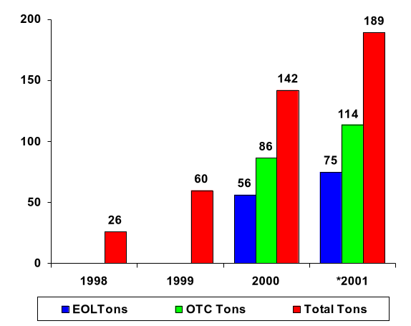
Coal Group Domestic Tons Traded
(MM Tons)
*Projected

Slide 62
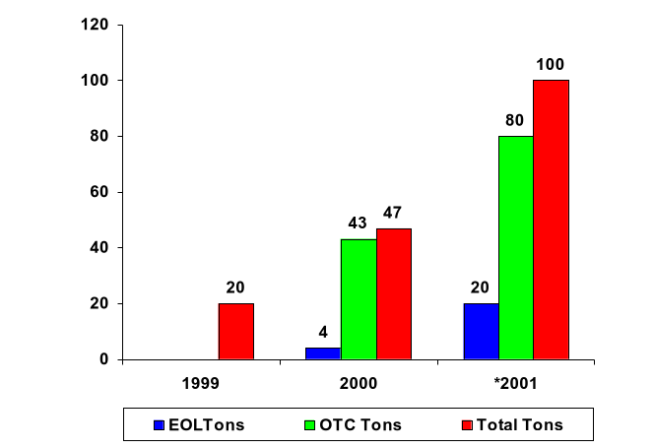
International Coal Tons Traded
(MM Tons)
*Projected

Slide 63
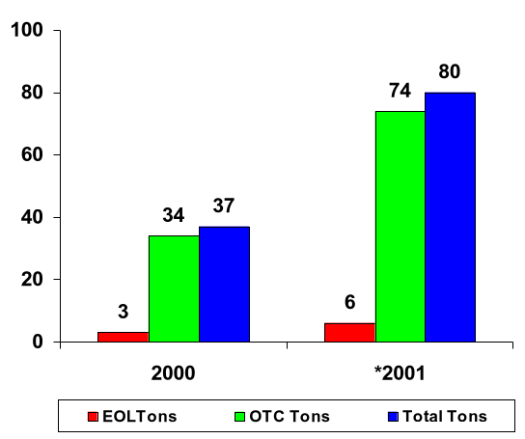
International Vessel Tons Traded
(MM Tons)
*Projected

Slide 64
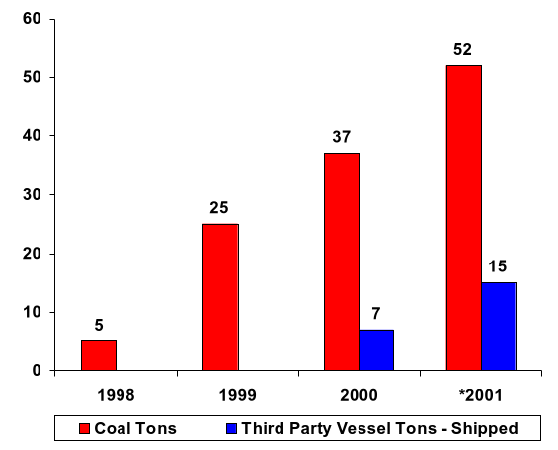
Coal Group Tons Shipped
(MM Tons)
*Projected

Slide 65
Major Areas of Activity
Coal, Emissions, and Vessel Trading
EOL and OTC
Mid-Market
Origination

Slide 66
The Dream Team
Synfuel
Stockpile Deals
Credit
Sites
O&M
Coal Feedstock
Synfuel Off-take
Monetizers
Market
Transportation - Barge/Rail
Credit
Station stockpile - optionality
Rail - trade capacity
Port - stockpile optionality
Vessels / Barges (US flag & international flag)
Coal - (domestic & offshore)
Currency - USD book in London
Emission Credits

Slide 67
Summary
Become acknowledged market leaders - global coal, vessel trading, and emissions
Trade to make money
Big origination deals
The Dream Season - $75 MM

Slide 68
Freight
Dan Reck

Slide 69
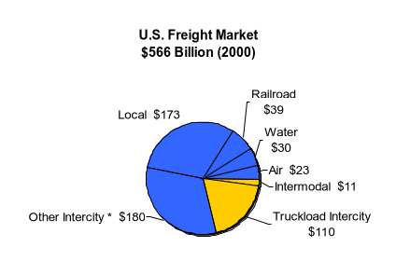
Freight Market
Global freight market size is approximately $2 trillion
US freight market size is approximately $566 billion
*Includes small package and LTL
<number>

Slide 70
Intermodal vs. Truck Freight

Slide 71
Freight Market Characteristics
Cost of supply = fuel + capital + labor/information technology
Industry supports robust spot market and thousands of intermediaries
Loosely-defined contracts and customer relationships
Mispriced optionality
Apparent diseconomies of scale?
  Asset-based companies
    JB Hunt, Swift
  Traditional intermediaries
    CH Robinson, Hub Group, Pacer, Landstar
    Saddled with existing structure and business model
  New model
    Quebecor
<number>

Slide 72
Enron Freight Markets Structure

Slide 73
Traditional Intermediary Business--Kravas
Intermodal Marketing Company - acquisition of Webmodal
  A functioning intermodal marketing company
    Team with average of 10+ years domain experience
    Pricing data and pricing engine that emulates truckload transportation
    Nationwide coverage with all major railroads and 45 drayage companies
    Blueprint for scalable processes and systems
  Time to market
    Accelerates Enron’s development of freight business by 12-18 months
  Customer relationships
    90 customers including Frito Lay, Ryder, Igloo Products, and UPS Logistics
    Surveys found appreciation for front-end interface, tracking, pricing, etc.
Truck Broker/Forwarder - acquisition/creation of freight forwarder
  Compete in spot market
  Acquire better understanding of truck freight market

Slide 74
Scalability
Average time to execute transaction can be reduced by 70% using technology
Reduced through
  Automated functions such as notification of late loads
  EDI, XML, or web communication of pricing, confirmation, tracking, and invoicing between carriers, shippers, and Enron
Average Per Load Time to Execute
(Minutes)
Order
Entry
Tracking
Confirmation
Scheduling
Invoicing
Collection
Total Average Time
Existing
Process Time
.9
14.3
10.4
5.4
7.7
2.9
41.5
Automation Time
.7
2.3
2.8
1.1
3.2
2.1
12.2

Slide 75
Trading—(tbd)
Risk management team with background in trading and structuring
Trading team will develop market for standard products and manage all freight risk:
Full Truckload Capacity
Intermodal Rail Capacity
Ocean Container Capacity
Air Freight Capacity
Warehouse Space
Diesel Fuel

Slide 76
Origination--Cumberland
Structured finance deals to provide Enron Freight with strategic positions
  Shippers (buyers)
    Structured Outsourcing, Replace Fleets with Contracts, etc.
  Truck capacity (ongoing consolidations)
  Rail capacity
  Ocean Container Carriers (acting as domestic IMC)
  Traditional intermediary acquisition analysis
  Technology/Logistics acquisition analysis
  Distressed Debt (15% of trucking firms RIP in 2000)

Slide 77
Resource Needs
New Building
300-500 people over the next 3 years

Slide 78
Weather
Mark Tawney

Slide 79
Table of Contents
Vision and Strategy
2001 Goals
Weather Risk Management
Historical Performance
Trading – Steven Vu
Origination – Gary Taylor
New Product Development – Claudio Ribeiro
Research – Joe Hrgovcic
Structuring – Sanjeev Khanna
International – TBD
The Winter Book
The Summer Book
Staffing
Notes:
<number>
<footer>
<header>
<date/time>

Slide 80
Vision and Strategy
VISION
To be the dominant market presence in all facets of the maturing weather risk management industry including trading (volumes and profit), marketing (noteworthy deals and dealflow), new product development, and research (internal and external).
STRATEGY
Leverage two of Enron’s key advantages, scale and scope, to accomplish our vision.
Our scale advantage stems from the resources Enron has amassed due to the overwhelmingly significant role weather plays in our core energy businesses. We (should) have the best systems, models, and research staff. Additionally, due to a “Go Big or Go Home” management directive, we have no choice but to pursue opportunities that others would find too large or too risky.
Our scope advantage results from our global presence and the diversity of the backgrounds of our personnel.

Slide 81
2001 Goals
Budget – 190% of 2000 earnings
  Create $38 million in gross margin and $24 million in EBIT
Go Big or Go Home
  Lever Enron’s scope and scale to create a true global group that can capitalize on opportunities around the world to take advantage of global arbs and execute global meteorological/climatological prop plays
Systems – from completely manual to fully automated
  Implement a fully integrated global front to back weather system
Origination – Fishing with Nets and Elephant Hunting
  Complete 15 “plain vanilla” end user transactions
  Originate 3 additional SMUD (dual trigger) like transactions; 1 structured tax related transaction and at least 1 new structured financial transaction

Slide 82
Weather Risk Management
Price
Expected Demand
Supply
P1
P0
Actual Demand
T0
T1
Volume
V₀
V₁
The weather derivatives market provides a venue for hedging volume risk, i.e. demand risk with respect to Btu based commodities and supply risk with respect to agricultural commodities.
As the supply of Btu based commodities is relatively fixed (but subject to shocks) in the short-run, weather derivatives can currently be used to hedge first order price changes. We are working on payoff profiles to hedge higher order price changes.

Slide 83
Profitability: Gross Margin Since Inception
Actual
Plan
Notes:
<number>
<footer>
<header>
<date/time>

Slide 84
Profitability: EBIT Since Inception
*Q4-99 Planned EBIT loss due to provision for bonuses
Notes:
<number>
<footer>
<header>
<date/time>

Slide 85
The Book: Counterparties - 65
End Users
Market Makers
Insurance Companies
Enron
Other
Atmos Energy
Accord Energy
Ace/Tempest
EAF (Australia)
Goldman Sachs
Berkshire Energy
Coral Energy
AIG
ECERIT (London)
Lehman
Bombardier Motor Company
Duke Power
American Re Capital Markets
ECT Gas Daily Options
WeatherWise
Columbia Energy
Dynegy
Aon Financial Products
ENA-Central
Conagra1
El Paso
Arrow Reinsurance Company
Enron Re
Cornerstone Propane L.P.
Koch
Associated Electric & Gas
EPMI
Corney & Barrow
Louis Dreyfus
Commercial Risk Reinsurance
CTG Resources
Mieco
Element Re
Del Marva Power & Light Co.
Reliant
Hannover Re
Societe Generale/ Barep
Kemper (Lumbermans)
Eastern Power Distributors
Southern Company
New Cap Re
El Paso Power Desk
Utilicorp/Aquila
PxRe
Energie Noord West
St. Paul Re
Energy West
Vitol
Swiss Re
Florida Power & Light
Williams
Zurich Re
Independent Energy
Inergy
Kinder Morgan
LG&E
Madison Gas & Electric
MidAmerica
Nova Scotia Power
Oneok
PG&E
Sacramento Municipal Utility District
Scottish Hydro
Southstar
Valley Resources Inc.
West Kootenay Power
Notes:
<number>
<footer>
<header>
<date/time>

Slide 86
The Book: Monthly Deal Count
2000
2001
Notes:
<number>
<footer>
<header>
<date/time>

Slide 87
Trading – Steven Vu
Trading book regionalized globally, with individual traders responsible for executing regional trades in concert with a global strategy
Take larger proprietary positions using North American as well as global weather patterns
Use cross-commodity relationships to fuel position taking and liquidity for origination support
Access capital/reinsurance markets using investment banks to generate risk capacity and optionality for US and international markets
Increase liquidity and the number of products available on EnronOnline.
Notes:
<number>
<footer>
<header>
<date/time>

Slide 88
Origination – Gary Taylor
Fishing with nets, not lines
  Mass education/awareness efforts result in discussions with only interested parties. Previous efforts pursued customers we thought to be weather sensitive. Current efforts bring in customers who believe that they are weather sensitive (TV commercials, website, articles, conferences, etc.)
  Create environment wherein weather risk is treated the same way as other hedgeable risks (interest rates, f/x, commodity prices, etc.) by educating debt and equity analysts and ensuring that companies that hedge are treated well by their respective markets
Elephant hunting
  Execute 3 structured weather-linked transactions along the lines of the SMUD transaction
  Execute 1 large or several small weather derivative tax plays with customers
  Execute 1 weather linked debt financing
Notes:
<number>
<footer>
<header>
<date/time>

Slide 89
New Product Development – Claudio Ribeiro
Develop new weather driven indices and products that eliminate basis risk and translate weather exposure into “comfort language” for those industries. In doing so, increase the liquidity of the weather market.
Power Demand Indices: The Weather Desk currently trades a PJM Demand Swap on EnronOnline. In the near future will begin trading NEPOOL and NYPP and, eventually, Alberta and California.
Natural Gas Consumption Indices: We are currently working on a possible UK index tied directly to Mcf consumption. In the US we are working on creating a temperature based index that approximates the weather impact on the AGA storage numbers.
Agriculture: Numerous correlation studies. We have already identified a corn price/extreme weather opportunity and are currently focused on designing a yield based hedge for grain elevators.
Cross-Commodities Products: We are in the process of designing weather index products that settle in the financial equivalents of commodity volumes.
Retail Products: We are exploring the creation of a “Bad Weather Days” Index that we believe will correlate well with retail sales activity.
Notes:
<number>
<footer>
<header>
<date/time>

Slide 90
Structuring – Sanjeev Khanna
Provide structuring support to origination and trading
Build a team that acts as a training ground for global origination and trading positions
Provide initial pricing support
Liaise between origination and trading
Develop spreadsheet tools to improve efficiency and effectiveness
Shepherd deals through Research, trading and origination
Develop cross commodity plays
Assist in the creation of more value-added products
Notes:
<number>
<footer>
<header>
<date/time>

Slide 91
Research – Joe Hrgovcic
Oversee the development of a front to back fully integrated weather research, pricing, and trading system and database
Incorporate 40 years of full reanalysis data (including e.g., upper level pressures, sea-surface temperatures, etc.) into the database to better identify global and local weather patterns
Develop a better understanding of climatic variability through the study of “teleconnections” such as ENSO, NAO, PDO, etc.
Improve weather database tools for filling in missing data and identification of non-reported shifts in temperature series
Develop a general method of conditioning near-future weather curves on near-past weather
Run general circulation climate models for seasonal and mid-range forecasting.
Establish outreach programs with academia and governments to stay at the forefront of weather research
Notes:
<number>
<footer>
<header>
<date/time>

Slide 92
International – TBD
Utilizing employees focused solely on weather in London, Tokyo, and Sydney, build a well integrated global team that leverages our knowledge, scope and scale.
London - Build full service weather trading office in London to cover the entire European market. Staffing will be a function of Oslo employee retention.
Tokyo - Hire one senior originator with banking and insurance industry contacts and an understanding of risk management products.
Sydney - Hire a senior trader, structurer, and meteorologist to trade Australia, Japan, and Hong Kong and support Tokyo based originator.
Continue to trade Asian cities during US trading hours.
Target insurance companies and speculators in international markets.
Notes:
<number>
<footer>
<header>
<date/time>

Slide 93
The Book: March Positions
(by Delta)
Seattle
Spokane
Grand Forks
Providence
Burlington
Portland
Bismarck
Fargo
Philadelphia
Green Bay
Boston
Minneapolis
Worcester
Boise
Sioux Falls
Madison
Detroit
New York
Casper
Chicago
Cleveland
Pittsburgh
Newark
Omaha
Columbus
c
Sacramento
Lincoln
Indianapolis
Cincinnati
Baltimore
Atlantic City
Fresno
Grand Junction
Wilmington
Bakersfield
Charlotte
Washington DC
Albuquerque
Amarillo
Little Rock
Atlanta
Columbia
Phoenix
Birmingham
Savannah
Tucson
Lubbock
Legend
Baton Rouge
Long
Short
Houston
$/Heating Degree Day (HDD)
|$16M| - |$30M| |$11M| - |$15M| |$6M| - |$10M| |$2M| - |$5M| less than |$2M|
As of February 20, 2000
Notes:
<number>
<footer>
<header>
<date/time>

Slide 94
The Book: Summer Positions
(by Delta)
Seattle
Hartford
Burlington
Minneapolis
Green Bay
Boston
Detroit
Binghamton
Providence
Madison
New York
Chicago
Cleveland
Des Moines
Columbus
Philadelphia
Newark
Sacramento
Salt Lake City
Indianapolis
Cincinnati
Atlantic City
Reno
Grand Junction
Fresno
Kansas City
St. Louis
Las Vegas
Dodge City
Charlotte
Oklahoma City
Memphis
Phoenix
Charleston
Tucson
Dallas
Shreveport
Legend
New Orleans
Long
Short
Houston
$/Cooling Degree Day (CDD)
|$16M| - |$30M| |$11M| - |$15M| |$6M| - |$10M| |$2M| - |$5M| less than |$2M|
As of February 20, 2000

Slide 95
Staffing
Mark Tawney
Vice President
Betty Coneway
Admin. Coord.
Yolanda Ford
Sr. Admin.
Todd Hall
Director
Joe Hrgovcic
Manager
Claudio Ribeiro
Manager
Sanjeev Khanna
Director
Gary Taylor
Manager
Steve Vu
Manager
Will Kelley
Manager
Y Tzamouranis
Manager
Eduardo Gil
Associate
Gregor Lehmiller
Manager
Partho Ghosh
Manager
S Ramachandran
Manager
Tim Norton
Sr. Specialist
Todd Kimberlain
Meteorologist
Kyle Berryman
Associate
Vacant
Associate
Bob Beyer
Manager
Vacant
Manager
Reno Casimir
Sr. Specialist
Huy Dinh
Analyst
Brian Harper
Temp
Structuring
Valter Stoiani
Associate
Catherine Woolgar
Associate
Salisha Ramos
Admin. Asst. II
Research
New Product
Development
Vacant
Associate
Mike Nguyen
Specialist
Risk
Management
Marketing
Rajib Saha
Specialist
Trading
Notes:
<number>
<footer>
<header>
<date/time>

Slide 96
Staffing
Mark Tawney
Vice President
Morton Eric Petterson
Manager
Ross McIntyre
Manager
Raymond Yeow
Vice President
Bjarne Schieldrop
Sr. Commercial
Takuro Shioda
Assocaite
Christian Werner
Manager
Didrik Thrane-Nileson
Sr. Support
Frank Lien
Analyst
Lars Elmlund
Analyst
Rognes Oystein
Analyst
Notes:
<number>
<footer>
<header>
<date/time>

Slide 97
Financial Trading
Gary Hickerson

Slide 98
Enron Global Markets - Financial Trading
Summary of Businesses
Interest Rate & Currency Trading
Manage Drift associated with commodity portfolios
Advise, structure and execute transactions for all Enron entities
Proprietary Trading
Global Product Coverage
Equity Trading
Proprietary Trading
Relative Value (long/short) Equity Fund
Convertible Arbitrage Fund
Sectors: Commodities, Technology, Financial
Agriculture Trading
Origination and Trading
eCommerce
Sectors: Softs, Grains, Meats
Operations and IT Support
Strong staff, infrastructure and controls
Broad capabilities and evolving state-of-the-art systems

Slide 99
Financial Trading Performance

Slide 100
Equity Trading
2000 Performance Highlights
Achieved $59 million (Plan: $20 million)
Establish London Office - Part I
  Legal, Recruiting, Systems, Operations
Redesign Technology Trading Model
Redesign Utility Trading Model
2nd/3rd Generation - Equity Trading System
Expanded Staff
2001 Goals
Produce $90 million income
Increase Limits and Sectors
Establish London Office - Part II
  Staff and Trading
Establish Tokyo Office
Implement Utility Trading Model
Expand Convertible Arbitrage
Implement 3rd/4th Generation Equity Trading System
  Web-Based, PDA’s
Implement Straight-Through Processing
  Order Management System
  Position Tracker
  Security Master
Expand Staff

Slide 101
Equity Trading
Sharpe Ratios
  Definition: Sharpe Ratio
  - For Financial Trading: • Cumulative Return
  • Divided by
  • Standard Deviation of Daily Returns * Square Root of Time

Slide 102
Agriculture Trading
2000 Performance Highlights
Investigate AG Business
- Grains - Exploratory Meetings
- Meats - Market Surveys
- Softs - Consultants
- Other - Legal
- Regulatory
Build Staff
Establish Initial Limits
Integrate Rudolff Wolff/MG
- Brokerage
- London Operations
2001 Goals___________________
$10 million in Revenue
Board Approval for Increased Limits
Focus Business Model
- Softs
- Grains
Launch EOL
- Softs
- Grains
Build Customers Relationships

Slide 103
Rate and Currency Trading
2000 Performance Highlights
Proprietary Trading $11 million (Plan: $15 million)
US Drift Income $158 million (Plan: $90 million)
Key Personnel Turnover
- Harry Arora
- Trena McFarland
- Shane Dallman
Close RW/MG FX Business in NY/London
EOL - Canada
Tokyo
Build Enron relationships
2001 Goals___________________
Produce $10 million income
Drift $155 million
Personnel
Tokyo Office
Building Enron relationships
Capture Enron Metals Cashflow and FX
Capture FX exposure in other areas
EOL - Interest Rates
EOL - Canada customers

Slide 104
Operations and IT
2000 Performance Highlights
Sheila Glover
- Monthly Reporting Package
- Efficient Legal/Tax Structures
London (Equity Trading)
Tokyo (Rate & Currency) Trading
- Processes strengthened
- Service Agent to Other Enron Business
Chris Constantine
- Web-based 3rd Generation Equity
Trading System
- Controls improved as books converted
from Excel to Trading System
- Report Server functionality established
- Portfolio/strategy trade designation and
reporting
2001 Goals__________________________
Sheila Glover
- Build Global Staff with Bench Depth
- Facilitate FX Analysis and Reporting for
other groups
- Support expanded businesses and
volumes
- Enhanced Management and Performance
Reporting
Chris Constantine
- Improve FX P&L and Risk Reporting
- P&L Decomposition Reporting
- Implement Straight-Through Processing
- Multi-Location Trading (eg. Tokyo/
Australia)

Slide 105
Summary - Financial Trading
Motivate staff……….
Grow earnings……….
Leverage new markets……….
Exploit new technologies……….
Maintain integrity and controls……….
Make money - Have Fun……….

Slide 106
Conclusion
Jeff Shankman

