Slide 1


Enron Global Markets
®
All Employee Meeting
Hyatt Regency
Houston, Texas
May 7, 2001

Slide 2
Today’s Presentation
EGM Overview
Operating Highlights
Business Unit Updates
Crude & Products
Coal
Weather
LNG
Q&A

Slide 3
EGM Overview
®
Mike McConnell
President & CEO

Slide 4
Enron Global Markets
New business unit focusing on global markets and commodities outside Enron’s traditional gas and power markets
Global Crude, Products, Petchems, and LPGs
Coal and Emissions
Shipping
LNG
Currency, Equities and Interest Rates
Freight
Insurance
Weather
Agricultural
EGM provides a true network for market making opportunities related to commodities that are highly liquid in physical or financial terms and are enormous in market size
EGM leverages the value of Enron’s existing network and international asset positions
EGM’s operations will coordinate and leverage with our North American, European, Australian, and Japanese businesses

Slide 5
EGM’s Wholesale Business
Crude &
Products
Coal
LNG
Emissions
Weather
EGM
Shipping
Insurance
Freight
FX/Rates/
Equities
Agribusiness

Slide 6
EGM’s Wholesale Business
Natural Gas
Power
Coal &
Emissions
Global Crude &
Products
Financial
Trading
Weather
Agriculture
LNG
Insurance
Freight
& Shipping
Pulp &
Paper
Merchant
Investments
Metals

Slide 7
Enron Global Markets
Creating New Markets in Global Commodities
Offices
Coal Activities
Crude and Product Activities
Weather
LNG Activities
LNG Ships
Houston
London
Oslo
Singapore
Seoul
Puerto Rico
New York
Tokyo
Sydney
Panama
Dubai
Johannesburg
Frankfurt
Europe
China
Australia
USA
Korea
South Africa
Japan
India
Colombia
Venezuela
Indonesia
Poland
Russia
USA
UK (Europe)
Singapore
Australia
Panama
Korea
Japan
Argentina
USA Europe
Japan
Australia
India
Puerto Rico
Venezuela
Georgia
Louisiana
China
Australia
Korea
Oman
Abu Dhabi
Bahamas
Indonesia
Malaysia

Slide 8
Key Accomplishments
New focused organization has added significant intellectual capital and earnings to wholesale group
Gross margin for Q1 2000 to Q1 2001 increased 36% to $100 million
Added $84 million of gross margin in Q4 2000 and $100 million Q1 2001
Started 2 new businesses: Agriculture and Freight Markets without losing focus
EGM businesses now see themselves as “core” with a full appreciation of their impact on Enron corporation
For example: Incremental $200 million EBIT = $135 million after tax
= EPS - $.16; P/E of 35 = $5.00/share and over $4.7 billion in market cap
Each business focused on their balance sheet, ROE & funds flow targets
The transfer of the Enron wholesale market making model will be illustrated in the growth in these businesses by year end
“Go Big or Go Home” philosophy

Slide 9
Enron Global Markets
Office of the Chairman
Mike McConnell - President & Chief Executive Officer
Jeff Shankman - Chief Operating Officer
Global Crude &
Products
John Nowlan
VP
Coal Group
George McClellan
MD
Global Risk Markets
Per Sekse
VP
LNG & Middle East
Rick Bergsieker
MD
LNG
Eric Gonzales
VP
Financial Trading
Gary Hickerson
MD
Enron Japan
Joe Hirl
VP
Freight Markets
Dan Reck
VP
Weather
Mark Tawney
VP
Fundamentals
Jen Fraser
Director
Finance & Structuring
Larry Lawyer
VP
Accounting
Brent Price
VP & CAO
HR
Shanna Funkhouser
Director
Legal
Alan Aronowitz
VP & GC

Slide 10
EGM Operating Highlights
®
Jeff Shankman
Chief Operating Officer

Slide 11

Developing High Growth Wholesale Business
Coal - $40 Billion Market
Crude & Products - $3 Trillion Market
Largest domestic coal market maker
Largest importer of coal into U.K.
Expanding into Asia
Coal, emissions and dry-bulk freight markets online
Leader in risk management products
Growing presence in global freight markets
Crude and products (gasoline, heating oil, jet, gasoil, residue) MTBE, petrochemicals, plastics and LPGs
Actively transacting online
Geographic product expansion
Largest petrochemical risk management portfolio in the world
Enron
Global
Markets
Weather - $1+ Trillion Market
LNG - $18 Billion Market
Leading market maker
Products offered in every state and 10 countries on 4 continents
Successfully transacting on EnronOnline
Product offering covers entire developed world
Creating a global network of LNG supplies, transportation, terminals and markets
Developing an online market making network
Growing Enron’s LNG shipping business
Leverage EnronOnline, North American, Asian, and European Networks

Slide 12
EGM - Gross Margin 1998-2001
Actual Actual Actual Plan
1998 1999 2000 2001
Gross Margin $116 $186 $206 $497
Gross Margin
$497
$186
$206
$116
Note: Puerto Rico, Middle East and LNG EBIT included in 4Q 2000 and 2001 only.

Slide 13
EGM - Gross Margin 1998-2001
Actual Actual Actual 2001 Plan
1998 1999 2000 Q1 2001
Gross Margin $116 $186 $206 $100 $497
Gross Margin
$497
$186
$206
$116
$100
Note: Puerto Rico, Middle East and LNG EBIT included in 4Q 2000 and 2001 only.

Slide 14
EGM - Earnings Growth 1998-2001
Actual Actual Actual 2001 Plan
1998 1999 2000 Q1 2001
EBIT $30 $81 $67 $46.3 $270
EBIT
$270
$81
$67
$46.3
$30
Note: Puerto Rico, Middle East and LNG EBIT included in 4Q 2000 and 2001 only.

Slide 15
Expansion of Existing Business
Consolidated EGM
($000’s)

Slide 16
Expansion of Existing Business
Consolidated EGM
($000’s)

Slide 17
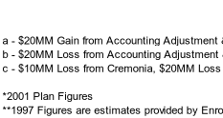

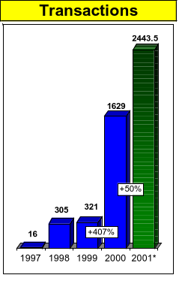
Expansion of Existing Business Transactions
Crude & Products
Coal & Emissions
Weather
*2001 Plans Figures

Slide 18
Business Unit Updates
®

Slide 19
Enron Global Products
®
John Nowlan

Slide 20
Enron Global Products
What We Are:
Almost All The Liquid “Stuff” In The World
Crude Oil, Gasoline, Heating Oil, Gasoil, Resid, LPG’s, Petchems
Big, Big Markets, Big Books, Big Deals
Crude Oil/Products Markets Trade Over 750 Million BBLS Day
LPG/Petchem Markets Over 100 Million BBLS Day
Counterparties BP, XOM, El Paso, Dynergy, J Aron, Morgan Stanley
Enron Trades On Average Over 20 Million BBLS Day And Growing
Executed The Largest To Date Transaction On EOL
Deals & Structures Out Over 10 Years
Growing
Trading, Building A Talent Pool in All Geographic Regions
Mid marketing - Origination - Focused & Growing
Products - Expansion In Petchems, Plastics, Ammonia, Ethanol
Committed To Being The Biggest & The Best
Our Markets Are Changing And We Are Driving The Change!

Slide 21
Enron Global Products
What We Are Not:
Thinking Small
We Want To Be The Significant Force In The Markets In Which We Participate
Happy With Incremental Growth
Want To Make Crude & Products A $500 Million+ Business
Boring
Developed Markets, Freely Trading
Impacted By Everything, Weather, Politics, Economics
Open 24 Hours A Day For Business

Slide 22
EGM Coal Group
®
George McClellan

Slide 23
EGM Coal Group
Domestic
Origination
Debt and Equity
Mines in W. Virginia, Kentucky, Pennsylvania and Illinois
New opportunities in Wyoming, Australia, and Indonesia
Trading
Largest domestic coal trader
Shipping to every major coal burning generator
The market maker for EOL, NYMEX Look-Alike, and OTC markets
New opportunities to trade rail & barge transportation services

Slide 24
EGM Coal Group
International
Global Business - Top 3 International Trader
Into the Stockpile Deals - Largest supplier of imported coal in the U.K.
Significant sales presence in Germany, Spain, and Hong Kong
Vessel Trading - Acting as market maker for coal, grain, iron ore, metals, and liquids
Coal originates from Colombia, Venezuela, Poland, Russia, China, Indonesia, Australia, and South Africa
Coal offices in London, Frankfort, Johannesburg, Beijing, and Sydney

Slide 25
Weather Risk Management
®
Mark Tawney

Slide 26
Weather Risk Management
Budget – 300% increase over 2000 Budget
Go Big or Go Home
Take advantage of Enron’s global presence and size to capitalize on opportunities around the world including transactions with multi-national companies and trading strategies that tale advantage of global meteorological opportunities
Innovate or Die
Develop products to bring the world’s weather exposure into our market. As an illustration of the potential market, the Department of Commerce estimates that, annually, $1 trillion of the US’s GDP is exposed to the weather
Hunt Elephants
Originate 5 large structured transactions (e.g., dual trigger, weather based financing, etc.)

Slide 27
Weather Risk Management
Risk
Management
Origination
Risk
Management
Risk
Management
Research
Structuring
Structuring
Structuring
New Product
Development
Origination
Origination
Structuring
Marketing
Marketing
Origination
Trading
Trading
Marketing
Trading

Slide 28
Enron Global LNG
®
Eric Gonzales

Slide 29
Enron Global LNG
Vision:
To become the world’s leading merchant marketer of LNG
Team:
We have assembled a world-class LNG team, with expertise in every aspect of the LNG business (shipping, development, trading, marketing)
Strategy:
Concentrate efforts on portions of the LNG value chain where Enron can manage risks (i.e. commodity pricing, shipping, basis, etc)
Gain control of a “critical mass” portfolio of elements in the chain to optimize positions. Positions to be created primarily through contracts and selective asset development (regas terminals, liquefaction capacity, shipping)
Key 2001 Commercial Objectives:
Continue expansion of trading activity with emphasis in immediate utilization of current shipping and regas terminals positions
Build multi basin supply portfolio with delivery diversion flexibility
Selective Asset Development efforts (examples: Project Jose, Bahamas Terminal)
Manage DPC supply and shipping issues

Slide 30
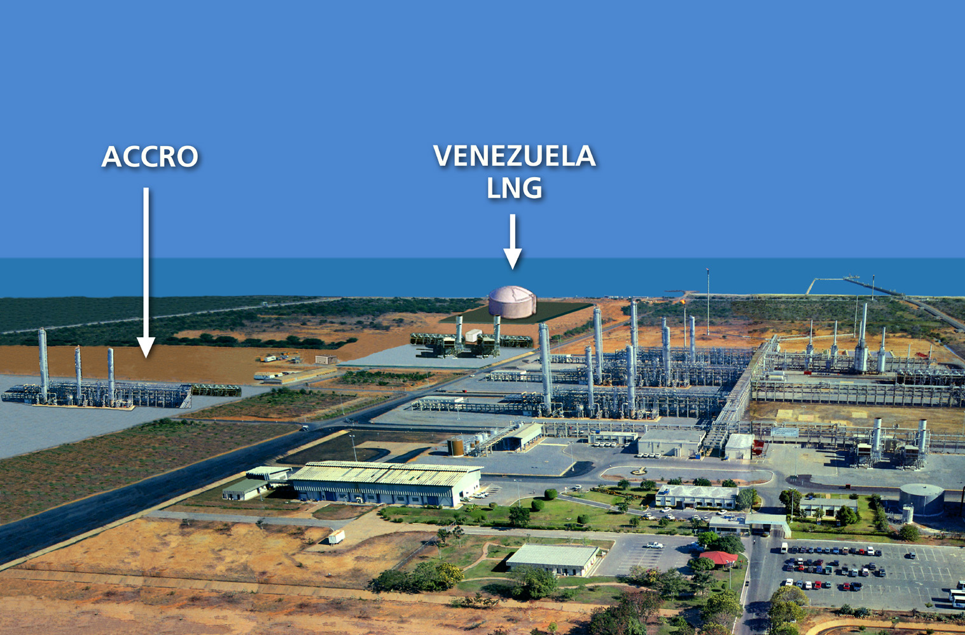
Project Jose
LNG liquefaction, storage, and export facility in Jose Venezuela
Enron currently holds 100% of project
300,000 MMBtu/d capacity of LNG
Estimated all-in capital cost: $700 MM
Commercial Operations Target date of Q1 2005
Gas supply to be provided by PDVSA
Target LNG markets: United States, Europe and Caribbean
Next Steps
Receive Export Approval from Venezuela Ministry of Energy
Execute GSA and associated agreements with PDVSA
Release 2 EPC contractor Feed Works Q3 2001
Receive required environmental and construction permits by end Q3 2001
Release EPC Contractor in late Q4 2001

Slide 31
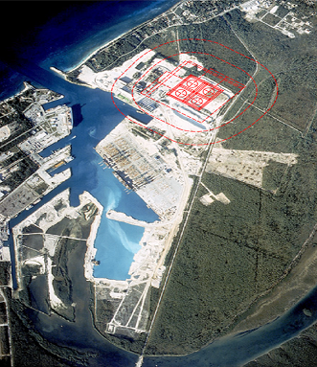
Bahamas LNG Terminal
The terminal will receive and off-load LNG from Atlantic LNG supplies
The terminal will store the LNG, vaporize it, and feed it into a 90-mile, 24” sub-sea pipeline. Initial terminal deliverability is expected to be 300-400 MMcf/d
The pipeline will deliver the natural gas to Florida, near Port Everglades
Total initial capital investment in the project of approximately US$ 400 million
Project can accommodate up to 900 MMcf/day throughput
Activities to Date
Secured terminal site end 2000
Permitting process underway
Open Season on FGT pipeline connection initiated April 2001
Next Steps
FERC pipeline application submittal scheduled for Q2 2001
EPC tender release Q2 2001
All required environmental and construction permits to be received by Q4 2001
EPC notice to proceed release Q4 2001
Project onstream Q4, 2004

Slide 32
Q&A
®

