Slide 1

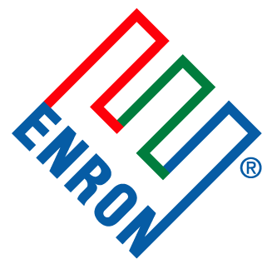
Enron Global Risk Markets
Contingent Call Option Product

Slide 2
About Enron
Enron is one of the world's leading electricity, natural gas and communications companies. Revenues were $101 billion in 2000, ranking #7 - Fortune 500.
We are a leading provider of financial and risk management services and commodities to customers around the world.
“America’s Most Innovative Company”, six consecutive years, 1996-2001 – Fortune Magazine
“Energy Company of the Year”, 2000 – Financial Times Energy Global Awards

Slide 3
Power Market Observations
Deregulation and industry divestiture have increased risk associated with transactions.
Price volatility has significantly increased market risk.
Power call option markets are not liquid – limited availability for cost effective hedging against both price and outage risk.
Until recently, there has been minimal direct protection against loss of power generation during volatile spot market conditions.

Slide 4
About our Product
Our Contingent Call Option Product is a derivative contract that protects power producers, marketers, and other market participants from unplanned generating outages during high spot market prices.
The product is a dual trigger contract that is callable under the following two conditions:
Occurrence of unplanned outage of a generating unit
Price of electricity is above a pre-determined spot market strike price

Slide 5
Example of Event and Price Risk
SYSTEM OUTAGE AND PJM INDEX PRICE HISTORY
350
325
Average Daily Price
$303.5
300
Outage Event
275
250
225
200
PJM AVERAGE DAILY PRICE ($/MWh)
175
150
$138.9
Payout
125
Event
100
75
$75.9
50
Strike = $50/MWh
25
0
1-Jul
3-Jul
6-Jul
10-Jul
12-Jul
16-Jul
18-Jul
20-Jul
24-Jul
26-Jul
30-Jul
1-Aug
3-Aug
7-Aug
9-Aug
13-Aug
15-Aug
17-Aug
21-Aug
23-Aug
27-Aug
29-Aug
31-Aug
TRADING DATE

Slide 6
Product Benefits
Product premium is approximately 10% of comparable call option on power, providing a more cost effective and efficient hedging tool for outage risk
Structure is flexible and highly customized to fit unique needs of customer
Product allows for not only hedging outages but has potential to increase generating revenues from firm sale of physical power

Slide 7
Who Benefits?
Wholesale Power Marketers
Buy contingent and sell firm power, forming an arbitrage opportunity
Merchant Generators
Hedge from unplanned outages and increase revenues by selling firm, rather than contingent power.
Investor Owned Utilities and Coops/Municipalities
Mitigates risk of significant system outages during periods of peak demand
Sell excess capacity on firm basis.
Large Industrials
Hedge exposure to large penalties if loss of generation.

Slide 8
Transaction Example
Utilities, Coops, and Municipalities:
Enron
Outage
Option
Premium
Firm Obligation
Generator
Customers
Fixed Tariff
A 500 MW outage during a price spike can cost the utility:
500 MW
1000 $/MWh
16 hours
$8,000,000 per day
almost $25MM for a 3-day event

Slide 9
Further Information
For further information on our product, please contact:
David Hoog @ David.Hoog@Enron.com

