Slide 1
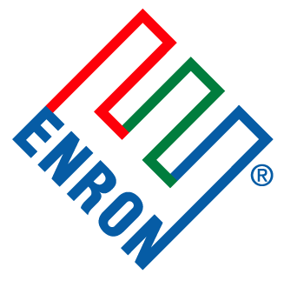
Enron Energy Services
Government and Regulatory Affairs Offsite 2000

Slide 2
Agenda
The EES concept
GRA support to EES
Product development

Slide 3
The EES concept

Slide 4
Energy Outsourcing: Value drivers
Integrating and optimizing the entire energy supply chain requires control of all three value drivers by a single decision maker.
Value Drivers
Utilities
O&M
Capital
Risk
Management
Fixed/semi-fixed prices & tariff analysis/negotiation
Monitoring/control of consumption
Reduced risk through greater control of maintenance schedule & standards
Lower risk premium through more accurate project risk analysis
Life Cycle Cost
Optimization
Reduced consumption
- More focused intellectual engineering
- Investment in new assets
Reduced O&M
- More focused intellectual engineering
- Investment in new assets
Reduced capital required per unit of output through improved equipment specification
Integration of market price information and remote monitoring & control of energy assets
Risk quantified maintenance techniques
Global services best practices
More efficient deployment of capital
Off-balance sheet finance structures
Scale in metering, billing, & collections
Scale procurement in services
Scale procurement in equipment procurement

Slide 5
Utility Representation Service (URS)
Description
Enron works with customer to identify opportunities to negotiate for lower rates with utility and checks accuracy of bills
Resulting savings are shared on a negotiated basis
Enron may work with customer behind-the-scenes if sensitivity requires it
Examples include:
Voltage Buy-Up
Special Contracts
New Tariff
Advantages
Optimizing asset usage
Brings EES expertise regarding regulations to customer
Serves as bill audit function
Key Requirements
Demonstrable experience and expertise in tariff analysis and negotiations

Slide 6
Supply Side Assets
Description
Enron will value the ability to own/operate supply side energy assets
Examples include:
Installation of peak shaving generation to reduce customer load and reduce the marginal rate of energy consumption
Paying the customer for options to call upon energy produced by on-site generator during critical times in the market
Finding value in fuel switching of assets (gas/electric/other)
Advantages
Optimizing asset usage and providing economic incentives to customer
Key Requirements
Favourable regulatory conditions for the installation and operation of assets
Ability to connect and sell back to grid
Favourable input/output commodity spread

Slide 7
Value Added Tender Service
Enron assists in the procurement of commodity
Customer takes the lowest price respondent from the RFP process and provides Enron with the right to match
If Enron matches, customer gives the lowest price bidder from the RFP process the ability to counter offer
Any additional savings resulting from the counter offer is shared by customer and Enron
Description
Original
Price
Market
Offer
EES
Match
Value from
Tender Sevice
Revised
Offer
Rate
1
2
3
4
Advantages
Win/Win Situation

Slide 8
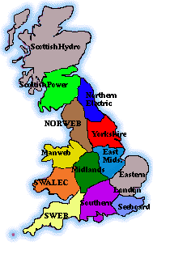
Retail Indexation
Enron creates an index by combining both commodity and delivery charges from a set of tariffs.
Description
Advantages
Ensures customer will be “at market”
Customer receives the full benefit of decreasing commodity and delivery prices
Customer benefits from diversified T&D portfolio
Key Requirements
Published unbundled tariffs (T&D, ancillary
services, CTC)
Clear generation charge through wholesale
commodity market or unbundled default generation

Slide 9
Bundled Fixed Price
Description
Enron offers a fixed price or savings to historic costs to meter/burner-tip
(commodity and delivery, exclusive of taxes)
Available in market with transparent default generation, pre economic open access date
Advantages
Provides immediate measurable savings
Provides predictable future costs
Transfers all volatility (commodity & delivery) away from customer
Key Requirements
Published transparent/unbundled tariffs (T&D, ancillary services, CTC)
Enforceable regulatory body that has set forth a plan for liberalisation
Transparent default generation or liquid wholesale commodity market

Slide 10
Wholesale “Plus” Indexation
Description
Enron passes through wholesale commodity costs
Fixing the costs of delivery through a basis adjustment
Advantages
Delivery volatility is eliminated for the term of the transaction
Market trends in delivery prices are reflected in the fixed cost component so that customers may benefit today from “levelisation” of delivery costs
Key Requirements
Published unbundled tariffs (transmission, delivery, ancillary services)
Enforceable regulatory body that has set forth a plan for liberalisation
Liquid wholesale commodity market or transparent default generation

Slide 11
Customised Risk Management
Structuring swaps and derivatives on either a wholesale or retail basis.
Cap/Floor/Collar
Description
Cap
Rate
Advantages
Floor
Index
Can provide for price certainty
Can mitigate the risks associated with price volatility
Can generate additional value to transaction
Term
Price remains in this range
Key Requirements
Participatory Structure
X% protection on
upward
price movements
Published unbundled tariffs (transmission, delivery, ancillary services)
Liquid wholesale commodity market
Development of forward volatility curves
Y% Shared
Savings on
downward
price movements
Rate
Index
Term
Price is at market in this range

Slide 12
Product Summary
Increasing Liberalisation
Increasing Risk Transfer
Product capabilities continually change with ongoing liberalisation.

Slide 13
Utility risk management
Regulatory
Curve/Product Dev
Origination/Up-sell
Structuring/Pricing
Risk Mgt
Wholesale
Curves
Products
Sales
Valuation
Booking
Retail
Reporting
Kyran Hanks
J.D. Burrows
Dung Tran
Jackson Vo
Dave Herleth

Slide 14
GRA support to EES
Market intelligence
Curve development
UK power
UK gas
Norway power
Netherlands gas

Slide 15
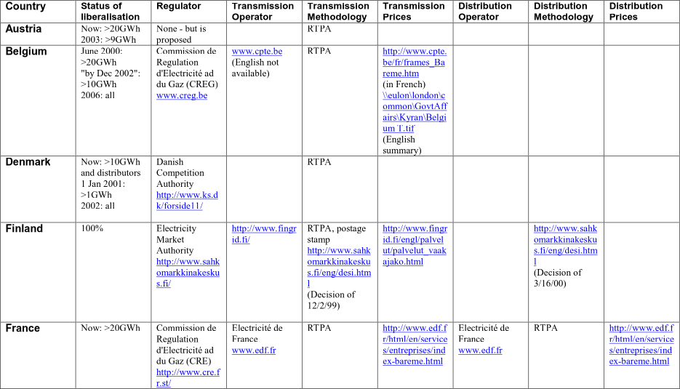
Market intelligence

Slide 16
Market intelligence

Slide 17
UK power
Tracked down all UK T&D charges
Modelled existing tariffs
Discussed assumptions with Ofgem
Assumptions
No significant opex cuts
Except from merger activity
Prices steady after 2005

Slide 18
UK power distribution curve 2000-09

Slide 19
UK gas
Modelled revenue
Discussed assumptions with Ofgem
Assumptions -
Second go at opex
Capex clawback
Reduced cost of capital
No reduction in regulatory value
UK gas team developing tariff analysis

Slide 20
UK gas transportation curve 2000-09

Slide 21
Norway power
Translated relevant documents
Modelled representative sample of tariffs
Met Norwegian regulator to discuss assumptions
Assumptions -
No great shocks in 2002 - UK not a comparator
Small opex cut in 2002

Slide 22
Norway power transport curve

Slide 23
Netherlands gas
Dutch CSS has already been modelled by Continental Gas Team
Assumptions -
NL to control prices like UK
Gasunie relatively efficient
But, more expensive than UK
Gasunie will trend slowly, but accelerating, to UK rates

Slide 24
Netherlands gas transportation curve, 2000-09

Slide 25
Other things -
Guidance on pan-European liberalisation - progress, issues etc
Other value drivers
Green energy?
Embedded generation

Slide 26
Product development

Slide 27

Background
Tyco International Ltd. is a diversified manufacturing and service company that designs, manufactures and distributes electrical and electronic components.
Tyco has facilities in the United Kingdom, France, and Germany. TYCO uses 47,067 MWh of electricity and 19,647 MMBtu of gas per year.
Enron Energy Services provided a creative Pan-European structure that optimized the value of the customer’s energy assets, while at the same time capping their rates.
10 year commodity management, and T&D bet
Sites located in UK, Germany, France, and Ireland
Proposal
Result

Slide 28

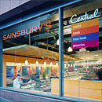
Sainsbury's is Britain’s longest standing major food retail chain. Sainsbury’s serves over 9 million customers in more than 400+ stores throughout England, Scotland, Wales and Northern Ireland.
Sainsbury’s spends more than £50,000,000 on electricity and gas annual.
Enron Energy Services provided a portfolio wide plan that would guaranteed the customer savings.
Largest margin contribution of committed deals, to date
Annual usage of 1,353,226 MWh and 611,372 Mmbtu
10 year commodity and T&D agreement for all 424+ sites
Background
Proposal
Result

Slide 29


Background
Owens Corning is a $5 billion global, industry leader with more than 20,000 employees around the world and with manufacturing, sales and research facilities in more than 30 countries.
Owens facilities in Europe produce fiberglass insulation, and composites. Owens uses 7,498,602 MWh of electricity and 30,780,279 MMbtu of Gas across several markets in Europe.
Enron Energy Services provided Owens with a Pan-European transaction.
Deal encompasses various markets from the most liberalized, Norway, to the least liberalized, France.
Created value in the non-liberalized markets through Value Added Tender service
Wholesale indexation for liberalized commodity market (U.K. Norway)
10 year energy commodity management, projects, and maintenance of assets.
Sites located in UK, France, Belgium, the Netherlands, Norway, Spain, and Italy.
Proposal
Result

