Slide 1


Lessons Learned Commercial Application of Regulatory Lessons EES International Working Group

Slide 2
Utility Does not Have to be Default Provider
Standard offer is a fixed kwh or rate freeze or index priced commodity for customers who have retail choice but do not choose a supplier.
Customers who do not choose a service provider default to utility or designated energy provider
Regulatory Lesson
If utility remains default service provider, a fully competitive market will not develop, even after the transition period.
Also, transfer of the subsidized incumbent role from utility to winning bidders will not create a competitive market.

Slide 3
Nature of Commercial Opportunity
Default Service Auction
To facilitate choice, the Commission should select by competitive bidding, a service provider for customers who do not make a choice.
The commission will determine the winning bid.
Default service price must include all costs associated with retail default service.
If a non utility default provider is not selected, the incumbent utility would remain default provider until next bid process. (Except in State like Texas where utilities are excluded from the merchant function altogether)

Slide 4
Commercial Application
Legislation and consummated deal
Connecticut
United Illuminating
Legislation
Texas

Slide 5
Connecticut: United Illuminating
Legislation: House Bill 5005., Public Act 9828
As a wholesale requirement, standard offers are often provided by utilities using their own assets
If a utility has divested its generating assets, it is supplied by a marketer responding to a formal solicitation
In the UI/Enron deal, UI purchased all its generation needs from Enron
The Enron/UI arrangement enabled UI to exit the merchant function from both the supply and load serving perspective
Enron obtained a short position and fixed prices to UI
Demonstrated Customer benefits
Projected profits for Enron

Slide 6
Project Summary
Enron to supply full requirements service for the United Illuminating company’s standard offer customers (residential, commercial, industrial, municipal loads) and special contract customers (industrials with high load factors)
UI Serves 310,000 customers, representing 20% of Connecticut load, 5% of NEPOOL load
Position: 21,884,530 PV Mwh short with 55% load factor 7,583,080 PV Mwh long hedge (primarily in 2000) 14,301,451 PV Mwh net short (primarily in 2001-2003)
Term: 1/1/00 through 12/31/03 for standard offer 1/1/00 through 12/31/07 for special contracts

Slide 7
UI Statistics
310,000 customers, 20% of Connecticut load, 5% of NEPOOL load
Summer peak of 1,200 MW with approx. 650 MW average load
Sales of 5.6 TWh/year
Member of NEPOOL and ISO-New England which has installed capacity of 25,000 MW with 24,000 MW of announced projects for 22,000 MW of load

Slide 8
Reasons for Entering into Transaction
Right Side of Trade in the Right Market
Reasons
Comments
Right Position
Right Location
Right Power Pool
Short position in overbuilt market
New England -- deregulating market with established ISO and power exchange
ISO is responsible for generation dispatch, transmission system reliability and meeting pool load
This transaction is a strategic business builder that allows ENA to continue developing the skill set necessary to excel in the power marketing business.

Slide 9
Texas
Legislation (Senate Bill 7) mandated elimination of “merchant function” from vertically integrated investor-owned utilities.
Customers less than 1000 kW assigned to utility marketing affiliate on first day of customer choice, at a rate 6% less than current rates through 2007.
Competitive roadblocks arising from native load exception eliminated
Cost subsidy issues between competitive and unregulated services offerings by the utility eliminated

Slide 10
Results
All customers get choice by day 1
Substantially reduces marketers acquisition costs
Proceeds from the bid can be used to mitigate utility’s stranded costs
Removes utility from the merchant function, facilitating the development of a competitive market structure
Creates robust competitive market at the end of the transition period.

Slide 11
An “Open Market” Does not Guarantee True Competition
Shopping credits are a cent-per-kilowatt-hour amount that is deducted from a customers bill when the customer chooses to purchase from a non-utility supplier.
Customers and suppliers participate in competitive retail markets when potential for rate reductions and profit exist.
Regulatory Lesson
Vibrant retail electricity markets contribute to competitive wholesale markets.
The rules governing utility service offerings can create incentives and disincentives that skew the market.

Slide 12
Nature of Commercial Opportunity
Shopping credits determine the competitive benchmark that non utility suppliers must beat so as to offer customers savings off the utility service
Customers and suppliers participate in competitive retail markets when potential for rate reductions and profit exist
Shopping credits must be sufficiently greater than the total cost of buying wholesale power, and delivering retail service to the consumer or there will be no retail competition.
Where shopping credits are set too low, a small unexpected rise in the wholesale cost can kill the retail market.
Competitive retail markets reduce the potential for de facto wholesale or default suppliers monopoly

Slide 13
Nature of Commercial Opportunity, cont.
Vibrant electricity markets contribute to dynamic efficiency by improving the information conveyed by the wholesale market.
Multiple credible players in the retail market contributes to the ability of new entrants to obtain contracts for outputs and attract financing.
Lack of retail entrants reduce the availability of innovations such as flexible payment plans, fixed-price contract, and energy services.
Lack of true retail competition means wholesale prices provide inaccurate signals regarding need for new build, desired technologies, and optimum project size, leading to price inefficiencies, and higher final prices for customers.

Slide 14
Commercial application
Shopping credit Model
Pennsylvania
Wholesale cost pass-through model
California.

Slide 15
Pennsylvania
Pennsylvania’s shopping credit model creates a price to compare which includes all of the cost of retail supply, rather than only the wholesale component.
Credits varied for each utility’s service area instead of across-the-board mandated rate cuts.
PA approach offered savings to all customers from participating in the electric market.
The size of shopping credit had a direct impact on market activity in various utility’s service areas
More that 475,000 PA electric customers representing more than 20% of the eligible load switched to new suppliers by March 1999.

Slide 16
Pennsylvania Cont.
Today, PA retail market is a very active thriving market, with greater customer participation than any other market.
Shopping credits provide a level playing field, forcing increased competition in terms of price and product offerings.
It results in more choices, convenience, and greater savings.

Slide 17
PA Pilot and Dereg Volunteer Stats as of April 3, 1999

Slide 18
California
CA Adopted the wholesale pass through model which tied shopping credits to the power exchange price, i.e. the price that producers sell generation in the wholesale market.
The power exchange price is the benchmark against which a non-utility supplier must compete.
Wholesale price pass-through creates an artificial price to compare, because it does not include all the cost components of retail supply.
Marketers have to sell their power at or below cost on the retail level in order to give customers an incentive to switch.
CA model places competitive suppliers at a disadvantage relative to incumbents, and entrenches existing players.

Slide 19
California Cont.
Wholesale price pass-through provide false economies by failing to provide the products that customers really want.
Customers cannot enjoy full benefits of competition , including lower prices for products consumers really want, more choices in products and services, and access to new technologies.
This artificial price comparison serves as a barrier to entry for new retail suppliers, and keeps customers from the full benefits of competition

Slide 22
A Regulated Market Does Not Preclude Commercial Opportunities
An ESP can offer energy products in a regulated market or in anticipation of market opening.
To manage price risk in a changing market environment, sound prediction as to price movement within the contract term is fundamental
Regulatory Lesson
Movement of the regulated prices, may affect the economics of the transaction.
Manage regulatory risk to ensure that CTC and T&D rates conform to forecast/contract assumptions..

Slide 23
Nature of Commercial Opportunity
Regulated Market without restructuring on the horizon
Regulated market with restructuring on the horizon
Partially deregulated market

Slide 24
Regulated Market Without Restructuring on the Horizon
Distributed Generation
Customer representation before local utility
Tariff arbitrage and utility representation
Correction of utility over-billing
Reduced demand charges
Energy efficiency measures
voltage buy-ups, production shift, reduced commodity consumption
Integrated energy and facility management outsourcing
managing commodities, capital, energy assets, energy information and facilities.

Slide 25
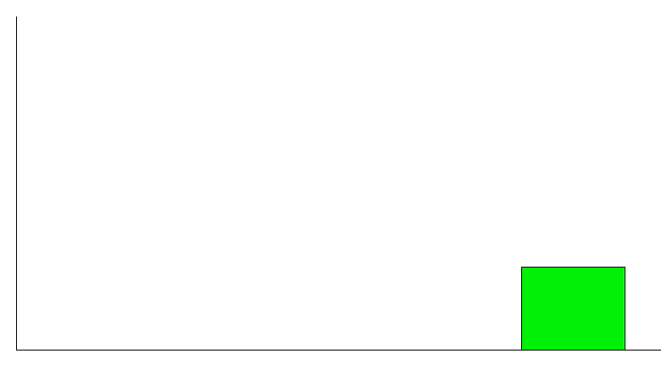
Regulated Tariff Pricing
Typical Tariff Declines as Usage Increases
Reduces Incentive to Invest in Energy Efficiency and Peak Shaving Assets
Price per
KWh
15¢
Regulated Utilities’
“Declining Block” Tariff
8¢
3¢
3¢
Amount of Monthly Usage
Marginal
Cost Tariff

Slide 26
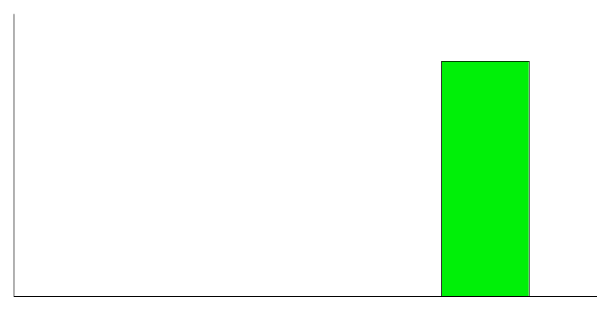
Deregulated Pricing - Early Phase
More Representative of True Power Costs
Improves Incentive to Invest in Energy Efficiency and Peak Shaving Assets
Lack of Real-Time Metering Continues to Hide Impact of Peak and Off-Peak Costs
Price per
KWh
10¢
10¢
5¢
Amount of Monthly Usage
Marginal & Average
Pricing (7 X 24 Day & Night)

Slide 27
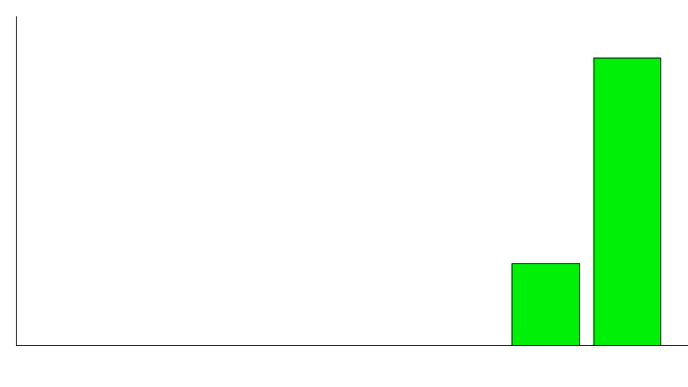
Deregulated Pricing - Fully Developed
True Marginal Cost Economics Drive Investment Decision Making
Price per
KWh
15¢
14¢
10¢
5¢
4¢
Amount of Monthly Usage
Off-Peak
Peak

Slide 28
Examples: Advantages of Deregulation
Return On Investment
Chiller Efficiency
20%
(Peak Shaving)
- High Peak Prices Put a Premium on
Reducing Consumption by Utilizing
Energy Efficient Assets
8%
3%
Return On Investment
Ice Storage
(Freeze at Night at Low Cost, Cool During the Day)
- Strategy Provides No Benefit Under Tariff Pricing
- Marginal Cost Pricing Encourages
Peak / Off-Peak Consumption Management

Slide 29
Distributed Generation and Interconnect Standards
Distributed Generation
Distributed generation is an electrical generating facility, electrical storage technology, or load management technology that may be connected parallel to, or isolated from a utility distribution system..
Can either supplement or substitute utility services
Can be deployed either on a customers meter or as a distribution grid application
Reduces the demand placed on transmission and distribution systems and thereby prevents overloading of the system.
Alleviates Grid congestion, improves power quality and reliability.
Mitigates market power concerns

Slide 30
Distributed Generation
Will expand customer choice and increase competition
Give customers greater flexibility and more direct control in meeting their energy needs
Offers grid side benefits by minimizing system losses.
Can be useful for shaving peak demand.
Deferring of additional T&D investments, and mitigating existing T&D constraints.
Can be used to satisfy regional and local installed capacity obligations.
Relieves load pocket problems, and provides ancillary services such as voltage and frequency regulation, spinning reserves, etc.

Slide 31
Commercial Application
International Markets
Consummated Deal: Nigeria.
Domestic Markets
Regulations.

Slide 32
Nigerian Barge Deal
Typical IPP participation in international energy markets involve asset development.
Construction of power plant requires substantial capital outlay
Power plants entail substantial commitment of time resources in land procurement and community negotiations and programs.
Precludes taking advantage of opportunity created by country emergency power needs.
Includes substantial exposure to political and regulatory risks in often unpredictable governments.
Involves considerable interface with World Bank, Environmental Lobby groups, etc

Slide 33
Typical Scenario
Inadequate supply to meet demand.
Recurrent power outages
Dilapidated generation, transmission and distribution systems, and unavailable government resources for rehabilitation.
Strong government support for privatization/restructuring, and for the project
Physical facilities for mooring a barge

Slide 34
Project Description Regulated Markets
Phase I
3*30 MW Barges for emergency power for 3 years (2 by September, 1999 and 1 subsequent will be located at Ijora)
Phase II
534 MW located in Lagos
230 km 24 inch pipeline from Escravos to Lagos

Slide 35
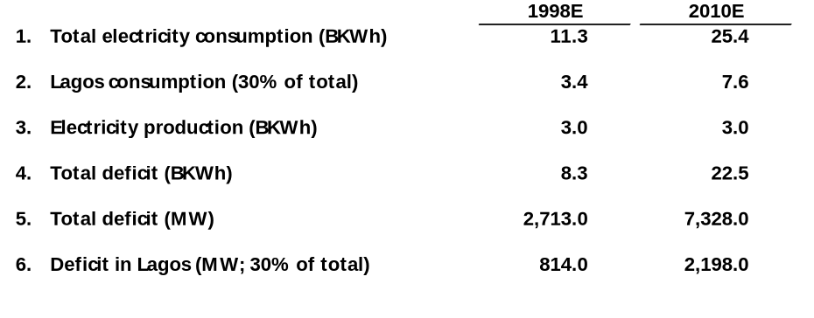
Projected Electric Supply & Demand for Nigeria
Note: 1). From EIA, DOE data; Population with electricity 43% in 1998, and government aim 85% in 2010; Assume electricity consumption annual growth rate of 7%. 2). 30% from Shell Study. 3). Shell study; Assuming no new production and no deterioration of current NEPA facilities. 5). This includes current captive generation of 60% of NEPA’s installed capacity.

Slide 36
Results
Enables easy market entry, and quick solution to energy needs of host country.
Emergency situation justify above average rate of return
Captures opportunity, creating a win/win situation
Limits initial capital outlay
Provides familiarity advantage for more permanent projects
Easier to secure project financing
Limits exposure to political and regulatory risks.
Often precipitates competition and restructuring
Has the advantages of distributed generation

Slide 37
Interconnect Standards
The grid is a complex web of generators, power lines, substations, transformers, switches and breakers, fuses, and other components that work in a synchronous mode.
A DG seeking interconnection faces burdensome installed distribution systems, rules, protective schemes and safety procedures.
Regulatory Lesson
Existing interconnection requirements written for units of at least 100 MW, and calling for detailed engineering studies, dedicated isolation transformers, and ground-fault-current-limiting reactors can be rewritten to accommodate DGs.

Slide 38
Nature of Commercial Opportunity
No other issue controls the future of DG, like interconnections.
The economics and ease of interconnection will determine whether DGs end up operating grid parallel; isolated via an automatic transfer switch; or completely separated from the grid.
A DG seeking interconnection faces an installed distribution system with burdensome protective schemes and safety procedures
The financial burden of DG interconnection - necessary modifications to the grid, equipment, studies, or services; rests with the DG owner
Utilities are competitors that will lose market share to DGs if interconnected
The need to enact broad industry/state standards and process for DG interconnection is imperative.

Slide 39
Commercial Application
Statewide Mandatory Standards
Texas (pending- Arizona, Florida, Massachusetts, New Hampshire
Industry Wide Standards.

Slide 40
Texas
PUCT Substantive Rules November 1999.
Specified and standardized customers rights and responsibilities in using on-site DG, and utilities responsibilities and procedures for interconnecting a customer’s generator to the grid.
PUC will develop interconnection manual outlining procedures, assumptions and calculations to be used by utilities in evaluating an interconnection request.
PUC will identify procedure and standards to pre-certify and standardize DG for easier customer choice and utility analysis.
Rules allow a utility to reject interconnection applications if they are shown to compromise safety and reliability.

Slide 41
Industry Wide Standards
Institute of electrical and electronics engineers(IEEE) is developing country wide interconnection standards.
Scheduled to approve a new standard - P929 addressing interconnection of small (less than 10KW) photovoltaic systems first quarter of 2000.
Though specifically addressing photovoltaics, P929 principles applicable to all inverter-based DG
IEEE standards coordinating committee is developing broader standard for all Distributed Generation sized less than 10 MW.

Slide 42
Results
Texas Electric customers can save money and maintain reliable service by generating their own electricity.
Customers with on-site DG could avoid shutdowns resulting from central power station outages or problems on the electric transmission and distribution grid.
On-site DG can reduce electricity distribution costs and increase reliability benefiting both the owner and the grid as a whole.
DGs use renewable energy sources such as wind power, solar panels or natural gas fired generators.
DGs can be very useful in providing ancillary services.

Slide 43
Regulated Market with Restructuring on the Horizon
All the opportunities in a regulated market without restructuring on the horizon.
Offer percentage off current rates in anticipation of market opening.
Offer products and services with a floating price
Retail/wholesale index
Offer products and services with a fixed price
savings are the results of reduction in commodity cost or the elimination of CTC.

Slide 44
Retail Index
In a regulated market with imminent deregulation on the horizon, customers may be unwilling to enter into fixed price deals because of anticipated price reduction due to deregulation.
Concluding deals which offers immediate or potential price savings, is beneficial.
To enter a long term contract (typically 10 years), in a market in transition requires management of price risk.
Accurate prediction of price movement within the contract term is fundamental.

Slide 45
Retail Index
Index captures change in retail energy prices.
Change in customer prices based on change in index
Index is a composite of end-user regulated rates current as of 15th of month.
Index is an average of component utility prices.
Where commodity is competitive, use published or publicly available commodity price.

Slide 46
Results
Index tracks changes in broad market trends.
Risk management market develops around retail electric indices, bringing more pricing choices.
Risk management products in out source deals.
Collar (increase not to exceed x%, decrease not to exceed y%
Enron buys a put (decrease not to exceed y%)
Enron sells a call (increase not to exceed x%.
Price volatility creates value.

Slide 47
Partial Deregulation
All the commercial opportunities in a regulated market with or without restructuring
Full service offerings including risk management and energy acquisition.
Wholesale competition
Management of customer’s energy supply

Slide 48
Nature of Commercial Opportunity (cents per KWh)
Regulated
Environment without Enron
Regulated
Environment with Enron
Deregulated
Environment with Enron
Distribution
Savings
Savings
Distribution
Retail Transmission
Distribution
Retail Transmission
Wholesale Transmission
CTC
Wholesale Transmission
CTC
Retail Transmission
Wholesale
Energy
Wholesale Transmission
Wholesale
Energy
Wholesale
Energy
Notes:
Customer Bundled Bill which they have traditionally paid to their monopoly utility has embedded within it, charges for recovery of generation investments, utility power purchase costs, wires infrastructure (T&D), plus utility rate of return.
The traditional utility rate base is being unbundled into wholesale energy, stranded costs (or CTC), wholesale and retail transmission, distribution and other items such nuclear decommission costs and public purpose programs.
Retail basis items included within the utility bundled rate include, customer specific load profile risk (energy cost vary according to when customer consumes energy), weather risk, ancillary service costs necessary to maintain transmission system reliability, energy losses and transmission system congestion costs which result in uneconomic dispatch of generation plant. These cost are being unbundled to be allocated to the retail customer or marketer service the retail customer.

Slide 49
Nature of Commercial Opportunity (cont.) (savings per KWh)
14¢
10¢
3¢
Notes:
Customer Bundled Bill which they have traditionally paid to their monopoly utility has embedded within it, charges for recovery of generation investments, utility power purchase costs, wires infrastructure (T&D), plus utility rate of return.
The traditional utility rate base is being unbundled into wholesale energy, stranded costs (or CTC), wholesale and retail transmission, distribution and other items such nuclear decommission costs and public purpose programs.
Retail basis items included within the utility bundled rate include, customer specific load profile risk (energy cost vary according to when customer consumes energy), weather risk, ancillary service costs necessary to maintain transmission system reliability, energy losses and transmission system congestion costs which result in uneconomic dispatch of generation plant. These cost are being unbundled to be allocated to the retail customer or marketer service the retail customer.

Slide 50
Additional Opportunities as Deregulation Fully Develops
Controlled Capital Assets (Billions)
Y/E 1998
$0.2
0.3
0.3
0.2
$1.0
Y/E 1999
$1.4
1.1
1.0
0.5
$4.0
Y/E 2000
$3.5
2.7
2.6
1.2
$10.0
Cooling
Heating
Lighting
Process Support
TOTAL:
$120 Million Additional Value Opportunity for
Every 1% in Efficiency Improvements
Notes:
Customer Bundled Bill which they have traditionally paid to their monopoly utility has embedded within it, charges for recovery of generation investments, utility power purchase costs, wires infrastructure (T&D), plus utility rate of return.
The traditional utility rate base is being unbundled into wholesale energy, stranded costs (or CTC), wholesale and retail transmission, distribution and other items such nuclear decommission costs and public purpose programs.
Retail basis items included within the utility bundled rate include, customer specific load profile risk (energy cost vary according to when customer consumes energy), weather risk, ancillary service costs necessary to maintain transmission system reliability, energy losses and transmission system congestion costs which result in uneconomic dispatch of generation plant. These cost are being unbundled to be allocated to the retail customer or marketer service the retail customer.

Slide 51
Uniformity in Business Processes
Coalition for Uniform Business Rules (CUBR)
Typically many states develop disparate business rules to implement similar legislative/regulatory requirements.
Also, many states develop and implement different set of processes and data exchange standards for same business process.
Regulatory Lesson
Non- Uniformity impedes competition, as marketers would require separate regulatory compliance processes for each state in which they compete.

Slide 52
Nature of Commercial Opportunity
Disparate business rules and data exchange protocols is a major barrier to competition for retail service providers active in many states.
Non-uniform business rules increase manpower and system costs with less effectiveness and efficiency.
Business rules that incorporate participant needs and proven best practices will serve to foster a thriving market.
Uniformity will facilitate creation of standardized industry practices and products.
Uniformity will afford better risk assessment, management and mitigation.
Non-uniform business rules will delay competition and its benefits to consumers.

Slide 53
Commercial application
Coalition for uniform business rules (CUBR).
Transmission Coalition

Slide 54
CUBR and Data Protocols
Coalition on Uniform Business Rules
Enron pulled together a diverse group of industry participants competing in multiple markets
Coalition identified best business practices, and developed consensus - supported uniform business rules and supporting data exchange protocols
September 1999, CUBR released uniform business rules regarding Supplier licensing, customer information, enrollment and customer switching, creditworthiness, billing and payments, electric and natural gas operations, electric metering, supplier tariff and agreements, performance standards and incentives, and utility - supplier dispute resolution process.

Slide 55
Transmission Principles Coalition
Organized a coalition to address certain key wholesale market issues in light of FERC’s Order 2000 and NERC’s strategic plan
Identified several key principles that each company intends to support
Key Issues
Independence
Transmission Rights
Inter-Regional Coordination
Transmission Expansion and Interconnection
Short Term Goal: Develop viable solutions to several key wholesale market issues over the next two months, with the intent of gaining broad industry support and ultimately being incorporated into the RTO filings around the country.
Long Term Goal: Establish credibility with FERC, NERC and legislators, by evolving into an organization that routinely offers viable solutions to the wholesale electric industry.

Slide 56
Results
Promotes competition and facilitates interaction between suppliers and utilities
Reduces manpower and system costs while increasing effectiveness and efficiency.
Lowers cost for all market participants
Eases market entry
Enables free movement of capital, goods and services
Stimulates the growth of innovative products and services to benefit the retail customer
Improves efficiency and effectiveness.

Slide 57
Complexity May Translate Into Opportunity
Energy Outsourcing
Is an arrangement where an energy service provider contracts with a customer, usually light industrial/commercial customer, to sell a bundled energy product which includes cooling, lighting, heating,
asset optimization and risk management.
This involves management of unique and complex customer energy situation and needs.

Slide 58
Energy Outsource Contracts Building Blocks
Commodity
40%
Labor
15%
Assets
45%

Slide 59
Value Levers
Baseline
10-Year
Costs
Commodity
Potential
Savings
Labor
Price
Tariffs
Volatility
Assets
Workforce
Best Practices
Sub-Contractor
Management
Known
Savings
Optimized
Economics
Equipment Cost
Efficiency
Operating
Practices

Slide 60
Value Proposition: Energy Assets
Operations of the Private Utility Vary Significantly
Manufacturing
Food Processing
Commercial Property
Public Institution
Financial Services
Underlying Components Are Very Common
Efficiency
Cooling
Lights
Plugs
Type of
Asset Used
Asset Age
Steam
Motors
Compressed Air
Hours of
Operation
Key Is to Build a Portfolio of Risk-Based Experience With
Each Component of the Private Utility

Slide 61
Value Proposition: Labor
Existing Situation: Two Companies Employ Fully Staffed Workforces to
Service Individual Sites
Site A
Site B
- Site A Employs 13 Maintenance Professionals
And Has a $1.7 Million Operating Budget
- Site B Employs 9 Maintenance Professionals
And Has a $1.3 Million Operating Budget
22 Professionals / $3.0 Million Operating Budget
Labor Force
Labor Force
Enron Solution: Utilize Centralized Dispatch and Mobile Workforce
Capabilities to Service Multiple Customer Sites
Site A
Site B
- Enron Employs 16 Maintenance Professionals
And Operates Both Sites With a $2.2 Million
Operating Budget
Mobile Labor Force
6 Person Headcount Reduction / $.8 Million Savings
Centralized Dispatch

Slide 62
Value Proposition: Energy Assets Component Knowledge
Cable Manufacturing
Shopping Mall
PROCESS
Twinning
Insulation
Preparation
Continuous
Vulcanization
Cooling
Testing
Heating
Cooling
Lighting
Misc.
(Elevators,
Registers, Etc.)
Comp. Air
Steam
Cooling
ENERGY USAGE
Cooling
Motors
Motors
Boilers
Lights
Comp. Air
Motors
Motors
HVAC
Motors
Motors
Fans
Plugs
Plugs
Plugs
Plugs
Fans
Plugs
Lights
Lights
Lights
Lights
Lights

Slide 63
Value Proposition: Energy Assets
Example: Asset Optimization
Cooling
Cooling
2 - 1,000 Ton, 20 Year Old Chillers
Onsite Personnel Operate & Maintain
Existing Energy Bill $1,000,000 Annually
Motors
Plugs
Lights
Enron
Approach
Lower Operating Costs by Replacing Existing Assets With Lower Capacity - Higher Efficiency Units
Install 2 - 600 Ton Chillers
Reduce Capacity of All Pumps and Fans
Redesign Duct Work & Pumps to Reduce Energy Loss
Install Remote Monitoring and Control Equipment to Fully Optimize Operation
New Energy Bill Is $500,000 Annually
IRR on Project > 30%

Slide 64
Value Proposition: Commodity
Gas to Power Arbitrage
Scenario 1: Gas Is Tolled to a Generation Plant
$3/Mcf
Gas Supply
Gas Price: $3 Mcf
Generation Cost: $30 MWh
Power Market Price: $30 MWh
$30/MWh
$30/MWh
Scenario 2: Divert Generation Plant Gas Into the Gas Market,
Buy Replacement Power From the Grid
Gas Contract Price: $3 Mcf
Generation Contract Price: $30 MWh
Gas Market Price: $10 Mcf
Power Market Price: $30 MWh
Volume 50,000 Mcf
Arbitrage Value $350,000
$3/Mcf
$10/Mcf
Gas Supply
Gas Market
$30/MWh
Power Grid
$30/MWh

Slide 65
Upsell Potential (TCV)
Client
M&A

Slide 66
Customer Execution Platform
Relationships
8 District Offices / 250 Professionals
Development Engineering
Architectural & Engineering Services
Construction / Project Management
Facility / Workforce Management
Account Management
Enron
District
Execution
Offices
In-House
Team
6,000 Sites / 4,500 Employees
Mechanical / Electrical Construction
HVAC Services
HVAC Franchising
Facility Management
Enron Facility Services
3 MM Sites Insured / 1,700 Field Engineers
Affiliation
Hartford Steam Boiler
Asset Risk Management
Proprietary Energy Database
Extensive Asset and Labor Database
Foundation of Web-Enabled Delivery System

Slide 67
Contract Structure: Savings / Value Growth
$
Baseline
10-Year
Costs
Optimized
Economics
Potential
Savings
Known
Savings
Guaranteed Savings

Slide 68
Contract Structure: Savings / Value Growth
$
Baseline
10-Year
Costs
Optimized
Economics
Potential
Savings
Known
Savings
Guaranteed Savings

Slide 69
®

