Slide 1
Enron Energy Services

Slide 2
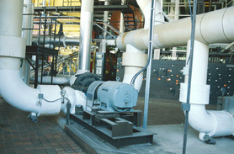
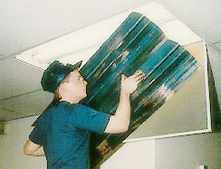
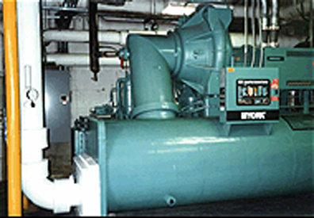

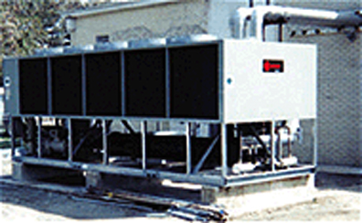
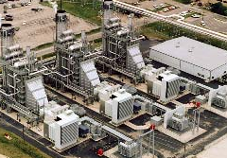
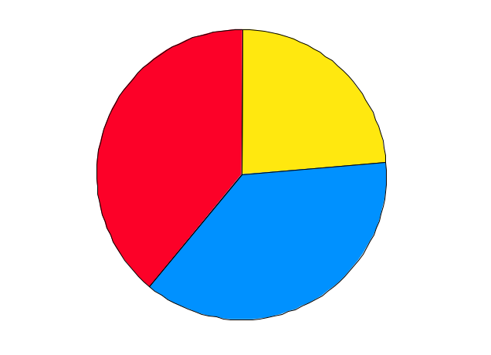
Energy Management Market
Public Utility
“Private Utility”
End Products
Energy Conversion Assets
Boilers
Lighting
Distribution
Chillers
Conditioned
Air
Transmission
Controls
Lighting
Generation
Power
Substations
Market Opportunities - United States
$465 Billion
Market Opportunities - Europe
$300 Billion
$180
$120
$70
$110
$175
$110
Commodity
Services: HVAC Services & Capital
Services: Facility Management

Slide 3
Enron Energy Services
Strong Sales and Service Execution
Fundamental Improvement in Market and Regulatory Environment Expand Opportunities
Extending Enron Energy Services Business Model to Related Markets and Products

Slide 4
Past Commitments
Analyst
Conference Excerpts From Prior Presentations
1996 Downstream Merchant
“Potential for Significant Shareholder Wealth Creation”
1997 “Established Necessary Infrastructure to Lead in a
Competitive End-user Energy Market”
1998 “Deregulation Created an Immediate Opportunity for Enron Energy Services to Manage Energy Needs of Companies…”
1999 “Market for Energy Outsourcing to U.S. Business Is Huge.
1999 Will Be a Breakout Year With Positive Earnings by
4th Quarter.”
2000 “2000 Will Be a Defining Year in Terms of Sales, Service
Execution and Income Growth…” “$16 Billion TCV and
$50 Million in IBIT.”

Slide 5
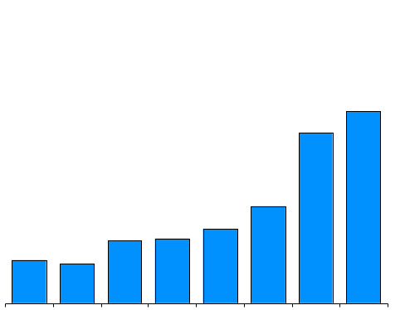
Enron Energy Services
Revenues
Quarterly
(Millions)
Annual
(Billions)
$1,657
$10.0
$1,476
$840
$4.6
$642
$542
$556
-8.1%
$370
$340
$1.8
Q199 Q299 Q399 Q499 Q100 Q200 Q300 Q400
1999
2000
2001E

Slide 6
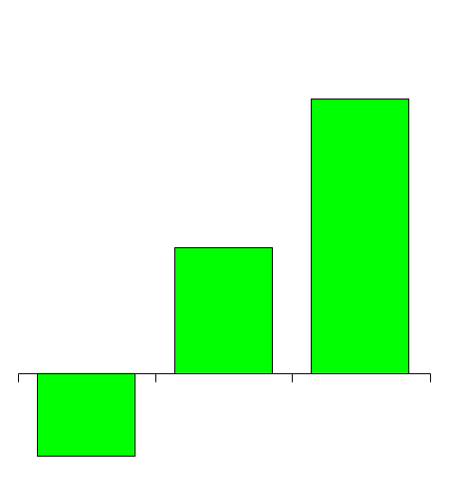
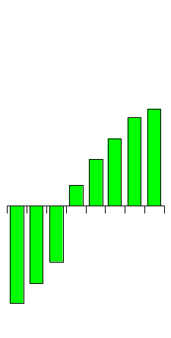
Enron Energy Services
IBIT
Quarterly
(Millions)
Annual
(Millions)
$225
$30
$33
$103
$24
$16
$50*
$7
Q199
Q299
Q399
1999
Q499
Q100
Q200
Q300
Q400
2000
2001E
($18)
($68)
($26)
($31)
*Original Target

Slide 7
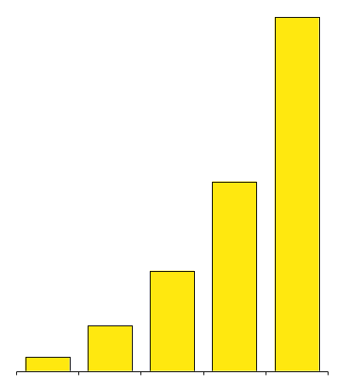
Enron Energy Services
TCV Growth
(Billions)
$30.0
$16.1
$8.5
$3.8
$1.7
1997 1998 1999 2000 2001E
TCV = Total Contract Value

Slide 8
North America
Strong Sales and Service Execution
Enron Has Made Energy Outsourcing An Accepted Business Practice
Transaction Flow And Efficiencies Accelerating
Sales and Marketing Channel Readily Extended To Other Markets And Products

Slide 9
Accelerating Deal Flow
(Billions of TCV)
$101.5
$44.5
Senior Executive Meeting
With Customer
Confidentiality
Agreement
$60.6
$24.9
$26.8
Exclusive Letter of Intent
$37.7
$19.4
$18.1
$30.0
$30.2
$ 7.4
$16.1
$17.6
Signed Contracts
$8.5
$10.9
Contract
Contract
Contract
Contract
Contract
Contract
Potential
Actual
Potential
Actual
Potential
Target
TCV = Total Contract Value
1999
2000
2001E

Slide 10
Efficiencies Are Increasing Productivity
(Large Outsourcing Customers)
  1997 2000 Target 2001
Sales Cycle (Months) 12-18 9-15 5-8
Time To Price A Deal (Weeks) 8 3 1
Credit Approval Cycle 2 wks. 2 days 4 hrs.
Referrals Per Deal 0 4 8
Client Meetings Per Deal 80 35 20
People Per Deal Entire Co. 15 6
Standardization Percentage 0% 25% 60%
Increase Speed:
Increase Capacity:
Sales and Supporting Infrastructure Are Systematically Managed For Superior Results

Slide 11
Sales and Marketing Channel Extendable
Current
Established
Sales Force
Fortune 1000
Future
Multiple Business Opportunities
Sales Support Infrastructure
Market Analysis and Targeting
Channel Strategy
Product and Salesforce Training
Advertising and Public Relations
Customer Relationship Management
Standardized Components/
Products
Customized Components/
Products
Risk Management
Pricing
Market Information Modeling

Slide 12
Europe
Strong Sales and Service Execution
European Market and Regulatory Environments are Similar to U.S.
Immediate Success In Middle Market
Outsourcing Business Has Successfully Launched

Slide 13
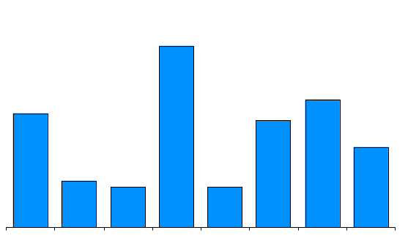
European Market Opportunities
Commodity Opportunities
(Billions)
Europe
$300 Billion
$27
$120
$70
$19
$17
$16
$110
$12
Commodity
Services: HVAC Services & Capital
Services: Facility Management
$7
$6
$6
U.K.
Spain
Neth.
Germ.
Nordic Region
France
Italy
Other

Slide 14
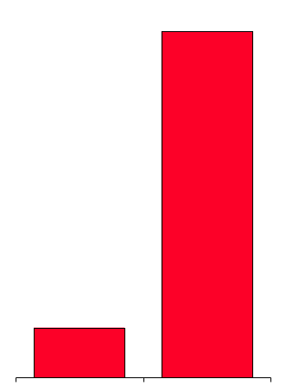
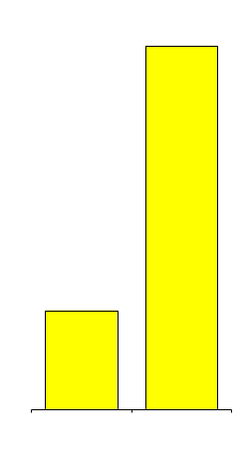
Success In Middle Market
Enron Direct Growth - U.K.
Overview
Customer Sites
Electricity Volumes
(Twh)
Headcount
Small Industrial and Commercial Customers
Direct and Third Party Sales Force
Low Overhead
Largest Non-Incumbent Retail Energy Supplier
134,000
11.7
188
Expansion
Spain
The Netherlands
Germany
51
27,000
1.7
1999
2000
1999
2000
1999
2000

Slide 15
Outsourcing Business
Has Successfully Launched
NORDIC
6 Potential
TCV = $0.6 Bn
BENELUX
2 Potential TCV = $0.1 Bn
…in addition
PAN EUROPEAN
6 Potential
TCV = $2.5 Bn
UK
4 Potential
TCV = $0.7 Bn
GERMANY
8 Potential
TCV = $1.4 Bn
25 Additional Prospects, TCV = $7.9B
2000 Success: 4 Contracts, $1.2 Bn TCV, 3 Countries
2001 Potential: 26 Contracts, $5.3 Bn TCV, 5+ Countries

Slide 16
Global Energy Services
Strong Sales and Service Execution
Executing On Service Requirements
Technology Applications are Yielding Enormous Benefits
Customer Satisfaction Results in Business Growth and Customer Referrals

Slide 17
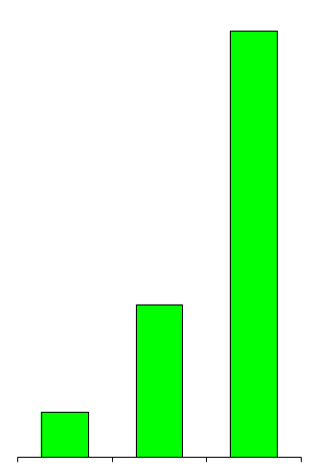
Enron Energy Services Portfolio
Facilities Under
Contract
Square Feet
Under Contract
(Billions)
Value of Assets
Controlled
(Billions)
28,800
2.8
$8.5
16,600
$4.0
11,500
1.0
0.3
$1.0
1998
1999
2000
1998
1999
2000
1998
1999
2000

Slide 18
Customer and Service Portfolio
State Legend
> 1,000+ Customer Facilities
> 100 - 1,000 Customer Facilities
> 0 - 100 Customer Facilities
Enron Energy Services Locations

Slide 19
Traditional Power Systems
Typical Cost & Consumption
Energy Cost (Tariff)
Consumption Pattern
c/Kwh
Customer
24 Hour Period
Traditional Tariffs Block Price Signals

Slide 20
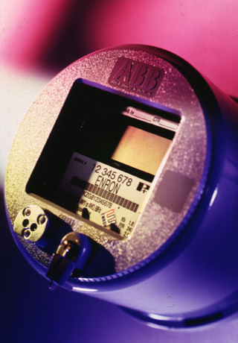
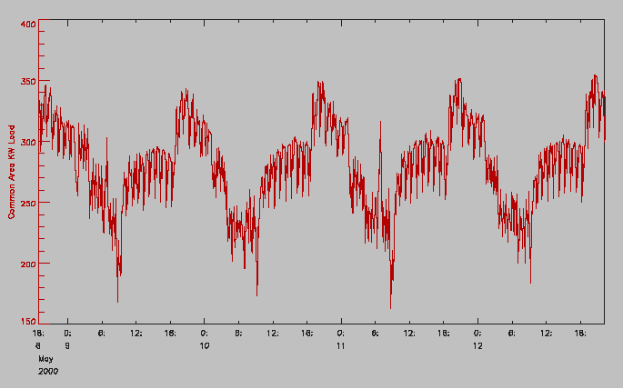
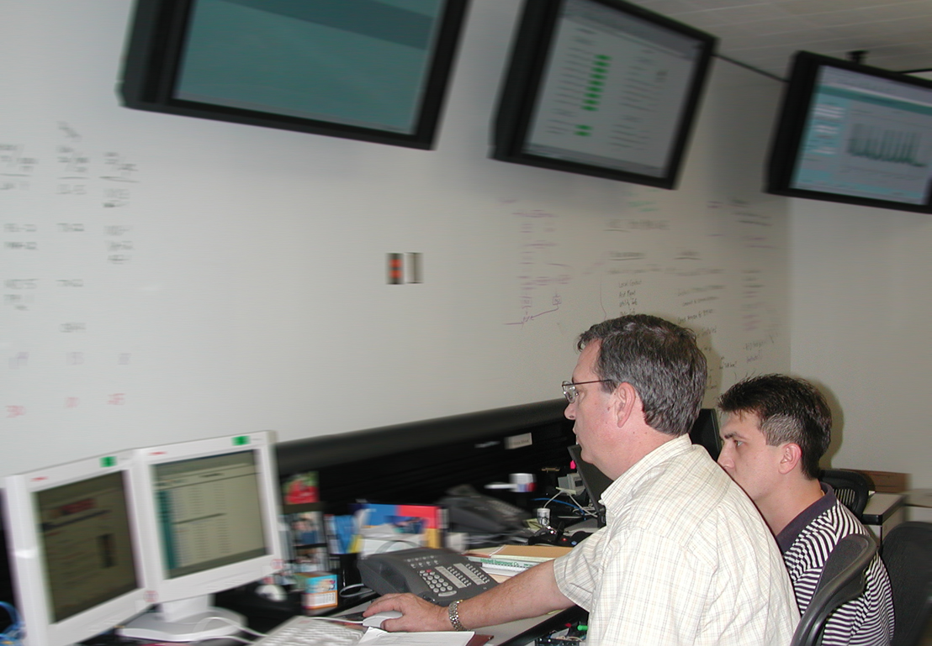
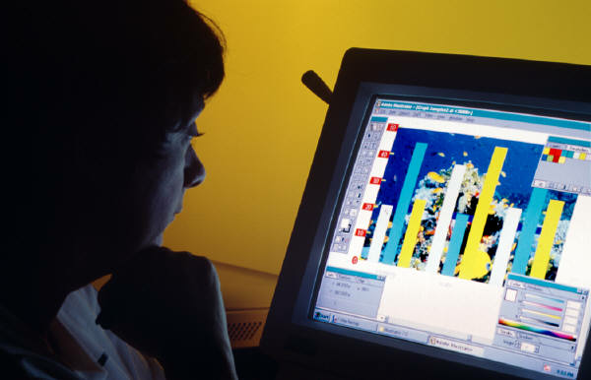
Enron Value Creation
Customer Site
Enron Building
Monitoring Technology
Intellectual Capital
Information and Expertise Used To:
Manage Energy Consumption and Supply on a Realtime Basis
Optimize Costs of Commodity, Energy Assets and Labor Collectively
Continuous Monitoring of Customer Satisfaction

Slide 21
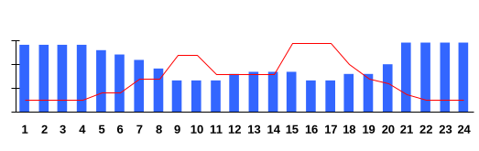
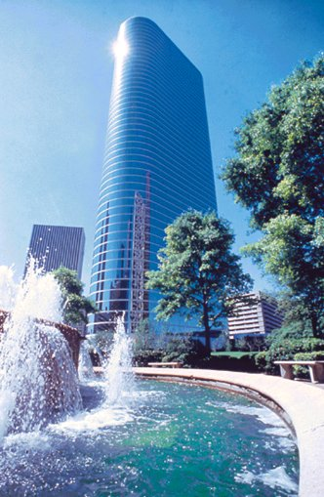
Technology Applications Yielding
Enormous Benefits
Enron Energy Services
Real-Time Cost & Consumption
c/Kwh
Energy Cost (Market)
Consumption Pattern
Demand
Prices
Enron
Customer
Weather
24 Hour Period
Traditional
c/Kwh
Energy Cost (Tariff)
Consumption Pattern
Customer
24 Hour Period

Slide 22
Value of U.S. Peak Power Reduction
Peak Load = 150 Bn Kwhs
5% of Total Peak Load
Valued At $35 Billion
=
$240 / Mwh
95% of Total Off-Peak Load
Valued At $140 Billion
=
Off-Peak = 3,000 Bn Kwhs
Time
Real Time Asset Performance Measurement Enables Enron To Capture Peak Power Value

Slide 23
Customer Satisfaction Results In Customer Referrals
Critical Metric to Ensure:
  Customer Referrals
  Contract Renewals
  Value Enhancement
  Opportunities
Exceeded 2000 Targets
Continuing to Raise
the Bar for Customer Satisfaction
4.00
4.20
Referral Threshold

Slide 24
Enron Energy Services
Strong Sales and Service Execution
Fundamental Improvement in Market and Regulatory Environment Expand Opportunities
Extending Enron Energy Services Business Model to Related Markets and Products

Slide 25
Fundamental Improvement in Market Environment
Utilities Will Abandon Regulated Merchant Services, Expanding Retail Opportunities
Upward Shift in Energy Prices Has Significantly Increased Demand for Enron Products and Improved Enron Value Proposition

Slide 26
Why Re-Regulation Won’t Happen
Stranded Cost Recovery
(Since 1998)
38 Utilities Recovering Stranded Costs
$50 Billion Collected
Mergers / Acquisitions
(Since 1996)
Utility Unbundling
(Since 1998)
69 Mergers Involving Utilities
26 Mergers Where Electric Utility Assets Changed Hands
18 Mergers Pending
54 Utilities Unbundling
$40 Billion in Generation Sold

Slide 27
Utilities Are Facing Increasing
Risk in Merchant Role
Utilities Recover Profits and Costs in the Following Way:
Utility Tariff =
Return on Assets + Energy Costs
Purchasing Energy Below Market Yields Only Pass-Thru; NO PROFIT
Purchasing Above the Market or Above Expectations
(e.g. California); RISKS LOSSES
Deregulation Increases the Risk Portion of the Tariff

Slide 28
Utilities Leaving Merchant Function
States w/Competitive
Default Supplier
Percent of National
C&I Market*
# of Utilities*
Current (Jan. 2001)
By July 2001
By Dec. 2002
Other
5%
36%
49%
12
49
73
* Cumulative

Slide 29
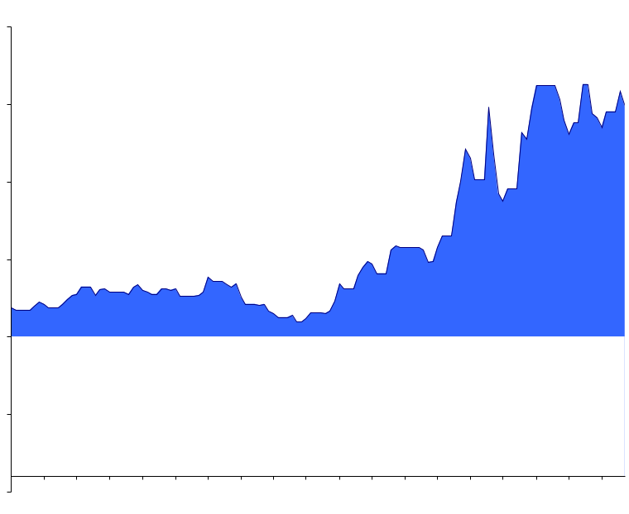
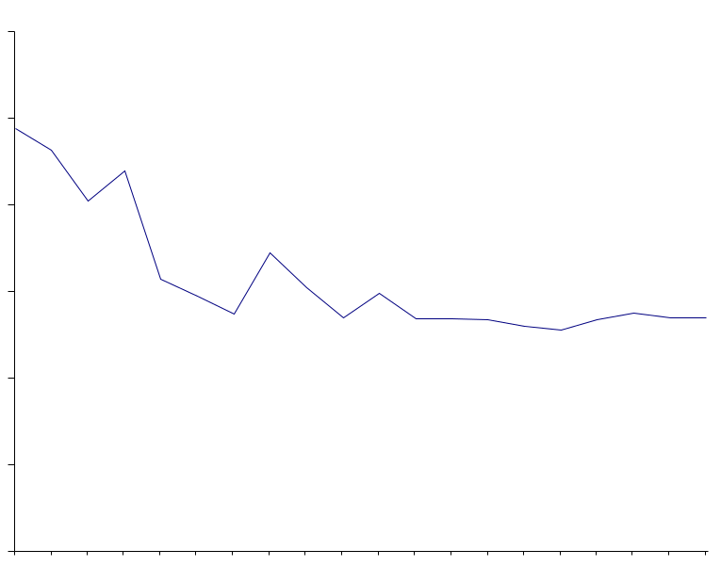
Utilities Forced To Increase Tariffs
Due To High Market Prices
(¢/Kwh)
24
24
Market Prices
20
20
Competitive Advantage
Tariff B
16
16
Underrecovery
Surcharge for Underrecovery
12
12
Market Prices
Tariff A
8
8
Estimated Fuel Costs
Estimated Fuel Costs
Return on Assets
4
Return on Assets
4
0
0
Sept. 00
Period 1
Jan. 01
Feb. 01
Period 2
Oct. 01
Increased Tariffs and Decreasing Forward Market
Prices Will Increase Demand For Enron’s Products

Slide 30
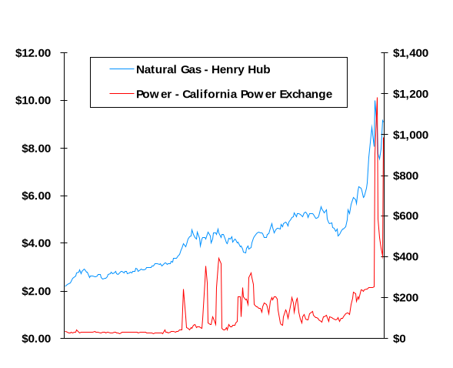
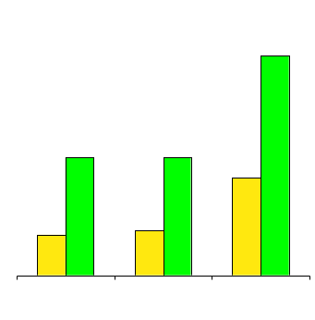
Energy Price Impact
On Companies’ Operating Expenses
2000 Commodity Prices
Energy Cost as % of Total
Operating Expenses
Nat. Gas
($/mmbtu)
Power
($/MWh)
54%
Jan.-00
Dec.-00
29%
29%
24%
10%
11%
Jan. 00
Dec. 00
Fast Food
Restaurant
Hotel
Mall
With or Without Deregulation, Impact of Rising Energy Costs
Will Increase Demand For Enron Products

Slide 31
Enron’s Value Proposition Extending
To More Customers
Average Spend Per Company (Annual)
Annual Energy Commodity Expense
Average Number of Sites
Number of Companies
Segment Spend (Billions/Year)
Fortune 100
$100,000,000+ 100 100 $120,000,000
$20,000,000+ 70 1,000 $56,000,000
$2,000,000+ 50 10,000 $3,300,000
$20,000 to $2,000,000 1.2 1,100,000 $44,000
>$20,000 1.0 7,000,000 $3,500
$12
Fortune 1,000
$56
Fortune 10,000
$33
Mass Market
$49
Small Mass Market
$18

Slide 32
Enron Energy Services
Strong Sales and Service Execution
Fundamental Improvement in Market and Regulatory Environment Expand Opportunities
Extending Enron Energy Services Business Model To Related Markets and Products

Slide 33
Partial List of Opportunities
Residential Energy Markets
Technology
  Power Quality
  Distributed Generation
  Demand Side Management
  Software
Insurance Products
Equipment Leasing

Slide 34
Residential Energy Markets
The New Power Company
Enron Identified Huge Residential Energy Market Opportunity - $150+ Billion
Formed Company (NPW) to Pursue Opportunity
  Strong Partners
  Strong Management Team in Place
  Raised $750 Million in Public and Private Funding
Status
  Fully Funded Business Plan
  Large Customer Base (Over 300,000)
  Current Commodity Price Environment Favorable for NPW

Slide 35
Emerging Energy Technologies
# Units
% of “EP”
Enron Has Accrued a Meaningful Customer Base Through Which to Distribute Energy Technology Solutions

Slide 36
Distribution Channel Will Determine Winning Technology
Computer Programming
(Market Share)
60%
40%
Power Quality
(Market Share)
20%
60%
0%
1990
1995
2000
Microsoft Apple
40%
VCR Technology
(Market Share)
20%
80%
60%
0%
1990
1995
2000
2005
40%
Technology A Technology B
20%
0%
1985
1990
1995
2000
VHS Beta

Slide 37
Power Quality Market Driven
By Scale and Energy Use
Energy Use Examples
Lights
Appliances
Elevators
Phones
Computers
HVAC
Servers
Controls
Mission Critical
% of Total Electricity Load
Today
2006
65%
20%
15%
10%
10%
20%
5%
25%
5%
25%
Power Quality Reliability
99.9%
99.99%
99.999%
99.9999%
99.99999%

Slide 38
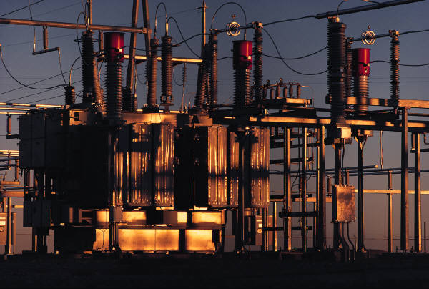
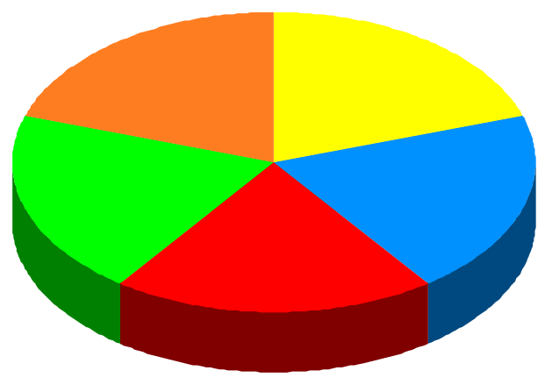
Enron Comprehensive
Power Quality Solutions
Power Quality of Grid
Reliability at Risk
Limited Power Quality
Commodity Price Volatility
Customer
Today’s Available Solution
Integration Risk
Technology Risk
Commodity Price Volatility
Customer
Energy
Information
Management
Commodity
Management
Enron’s Bundled Solution
Business Interruption Protection
Technology Risk Management
Commodity Price Protection
Capital
Management
Equipment & Technology
Facility
Management
Customer

Slide 39
Solution Drives
Marginal Cost of “9”
Current Market Solution
Commodity and Asset Risk Management
Capital Cost
Enron’s Solutions
Power Quality
.9
.99
.999
.9999
.99999
Technology Developments Will Shift Cost Curve To Right
Total Risk Management Will Flatten Cost Curve Across 9’s

Slide 40
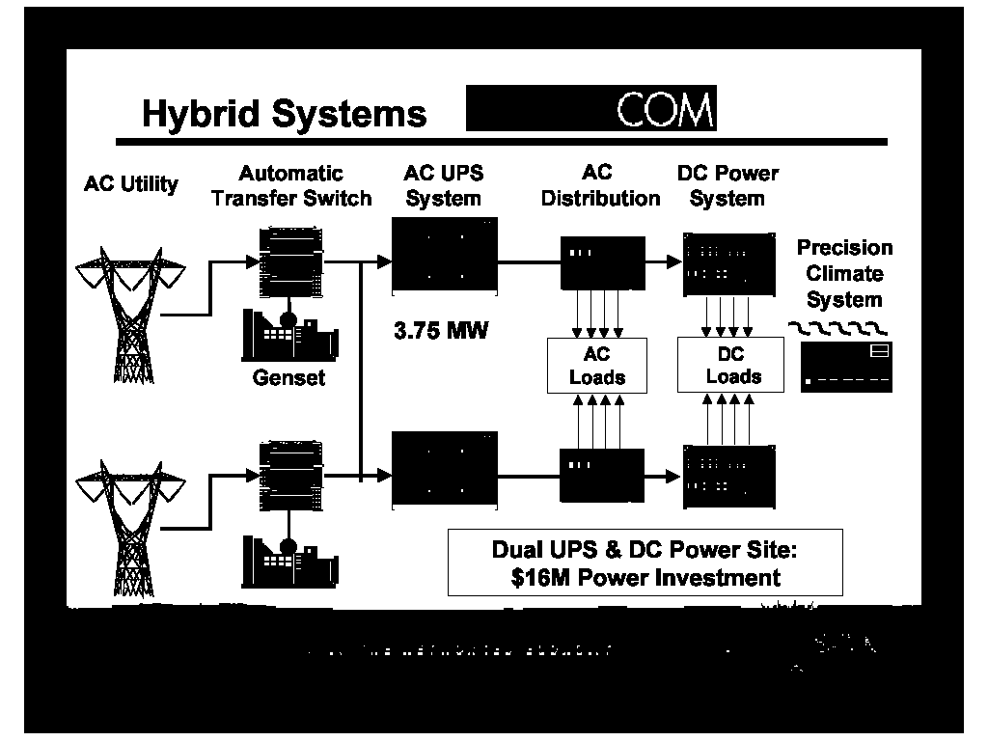
Convergence of Broadband and Power Quality
Fuel Cell Provider
Broadband
Data Services
$
$
Equipment
Risk
Management
Server/Digital
Equipment Provider
Equipment
FiberOptic
Data Center
Other Customers
$
$
Optionality
$
Enron Energy Services Will Expand Its Offering Of Power Quality Solutions In 2001 Through Partnerships With Industry Leaders

Slide 41
Enron Energy Services
Strong Sales and Service Execution
Fundamental Improvement in Market and Regulatory Environment Expand Opportunities
Extending Enron Energy Services Business Model to Related Markets and Products

