Slide 1
E-Commerce: An Enron View
Mike S. McConnell
Vice Chairman & Chief Operating Officer
Enron Net Works
Corporate Executive Board
July 21, 2000
San Francisco, California

Slide 2
Presentation Summary
Current Market Conditions
Enron’s Perspective
EnronOnline
Conclusions

Slide 3
“ It is Not the Strongest of the Species
That Survives, Not the Most Intelligent,
but the Most Responsive to Change.”
Charles Darwin
The Origin of the Species

Slide 4
Endless Possibilities.TM
Worlds leading energy company.
$40.1 billion in annual revenues.
$33.38 billion in assets.
Transports 15% of US natural gas.
Operates one of the nation’s largest natural gas transmission systems.
Largest gas merchant in the US, Canada, and the UK.
Largest electricity merchant in the US, UK, and Nordic Region.
Manages the largest natural gas derivatives book in the world.
Over 20,000 employees worldwide.
Activities in over 30 countries.

Slide 5
Energy Businesses
New Businesses
Transportation
&
Distribution
Wholesale
Energy
Retail
Energy
Broadband
Services
Net Works

Slide 6
Current Market Conditions
Many industries exist that sell commodity - like products through legacy distribution channels comprised of complex sales forces and long term relationships with little price transparency (“Dine ‘Em and Sign ‘Em”).
  Result - Enormous inefficiencies exist in the pricing of commodity products.
The internet provides a unique opportunity to have immediate and inexpensive access to customers through a web-based transaction platform.
  Result - All incumbent companies are vulnerable due to reduced/no barriers to entry.
The equity markets have created an enormous value differential between old economy businesses and new economy businesses.
  Result - Possible rate of return opportunities are multiples of historical rates of return (“Winner Takes All”).

Slide 7
“ In five years time, all companies will be
internet companies, or they won’t be
companies at all.”
Andrew Grove
Chairman, Intel Corp.

Slide 8
U.S. eCommerce Growth
B2B
B2C
Source: Forrester Research, Inc.

Slide 9
Worldwide eCommerce Growth
Source: Forrester Research, Inc.

Slide 10
Lessons Learned
Principal based vs. Exchange based (“Bulletin Board”) is THE ONLY SUSTAINABLE eCOMMERCE B2B MODEL.
Everyone is a potential competitor.
Time to market is critical with product roll-out (first mover advantage).
Must continue to innovate to maintain first mover advantage.
Business model could have broad applications in other industries.

Slide 11
Why Enron?
We have been B2B for years.
We have strong skills in risk intermediation and good systems to control risk.
We are already positioned as having successfully migrated from the “old economy” to the “new economy” company.
We have a proven Business Model and track record of transforming markets.
We have successfully sourced capital for all potential investments.

Slide 12
Business Strategy
Identify industries that have commodity-like products where the incumbents are predominantly using legacy distribution channels.
Determine entry vehicle into the industry (i.e. partnership, acquisition, contractual rights, etc.).
Deploy eCommerce platforms to capture market share rapidly.
Use spot liquidity to become major participant.
Combine Enron’s IT Group and eCommerce efforts into one commercial organization for focused execution of the business plan with the objective of increasing Enron’s multiple.

Slide 13
Execution Plan
Upgrading
  Streamlining processes to do business the best, most
  efficient way we can.
Expanding
  Growing market share in current businesses.
Penetrating
  Rapidly establishing significant stakes in new markets.

Slide 14
eCommerce Initiatives
Energy EnronOnline.com
Credit EnronCredit.com
Pulp & Paper ClickPaper.com
Metals MG plc (EnronOnline.com)
Financial Products DealBench.com
Energy Settlements CommodityLogic.com

Slide 15
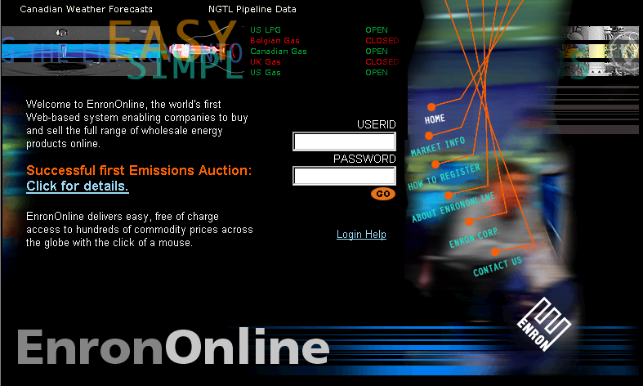
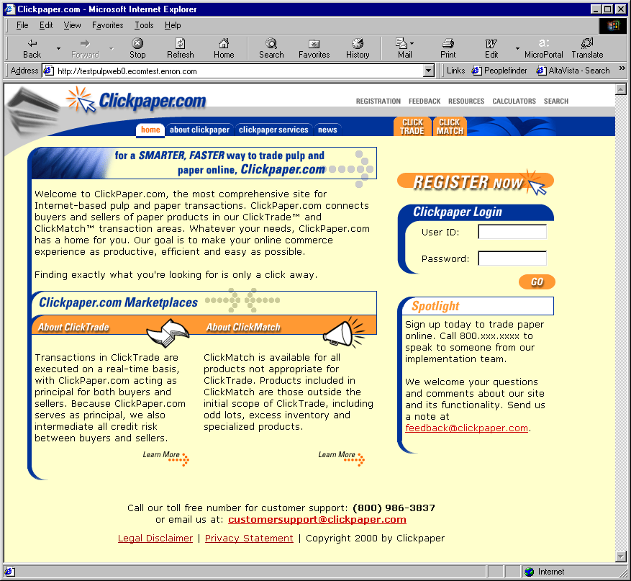
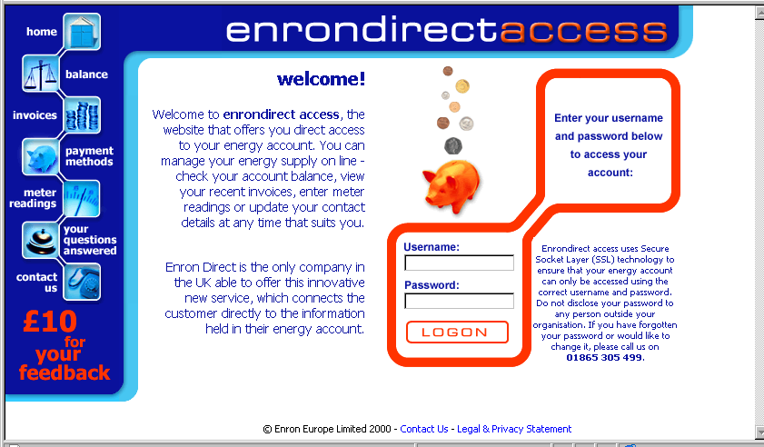
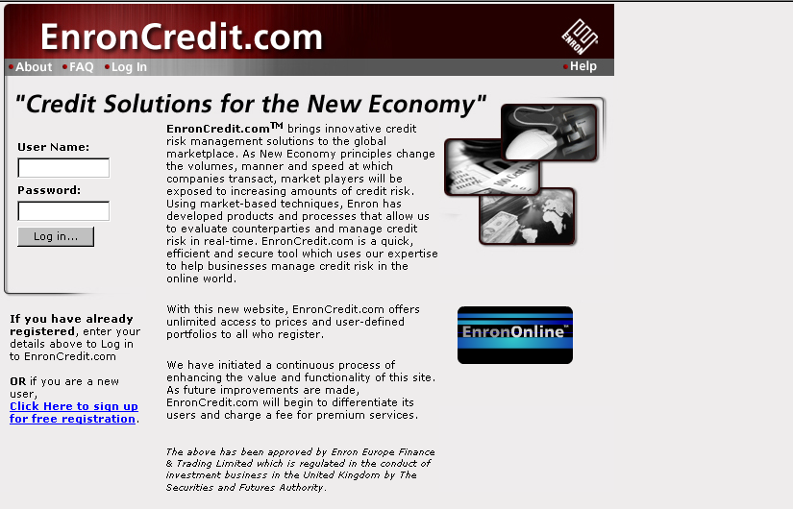
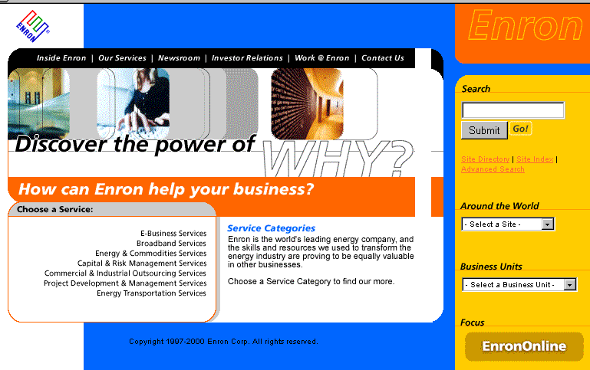
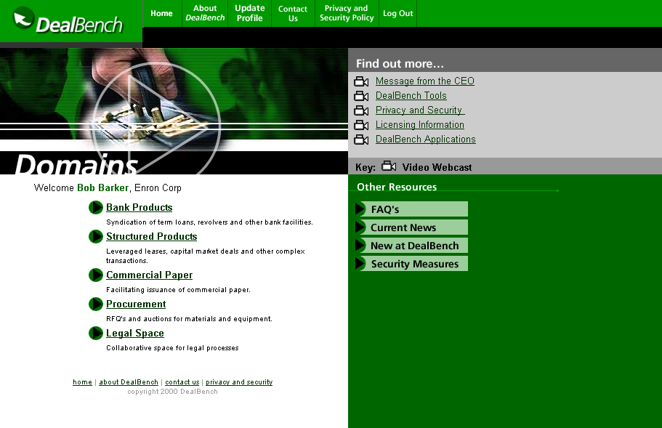
Enron Net Works

Slide 16
Enron’s Global eCommerce Activities
= EnronOnline Trading Activity
= Other eCommerce Activity

Slide 17
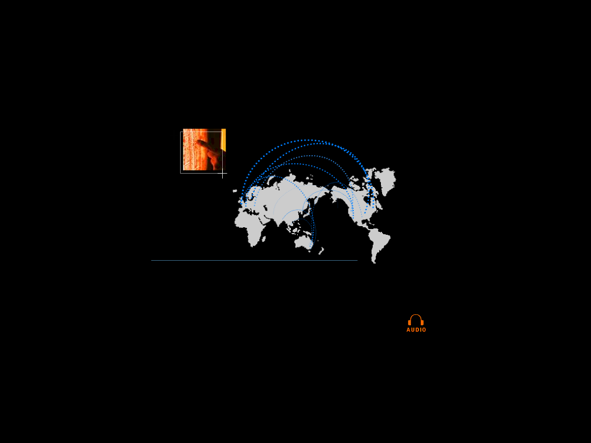

eCommerce is Becoming Core to the Global Energy Business
01010
91919
01382
83710
91817
01010
91919
01382
83710
91817
01010
91919
01382
83710
91817
01010
91919
01382
83710
91817
91919
010102374621985712398571928509129759812659821598601010237462198571239857192850912975981265982159860101023746216
010102374621985712398571928509129759812659821598601010237462198571239857192850912975981265982159860101023746298
global networks

Slide 18
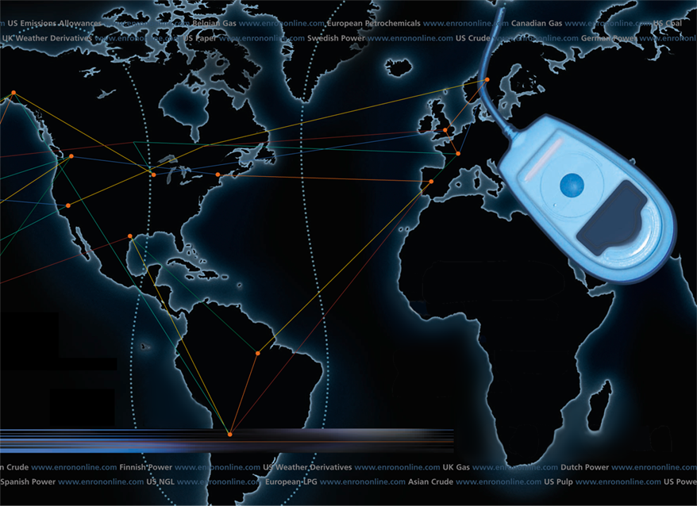
Putting the Energy into e-commerce
EnronOnline
TM
TM
Notes:
Note:
There are 2 invisible boxes drawn over the top and bottom of the mouse
These will be the hot spots on the screen
To Set Up:
Right click over top of mouse
Go to “Action Settings”
Pick the “Mouse Click” tab
Go to the “run” section and click the browse button
Locate the “Enron.exe” and click it
Now in the run section it should have the path leading to the “Enron.exe”
Now repeat the process for the bottom (if you want both spots to be “hot”)
Note:
When testing you might get an “Enable macros” screen.
DO! enable them or the movie won’t run.

Slide 19
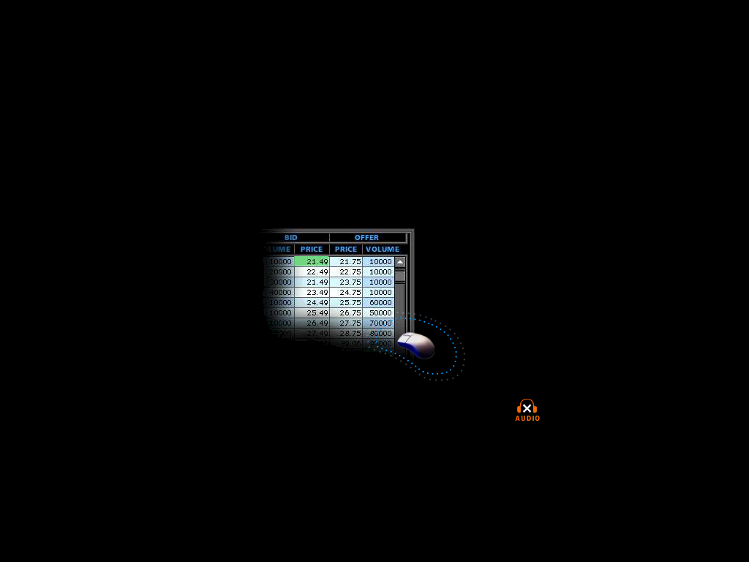

What is EnronOnline?
A Free, Internet-based, Global Transaction System Which Allows Counterparties to View Real Time Prices From Enron’s Traders and Transact Instantly Online
click & transact
Putting the Energy into e-commerceTM

Slide 20
How does EnronOnline differ from current way our customers currently conduct business?
Currently With EnronOnline
Internet
Enron
Enron
Putting the Energy into e-commerceTM

Slide 21
Benefits of EnronOnline
Free of charge
Real-Time Pricing Information
Access to complementary markets and product information
Simple access via the Internet
Easy to use
Fast and Secure Execution
Enron’s Best Prices
Putting the Energy into e-commerceTM

Slide 22
EnronOnline Launch Schedule
    November 1999 US & Canadian Natural Gas
    December 1999 US Power
    Nordic Power
    Plastics
    Pulp & Paper
    Coal
    January 2000 Belgian Natural Gas
    Emissions
    German Power
    LPG
    Oil & Refined Products
    Petrochemicals
    Spanish Power
    Swiss Power
    UK Natural Gas
    UK Power
    US Weather
Putting the Energy into e-commerceTM

Slide 23
Enron’s global wholesale transaction business
…………..moves online
    February 2000 EnBank Virtual Storage Auction (UK)
    European Weather
    March 2000 Australian Power
    Credit Derivatives
    Dutch Power
    Emissions Auctions (US)
    April 2000 Austrian Power
    May 2000 Bandwidth
    European Coal
    Asian Crude & Products
    June 2000 Pipeline Capacity Auction
Putting the Energy into e-commerceTM

Slide 24
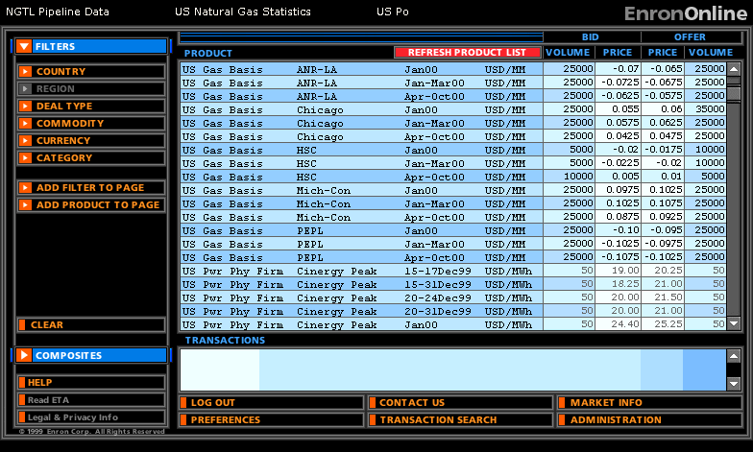
Quotes Page
Putting the Energy into e-commerceTM

Slide 25
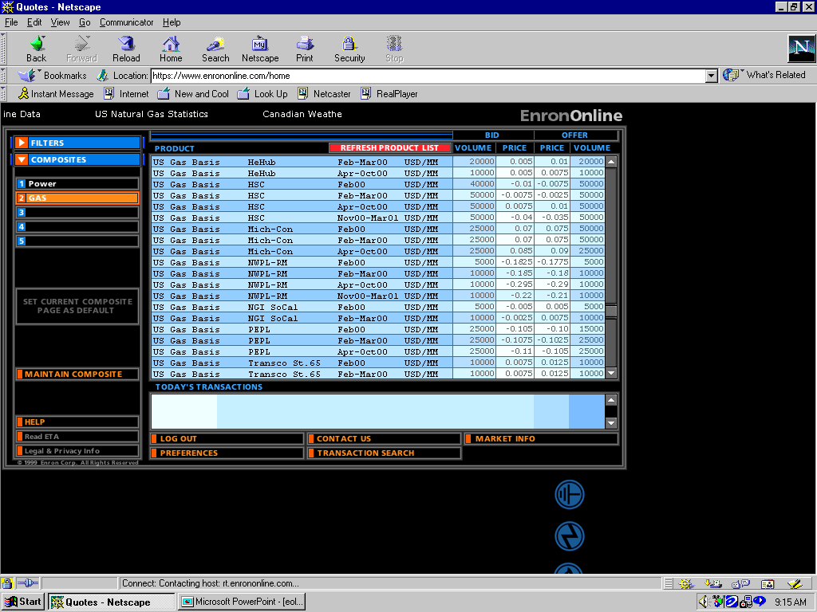
Click on Bid or Offer Price
Putting the Energy into e-commerceTM

Slide 26
Submission Screen
Putting the Energy into e-commerceTM

Slide 27
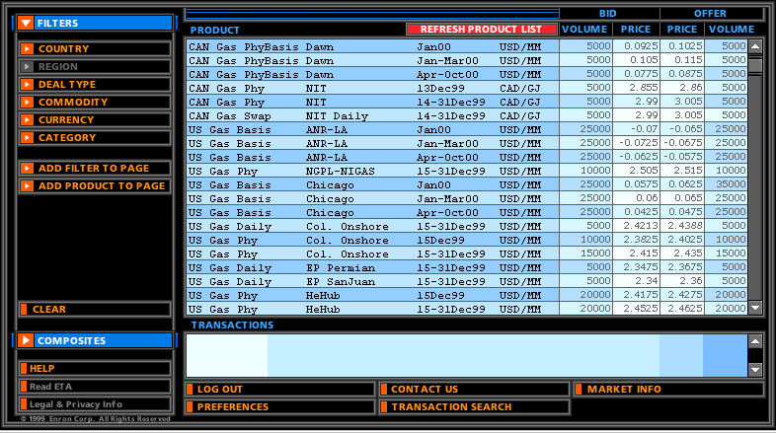
Successful Transaction
Putting the Energy into e-commerceTM

Slide 28
EnronOnline Statistics
Total Life to Date Transactions > 196,000
Currently > 52 % of Enron’s Transactions
Average Daily Transactions > 2,000
Life to Date Notional Value of Transactions > $96 billion
Daily Notional Value Approximately $1 Billion
Currently > 45% of Enron’s Notional Volume
Number of Products Offered - Approximately 820
Number of Currencies Traded in = 13
Development Time Approximately 7 Months
Announcement Date October 26, 1999
Launch Date November 29, 1999
As of 7/5/00

Slide 29
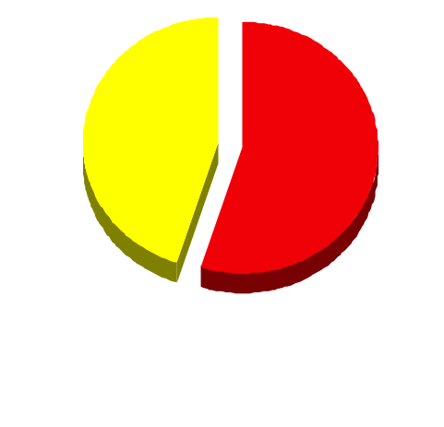
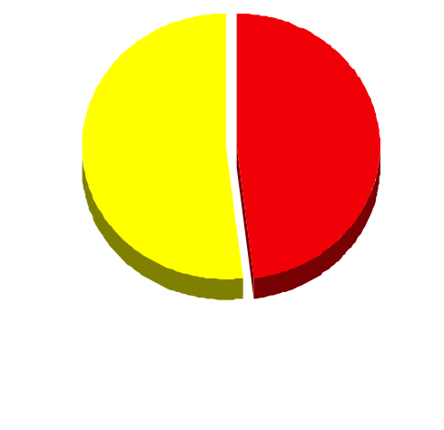
EnronOnline Versus Traditional Channels
(Currently)
Volume
Transactions
45%
52%
48%
55%
EnronOnline
Traditional Channels
Putting the Energy into e-commerceTM

Slide 30
eCommerce Business Comparison
Value of Goods
(Millions)
Business To Consumer (B2C)
eBay
Amazon.com
Dell.com
$ 2,650
1,600
10,190
1999 Data*
Business To Business (B2B)
FreeMarkets
Cisco
Intel
Altrade
$ 1,400
9,480
10,500
12,000
2000 Est.**
EnronOnline
> $ 96,000
* Est. 1999 Annual Results
** Annualized Based on Results to Date
Putting the Energy into e-commerceTM

Slide 31
"EnronOnline was having problems this morning, so we were flying blind,"
Gas Daily April 11th, 2000
Putting the Energy into e-commerceTM

Slide 32
Putting the Energy into e-commerceTM

Slide 33

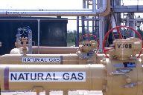
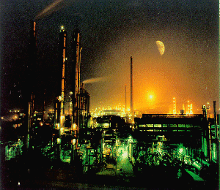

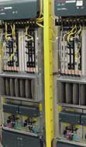





Enron Today
Enron Tomorrow
Natural Gas
Energy
Broadband
Telecommunications
Petrochemicals
Electricity
Metals
Coal
?
Paper
Weather
P/E Multiple: 57x
P/E Multiple: 57x +

