Slide 1

ePowering the Net Economy
Dec. 7, 1999

Slide 2
The Internet Explosion Continues
CAGR
Internet Users
1998 65 mm
2002 250 mm
40%
Business Internet
Services
1998 3bb
2002 28bb
75%
eCommerce
1998 25 bb
2002 425 bb
103%
High Bandwidth
1998 10 bb
2002 160 bb
100%
Forester Research and IDC

Slide 3
Enron Communications’
Business Strategy
ePowered Application Services
Bandwidth
Management
Delivered Through a Unique Business Model
Enron Intelligent Network
Intelligent
Network
Introduces New Level of Control, Security and Quality Required by e-business Applications
Bandwidth Management
e-business
Applications
Optimize Physical Reach and Develop Market Opportunities
Goal: Become the leading global e-commerce delivery platform
Notes:
Developing an intelligent platform that enables the
development and delivery of internet-based, mission critical e-business applications.
First mover in a new category of
communications company.
Building intelligence into the network.

Slide 4





Enron’s Intelligent Network
Content
Providers
Enron
PoP
Enron
PoP
End
Users
ISPs
ISPs
WAN
_{MAN}
_{MAN}
WAN
WAN
WAN
Third Party WAN’s
_{MAN}
Enron WAN
_{MAN}
_{MAN}
Enron Pure IPSM Network
Includes Fiber, DWDM and Routers
Pure IP Benefits
Higher Speed
Lower Equipment and
Operating Costs
Higher Reliability
Greater Scalability

Slide 5
Enron’s Intelligent Network
Content
Providers
Enron
PoP
Enron
PoP
End
Users
ISPs
ISPs
WAN
_{MAN}
_{MAN}
WAN
WAN
WAN
Third Party WAN’s
_{MAN}
Enron WAN
_{MAN}
_{MAN}
Distributed
Servers
Enron Pure IP Network
Distributed
Servers
Distributed Server Benefits
Creates Partnerships with ISPs and Economically Extends Network Reach
Functions as System Interconnect and Serves as Product Delivery Point Places Application Services “One Hop” From End User, Improving Quality of Service

Slide 6
Enron’s Intelligent Network
Content
Providers
Enron
PoP
Enron
PoP
End
Users
ISPs
ISPs
Intelligent Layer
WAN
_{MAN}
_{MAN}
WAN
WAN
WAN
Third Party WAN’s
_{MAN}
Enron WAN
_{MAN}
_{MAN}
Distributed
Servers
Enron Pure IP Network
Distributed
Servers
Intelligent Layer
Provides Ability to Control Delivery and Routing of Data
Key Difference Between Enron’s Network and Existing Delivery Platforms
Extends Network Functionality to Application Developers

Slide 7
Enron Intelligent Network Reach
_{Seattle}
_{Portland}
_{Minneapolis}
_{Toronto}
_{Boston}
_{London}
_{Albany}
_{Boise}
_{Paris}
_{Detroit}
_{Copenhagen}
_{Salt Lake City}
_{Omaha}
_{New York}
_{Denver}
_{Cleveland}
_{Munich}
_{Sacramento}
_{Kansas City}
_{Chicago}
_{St. Louis}
_{Philadelphia}
_{Amsterdam}
_{San Francisco}
_{Las Vegas}
_{D.C.}
_{Rome}
_{Asia}
_{San Jose}
_{Albuquerque}
_{Charlotte}
_{Los Angeles}
_{Phoenix}
_{Atlanta}
_{San Diego}
_{Dallas}
_{Jackson}
_{New Orleans}
_{Orlando}
_{Houston}
_{Miami}
_{San Antonio}

Slide 8
ECI Distribution Alliances
Cmetric
Easystreet
Electric Lightwave
Epoch Internet
Firstworld
Flash.net
GST
GTE internetworking
InterNap
Netrail
NorthPoint
OrcoNet
PDQ.net
RCN
RMI.Net
showdigital
TeleCommute Solutions
Verio
Villagenet
Represent Over 400 PoPs
Directly Accessing 17 Million Desktops

Slide 9
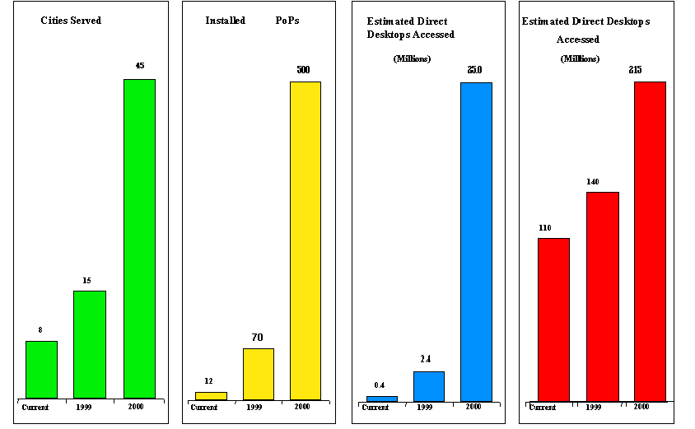
ECI Reach
Estimated Indirect Desktops

Slide 10
Rising Demand for Quality Streaming Media
New households will opt for Broadband#
1 million North American households - Now
~26 million subscribers by 2003
36% of the online population
Webcast users are very active*:
75% watch at least 30 minutes of video/wk
50% plan to watch more
70% click for content info
60% click for ad info
49% buy advertised products online
Audio still much more popular than video
due to the quality of the experience!
# Forrester(July 1999)
* Arbitron NewMedia(1999); n=1527; Users selected from Broadcast.com and Vtuner.com websites

Slide 11
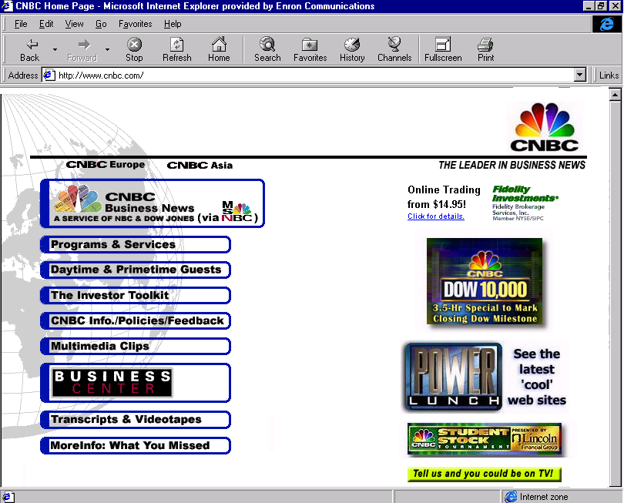

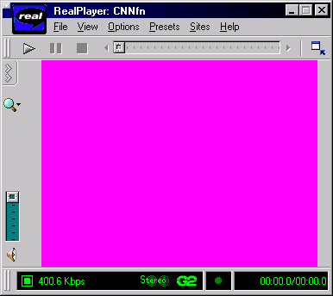
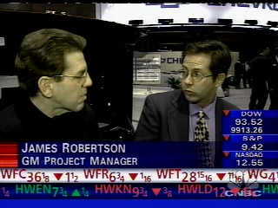
Imagine….
An internet capable of delivering high quality, high bandwidth applications such as video.
The ability to get various information sources (CNN, MSNBC, etc.) to your desktop at the push of a button.
Freedom from needing to buy dedicated, high-speed circuits from multiple providers.
The Future is Here Today!

Slide 12
ePowered Media Cast
Delivers 1 kbps to 1 Mbps⁺ Rich Streaming Media
Utilizes the EIN to assure quality broadband delivery
Scales to 100K Simultaneous Users & Beyond
Supports Live, On-Demand & Scheduled Events
Unicast & Multicast Enabled
Leverages RealNetwork G2 & Windows Media Technology
QuickTime and MPEG-1 Support in 2000
Fulfills the Demand for High Quality, High Bit Rate Streaming Media

Slide 13
Media Cast - Value Proposition
Content Providers
The Internet becomes a viable, high quality distribution platform
for rich media
Better reach to targeted audiences
Can now support large, simultaneous audiences
Only pay for content actually viewed by end-users
Create an Immersive Interactive Internet environment
Internet Service Providers
Differentiated, value-added service for subscriber base
New revenue stream not previously available - 100% success based
Opportunity to enable future ECI applications
End Users
Access to rich media never before available - rate adaptive!
View content on demand, when desired at highest speed possible

Slide 14




Media Cast - Content Distribution
3
Storage,
Archiving &
Content
Managment
1
Acquisition
4
Replication
2
Encoding
ePowered
ISP’s
G2
Enron Intelligent Network
NTSC
Streams are distributed to edge servers co-located with ePowered Internet Service Providers via:
1 DS-3 or OC-3 Metropolitan Area Connectivity
2 Fast Ethernet Interconnect when Co-Located
3 Satellite

Slide 15
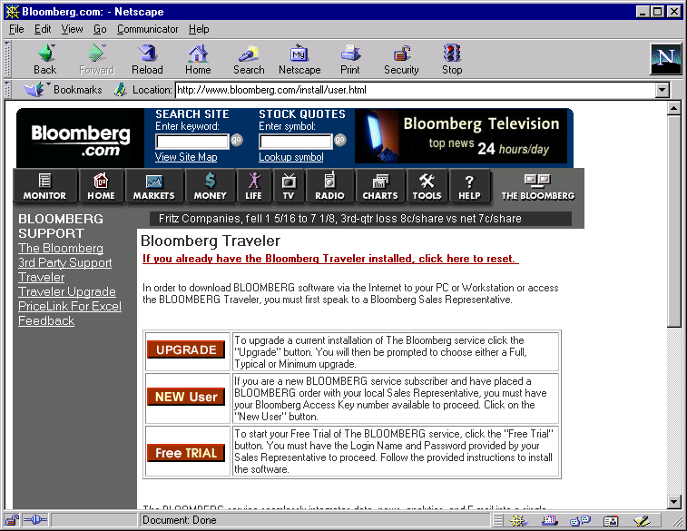
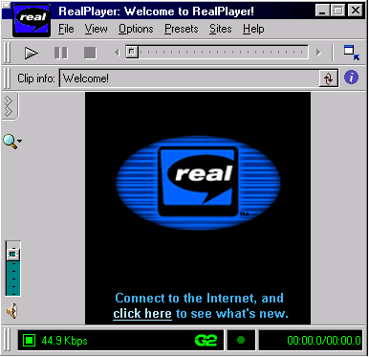
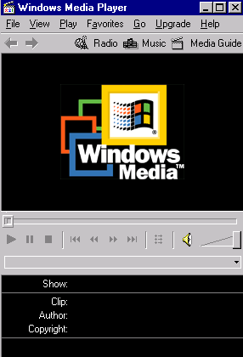
Media Cast - Content Viewing
1
End User browses content provider’s web site
3
End User is re-directed to closest ECI Edge Server for stream
2
End User clicks on streaming media link
xyz.com
ePowered
ISP
Internet
Internet
“Best Effort”
End User
ECI
Server Farm
(Co-Located)
EIN
Encode
Content
Provider
4
High Quality rich media is streamed without delay and congestion to End User’s media player (1-hop routing)
EIN
“Guaranteed QoS”

Slide 16
What if an ISP is not ePowered?
ECI is turning up TerraBit Server Farms in major cities to reach all non-ePowered end-users. These regional stream servers will have 2-hop routing to all major Tier 1 Internet Service Providers, creating a second level, high guality stream delivery platform.
Enron Intelligent Network
High Quality rich media is streamed without delay and congestion to End User’s media player
Encode

Slide 17
Media Cast - Competitive Advantage
Stream Speed Support
Up to 1 Mbps streams
Unlimited stream license from Real Networks
Technology & Scalability
Fiber and satellite distribution
Carrier class routers & servers
OC12/48/192 capacity
24x7 support center with functional Extranet

Slide 18
Media Cast Features
Content Management, Administration & Distribution
Secure movement of the content from the provider to the edge
Reserving bandwidth and establishing replication strategy
Management of content expiration at the edge
Content Resolution, Streaming/Serving & Viewing
Accepting and rendering requests for live or on-demand content
Event scheduling
Schedule and confirm live events
Capture event characteristics and reserve the required bandwidth
Stream Monitor & Log Processing
Tracking the quality of the stream from particular edge servers
Retrieving usage data from edge locations
Converting data into relevant billing info
Usage & Reporting
Generation of summary and detailed usage reports
History reports and SLA reports

Slide 19
Media Cast Functional Specification

Slide 20
Media Cast Functional Specification (Cont.)

Slide 21
Media Cast Functional Specification (Cont.)

