Slide 1

Enron Communications: delivering a whole new Internet experience

Slide 2
Enron Corporation - Overview
Worldwide Leader in Deregulating Industries
#27 on Fortune 500 List with $30⁺B in revenue
Rated by Forbes Magazine as “Most Innovative Company in America” 4 years in a row
Experienced in physical commodities trading,
risk management and financial services
Enron Communications is wholly owned subsidiary of Enron Corporation (ENE).

Slide 3
Enron Communications (ECI)
Founded 1997
Dual Headquarters in Portland and Houston
Building out a Global Fiber Optic, Pure IP, Distributed Server Network
Network Application Service Provider
Enron Communications is NOT
An Energy Company
A Wholesale Carrier or ISP or Telco

Slide 4





















Diverse and Experienced Management Team

Slide 5
Enron Communications
Business Strategy
Bandwidth
Management
Enron Intelligent Network
Introduces New Level of Control, Security and Quality Required by e-business Applications
e-business Applications
Intelligent
Network
Delivered Through a Unique Business Model
Bandwidth Management
e-business
applications
Optimize Physical Reach and Develop Market Opportunities
Notes:
Developing an intelligent platform that enables the
development and delivery of internet-based, mission critical e-business applications.
First mover in a new category of
communications company.
Building intelligence into the network.

Slide 6
Communications Network
_{Seattle}
_{Portland}
_{Minneapolis}
_{Toronto}
_{Albany}
_{Boston}
_{Salt Lake City}
_{New York}
_{Sacramento}
_{Denver}
_{Chicago}
_{Washington D.C.}
_{San Francisco}
_{San Jose}
_{Albuquerque}
_{Los Angeles}
_{Dallas}
_{San Diego}
_{New Orleans}
_{San Antonio}
_{Houston}

Slide 7
Communications Network
_{Seattle}
_{Portland}
_{Minneapolis}
_{Boston}
_{Boise}
_{Toronto}
_{Albany}
_{Detroit}
_{Salt Lake City}
_{Omaha}
_{New York}
_{Chicago}
_{Cleveland}
_{Sacramento}
_{Denver}
_{Kansas City}
_{Philadelphia}
_{St. Louis}
_{Washington D.C.}
_{San Francisco}
_{San Jose}
_{Las Vegas}
_{Charlotte}
_{Tokyo}
_{Albuquerque}
_{Los Angeles}
_{Phoenix}
_{Dallas}
_{Atlanta}
_{San Diego}
_{Jackson}
_{New Orleans}
_{Orlando}
_{San Antonio}
_{Houston}
_{Miami}

Slide 8
Communications Network
_{Seattle}
_{Portland}
_{Toronto}
_{Albany}
_{Boston}
_{London}
_{Boise}
_{Minneapolis}
_{Paris}
_{Detroit}
_{New York}
_{Copenhagen}
_{Salt Lake City}
_{Omaha}
_{Munich}
_{Denver}
_{Chicago}
_{Cleveland}
_{Amsterdam}
_{Sacramento}
_{Philadelphia}
_{San Francisco}
_{St. Louis}
_{Washington D.C.}
_{Rome}
_{Kansas City}
_{San Jose}
_{Las Vegas}
_{Charlotte}
_{Albuquerque}
_{Tokyo}
_{Los Angeles}
_{Phoenix}
_{Atlanta}
_{Dallas}
_{Jackson}
_{San Diego}
_{New Orleans}
_{Orlando}
_{San Antonio}
_{Houston}
_{Miami}

Slide 9
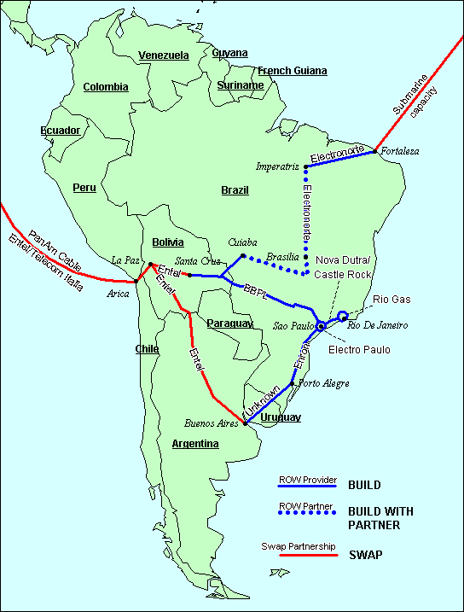
South American Development

Slide 10
Pure IP Backbone Architecture
Cisco 12012 GSR / Ciena Sentry DWDM
IP POS Native; no L2 overlay networks, TDM, etc.
Application Ready
  distributed high powered Sun servers
  InterAgent middleware enabled
Advanced Traffic Engineering/Management
  QoS through MPLS, WRED
  intelligent provisioning
OC-12 / OC-48
GSR
Backbone Routers
GSR
OC-12
Aggregation Router
Server
DS-3/OC-3 via Channelized OC-12

Slide 11
Enron Intelligent Network
e-Commerce Applications
Enron Intelligent Network (EIN) API’s
InterAgent®
OSS
BILLING
QoS
SCHEDULING
DIRECTORY
SERVICES
MEDIA
SERVICES
Network
Mgt
Caching &
Configuration
Forward
reservations
Policies,
Permissions,
State
Streaming,
Transport
Metering
Distributed Servers
Pure IP_{SM,} Routers, DWDM, Fiber
Notes:
Proven, Commercial Technology Owned By Enron
Optimizes Data Flow Independent of System Ownership
Through Messaging Between Servers, Determines Optimum Route, Minimizes Hops and Transfers Data Faster and More Reliably
Allows Metering of System Use and Usage-Based Billing
Key Tool for Bandwidth Management

Slide 12


Slide 13
Initial ePowered Applications
ePowered Media Cast™
  High Quality Video Streaming for Live, On-Demand and Scheduled Events
  10 Times Faster than the Internet, Large Viewing Window and Stereo Sound
  Ad-Based, Subscription or Pay-for-View Contracts
  Product Delivery Begins Third Quarter 1999
ePowered Media Transport™
  Flexible, Affordable Broadcast TV Transport
  Provides Alternative to Satellite and Land-Based Networks
  Usage-Based Contracts
  Commercially Available Early Fourth Quarter 1999
ePowered Conferencing™
  High Quality Video Conferencing and Collaborative Sessions for the Desktop
  Strategic Alliances With PictureTel and MShow
  Uses Standard Web Tools and a Single Web Interface
  Contract Revenue Shared on a Predetermined Basis
  Commercially Available End of Fourth Quarter 1999

Slide 14
ePowered Media Cast
FEATURES
Streaming delivery of live and/or archived events
Internet experience marked by no delays and business quality video distribution to any desktop
Stereo sound and a large viewing window
Real G2, Windows Media Player, QuickTime and MPEG-1 formatted content
Many times faster than what is currently available over the World Wide Web
Delivery speeds of 8 kbps to 1 mbps and beyond

Slide 15
Media Cast Roadmap
Media Cast R4.0
All R3.0 plus
MPEG1 support
Digital Watermarks
Advanced Stream Monitoring
Media Cast R3.0
All R2.0 plus
Quicktime and MP3 support
Intelligent Content Management
Selective Content Distribution
Pay per View Payment Transaction Support
Satellite distribution
Media Cast R2.0
All R1.0 plus:
WMP High Bit Rate - Up to 1Mbps to ePowered ISPs
Multicast
Pay per View
GUI for content management
Media Cast R1.0
G2 High Bit Rate - Up to 1Mbps to ePowered ISPs
G2 Low Bit Rate - Up to 100 Kbps to all desktops
WMP Low Bit Rate(Sept.-Limited, Oct. Full deployment) - Up to 100 Kbps to all desktops
Current
Q4’99
Q1’00
Q2’00

Slide 16




Overview: Content Distribution
Enron Content
Locator
ISP POP
Customer
Site
Internet
ISP
edge
router
Content
Provider
End Station
EIN
Customer
Access Router
Collocated
Server
www Server
3
2
1
3
Distribution to
regional co-located
servers
Stream
Encoder
2
Replication to
major servers
throughout EIN
1
Video source encoded
Live or demand program
Sent into major EIN PoP

Slide 17
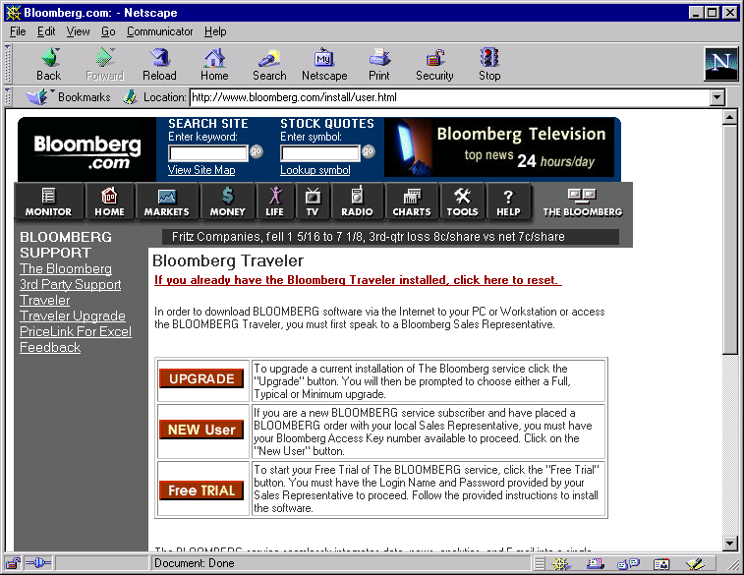
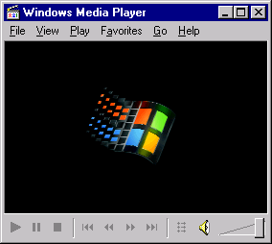
Overview: Content Delivery
3
Content
Locator returns URL for nearest server
Enron Content
Locator
2
Link to content has URL of Content Locator
4
Customer
Site
ISP PoP
Browser launches Player
Internet
ISP
edge
router
Content
Provider
End Station
1
End user
visits Content Provider’s Web site
Customer
Access Router
Collocated
Server
www Server
EIN
5
Player requests content URL on local server
Stream
Encoder
6
Media stream sent

Slide 18




What if my ISP is not ePowered?
TerraBit Server Farms in major cities reach all non-ePowered end-users. These regional stream servers will have 2-hop routing to all major Tier 1 Internet Service Providers, creating a second level, high quality stream delivery platform.
Enron Intelligent Network
High Quality rich media is streamed without delay and congestion to End User’s media player
Encode

Slide 19
Network Reach
Current Distribution
Epoch Internet
InterNAP
Easystreet
Flashnet
Northpoint
Verio
GTE
Showdigital
Telecommute Solutions
PDQ.Net
ICS VillageNet
Firstworld
Orconet
Representing Over 400 POPs, Directly Accessing 17 Million Desktops
_{Seattle}
_{Portland}
_{Boston}
_{London}
_{Minneapolis}
_{Toronto}
_{Albany}
_{Paris}
_{Boise}
_{Detroit}
_{Salt Lake City}
_{Omaha}
_{New York}
_{Copenhagen}
_{Cleveland}
_{Munich}
_{Sacramento}
_{Denver}
_{Chicago}
_{Amsterdam}
_{San Francisco}
_{St. Louis}
_{Philadelphia}
_{Rome}
_{Kansas City}
_{Washington D.C.}
_{San Jose}
_{Las Vegas}
_{Charlotte}
_{Tokyo}
_{Albuquerque}
_{Atlanta}
_{Los Angeles}
_{Phoenix}
_{Dallas}
_{Jackson}
_{San Diego}
_{New Orleans}
_{Orlando}
_{San Antonio}
_{Houston}
_{Miami}
Cities Served
Installed
POPs
Direct Desktops
Indirect Desktops
Accessed
Accessed
45
500
(Millions)
25.0
(Millions)
215
140
110
15
8
80
12
0.4
2.4
Current
1999
2000
Current
1999
2000
Current
1999
2000
Current
1999
2000

Slide 20
Media Cast - Value Proposition
Content Provider
Makes the Internet a viable, high quality distribution platform
for rich media
Can better reach targeted audiences
Can now support large, simultaneous audiences
Only pay for content actually viewed by end-users
Internet Service Provider
Differentiated, value-added service for subscriber base
New revenue stream - 100% success based
Opportunity to enable future ECI applications
End User
Access to rich media never before available - rate adaptive!
View content on demand, when desired, at highest speed possible

Slide 21
Interconnect Architecture
2 x OC-12 to
Enron Communications Network
ECI Metropolitan PoP
Backbone Routers
OC-12
Aggregation
Router
Server
Content Distributor Site
DS-3 or OC-3
Servers
Collocated Cisco 7206 and Sun Netras
Fast Ethernet
Ethernet
Switch
Collocated Cisco Catalyst
DEMARC
Distributor Router

Slide 22
Network Performance
High rate media streams via the Enron Intelligent Network, not the Internet
  reduces backbone transit utilization
  maintains content closest to network edge
  supports both real-time & on-demand model
Capacity Planning Considerations
  capacity of regional network
  load on edge routers
  capacity on last mile link
  performance of the enterprise network

Slide 23
Operational Considerations
Customer address space registered through Enron’s web site
  necessary for accurate billing, revenue sharing
  prevents customers of upstream providers from using the wrong media server
Site requirements
  Single 19” or 23” rack
  -48VDC or 120VAC Power
  Fast Ethernet connections into edge routers
  Variations possible

Slide 24
Reporting
Data recorded by each server
Reports generated from statistics compiled for each Content Distributor
  overall
  by PoP
  by region
  by Content Provider
  by program / content type
Secure online access to results
  maintains user and provider privacy, integrity

Slide 25
Service and Support
ePowerOnline Partner Web Site
  registration and setup
  reference information and documents
  revenue or billing information
  statistics and reporting
  trouble reports and status
Dedicated Engineering Assistance
24x7 NOC Support
  (800)267-7028
  noc@enron.net

Slide 26
Enron Communications
Enriching the Internet Experience
Rapidly Establishing Valuable Market Reach
Offering Application Products and Participating in Fast Growing Segment of High Bandwidth eCommerce
Delivering Value to Customers with a Unique Business Model that Accelerates Market Penetration and Profitability
Goal: Become the Leading Global eCommerce Delivery Platform

