Slide 1
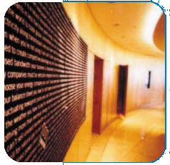

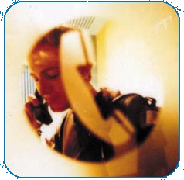


Government Affairs - The Americas
December 8, 2000 Staff Meeting
RCR / Budget / Communication / Value
<number>
Notes:
Hi. Thanks for having me here. I want to talk to you all today about the RCR database, the budget, communication initiatives and the value that comes from them.

Slide 2
2001 Objectives
RCR Database
Budget
Communication
Notes:
RCR Database – The objective here is to create a system that utilizes the RCR database to its fullest potential. I’ve had several opportunities to review the database and my review indicates that we are not keeping track of what we’ve spent, what we’ve asked for, the status of the RCR project and if completed if the RCR project met its objectives.
Budget – The budget for next year is limited so we need to keep track of all expenses. The costs relating to the RCR are a big part of our budget. In addition, we need to keep track of all other costs and expenses that will hit the individual cost centers. I will be working with each cost center owner each month to help make sure we are meeting the budget objectives for the cost center and the budget objectives for the group as a whole.
Communication – I will be working with each of you to create a system that allows us all to share information. The goal is to eliminate duplication of efforts and provide us all with a better understanding of our goals and objectives. I am a strong advocate of team work and I believe that value is added when you work with others to achieve the groups objectives.

Slide 3
Public Affairs Project Tracking
<number>

Slide 4
The Project
The project is the base document for all information
  To create a new Project, click on “Create”, “Project”.
Database Structure
Origination
(new 7/13)
Valuation
Update(s)/ Activity Report
RCR(s)
Project
Risk(s)
Cost Tracking
Federal Legis Rpt
Mitigation Plan(s)
Notes:
I understand that Elizabeth Linnell gave a great presentation earlier this year on the project database so I don’t want to go over the same material again. I will tell you to please remember that before a RCR can be submitted you need to create a project first. We will be sending out some reference materials for each of you on how the system works and the connection between the project database and the RCR process.

Slide 5
Project Basics
Entry
Field Req? Format
(1) No Auto populate, not changeable
(2) No Auto populate, changeable
(3) Yes Short title, example – “TX PUC Licensing Proceeding”. Not “Request to Hire Outside Consultant to Represent Enron’s Interests at Texas PUC Proceeding Regarding Licensing”
This field can also be a goal: Ex. MTBE Duty Drawback rather than a listing of each bill associated with the projected final outcome
(4) Yes Pick List. If you choose the US, you will be required to choose Federal or a particular state
(5) Yes Text entry – Enter relevant project details.
(6) No Text entry
(7) No Defaults to Medium
(8) No Defaults to Active, needs to be changed if status changed to Inactive or Completed
Notes:
I’m going to skip over this slide. I understand that the slide presentations will be e-mailed and the slides along with the training booklets should help you get through this process.

Slide 6
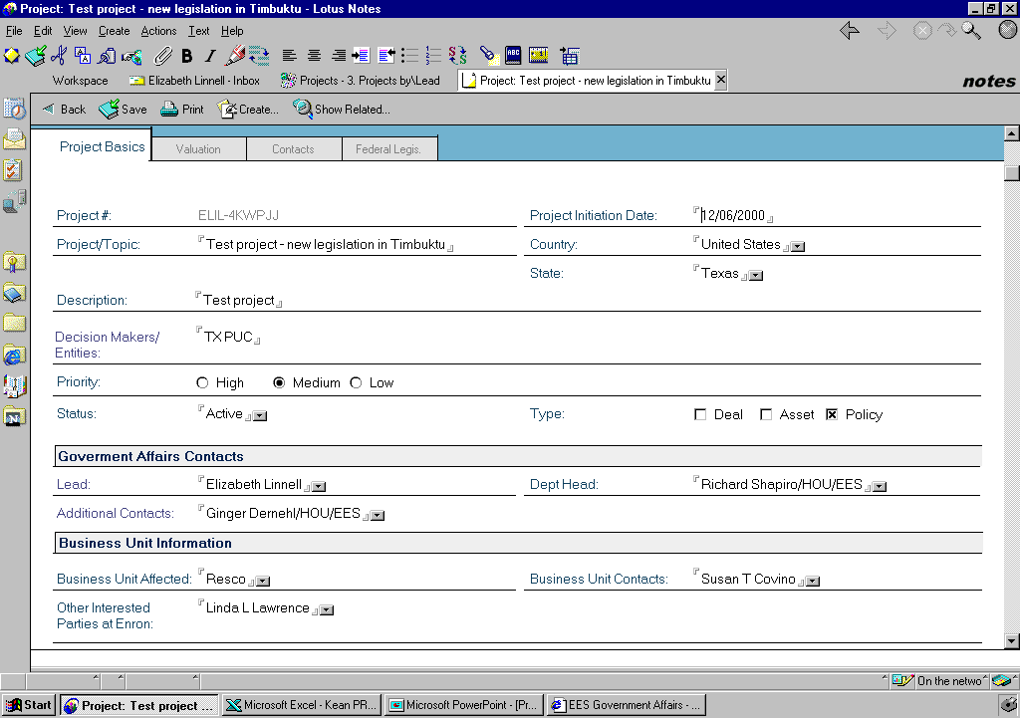
Basics Tab
(1)
(2)
(3)
(4)
(5)
(6)
(7)
(8)
(9)
(10)
(12)
(11)
(13)
(14)
(15)
(16)

Slide 7
Project Basics - Continued
Entry
Field Req? Format
(9) Yes Check box
(10) No Defaults to your name. If someone enters system data on your behalf, this field needs to be changed.
(11) No Other Public Affairs contacts on the project
(12) Yes Select from pick list. Needs to be entered since some project data is tracked by department head.
(13) Yes Choose from picklist
(14) No Field to store information on business unit contacts
(15) No Other interested parties at Enron - Ex. Commodities traders, pipeline Gov’t Affairs
(16) No (not shown) Any document can be attached here for permanent reference.

Slide 8
Basics Tab
(1)
(2)
(3)
(4)
(5)
(6)
(7)
(8)
(9)
(10)
(12)
(11)
(13)
(14)
(15)
(16)

Slide 9
RCR
Entry
Field Req? Format
(1) Yes Text entry - please be specific
(2) Yes Check box
(3) No Background and reasoning for the expenditure
(4) Yes Enter as a number, program will change to $
(5) N/A This links you back to the parent project.
(6) N/A The RCR Committee will change this field.
(7) N/A The RCR Committee will fill in this field.
(8) N/A The RCR Committee will fill in this field.
(9) N/A The RCR Committee will fill in this field.
(10) N/A The RCR Committee will fill in this field.
(11) N/A This field will automatically populate when the cost tracking is entered (after the RCR has been approved).
(12) No Any document can be attached here for permanent reference.
Notes:
The first field requires you to name your project. Be specific in naming your project. If the RCR request is for NY ISO related work for example please reference that in your title. The second field is required. There are 4 type categories to chose from – Advocacy, Risk Management, Deal Support and Origination. The 3rd field is not required but allows you to insert comments on the project and the reason for the expenditure request. The 4th field is required – if you want any money you have to let us know how much you want. The 6th field will be filled out by the RCR Committee after the weekly RCR meeting. The RCR Committee meets every Monday and reviews all RCR requests submitted prior to that time. The 9th field will be filled out by the RCR Committee and will provide the basis for the approval or denial of the RCR request. In some cases the RCR committee will not approve the RCR expenditure amount requested. In some cases the committee will approve an expenditure amount higher or lower than the requested amount. The 11th field will automatically populate when the cost tracking is entered.

Slide 10
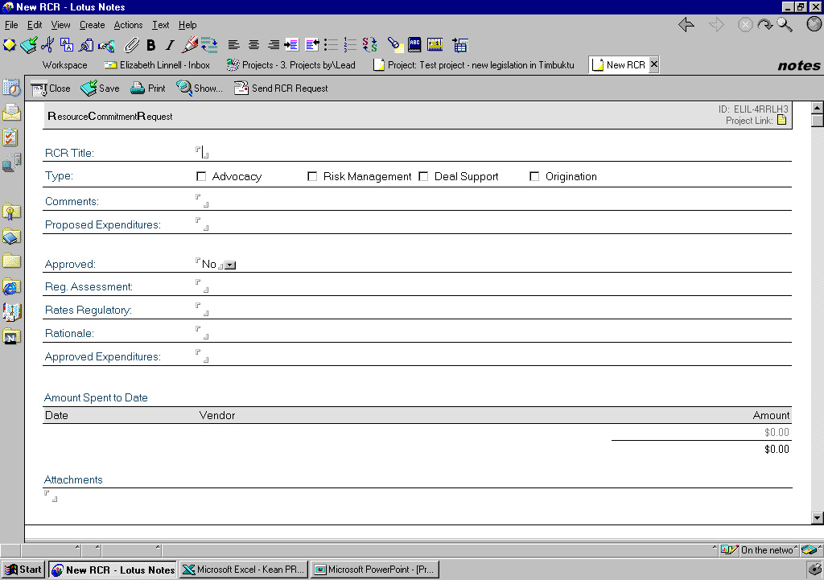
(1)
(5)
(2)
(3)
(4)
(6)
(7)
(8)
(9)
(10)
(11)
(12)

Slide 11
RCR Database - Cost Tracking
Requested
Approved
Spent to Date
Status
$7,076,400
$5,085,650
$2,745
Open
Notes:
There is no room in the budget for discretionary costs to be processed without going through the RCR process. There is approximately 9 million dollars in the budget for outside services which is less than the budget for last year. As you can see by this slide we need to be better about tracking what we spend. If an RCR was approved for a certain amount we need to take all necessary steps to stay within the approved expenditure amount. If there is a perception that you are going to need more money to reach the objective of the RCR then you will need to submit another RCR for approval.
Spent to date – Ginger had an idea that I think is a good one. To know what invoice goes with what RCR we should require the vendor or outside service provider to indicate on the invoice the RCR title and RCR unique identifier. Another idea is to have the unique RCR identifier connect to a SAP work order number so that when the invoice comes in from outside the invoice is coded to the SAP/RCR work order number before it can be paid.
Status – We need to make sure that when a RCR project is resolved the RCR database should get updated. When we update the RCR database with the project status we can indicate if the objective of the RCR was met. The status information can be used at the end of the year to show the value added by the project and the value the project had on meeting our overall goals and objectives.

Slide 12
RCR Database - Cost Tracking - Advocacy
Requested
Approved
Spent to Date
Status
$2,153,476
$1,393,374
$0
Open
Notes:
I mentioned earlier that the RCR database has 4 distinct types – Advocacy, Risk Management, Deal Support and Origination. This slide shows what was Advocacy RCR’s were requested and approved. As you can see we evidently haven’t spent any money on the RCR’s submitted in this category.

Slide 13
RCR Database - Cost Tracking - Deal Support
Requested
Approved
Spent to Date
Status
$979,700
$724,200
$2,745
Open
Notes:
This slide indicates that we’ve only spent $2,745 dollars on the approved RCR’s relating to Deal Support.

Slide 14
RCR Database - Cost Tracking - Origination
Requested
Approved
Spent to Date
Status
$228,000
$223,000
$0
Open
Notes:
Again, another slide on the amount requested, approved and spent on RCR’s relating to Origination efforts within EGA.

Slide 15
RCR Database - Cost Tracking - Risk Management
Requested
Approved
Spent to Date
Status
$755,140
$631,640
$0
Open
Notes:
This is another slide on what we requested, approved and spent on RCR’s dealing with Risk Management.

Slide 16
RCR Database - Cost Tracking - Not Categorized
Requested
Approved
Spent to Date
Status
$4,027,634
$3,073,986
$0
Open
Notes:
This is an interesting slide. We have approximately $3,000,000 in approved RCR’s that are not categorized but we haven’t spent any money on these mystery RCR’s so that may be a good thing.

Slide 17
Cost Tracking
Entry
Field Req? Format
(1) Yes/No Default will be entry date, can be changed to invoice date
(2) Yes Pick list. If the vendor isn’t already on the list, type in vendor name and it will be added to list for future use.
(3) Yes Numerical entry
(4) No Any document can be attached here for permanent reference.
Notes:
These slides show that for next year we need to do a better job on keeping track of the costs approved and to do that we need to follow the procedures in the Cost Tracking part of the RCR database.

Slide 18
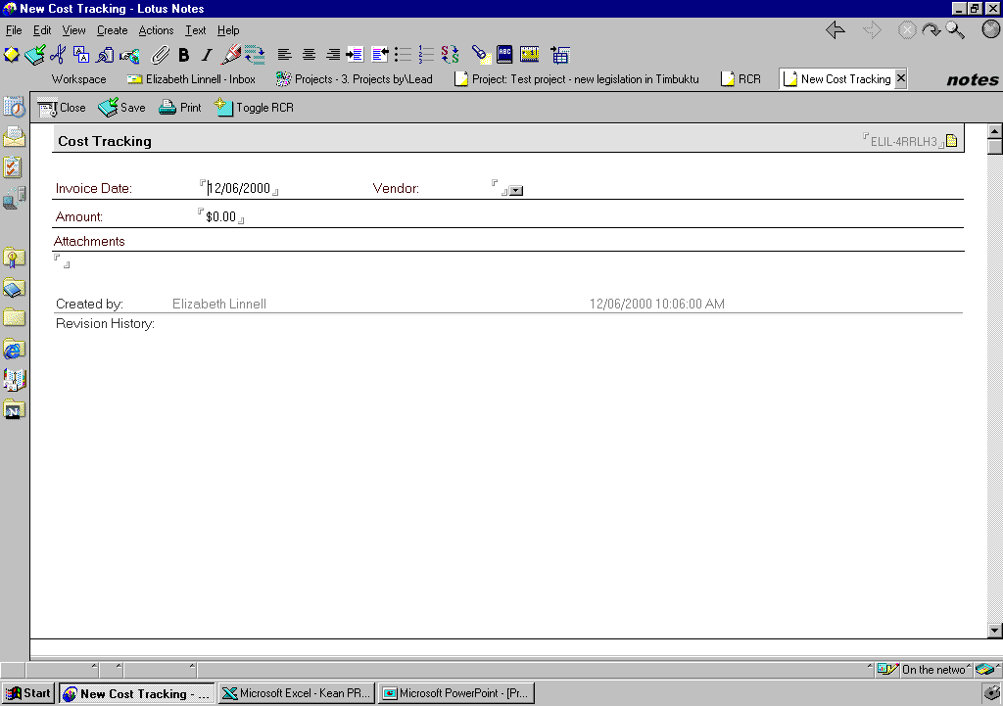
(1)
(2)
(3)
(4)
Notes:
Field 1 is the invoice date. There is a default in this field to the entry date. We need to make sure that we use the invoice date. The objective is to update the cost tracking monthly as invoices are processed for payment. The cost tracking won’t work unless we make the effort to update the database as invoices are received. Field 2 requires you to input the vendor name. The 3rd field is again required and is the amount of the invoice. The 4th field is not required but if you wanted to attach a document for reference this is the field you would use.

Slide 19
Cost Tracking
Need to work out within your department how to identify which invoices apply to which RCRs
  Identify for your assistant when you approve the invoice
  Have vendors identify the RCR number or extension on the invoice they submit
  Have RCR number or extension tied to coding procedure
Notes:
As I mentioned earlier. You need to work out how to identify which invoice goes with which approved RCR. You can identify for your assistant the RCR number when you approve the invoice. You can have the vendors identify the RCR number or extension on the invoice they submit. Another alternative is to have the RCR number tie to a SAP work order number. Without the RCR number referenced in the coding the invoice could not be paid.

Slide 20
2001 Budget
Fixed Costs
Discretionary Costs
Business Unit Allocation
Salaries & Wages - Canada and Mexico
Salaries & Wages
Travel and Entertainment
Outside Services - Retainers
Contributions
Associations
Rents
RCR related costs to come from Rick Shapiro budget
Office supplies - Houston
Office supplies - field
Implementing a system to track which Cost Centers support which business unit
Notes:
Fixed costs – The fixed costs for the 2001 budget will include costs associated with salaries and wages. Salaries and wage costs will come out of Rick Shapiro’s budget for all cost centers except Canada and Mexico. Travel and Entertainment related costs will come out of each cost center. The outside service costs (retainers) will come out of Rick’s budget but each cost center will need to be accountable for the invoice costs that come out of their groups. In other words if your assistant codes the invoice you need to be aware that no matter how the invoice is coded you will need to be responsible for the invoice amount. I will be tracking the amount approved for each cost center and comparing that amount to actuals each month. The assistants should be sending all coded invoices to Ginger before they go to accounting. The cost center owners will still receive their SAP reports along with a report from me that shows approved budget numbers compared to actual costs regardless of whether the costs are coded to their cost center. This information will include monthly and year to date totals similar to the SAP format.
Discretionary Costs – RCR related costs will come out of Rick’s budget. Should we not be able to work with accounting on the SAP work order idea invoices for RCR related projects will be coded to Rick Shapiro’s budget. In order for the RCR invoice to be coded and accounted for properly outside service providers will have to understand the importance of the RCR identifier.
Business Unit Allocation – We are working on a system that will track what time is spent for a particular business unit. We would do an allocation based on percentages. This allocation methodology would be used to show our client base the value added. Your allocation for 2001 was “x” but our records show that we actually had “x” percentage of our resources dedicated to your business unit and should have received an allocation of “x”.

Slide 21

Communication
Internal
External
Weekly Report
EGA Interactive Newsroom
Notes:
One of my objectives for next year is to work with each of you on providing a better system of communication across departmental lines. There are a lot of communication related systems in development and I hope to be able to tie onto one of them to distribute a weekly report that highlights the major goals, objectives and accomplishments for each department. In the end we are looking to provide information to EGA employees on our goals and objectives and where we stand on reaching those goals and objectives.
External – One idea is to have an interactive newsroom that would be intranet based to go to each business unit. The newsroom would allow a reader to click on a story that interests them and reply back to that story with comments and suggestions. The newsroom would be activated monthly. I understand that there may be systems in development similar to this and hopefully we can work together to create a better communication system that allows us to share information to achieve the greater good.

Slide 22
RCR + Budget + Communication = Value
Notes:
When we hold ourselves accountable for the costs we spend, we communicate internally and externally our goals and objectives we add value to our goals and objectives. Thanks for your time.

