Slide 1
Proposal to Restructure California Resource Base QF Buyout Proposal
Proposed by Enron North America
To Socal Edison
August 28, 2001

Slide 2
QFs in the California Market
QF contracts form a significant (25 % or higher) of the resource base in California.
QF contracts have been “out of market” and expect to be “out of market”.
QFs have relatively high operating costs, may emit a high level of emissions and are inefficient relative to new resources.
These high cost resources are must take by the utility and form a baseload supply rather than operating on the margin. This prevents the market from sourcing these assets with more efficient resources.

Slide 3
Value Proposition
QF capacity exceeds 3600 MW in SCE
The cost of these QF PPAs exceed market prices by over $ 3 Billion
The current market is such that:
Can buy out QF PPA
Replace QF energy with firm market energy
Save rate payers an estimated $ 1 billion on a discounted cash flow basis (through discount on future payment or repayment of outstanding debt)

Slide 4
QF Supply – Demand Example Summary
Capacity +
Energy (SRAC)
Demand line for QF Energy
Potential Savings
Total Power Cost, $
QF Supply Line
Cost to Amortize
Contract Buyouts
Market Replacement
Energy
Quantity
Total # Contracts
Savings Formula:
Savings = Existing QF Payments - Replacement Energy Cost - Debt Repayment

Slide 5
Dual Auction QF Restructuring
Conduct Dual Auction for Buy Out and Replacement Energy
Auction to Buy Out and Terminate QF Agreement
Auction to Purchase Replacement Energy
QF Contract Buy Out Auction
Replacement Energy Auction
QF “bids” in contract buyout payment ($/kw)
Bids evaluated against replacement energy price, potential savings.
Lowest “bids” accepted.
Suppliers “bid” in firm energy (Std. EEI Firm Energy)
Bids evaluated against QF buyout bids and potential savings.
Lowest “bids” accepted.
Replacement quantity offsets capacity of QF buyout.
Auction
Platform

Slide 6
Example: Potential Buy Out Value
Where is the value?
Economic Analysis ($000) :
Existing Payments:
PV(10%) of future Payments to QFs under existing PPAs $ 2,203,173
Minus:
Contract Restructuring Cost:
QF Buyout + Replacement Energy $ 1,746,616
Potential Savings : $ 456,556

Slide 7
Description of Terms and Assumptions:
PV of PPA: Present Value of the total payments made to the QF, by asset type, on a discounted cash flow basis of 10%.
PV of of the Cost of the QF Buyout: Estimated enterprise value of the existing QF assets, by asset type. Calculated as the existing PPA revenues less the fixed (excluding debt payments) and variable expenses, on a 10% discounted cash flow basis. (Note: Assumes NO asset value of costs upon end of or termination of existing PPA)
PV of Cost of Replacement Energy: Present Value of the total future payments to be made by the utility for firm energy to replace the existing QF energy supplies. Values determined on a discounted cash flow basis of 10%.
Total Cost: Cost of the QF Buyout plus the Cost of the Replacement Energy.
Total Savings: Delta between the existing PPA payments to the QF and the Total Cost, which is the cost of the Buyout plus Replacement Energy.

Slide 8
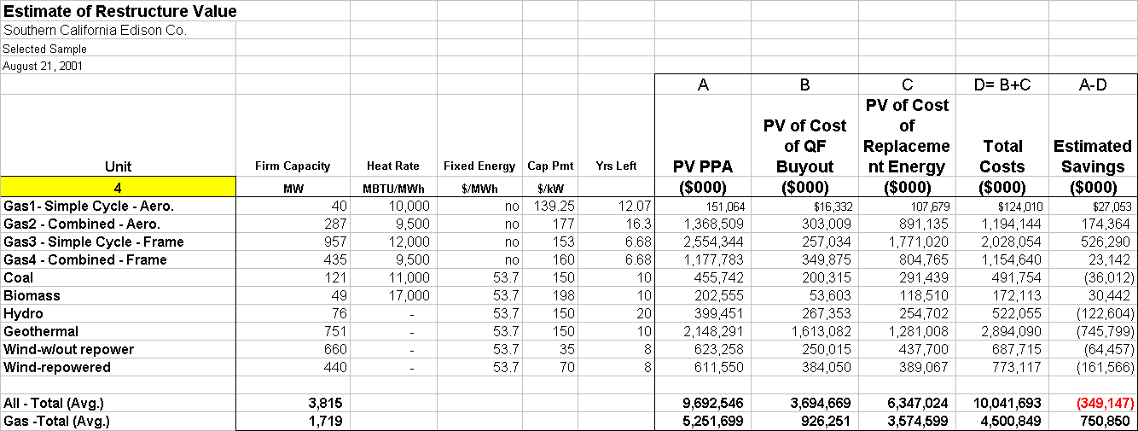
Detailed Analysis of Potential Savings:
Assumptions:
Columns A, B and C assume 10 discount factor.

Slide 9
Dual Auction Execution
Raise QF buyout payment through securitization of Rate Payer revenues
PUC reviews structure and
pre-approves methodology
Credit Support
Assign QF Agreements
Security
Market
Rate Payer
Revenues
PUC
Prudence
Approval
SCE
(or Holding Co.)
Lump Sum
Payment for QFs
Auction #1
Buyout
Payment
Auction #2
QF’s Offer On
Contract Buyout
( $/kw of Capacity)
Firm Energy
$
Buy Out
Auction
Energy
Auction
Savings Formula:
Savings = Existing QF Payments - Replacement Power Cost - Debt Repayment

Slide 10
Win -Win Structure
Rate Payers Win
Lower cost of Energy
Lower Stranded Cost
Viable Utility
Resource Stack becomes more efficient (emissions, costs, etc)
Edison Wins
Eliminates high price contracts
Eases the Tariff Rate-Cost Crunch
Moves Utility closer to Solvency
QFs Win
Receives acceptable rate of return on asset
Receives back payments
Eliminates ongoing debate regarding capacity/energy payments

Slide 11
Maxim for the Day
Encourage experimental doodling.
Listen to anybody with an original idea, no matter how absurd it
might sound at first.
William McKnight
3M 1914-1966
National Medal of Technology

Slide 12
Proposition
Provide the Utility with market based “firm” replacement energy.
Provide source of funds to repay the QF owners for past due debts owed by the Utility.
Create added “headroom” under rate cap.
Provides the Asset owners with a reasonable return on equity , repayment of debt, and restructuring of related contracts.
Provides a mechanism for existing QF owners to restructure existing operation, repower to provide for increases in efficiency, free up emission credits etc.

