Slide 1
Proposal to Restructure California Resource Base QF Buyout Proposal
Proposed by Enron North America
To Socal Edison
August 22, 2001

Slide 2
QFs in the California Market
QF contracts form a significant (25 % or higher) of the resource base in California.
QF contracts have been “out of market” and expect to be “out of market”.
QFs have relatively high operating costs, may emit a high level of emissions and are inefficient relative to new resources.
These high cost resources are must take by the utility and form a baseload supply rather than operating on the margin. This prevents the market from sourcing these assets with more efficient resources.

Slide 3
Proposal - Restructure QF Contracts to:
Provides the Utility with market based “firm” replacement energy.
Provides source of funds to repay the QF owners for past due debts owed by the Utility.
Create added headroom under rate cap.
Provides the Asset owners with a reasonable return on equity , repayment of debt, and restructuring of related contracts.
Provides a mechanism for existing QF owners to restructure existing operation, repower to provide for increases in efficiency, free up emission credits etc.

Slide 4
Value Proposition
Excess of 3600 MW of QF capacity in SCE territory
On Present Value Basis, the costs of the QF PPAs exceed market prices by over $ 3 Billion
At current market prices
Can buy out QF PPA
Replace QF energy with firm market energy
Save rate payers an estimated $ 1 billion on a discounted cash flow basis (through discount on future payment or repayment of outstanding debt)

Slide 5
QF Supply – Demand Example Summary
Capacity +
Energy (SRAC)
Demand line for QF Energy
Potential Savings
Price
QF Supply Line
Added Cost to Amortize
Contract Buyouts
Market Replacement
Energy
Quantity
Total # Contracts

Slide 6
Illustrative Example of Buy Out Values:
Assumptions:
Aggregate Capacity MWs: 957
Est. Heat Rate,MBtu/MWh 12,000
Aggregate Capacity Payment, $/kw-year 153
Remaining Term of PPA,yrs 6.68
Economic Analysis ($000) :
Spread on PPA revenues less $ 45.00/MWh Replacement Power
discounted at preferred rate component discount rate of 10 %: $ 649,947
Minus:
Projected Asset Buyout Cost (Enterprise Value + Fututre Merchant Value)
Calculated on a discounted cash flow basis
( 10% PV Discount Rate) ( PPA Revenues – Expenses) - $ 256,151
Potential Savings : $ 393,796

Slide 7
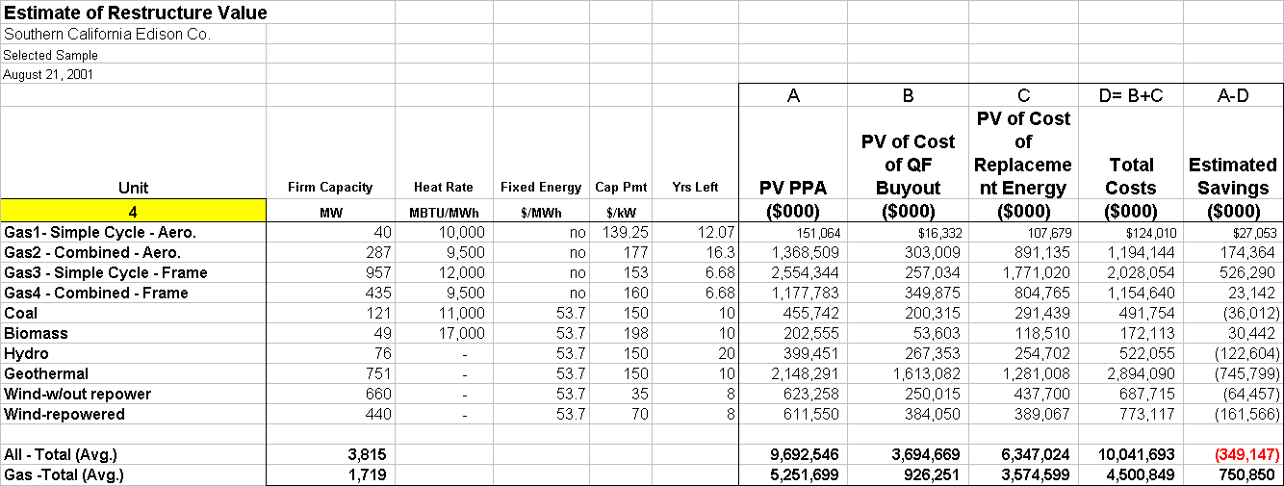
Detailed Analysis of Potential Savings:
Assumptions:
Columns A, B and C assume 10 discount factor.

Slide 8
Dual Auction QF Restructuring
Buy Out Auction
Replacement Energy Auction
QF “bids” in contract buyout payment ($/kw)
Bids evaluated against replacement energy price, potential savings.
Lowest “bids” accepted.
Suppliers “bid” in firm energy (Std. EEI Firm Energy)
Bids evaluated against QF buyout bids and potential savings.
Lowest “bids” accepted.
Replacement quantity equals offsetting QF buyout capacity.
Auction Platform

Slide 9
Dual Auction
Raise QF buyout payment through securitization of Rate Payer revenues
PUC reviews structure and
pre-approves methodology
Credit Support
Assign QF Agreements
Security
Market
Rate Payer
Revenues
PUC
Prudence
Approval
Lump Sum
Payment for QFs
Socal Edison
Auction #1
Buyout
Payment
Auction #2
QF’s Offer On
Contract Buyout
( $/kw of Capacity)
Firm Energy
$
Buy Out
Auction
Energy
Auction
Savings Formula:
Savings = Existing QF Payments - Replacement Power Cost - Debt Repayment

Slide 10
Win -Win - Win
Rate Payers Win
Lower cost of Energy
Lower Stranded Cost
Viable Utility
Resource Stack becomes more efficient (emissions, costs, etc)
Edison Wins
Eliminates high price contracts
Eases the Tariff Rate-Cost Crunch
Moves Utility closer to Solvency
QFs Win
Receives acceptable rate of return on asset
Receives back payments
Eliminates ongoing debate regarding capacity/energy payments

