Slide 1
Draft 1/17/01 Commercial and Business Development

Slide 2
Western
Canadian Basin
System Map
Montana
North
Dakota
Minnesota
Michigan
Wyoming
South
Dakota
Wisconsin
.
16,500 Miles
4.3 Bcf/d Market Area Peak
2.0 Bcf/d Field Area Deliveries
59 Bcf Storage
Rocky Mountain Basins
Nebraska
Iowa
Market Area
Kansas
Illinois
Hugoton
Basin
Supply Area
Missouri
Oklahoma
Anadarko
Basin
New Mexico
Permian
Basin
Texas
Gulf
Coast
Storage Locations
Notes:
In addition to our growth opportunities, NNG continues to be a prominent player throughout the Midwest. Our Northern system serves as a key connection between Midwest utility customers and critical gas supplies to the north and south, providing our customers with supply optionality.
Northern Natural, with over 16,000 miles of pipe, is the largest single pipeline system in the U.S. and serves a market area in the upper Midwest, principally, Minneapolis, Wisconsin, Nebraska, Iowa and Illinois.
Northern is directly connected to the Permian, Anadarko and Hugoton supply basins in Texas, Oklahoma and Kansas. Through the Trailblazer pipeline system, which we have a 1/3 equity interest, we connect to supplies in the Rocky Mountains. And our NBPL system delivers up to 1.3 Bcf/D of Canadian supplies. This provides our customers with great supply options.
Northern also operates 56 Bcf of storage, providing shippers both physical and financial flexibility in managing their gas supply portfolios.
We are 95% contracted through 2003 in the market area. 85% revenues are fixed demand charges, and we have no rate case requirement through 2003.
We recently completed an open season for our market area to understand our customers needs for the future. We had non-bidding requests for over 300 MMcf/d of new capacity. We are working with customers to finalize deals.

Slide 3
Gas Demand Growth
2000 - 2005 Increase (Bcf)
North Central
North Central Region:
ND, MN, MI, WI, SD, IA, IL, IN, OH, NE, KS, MO
547
North Central
New England
547
New England
California/
California/
219
Pacific Northwest
219
Pacific Northwest
548
548
South Central
South Central
Mid Atlantic
146
146
Mid Atlantic
292
292
Total U.S.
Total U.S.
South Atlantic
South Atlantic
2,665
2,665
694
694
Southwest
Southwest
Other
Other
Other
219
Other
219
Gas
Gas
Gas
-
-
-
Fired
Fired
Fired
Generation
Generation
Generation
Northern Natural Gas Pipeline
Source:
WEFA, Cambridge Energy, Enron Corp., Industry and Analyst Publications

Slide 4
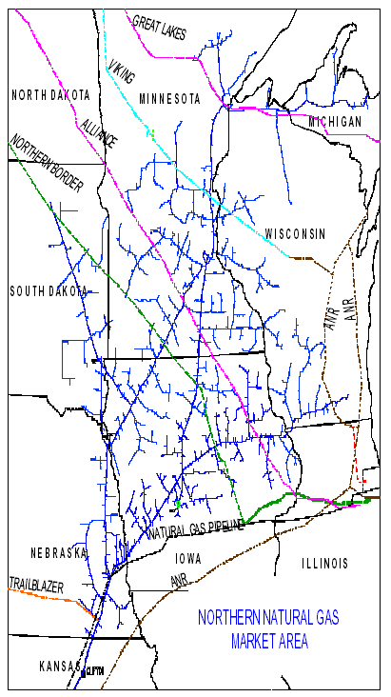
Market Area
NNG’s pipeline in the Market Area was built primarily as a delivery system integrated with the facilities of Local Distribution Companies with over 2,000 delivery points. This grid system is expensive to duplicate by competing parties.
Growth of natural gas usage by LDC’s in the Market Area is 1-2% per year.
Additional growth is expected with new construction of power and ethanol plants.

Slide 5
Market Area Competitors
Major competitors in the Market Area:
Alliance
ANR Great Lakes
Natural Gas Pipeline
Northern Border
Trailblazer
Viking

Slide 6
Traditional Market Area - Competitive Threats
Minnesota – Stable earnings through 2007.
Iowa – Lower value due to competing pipelines, but stable through 2005.
Wisconsin /Chicago – At risk in 2003. Market prices are below max tariff rates due to high concentration of competing pipelines.
Great Lakes
ANR
Alliance
Northern Border
Competitive Threat Areas
Notes:
North end of NNG Pipeline
Minnesota –(EF)
Captive markets historically
Physical assets go to town boarder – different than TW or FGT – more complex but helps keep out competition
Contracted through 2007
Iowa/Wisconsin – (ABC, D)
Des Moines, East of Dubuque, Milwaukee
Greater degree of competition
Chicago pricing
South end
Grid, multiple interconnects, supply oriented
Depletion – declining reserves
Selling non productive assets
Cost allocation from South to North – becoming more of an issue – 2003 Rate Case issue
Had success on pricing desk building business. - e.g.CMS/Reliant/Dominion Deal

Slide 7
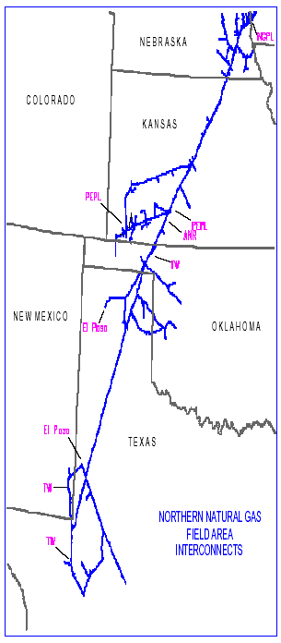
South End System
Built to connect traditional market area with MidContinent and Permian supply regions.
NNG is a transporter in the national pipeline grid with connections to multiple supply basins and interconnecting pipelines.
Short term contracts.
Wider Customer Base
Bi-directional flows
Notes:
Used to own all of the gathering. When sold, dynamics of pipeline was changed.
History of Revenues:

Slide 8
Market Growth Strategies
Western
Canadian Basin
Project MAX: Market Area Expansion (See detail page 20)
Capture growth with minimal capital requirements
New gas fired power plants
Interconnect expansions for Market and Supply areas
Estimated demand growth is 1-2%
Montana
North
Dakota
Minnesota
Michigan
Wyoming
South
Dakota
Wisconsin
.
Market Area
Rocky Mountain Basins
Nebraska
Iowa
Kansas
Illinois
Hugoton
Basin
Supply Area
Missouri
Oklahoma
Anadarko
Basin
New Mexico
Permian
Basin
Texas
NNG Assets
Major Pipeline Interconnects
Storage
Great Lakes
Viking
Northern Natural Pipeline
Northern Border
Trailblazer
Notes:
In addition to our growth opportunities, NNG continues to be a prominent player throughout the Midwest. Our Northern system serves as a key connection between Midwest utility customers and critical gas supplies to the north and south, providing our customers with supply optionality.
Northern Natural, with over 16,000 miles of pipe, is the largest single pipeline system in the U.S. and serves a market area in the upper Midwest, principally, Minneapolis, Wisconsin, Nebraska, Iowa and Illinois.
Northern is directly connected to the Permian, Anadarko and Hugoton supply basins in Texas, Oklahoma and Kansas. Through the Trailblazer pipeline system, which we have a 1/3 equity interest, we connect to supplies in the Rocky Mountains. And our NBPL system delivers up to 1.3 Bcf/D of Canadian supplies. This provides our customers with great supply options.
Northern also operates 56 Bcf of storage, providing shippers both physical and financial flexibility in managing their gas supply portfolios.
We are 95% contracted through 2003 in the market area. 85% revenues are fixed demand charges, and we have no rate case requirement through 2003.
We recently completed an open season for our market area to understand our customers needs for the future. We had non-bidding requests for over 300 MMcf/d of new capacity. We are working with customers to finalize deals.

Slide 9
Supply Sources
Ample supply access to serve Major Utilities
and Industrials in the Upper Midwest

Slide 10
Supply Area Trends
Western
Canadian Basin
Montana
North
Dakota
Minnesota
Michigan
Wyoming
South
Dakota
Wisconsin
Rocky Mountain Basins
Nebraska
Iowa
Kansas
Illinois
Market Area
Hugoton
Basin
Supply Area
Missouri
Oklahoma
Anadarko
Basin
New Mexico
Permian
Basin
Texas
Source WEFA, INC Natural Gas Outlook 2001

Slide 11
Number of Customers by Type
Based on 12/2000-11/2001 Production Months

Slide 12
Percent of Total Revenue by Customer Type
Based on 12/2000-11/2001 Production Months

Slide 13
Contract Structure
Long Term contracts (TF) are typically held by LDC customers to serve residential, commercial and industrial customers behind the city gate. These contracts are primarily made up of annual and winter-month service periods. Long term contracts are typically executed in groups during rate case cycles. Customers holding long term contracts are predominately captive to the NNG system and pay maximum rates.
Short Term contracts are typically for daily and monthly periods (TF, TFX, TI). These contracts usually fill the need for marketing and producer groups to move gas on a short term basis. The customers are predominately non-captive and purchase transportation based on price spread opportunities over one or two seasons.

Slide 14
Contract Structure
Rate Schedule
Description
Typical Use
TF
Firm Throughput Service
Used primarily by LDC markets made up of residential, commercial
and industrial users.
TFF is a service available for receipt in the Field Area and delivery
to the field/market demarcation point.
TFX
Firm Throughput Service
Available for Field and Market Areas with flexibility in term length
and monthly/seasonal quantities. Used primarily for short term firm
transportation.
TI
Interruptible Throughput Service
Available for Field and Market Areas on an interruptible basis.
GS-T
Firm Throughput Service -
Available for Market Area Small Customers with daily firm
Small Customer
entitlement of 5,500 mcf or less.
SMS
System Management Service -
Available as a companion service to Firm Throughput Service and
No Notice Service
provides no-notice firm delivery.
FDD
Firm Deferred Delivery -
Available for firm storage services. Provides shipper the ability to
Storage Service
have natural gas transported to or received from Northern on a
deferred basis.
IDD
Interruptible Deferred Delivery -
Available year-round for interruptible storage services. Provides
Storage Service
shipper the ability to have natural gas transported to or received
from Northern on a deferred basis.

Slide 15
Revenue Sources
Firm Transport - Market
80%
Demand
84%
Storage
11%
Commodity
Interruptible Transport - Field
Firm Transport - Field
16%
1%
7%
Interruptible Transport – Market
1%

Slide 16
Currently Under Contract
Expiration Dates for Reservation Revenues
Contract Year Basis
Currently Under Contract
Contract Year Basis
160
$141.5
140
$ 95.0 Million Market Value
$130.5
120
100
millions
80
$
60
$30.4
40
20
$20.4
$10.9
0
2003-4
2004-5
2005-6
2006-7
2007-8
Market
Field
Storage
2003 FDD: 22 Customers; 28 BCF
Transport: 72 Customers; 1.6 BCF/D
Notes:
Above graph shows the $ value per contract year of contracts expiring in the respective years.
For example, the value of a full contract year for contracts expiring in 2003 = $141.5 million (coincident with rate case).
Of the $141.5 million, $12.4 million is from TFF of 287/d
Market Value is estimated at $95.0 million
Market $xx.x
Field $xx.x
Storage $xx.x
Lock in contract extensions b4 Rate Case

Slide 17
Top 10 Shippers – Transportation Revenue
Top 10 - Expiration Data
Contract Year
% of Revenue
2002-2005
45%
2006-2010
51%
2010-2013
3%
Note:
Rollover/Evergreen
1%
For the Accounting Months of December 2000 through November 2001
Top 10 Customers represent 69% of total revenue for this time period.

Slide 18
Historical Breakdown of Transport Revenue Firm/Interruptible
Notes:
Source: Commodity/Demand Margin Reports
2000 had increase in So Onshore due to volatility.
1999 had a one-time increase due to Seasonal Rates.
1998 was 16% warmer than previous year.

Slide 19
Seasonality – Revenue/Volume
Source: MFE

Slide 20
Project MAX Market Area eXpansion
Volume requests received during Open Season = 368,500 MMBtu/d
Traditional growth = 176,500
Electric generation = 192,000 (96,000 is uneconomical and will not be pursued)
Traditional growth is approximately a 4% increase in NNG’s current peak day market.
Requested volumes are staggered over a six-year period beginning in 2002 with the largest percent to begin in 2003.
Customer meetings are currently in progress
Precedent Agreements to be completed in February 2002
FERC filing scheduled to be filed prior to August 2002
Construction to begin Spring 2003

Slide 21
Power Plant Expansions
Cottage Grove
Cogentrix
240 MW
34,000 MMBtu/d-F
(1997)
Xcel
1035 MW
135,000 MMbtu/d-F/I
(2003-9)
Inver Hills
NSP Generation
343 MW
70,000 MMBtu/d-I
(1999)
Pleasant Valley
Great River Energy
445 MW
82,000 MMBtu/d-I
(2001)
Black Dog
NSP Generation
225 MW
35,000 MMBtu/d-I
(2003)
•
•
•
Whitewater
Cogentrix
240 MW
30,000 MMBtu/d-F
(1997)
Wisdom
Corn Belt
85 MW
16,000 MMBtu/d-I
(2004)
•
•
Salt Valley
Lincoln Electric
159 MW
24,000 MMBtu/d-F
(2003)
•
•
•
Alliant
800 MW
110,000 MMBtu/d-F/I
(2003-4)
NPPD
250 MW
36,000 MMBtu/d-F
(2005)
Cass County
OPPD
330 MW
67,000 MMBtu/d-I
(2003)
Pleasant Hill
MidAmerican
770 MW
180,000 MMbtu/d-F/I
(2003-5)
•
Recent Plants
Proposed Plants
Potential additions of 737,000 Mmbtu/d
Additions represent about 200% of current connected gas fired generation.
Source: NewGEN and PowerDAT, 2002

Slide 22
Ethanol Plant Expansions
Rosholt
1,800 MMBtu/d
Big Stone
Millbank, SD
1,500 MMBtu/d
Agri Energy
Luverne, MN
1,200 MMBtu/d
Sioux Center IA
1,600 MMBtu/d
(9/01)
Granite Falls, MN
3,000 MMBtu/d
Heartland Corn
Winthrop MN
1,500 MMBtu/d
Al Corn Clean Fuels
Austin, MN
1,500 MMBtu/d
Galva, IA
2,400 MMBtu/d
(12/01)
Wentworth, SD
5,300 MMBtu/d
Pro Corn LLC
Preston, MN
1,500 MMBtu/d
Little Sioux, IA
4,500 MMBtu/d
(2002)
•
Columbia County, WI
3,000 MMBtu/d
•
•
•
Monroe, WI
4,000 MMBtu/d
Earlville, IA
2,000 MMBtu/d
Minnesota Corn
13,000 MMBtu/d
Denison, IA
2,400-
3,250 MMBtu/d
Hardin County, IA
3,000 MMBtu/d
•
Coon Rapids, IA
4,750 MMBtu/d
(2002)
Plants Being Built
Proposed Plants
Potential additions of 58,000 Mmbtu/d
Seven additional plants at confidential locations are being considered. (40,000 MMBtu/d Total.)
Estimated 75% increase in ethanol production over the next two years. (California Energy Commission)
Existing Direct Connects
-

