Slide 1
Yours is a Very Bad Hotel
A graphic complaint prepared for:
Joseph Crosby
General Manager
Lisa Rinker
Front Desk Manager
DoubleTree Club Hotel
2828 Southwest Freeway
Houston, Texas

Slide 2
In the Early Morning Hours of
November 15, 2001, at the DoubleTree Club Houston, We Were Treated Very Badly Indeed.
We are Tom Farmer and Shane Atchison of Seattle, Washington.
We held guaranteed, confirmed reservations at the DoubleTree Club for the night of November 14-15.
These rooms were held for late arrival with a major credit card.
Tom is a card-carrying Hilton HHonors Gold VIP…
Yet when we arrived at 2:00am… we were refused rooms!

Slide 3
Refused Rooms… Even When We’re
“Confirmed” and “Guaranteed”?
Mike, your Night Clerk, said the only rooms left were off-limits because their plumbing and air-conditioning had broken!
He’d given away the last good rooms three hours ago!
He’d done nothing about finding us accommodation elsewhere!
And he was deeply unapologetic!

Slide 4
Quotations from Night Clerk Mike
“Most of our guests don’t arrive
at two o’clock in the morning.”
-- 2:08 am, November 15, 2001
Explaining why it was
OUR fault that the DoubleTree Club
could not honor our guaranteed reservation

Slide 5
We Discussed With Mike the Meaning of the Term “Guarantee.”
guar·an·tee (g r n-t ), n.
  Something that assures a particular outcome or condition: Lack of interest is a guarantee of failure.
    A promise or an assurance, especially one given in writing, that attests to the quality or durability of a product or service.
    A pledge that something will be performed in a specified manner.
(Save this for your future reference.)

Slide 6
Mike Didn’t Much Care.
He seemed to have been betting that we wouldn’t show up.
When we suggested that the least he should have done was line up other rooms for us in advance… Mike bristled!

Slide 7
Quotations from Night Clerk Mike
“I have nothing to apologize to you for.”
-- 2:10 am, November 15, 2001
Explaining why we were wrong
to be upset that our “guaranteed”
rooms weren’t saved for us

Slide 8
The Career Path of Night Clerk Mike
(He peaked last week.)
November 15, 2001:
Rude Hotel Clerk
1995:
Subway Sandwich
Maker
2004:
McDonald’s
Sandwich Maker
1985:
Paper Boy
2014:
Septic Tank
Cleaner

Slide 9
Mike Wasn’t Too Optimistic About
Finding Us a Place to Sleep.
2:15 in the morning is a heck of a time to start looking for two spare hotel rooms!
Mike slowly started dialing around town.

Slide 10
Quotations from Night Clerk Mike
“I don’t know if there ARE any
hotel rooms around here… all these
hotels are full.”
-- 2:12 am, November 15, 2001
Just starting to look for alternate
accommodation for us, even though he’d filled
his own house up by 11:00pm

Slide 11






Mapped Against Other Hospitality Providers, Your
DoubleTree Club Fared Badly on November 15, 2001.
GROWTH-ORIENTED
DESPISES &
MISTREATS
CUSTOMERS
TREATS
CUSTOMERS
WELL
HEADING FOR COLLAPSE

Slide 12

Mike Finally Found Us Rooms Here.
Shoney’s Inn & Suites is a dump.
It is six miles further away from downtown Houston, which makes a difference in morning rush-hour traffic.
Had we wanted to stay at Shoney’s, we would have called them in the first place.
We could only get smoking rooms.

Slide 13
The Experience Mike Provided Deviated from Usual Treatment of an HHonors Gold Member.
Expected HHonors Gold Member Benefits | Actual Benefits Provided by DoubleTree Club 11/15
Confirmed reservation | Ignored reservation
Upgraded room when available | No room available
Free continental breakfast | Free confusing directions to shabby alternate hotel
HHonors points plus frequent-flyer miles | Insolence plus insults

Slide 14
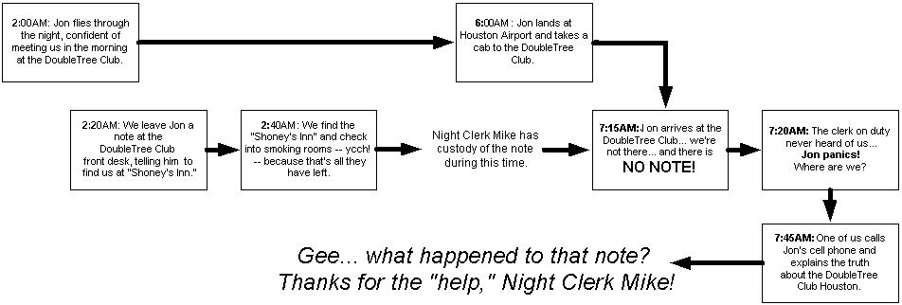
Jon, a colleague, was arriving in Houston on an overnight flight and coming to join us at the DoubleTree Club first thing in the morning. As we had to go stay elsewhere, we wrote
Jon a note and left it in care of Mike the Night Clerk.
Even After We Left the DoubleTree Club, Our
Troubles Weren’t Over, as This Timeline Shows.

Slide 15
We Are Very Unlikely to Return to the
DoubleTree Club Houston.
Lifetime chances of dying in a bathtub: 1 in 10,455
(National Safety Council)
Chance of Earth being ejected from the solar system by the gravitational pull of a passing star: 1 in 2,200,000
(University of Michigan)
Chance of winning the UK Lottery: 1 in 13,983,816
(UK Lottery)
Chance of us returning to the DoubleTree Club Houston: worse than any of those
(And what are the chances you’d save rooms for us anyway?)

Slide 16
Revenue Lost to the DoubleTree Club
Houston as a Result of our November 15 Incident
Calendar
2001
Calendar
2002
Shown in U.S. dollars

Slide 17
We’ll Be Sending This Presentation to Promus Properties.
And to some friends.
We hope they’ll share it with their friends!
If you’d like a hard copy, email us at:
BearX220@hotmail.com.
Good luck!
And give our best to Mike!

