Slide 1
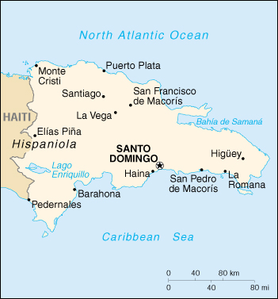

LNG Offsite
November 20, 2000
Dominican Republic LNG and Power Plan Facility

Slide 2
Initial Concept
Bring natural gas/LNG to Dominican Republic
Creates LNG demand for the Atlantic Region/Jose LNG Project
Construct an LNG regasification terminal located on the south coast
Enron & Unión Fenosa to build a 500MW combined cycle power plant next to the terminal
Joint Development Agreement executed in August 2000
Fundamental business premise in the JDA is the integration between Enron & Unión Fenosa throughout the value chain
Co-owners of power plant (large PPA with Unión Fenosa’s Discos)
Co-owners of LNG terminal
Provides regasification services to power plant and eventually to other gas consumers
Unión Fenosa to become a minority partner in Jose LNG project
Notes:
1

Slide 3
Project Structure
UF
$33MM
ENE
$72.5MM
UF
50%
50%
50%
50%
Banks
Equity
Debt
Equity
35%
$66
65%
$398
35%
$145
LNG Supplier
LNG Terminal
Power Plant
500MW
UF’s Discos
PPA
Gas Supply Agreement

Slide 4
Value Added Chain & Project Contracts
Up-stream
Mid-stream
Down-stream
Fuel Supply Contract
Shipping
Agreement
Shipping Fee - Fixed
PPA Contract
EDENORTE
&
EDESUR
Fuel Supply - ToP Basis
- Variable
Long term power purchase (20-y)
Capacity obligation, plus 70-80% energy commitment
Jose LNG Project
LNG Shipping
LNG Terminal
Power Plant 500MW
Vaporization & Storage
Services - Fixed
20-30% of energy will be sold to spot market
Tolling
Agreement
Market Deliveries
Spot Market

Slide 5
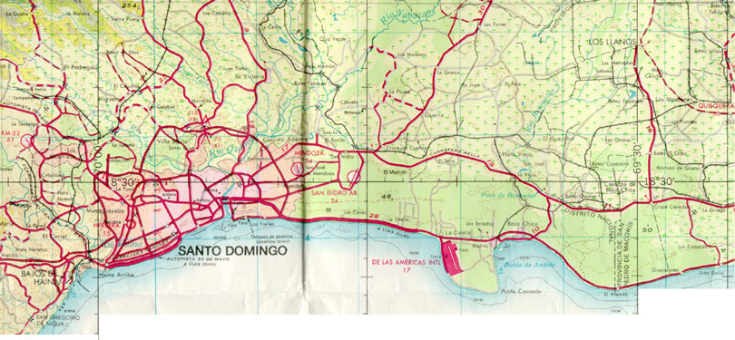
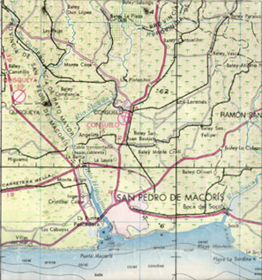

Project Status
Land Option secured
Major permitting obtained
Environmental permits
Generation concession
SHA and PPA between the parties currently under discussion
Discos have to bid Energy purchase contracts
GSA draft just started last week
RFP’s for EPC of the power plant to be issued by end November
No financing activities yet
Existing
Scheduled
Proposed
Enron
500MW
Cogentrix
300MW
Proposed
Gas Pipelines
AES
270MW
AES-Destec
220MW
Haina
100MW
Airport
Port Site
Itabo
105MW
Punta Caucedo

Slide 6
Current Circumstances
AES is developing a similar Project, which is more advanced
Same location
300 MW power plant
COD April 2003
Two LNG Terminals scenario
Competition between terminals will drive prices down (limited upside potential)
LNG market is limited – Currently not more than 1,500 MW
Substantial LNG demand growth beyond that unlikely
Highly lucrative, more creditworthy alternative markets for Jose’s LNG are being identified
Very strong gas market
Under current conditions, Jose will be absorbed easily in US terminals with very high net- backs
Credit worthiness of US and/or European buyers improve financiability of Jose
Enron’s appetite for large power assets has decreased

Slide 7
Proposed Strategy
Aim for a One Terminal situation – Sit-down with AES with Action Plan
Requires that we have our main permits in hand (Environmental, Generation, and Fuel Imports and Sales). If not, we are not a serious competitor
We are almost there
Unión Fenosa wants the JV to negotiate with AES quickly
Results:
Lower equity exposure
Taking a position in the natural gas monopoly in the island
Optimize size of the power plant
Explore alternatives to minimize/eliminate Enron’s equity exposure in the power project
Substantial turnaround of the deal as it stands
Unión Fenosa an important counterpart of Enron in several markets

