Slide 1


Diversity…It’s not only about
the numbers…It’s about our
ability to innovate.

Slide 2

DIVERSITY WITHIN OUR CULTURE
Respect, Integrity, Communication and Excellence are based on appreciation of individuals and their ideas
Seeing things differently is essential to creating Excellence at Enron
Cultivating and merging individual ideas across Enron is the cornerstone of our culture
Open systems thrive while closed systems wither

Slide 3

DIVERSITY CREATES INNOVATION
Everyday, with their individual ideas, Enron employees change the world
Different backgrounds and ideas are recruited, encouraged and rewarded
Key to our success is the expectation of employees to identify new ways of doing things

Slide 4

DIVERSITY IN OUR WORLD CLASS TEAM
We track employee statistics but they do not tell the Enron Diversity story
A team of open minds brings a higher return on our human capital
Working together with our different backgrounds and ideas generates amazing things

Slide 5

DIVERSITY IS A COMPONENT OF OUR VISION & VALUES
RESPECT
INTEGRITY
COMMUNCIATION
EXCELLENCE

Slide 6
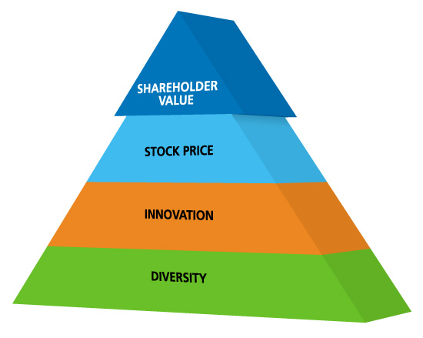

Slide 7

Diversity in Action at Enron
There is probably no better recent “big ticket” example of Enron capitalizing on “out of the box” thinking than the conceptualization and successful start-up of EBS - extending our wholesale business model to a new industry. This was consistently cited by focus group participants and is certainly a strategic choice that is highly visible to the market place and our shareholders.
In 1999, funding projects in emerging markets was difficult due to macroeconomic factors. To overcome these difficulties, the India Dahbol Phase II Project required a team of people from diverse functional and geographical backgrounds. There were developers, engineers, people with accounting tax, finance, and legal backgrounds. The expertise of all these people was necessary to achieve financial close. On May 6, 1999 the Enron India team closed $1.8 billion of financing for the Dabhol Phase II project. It was important to "close" financing so that construction on what will be the largest gas-fired plant in the world could begin.
An opportunity that led to a transaction of significance to Enron was the Peoples Gas project. Because of the diversity of individuals who were on the team a transaction was closed and significantly impacted the bottom line. Enron put a team of people together from legal, finance, customer relations, risk and tax - of all capabilities and skills to come together and grow a new business. Because of the diversity of the people, Enron now has offices in Chicago and several multi-year contracts.
Florida Gas continues to create successes by utilizing creative input. For example, an employee who spent a lot of time in Europe shared a new approach he learned there - This was to use electricity to compress gas instead of natural gas. This was not only cost effective but also environmentally friendly.

