Slide 1
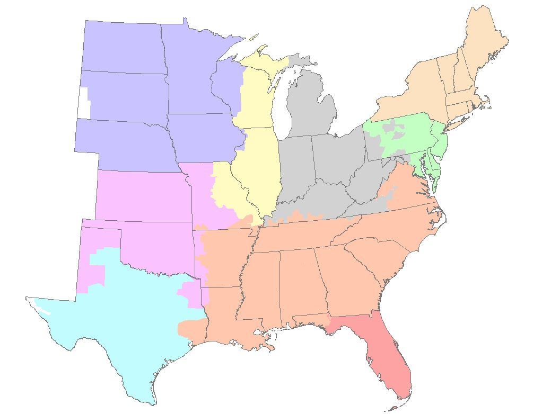
Enron East Power Development
Site Bank Map
NPCC
MAPP
MAAC
MAIN
ECAR
SPP
SERC
Legend
Sites Under Option
ERCOT
FRCC
Additional Targeted Sites

