Slide 1

DerivaPrice.com
Enron Presentation

Slide 2
Outline
The Company
Business Strategy
SciFinance and ASPEN Technology
DerivaPrice.com/DerivaStar.com - Product Overview
Market analysis
Financial analysis
Resource analysis

Slide 3
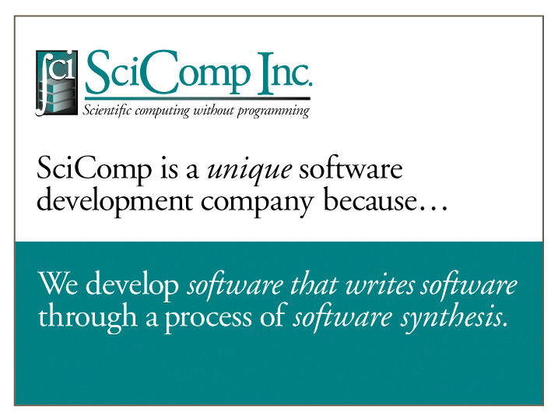
Insert Product Photograph Here

Slide 4
SciComp Inc.
History
Business Strategy
SciComp today
Team

Slide 5
SciComp History
Founded in 1994
$1.9 million USDoC NIST grant funded development of SciNapse/SciFinance
SciNapse - 3 years development
SciFinance - 1 year development
First VC - August 1998 - $1.5 million
Introduced SciFinance - October 1998
First sale - Merrill Lynch - January 1999

Slide 6
Business Strategy
Develop underlying technology
Completed - SciNapse
Prove technology through commercial application
Completed - SciFinance for risk management industry
Penetrate $1.2 billion market for pricing derivatives
DerivaPrice.com - Financial markets
DerivaStar.com - Energy markets
Scale SciNapse technology to new industries
Strategy to be developed

Slide 7
SciComp Today
Marketing SciFinance to large investment and commercial banks
Developing components of DerivaPrice.com
Seeking strategic investment partner

Slide 8
Management Team
Elaine Kant - CEO
25 years’ experience
Schlumberger - led projects to improve productivity through technology
Curt Randall - VP Applications
25 years’ experience
Recognized leader in finite methods of derivative pricing
David Johansen - VP Sales & Marketing
25 years’ experience
Managing, marketing and selling technology-based solutions
Larry Schumann - COO & CFO
23 years’ experience
Operational and financial management in private and public companies

Slide 9
SciFinance™ Product overview
SciFinance™
Software synthesis technology applied to risk management industry
ASPEN Specification Language
Key customers:
Goldman Sachs – Bear Stearns
Merrill Lynch – Fortis Group
Innovation
Unique position to meet market needs

Slide 10

SciFinance Users
Quantitative Analysts
Financial Engineers
Risk Managers
Auditors
Financial Controllers
Money Managers
Notes:
<number>
<footer>
<header>
<date/time>
SciFinance is currently being tested at three of the top ten U.S. investment banks. Some of the code that SciFinance has generated has already been put into regular use for pricing derivatives. Our early users are very impressed with its abilities. The industry consultants who have reviewed it say SciFinance could revolutionize the way the industry prices derivatives.

Slide 11

SciFinance™ - Product Overview
ASPEN Specification Language
User creates a short specification of problem
SciFinance generates thousands of lines of documented C code.

Slide 13
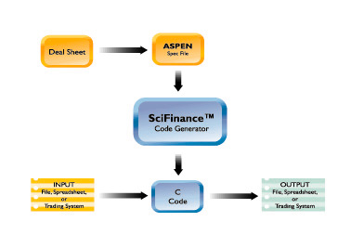
SciFinance
Not a black box
Not a glass box
A completely open box … putting you in complete control

Slide 14
Penetrate risk management industry
Capture significant portion of $1.2 billion market with:
DerivaPrice.com
B-to-B ASP
Financial workbench
Automatically generates prices for OTC derivatives
Over the WWW
For a variety of users

Slide 15
Penetrate risk management industry
The same technology can be applied to develop pricing models for energy OTC derivatives:
DerivaStar.com

Slide 17
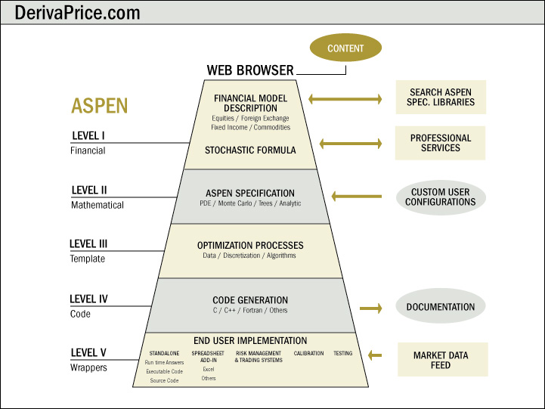

Slide 18
On-line Information
Busy risk managers are demanding on-line information that meets their needs
Over 1,500 risk management professionals registered to use eRisks.com, a risk-management information site, in its first month
When Savvysoft launched www.freecreditderivatives.com, thousands of users from 30 countries logged onto the site to access the information

Slide 19
DerivaPrice.com Competitive Advantage
Proprietary technology enables SciComp to be the only company that can meet all of the market’s pricing needs
Universal ASPEN specification language
Rapidly and efficiently move with market
Credibility - “blue-chip” customer base

Slide 20
DerivaPrice.com/DerivaStar.com “One-stop-shop” for custom pricing solutions
Flexibility
Customized pricing with choice of methodologies
Monte Carlo • Lattice (tree)
PDEs (current SciFinance methodology)
Broad coverage
Customized pricing for all types of securities
Ease of use
Stratified to match the sophistication of user
Consistency
ASPEN specification language

Slide 21
DerivaPrice.com/DerivaStar.com “One-stop-shop” for custom pricing solutions
Not a black box
Open architecture - option to receive source code
Not a library package
Documentation
Integration with IT systems
Consultation
Information source

Slide 22
Scale SciNapse to New Industries
Underlying SciNapse technology can be applied to any industry that utilizes high-level math for modeling and other purposes
Microprocessor chip and circuit design
Chemical and biological modeling
Pharmaceutical - drug design
Aerospace
Others

Slide 23
Market Summary
Defined
Customers
Size and growth
Trends
Opportunity

Slide 24
Derivatives Securities Segment of Risk Management Industry - Defined
Risk management
Derivative securities
Exchange traded
OTC
Hedge products

Slide 25
Customers
Sell-side
Large international investment/commercial banks - 400
Mid-sized regional investment/commercial banks - 200
Insurance companies 1,000
Energy companies - 1,000
Buy-side
Trading firms - 500
Hedge funds - 5,830
Asset mgmt. - 200
Corporate treasuries - 1,000
Pension funds - 4,489
Mutual funds - 10,000

Slide 26
Risk Management IT

Slide 27
Market potential - Other industries
Simulation software product sales - U.S. spending - $7.8 - $10 Billion
Number of potential users - 1,000,000

Slide 28
Goals & Objectives
Sales Goals - DerivaPrice.com/DerivaStar.com
Product Development Schedule
Financial Projections

Slide 29
Sales Projections

Slide 30
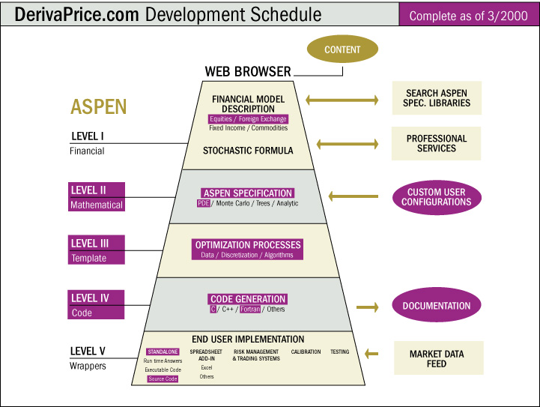

Slide 31
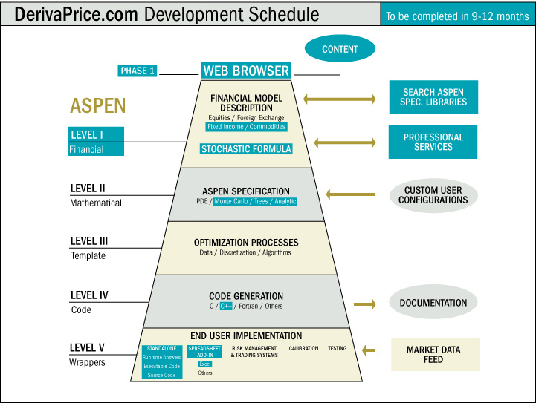

Slide 32
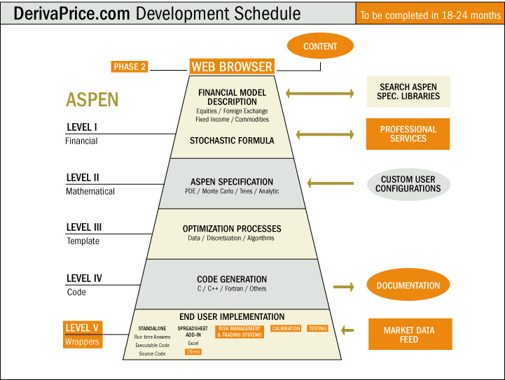

Slide 33
Financial Projections (excluding applications in new industries)

Slide 34
Resource Requirements
Technology Requirements
Personnel Requirements
External Requirements
Financial Requirements

Slide 35
Technology Requirements
Internal development
ASPEN Level I
Stochastic Formula
C++ code generator
Consultant-assisted development
Monte Carlo
Implementation/calibration
Alliance-acquired
Lattice (tree) methodology
Spread sheet add-in (announced and in Beta)

Slide 36
External Requirements
ASP Infrastructure
Security
“Back-office”
Out-sourced server

Slide 37
Financial Requirements

Slide 38
Risks & Rewards
Risks
Development takes longer than projected
Market does not accept ASP
Personnel can’t be hired quickly
Addressing Risks
Outsource development
Alliances - Marketing and technology
Rewards
IPO
Buy-out

Slide 39
Development Funding
Seeking $9.0 million second round VC funding
Common or convertible preferred stock
Have lead investor - Dallas-based VC
Seeking strategic investor partner - $4 - 5 Million
Terms- negotiable

