Slide 1
OPERATOR QUALIFICATION

Slide 2
The Operator Qualification Rule...
Requires pipeline operators to develop and maintain qualification programs for individuals performing covered tasks on pipeline facilities.
The Rule is intended to improve pipeline safety by ensuring a qualified workforce.
Rule published : August 27, 1999.

Slide 3
Key Elements...
The Operator must identify Covered Tasks using the four-part test;
Ensure thorough evaluation of individual’s performance;
Allow non-qualified individuals to perform a cover task, if directed and observed by a qualified individual;

Slide 4
Key Elements (cont’d)...
Evaluation of an individual if the operator has reason to believe that the individual is no longer qualified to perform a covered task or contributed to an incident;
Communicate changes that affect covered tasks to individuals performing those tasks;
Three year intervals for re-qualifications;
Record keeping and Retention

Slide 5
Covered Tasks Four Part Test...
Is an activity that:
Is performed on a pipeline facility;
Is an operations or maintenance task;
Is performed pursuant to a requirement in 49 CFR 192 or 195; and
Affects the operation or integrity of the pipeline.

Slide 6
Time Table...
August 27, 1999 DOT to publish NPRM in Federal Register.
April 28, 2001 Written Operator’s Qualification Plan to be completed and may be audited by DOT (18 months after the Effective Date).
October 28, 2002 All Operators to be in compliance (38 months after the Effective date).
October 28, 2005 Team Member Re-qualification (3-year re-qualification period).

Slide 7
Affected Personnel...
SBP Teams
Technical Specialists
Compression Services
Special Projects Team
Stopple Crew
Directors
Team Advisors
OCC
Gas Control
Oil Control
Contractors
Sub-Contractors

Slide 8
Implementation...
Survey exempt groups to determine which covered tasks are performed independently;
Distribute Skill Qualification Manuals to the Management of newly affected personnel, including all covered tasks;
Management assigns a verifier and distributes the Skill Qualification Manuals ;
SBP/Training Team will track each qualification using the SBP record keeping system.

Slide 9
Covered Category List
The Operator Qualification program is built around 44 task categories.

Slide 10
OQ Documentation
The next slide is an excerpt from the Gas Control SQM. Note that in Section 3, Performance Requirements #9 and #10 are not Covered Tasks. In Section 4, PR #1 is a Covered Task. Only PRs that apply to the specific Gas Control group need to be verified at this time. Only Covered Tasks will be recertified every three years. If a task does not apply to the group, put an “X” in the box.

Slide 11
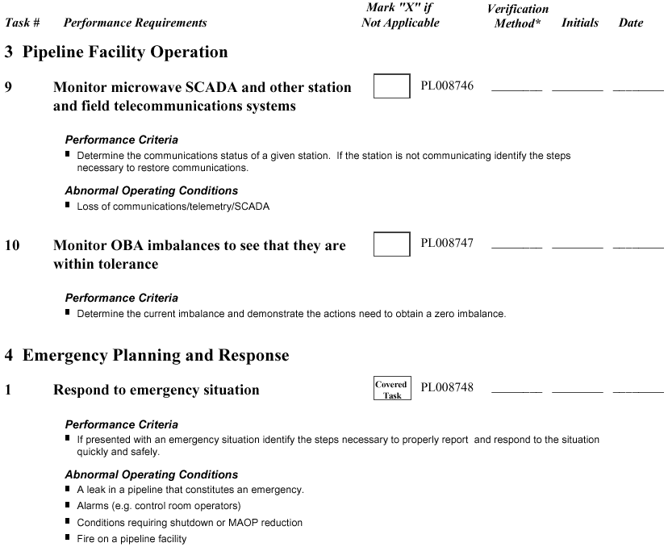
Gas Control SQM

Slide 12
OQ Documentation
The “Verification Method” can be either “D” (documentation) or “S” (simulation). Simulation should be used only when it is not appropriate to demonstrate the task at the time of the verification session. If the task is to close valve #123, but to do so would interrupt operations, the employee can simulate by pretending to execute all the steps to valve closure without actually throwing switches, making phone calls, adjusting flows and pressures, etc.

Slide 13
OQ Documentation
The next slide is an excerpt from the Gas Control Training and Verifiers Guide. Some of the elements that may be included in the data for each task are: “Performance Criteria” reflects the criteria against which employee performance of the task will be judged. “Action Statements” suggest practice activities or provide additional information. “Abnormal Operating Conditions” may be encountered as the task is performed. “Confirming Your Understanding” contains additional study questions. Other elements are self explanatory. (Note: there is no written test required for qualification at this time)

Slide 14
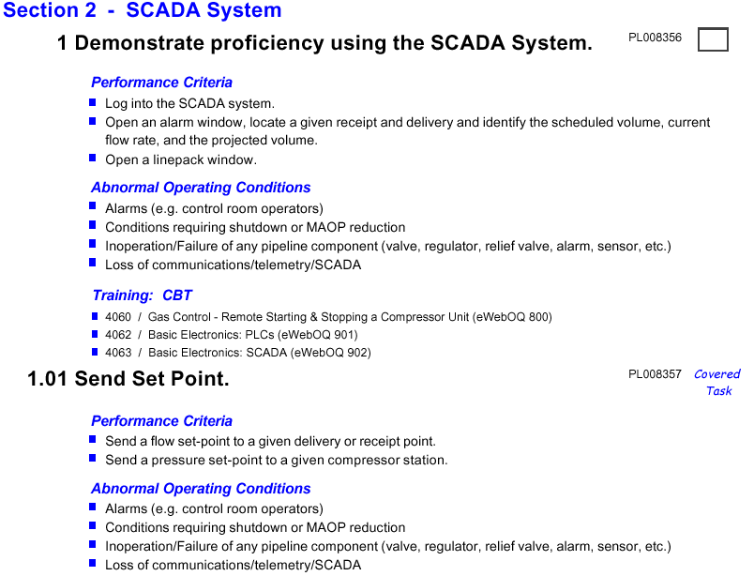
Gas Control TVG

Slide 15
Additional Information
For more information call the Training Coordinator in your area.
North Operations:
Andrea Woody → 402-398-7451
Southeast Operations:
Lupi Trevino → 713-345-1658
Southwest Operations:
Gloria Wier → 505-625-8070

