Slide 1
Curve Query Tool – Modification – “Historical Band”
Explanation of Function
Historical Band:
Purpose: To identify the “band” (minimum and maximum) that each
reference date in the forward curve has traded between
two points in time.
Benefit: This would allow quick visual assessment of whether the
curve is being re-marked inconsistently (for instance, a
wider band in the back versus the front of the curve
Implementation: Would probably require some minor modification to the
current “Curve Grabber” front-end. However, a limit
might have to be imposed on the range of reference dates
or the number of curves which can be pulled at once.

Slide 2
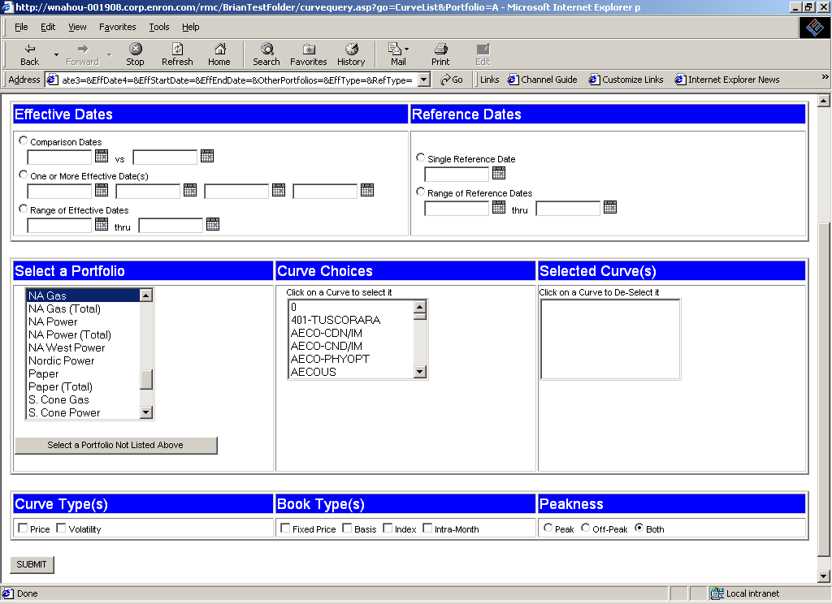
Curve Query Tool – Modification – “Historical Band”
Input Screen
“Trading Band” (only the high and low values for the selected range of Effective Dates)
Do we want to limit the range to something like 3 months?

Slide 3
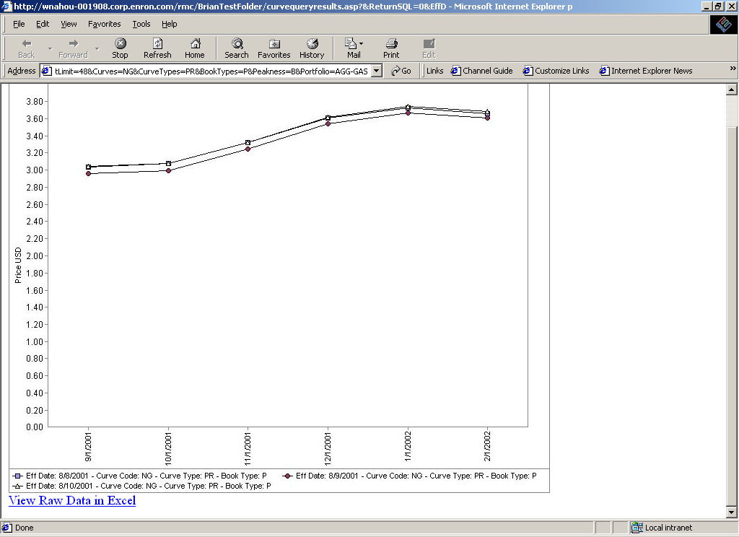
Curve Query Tool – Modification – “Historical Band”
Output Screen
8-1-01
9-1-01
10-1-01
11-1-01
12-1-01
1-1-02
2-1-02
3-1-02
4-1-02
5-1-02
6-1-02
7-1-02
8-1-02
9-1-02
10-1-02
11-1-02
12-1-02
1-1-03
2-1-03
3-1-03
4-1-03
5-1-03
6-1-03
7-1-03
8-1-03
9-1-03
10-1-03
11-1-03
12-1-03
1-1-04
2-1-04
3-1-04
4-1-04
Upper Limit
Lower Limit

Slide 4
Curveshift P&L “Drilldown”
Explanation of Function
P&L Sensitivity:
Purpose: To identify the main contributors to P&L:
* Total P&L
* At any reference date along the forward curve
P&L would be ranked by both gains and losses according
to absolute value to reveal instances where large
offsetting gains and losses result in small total P&L
Benefit: This would allow a user to quickly identify the principal
contributors to P&L
Implementation: The 3d charts currently allow this down to a sub-portfolio
level but not to a curve level. Development at curve level
will probably be faster implementing in regular RAC
website. User-interface and back-end process still to be
determined.

Slide 5
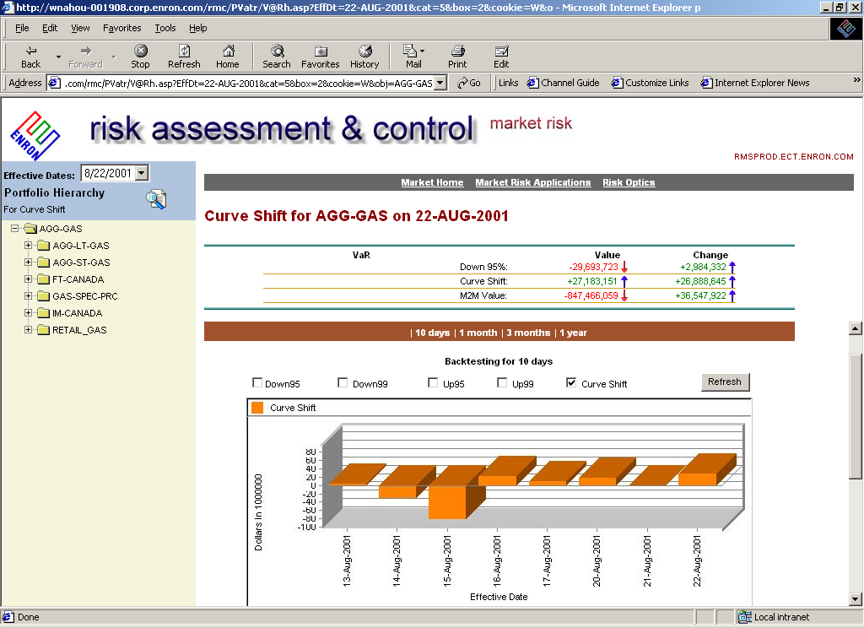
Curveshift P&L “Drilldown”
Hypothetical Input Screen (not determined yet)
Select a point to see its main contributors of P&L

Slide 6
Position “Drilldown”
Explanation of Function
Position Sensitivity:
Purpose: To identify the main contributors to Position
* Total Position
* At any reference date along the forward curve
Position would be ranked by both long and short positions
according to absolute value. Positions could be viewed
be benchmark, delta, gamma, and gross (notional).
Benefit: This would allow a user to quickly identify the principal
contributors to total Position and view offsetting positions.
Implementation: The 3d charts currently allow this down to a sub-portfolio
level but not to a curve level. Development at curve level
will probably be faster implementing in regular RAC
website. User-interface and back-end process still to be
determined.

